Slide 1

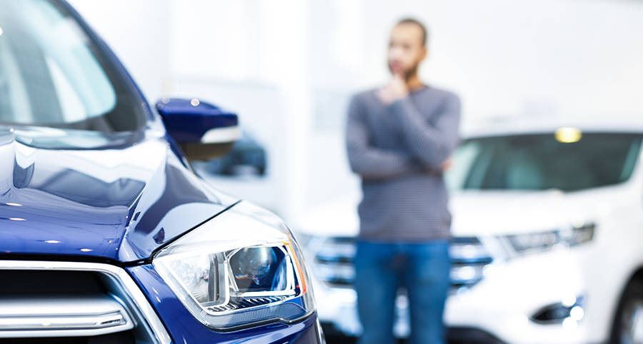
Used Vehicle Buying:
Improving the Buyer and Seller experience through inference and prediction models
Analysis by Group1 [Ralph Parlin | Patrick Prioletti | Brian Schramke | Kobi Wiseman]
Photo Source: https://www.requestyourcar.com/blog/details/questions-to-ask-before-buying-car/

Slide 2
Used Vehicle Buying
Purpose & Agenda
Purpose
This brief is an executive level overview of analysis on used Vehicle Buying that and offers inference and prediction models to improve transactions for buyers and sellers.
Agenda
Project Summary
Research Questions
Data Summary and Treatment
Exploratory Data Analysis
Modeling
Conclusion

Slide 3
Used Vehicle Buying
Project Summary
Project Objective:
XXXXX
Data:
XXX
XXX
XXX
Key Predictors:
XXXX
XXX
Approach:
Through descriptive statistics, visualizations, and modelling, identify key differentiating features that help explain the variance in vehicle prices and market timings

Slide 4
Used Vehicle Buying
Research Questions
Questions that focused the analysis:
What underlying patterns exist in the data? Is there something there that we can’t see? How can the data be clustered/assigned persona? [Cluster Analysis/PCA]
XXXXXXX? [OLS Regression Analysis]
How do we best predict XXXXX [Decision Tree Classification]

Slide 5
Used Vehicle Buying
Data Summary
The Data
XXX
XXXX
Treatment for Missing Data
XXXX
XXX
XXX
XXX
XX

Slide 6
Used Vehicle Buying
Exploratory Data Analysis (1 of 5)

Slide 7
Used Vehicle Buying
Exploratory Data Analysis (2 of 5)

Slide 8
Used Vehicle Buying
Exploratory Data Analysis (3 of 5)

Slide 9
Used Vehicle Buying
Exploratory Data Analysis (4 of 5)

Slide 10
Used Vehicle Buying
Exploratory Data Analysis (5 of 5)

Slide 11
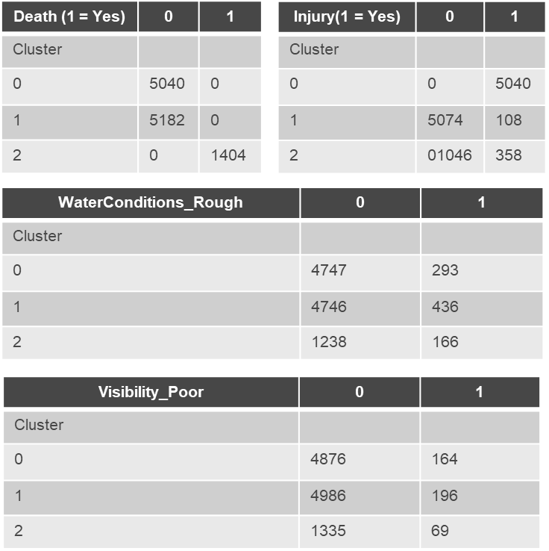
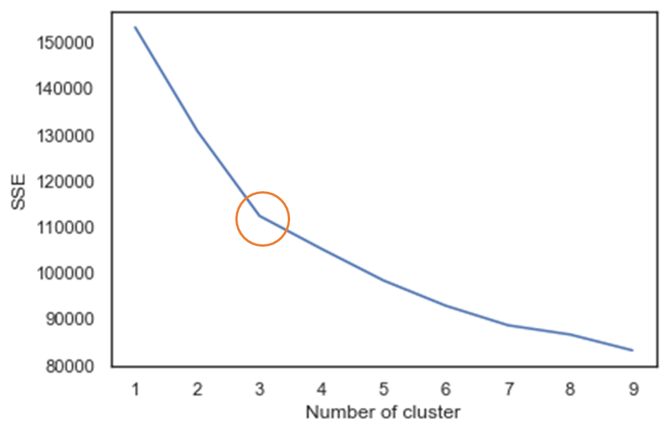
Used Vehicle Buying
Modeling and Prediction (1 of 3)
Cluster Analysis
Utilized Kmeans
Plotted and looked for “elbow”
Cluster 0: Consist of accidents that lead to injury, occur primarily during the day, least likely to occur during rough water conditions, and least likely to occur during poor visibility.
Cluster 1: Consists of accidents that did not lead to death, and may or may not have lead to injury, occur during the day, due not usually occur during rough water or poor visibility (but are more likely than cluster 0 to occur during rough water and poor visibility conditions).
Cluster 2: Consists of accidents that lead to death, often have injuries, occur primarily during the day but are more likely than the other clusters to occur during the night, more likely than the other clusters to occur during rough water conditions, and more likely than the other clusters to occur during poor visibility.

Slide 12
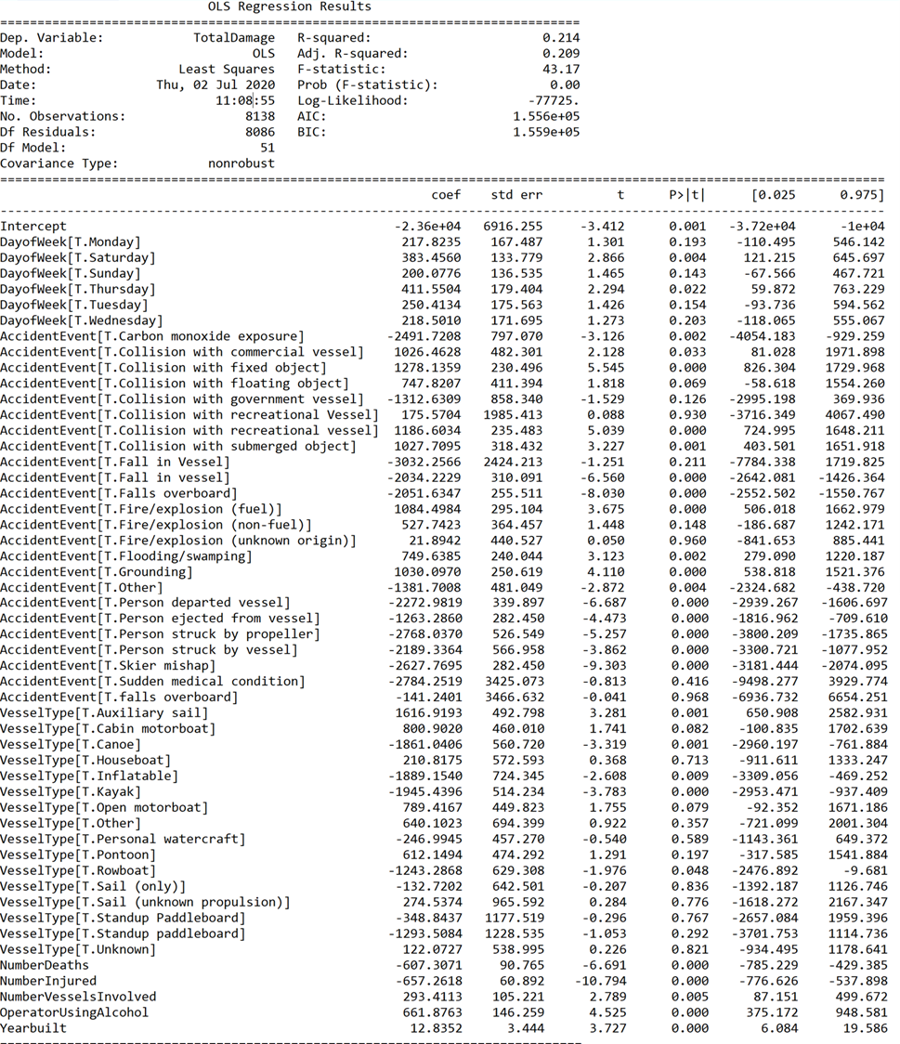
Used Vehicle Buying
Modeling and Prediction (2 of 3)
OLS Regression Model
Identify leading features that explain the variation in the total cost of damage for accidents
Employed backwards elimination using the P-value approach
Stepwise process concluded on the fourth step
General equation for my model:
TotalDamage = B0 + B1*NumberDeaths + B2*NumberInjured + B3*NumberVesselsInvolved + B4*DayofWeek + B5*AccidentEvent + B6*OperatorUsingAlcohol + B7*VesselType + B8*Yearbuilt
Q-Q plot showed assumption for normal residuals challenged
Resulted in a R-squared value of 0.21 the MSE is 502,620,146.89

Slide 13
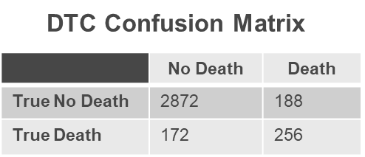
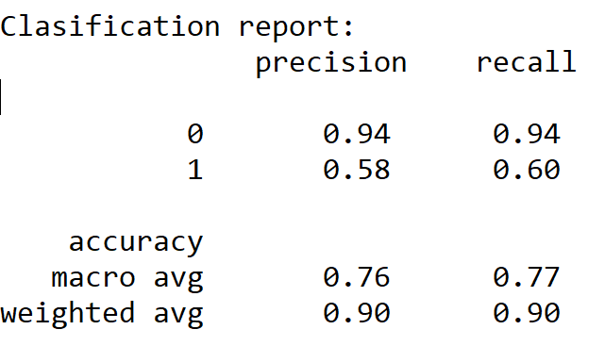
Used Vehicle Buying
Modeling and Prediction (3 of 3)
Classification Decision Tree
Help answer research question 2 by predicting if an accident is likely to have resulted in death based on a collection of given features.
Created dummies but dropped the NumberDeaths, NumberInjured, and Injury (1 = Yes) from the dataframe. Failing = accuracy of 1
Generally, this model is pretty good at predicting when deaths do not occur, but suffers slightly at making trustworthy predictions on actual deaths. However, the model performs generally well with an overall accuracy of .90.

Slide 14
Used Vehicle Buying
Closing
Conclusion
XXX
XXX
XXX

Slide 15
Used Vehicle Buying
Thank you

