Slide 1


Used Vehicle Buying:
Improving the Buyer and Seller experience through inference and prediction models
Analysis by Group1 [Ralph Parlin | Patrick Prioletti | Brian Schramke | Kobi Wiseman]
Photo Source: https://www.requestyourcar.com/blog/details/questions-to-ask-before-buying-car/

Slide 2
Used Vehicle Buying
Purpose & Agenda
Purpose
This brief is an executive level in-progress review of analysis on used vehicle buying that offers inference and prediction models to improve transactions for buyers and sellers.
Agenda
Project Summary
Research Questions
Data Summary and Treatment
Exploratory Data Analysis
Modeling
Next Steps

Slide 3
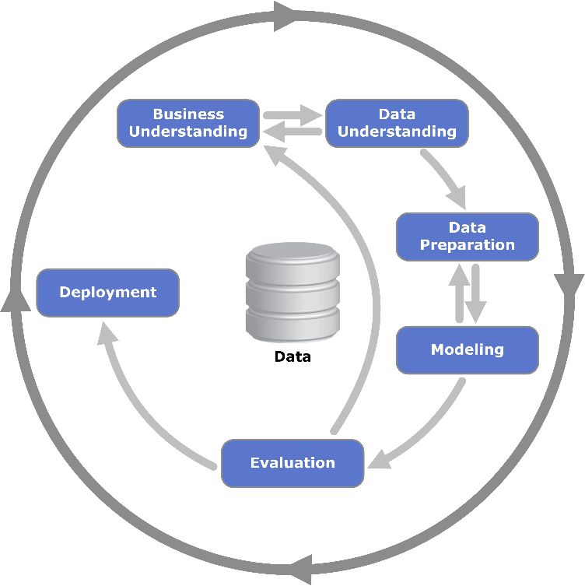
Used Vehicle Buying
Project Summary
Project Objective:
Improve Buyer and Seller experience through inference and prediction models
Problem Statement:
Current processes for determining the price of a used vehicle creates pain points for both U.S. vehicle buyers and sellers as they struggle to determine a vehicle’s fair market value. However, the valuation process can be improved through effective modeling.
Approach: ​
Through descriptive statistics, visualizations, and modelling, identify key differentiating features that help explain the variance in vehicle prices and market timings​
We followed the basic outline of Cross-industry Standard Process for Data Mining (CRISP-DM)
Iterated business rules from which to launch independent modeling
CRISP-DM
Business Rules
Image Source: https://en.wikipedia.org/wiki/Cross-industry_standard_process_for_data_mining

Slide 4
Used Vehicle Buying
Project Summary
Data:
Real data on U.S. used vehicles from sale data on CarGurus updated on 21 September, 2020
3,000,000 observation across 66 features
After cleaning we reduced to 595,365 across 55 features
Dropped several columns deemed unimportant
Scoped out all observations price > $90,000 (modeling for average buyer)
Key Predictors:
Vehicle attributes [milage, horsepower, body_type, fuel_economy]
Sale attributes [daysonmarket, is_certified, listed_date]
Regional attributes [city, dealerzip, lat/long]

Slide 5
Used Vehicle Buying
Research Questions
Questions that focused the analysis:
Used Vehicle Market Patterns:
What underlying patterns exist in the data? [Summary Statistics / EDA] Ralph/Brian/Patrick haves started this, just need to expand on it
Is there something there that we can’t see? [K-Means Clustering/PCA] Kobi/Patrick time permitting
For example, we could use it to find top 5 markets based on lat/long
How can the data be clustered/assigned a persona/group? [K-Means Clustering/PCA] Kobi/Patrick time permitting
Price Setting and Price Expectations: Ralph or Patrick
How can sellers set fair prices and how can buyers benchmark for value determinations? [Prediction: OLS Regression Analysis/Stepwise] Ralph, [Random Forest] Patrick
What are the most important features that help predict the price of a used vehicle? [Inference: OLS Regression Analysis/Stepwise] Ralph, [Random Forest] Patrick
What impact does a vehicle having been in an accident have on price?
Vehicle Time on Market: Kobi owns this
What impact does a vehicle having been in an accident have on the time the vehicle spends on the market [Inference: Logistic Regression] Could also employ Random Forest here as the Prof recommended
Determine how a vehicle’s price (which will be used as a predictor, unlike the linear model) on the probability for a vehicle to be listed on the market for a long time. [Inference: Logistic Regression] We could also use Naive Bayes here to provide probabilities to each feature, but this is not covered in this class. Logistic regression may be tricky/unbalanced if we only do a binomial. We could do random forest here as well.
Previous Vehicle Usage and History: Brian owns this
How can we determine is a vehicle was previously part of a commercial fleet or a taxi to help buyers avoid heavy use vehicles. Brian [Prediction: logistic Regression]. This would also be a good opportunity to use Random Forest as well.

Slide 6
Used Vehicle Buying
Data Summary
Treatment for Missing Data
Boolean Columns:
Set NAs to False
Categorical Columns for Body Type, Fuel Type, Transmission, Wheel System
Replace NAs with dominate value in category
Integer Columns:
Median Replace
Double Columns:
Mean Replace
Engine Type:
If cylinder count = 6,8,10, or 12: Set as “V” type
If cylinder count < 6: Set as “I” type
All others set as “I” type

Slide 7
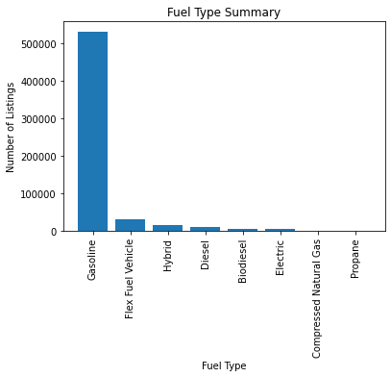
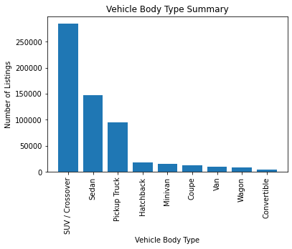
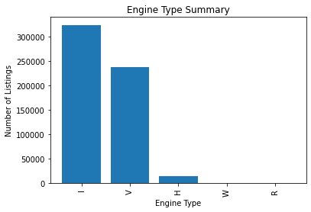
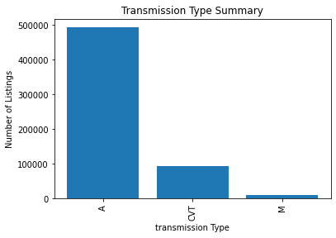
Used Vehicle Buying
Exploratory Data Analysis (1 of 4)
Notes:
Implications of imbalance

Slide 8
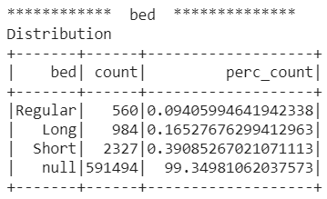
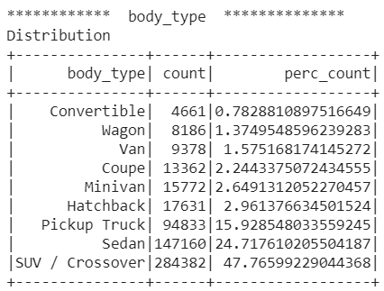
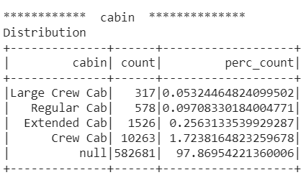
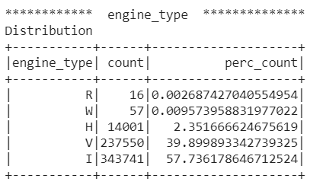
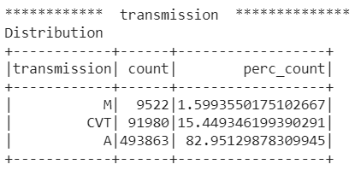
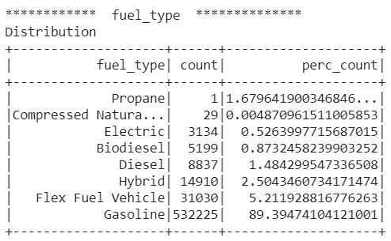
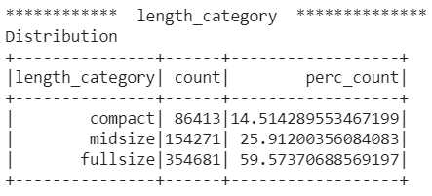
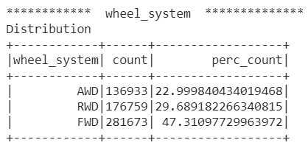
Used Vehicle Buying
We'll probably just use one of these to drive home a point about class balance in our categorical predictors
Exploratory Data Analysis (2 of 4)

Slide 9
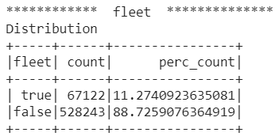
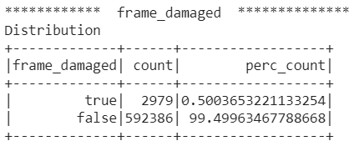
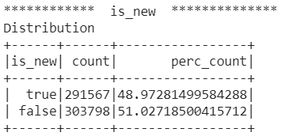
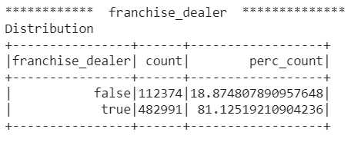
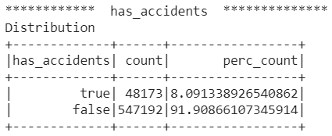
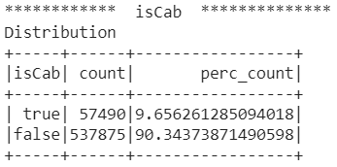
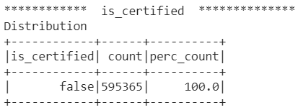
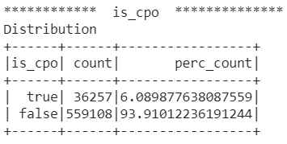
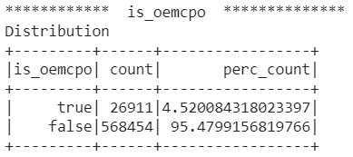
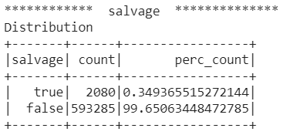
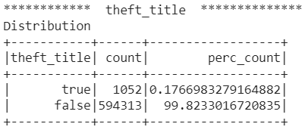
Used Vehicle Buying
We'll probably just use one of these to drive home a point about class balance in our categorical predictors
Exploratory Data Analysis (2 of 3)

Slide 10
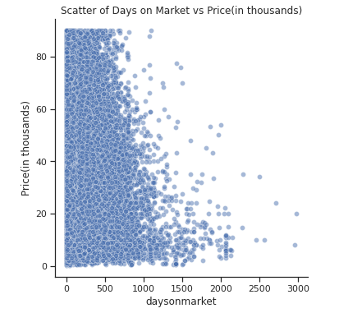
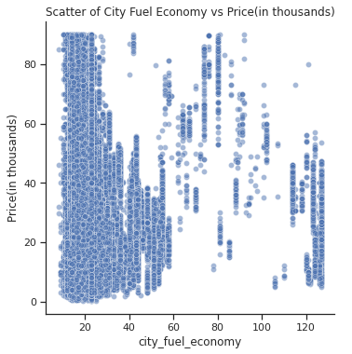
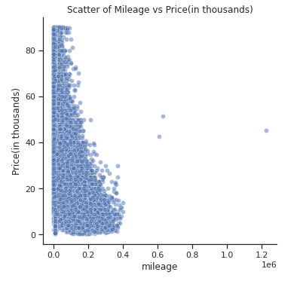
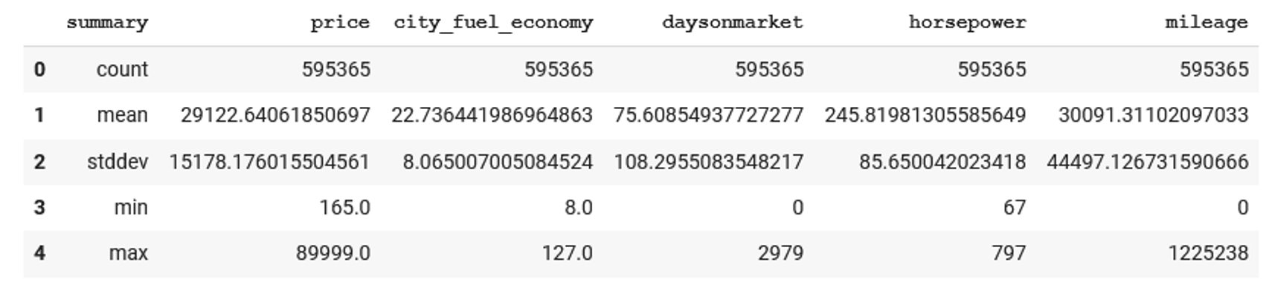
Used Vehicle Buying
Exploratory Data Analysis (2 of 3)
(In days)
(MPG)
(Thousands)

Slide 11
Used Vehicle Buying
Exploratory Data Analysis (2 of 3)
PCA
KNN

Slide 12
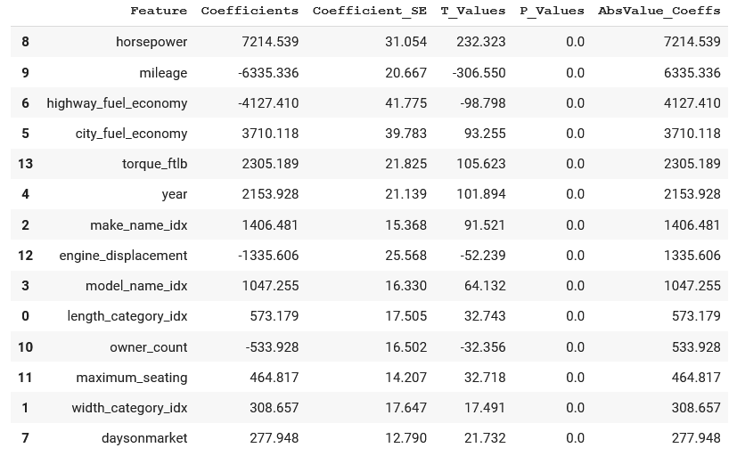
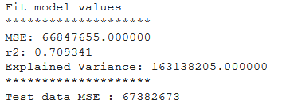
Used Vehicle Buying
Modeling and Prediction (1 of 4)
Regression Model
In support of answering research question 2A and 2B: Price Setting and Price Expectations
Prediction of price; Inference on leading features that explain price variation of a used vehicle
33 Models Total:
30 x models (with 3 CVs)
Conducted grid search
regParam[0.0, 0.01, 0.02, 0.03, 0.4, 0.7]
elasticNetParam [0.0, 0.2, 0.4, 0.5, 0.7]
3-Fold Cross Validation
1xTuned
elasticNetParam=0.2, regParam=0.03
1xTuned(-) to get t/p-values
elasticNetParam=0.2, regParam=0.03, solver='normal’
1XStepwise
Best Model Resulted in
R-squared value of 0.71
MSE value of 66,847,655
PMSE (prediction MSE) value of 67,382,673
Summary Table

Slide 13
Used Vehicle Buying
Modeling and Prediction (1 of 4)
Logistic Regression Model
In support of answering research questions 3A and 3B: Time listed on the market based on listing price and having history of accidents
Prediction of the probability for a listing to stay on the market for more than 150 days; Inference on leading features that explain a used car to stay on the market more than 150 days
Model sample split by training, validation and test, with the proportions of 60-30-10 respectively.
The model resulted in:
AUC ROC of 0.63
Feature Importance Table
Feature | Coefficient | Probability
price | 0.000411
city_fuel_economy | 0.000316
model_name_idx | 0.000261
highway_fuel_economy | 0.000228
make_name_idx | 0.000206
year | 0.000008
width_category_idx | -0.000163
maximum_seating | -0.000247
owner_count | -0.000265
HasAccidents | -0.000272
torque_ftlb | -0.000284
horsepower | -0.000445
engine_displacement | -0.000573
length_category_idx | -0.000606
mileage | -0.000902

Slide 14
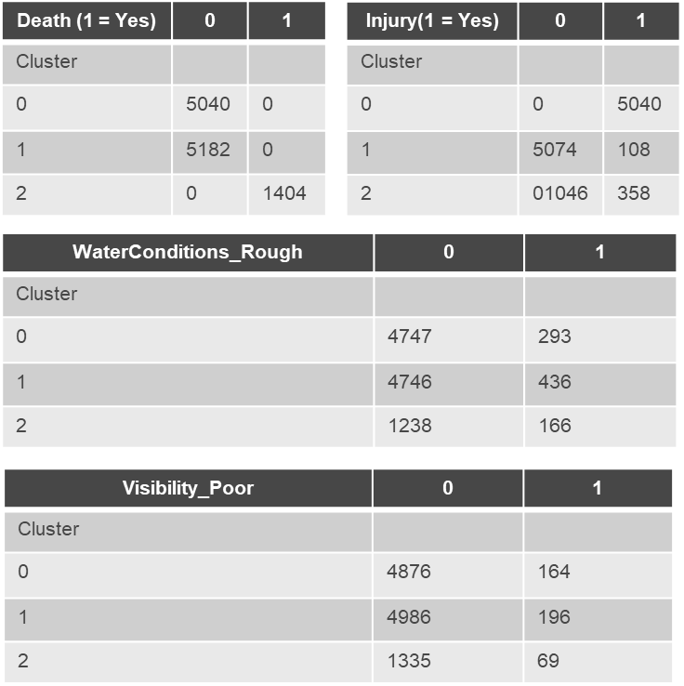
Used Vehicle Buying
Modeling and Prediction (2 of 4)
Random Forest
Utilized Kmeans
Plotted and looked for “elbow”

Slide 15
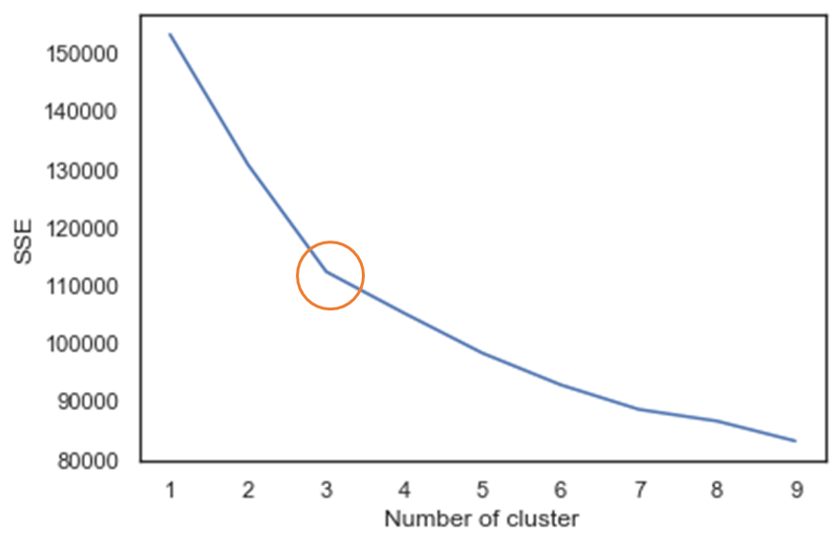
Used Vehicle Buying
Modeling and Prediction (3 of 4)
Cluster Analysis
Utilized Kmeans
Plotted and looked for “elbow”
Cluster 0: Consist of accidents that lead to injury, occur primarily during the day, least likely to occur during rough water conditions, and least likely to occur during poor visibility.
Cluster 1: Consists of accidents that did not lead to death, and may or may not have lead to injury, occur during the day, due not usually occur during rough water or poor visibility (but are more likely than cluster 0 to occur during rough water and poor visibility conditions).
Cluster 2: Consists of accidents that lead to death, often have injuries, occur primarily during the day but are more likely than the other clusters to occur during the night, more likely than the other clusters to occur during rough water conditions, and more likely than the other clusters to occur during poor visibility.

Slide 16
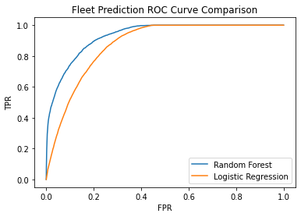
Used Vehicle Buying
Fleet Prediction Analysis (4 of 4)
Logistic Regression and Random Forest Classifier
Help answer business question 4.A of examining previous vehicle usage history to predict if vehicles were ever used in a commercial fleet
Used grid searches to train logistical regression (LR) and random forest (RF) classifier model and compared results
LR used scaled features to enable feature importance inference
The RF model outperformed the LR model with and Area under ROC score of 0.931 vs 0.874
The models demonstrated some overlap in feature importance
RF model would most likely need to be retrained at least annually to maintain accuracy
Random Forest Feature Importance
Logistic Regression Feature Importance
Feature | Weight
year | 0.312616
is_new | 0.185632
Mileage | 0.151958
model_name | 0.076587
franchise_dealer | 0.062528
savings_amount | 0.054503
City | 0.032236
make_name | 0.028527
Price | 0.025108
owner_count | 0.016571
Feature | Weight
is_new | 4.94394
salvage | 1.57354
torque_grade | 0.87469
is_cpo | 0.67043
franchise_dealer | 0.5861
owner_count | 0.50653
frame_damaged | 0.35975
theft_title | 0.33304
is_oemcpo | 0.28309
maximum_seating | 0.27119
Notes:
LR Grid Search: regularization parameters of 0, 0.01, and 0.02, and elastic net parameters of 0, 0.1, and 0.3. The best model had an alpha of .3 and lambda of 0
RF Grid Search number of trees at 20, 30, and 40 as well as max depth of 3, 5, and 7. The best model used a max depth of 5 and 20 trees
Top 10 positive feature (LR)
owner_count 0.50653
frame_damaged 0.35975
theft_title 0.33304
is_oemcpo 0.28309
maximum_seating 0.27119
transmission_display 0.11184
fuel_type_x 0.0397
body_type_x 0.03769
back_legroom 0.01895
Width 0.01353
Top 10 negative features (LR)
is_new -4.94394
Salvage -1.57354
torque_grade -0.87469
is_cpo -0.67043
franchise_dealer -0.5861
engine_type_x -0.13042
seller_rating -0.12277
wheel_system_x -0.10669
transmission_x -0.06613
engine_cylinders -0.04303
Since the RF model uses year as the its most important feature, the model may need to be retrained annually or semi-annually to maintain accuracy overtime. Fleet vehicles entering the used market may be of a certain vintage each year and change as fleets update their inventory. The logistic regression model may maintain its accuracy longer as the characteristics of its most important features will not change from year to year.

Slide 17
Used Vehicle Buying
Closing
Summary of Modeling
With respect to modeling price, it appears our best model was _________________

Slide 18
Used Vehicle Buying
Closing
Next Steps
Regression modeling
Expand the grid search
Improve the stepwise procedure
Restructure/Transform some of the features and remodel
XXX
XXX
XXX
Complete the report (Report and code no later than 29 November)

Slide 19
Used Vehicle Buying
Thank you!
Questions?

