Slide 1
IST 718 FINAL PROJECT PRESENTATION – GROUP 2
JING SUN, ZEQUN CHE, YIFAN WANG
Notes:
ZC: Hi class, we are group 2. I am glad to introduce our project to you. My name is Zequn. … ...

Slide 2

TABLE OF CONTENTS
Project overview
Roles and responsibilities
Dataset information
Data Exploration
Predictions and inferences
Workflows
Methods
Results Summary
Problem and solutions
Summary of inference
Notes:
ZC: This is the contents of our presentation today. We gonna introduce the overview first.

Slide 3

PROJECT OVERVIEW
Enhance the health rate of newborn infants
Natality Birth Data of infants’ health situations and the information of their parents
National Bureau of Economic Research
Details
Analyzing the dataset will help us find the key factors of fetal viability and newborns’ health situation.
Build a model which can predict the health of newborn infants.
Notes:
ZC:
‘Newborn infants are the hopes of the parents and also the future of the world. People all hope that newborn infants could be healthy. However, there are still some unfortunate infants which are not healthy when they are born.’
For helping enhance the health rate of newborn infants, we got the open data which is about Natality Birth Data of infants’ health situations and the information of their parents. The data is from the National Bureau of Economic Research. The dataset records most situations of newborn infants in detail.
We believe that analyzing the dataset will help us find the key factors of fetal viability and newborns’ health situation.
Furthermore, analyzing the dataset could build a model which can predict the health of newborn infants.

Slide 4
Goal
Data analytics on 2018 Natality Birth Data and find insights
Build models to predict natality and infants’ health situation
We are able to interpret the models and capture key influencing factors.
Notes:
ZC： The main goal of this project is to perform data analytics on 2018 Natality Birth Data and find insights related to the newborn infants’ health.
We build models to predict natality and infants’ health situations.
We are also able to interpret the models and capture key influencing factors.

Slide 5
ROLES AND RESPONSIBILITIES
Member Names | Tasks
Jing Sun | Predicting congenital anomalies
Zequn Che | Predicting abnormal conditions
Yifan Wang | Data preprocessing and predict infant lives
Notes:
ZC: This is the roles and responsibilities of our group, everyone of our group will take one of tasks.
Jing will predicting the congenital anomalies.
I am working on the abnormal conditions.
Yifan will do the data pre-processing and the predict important features of infant live.

Slide 6
DATASET INFORMATION
3801534 rows and 240 columns (2018)
The predictors:
Basic birth info, Maternal Behavior, Pregnancy risk factors , and Characteristics of labor and delivery etc.
Newborn mortality rate is 0.255%
421343 infants have abnormal conditions, 11.083%
13314 infants have Congenital anomalies, 0.350%
Link to the dataset: https://data.nber.org/data/vital-statistics-natality-data.html
Notes:
ZC:
The original data that we got is very huge. It contains about 3 million 8 hundred thousand rows, and 2 hundred and 40 columns. Each row represents one birth record in 2018.
The predictors can be roughly be categorized into categories like: Basic birth info, Maternal Behavior, Pregnancy risk factors , and Characteristics of labor and delivery.
The newborn mortality rate is 0.255%
About 4 hundred and 20 thousand infants have abnormal conditions, which represent about 11% of the total.
About 13 thousand infants have congenital anomalies which represent about 0.35 percent of the total.

Slide 7
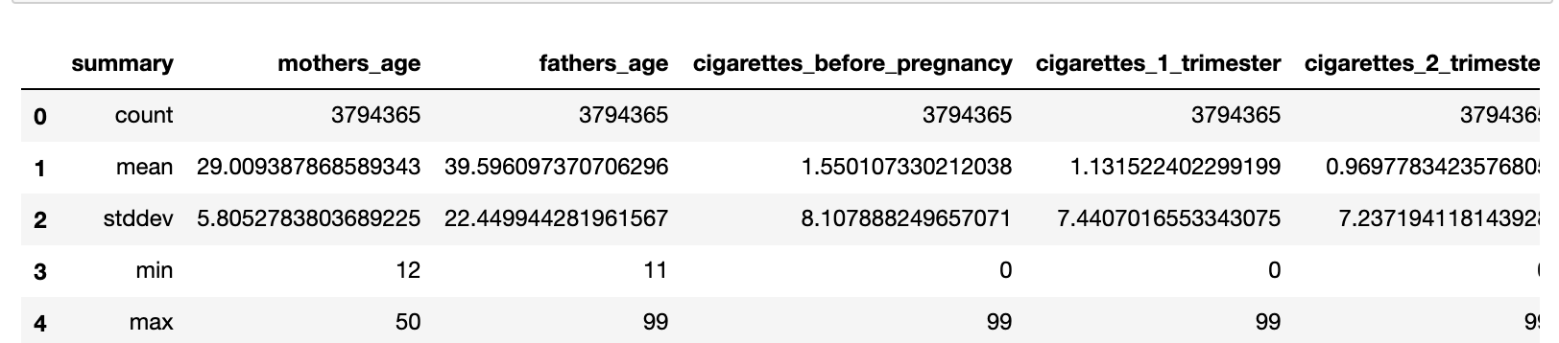
DATA EXPLORATION
Basic numerical data statistics:
Note: based on the dataset user guide, 99 means unknown cases, which needs to filter out later.
Notes:
ZC:This is the basic numerical data statistics, we could see the basic data of the feature. It helps us understand the data.
In this example, the 99 years old means unknown cases, this will be fixed later.

Slide 8
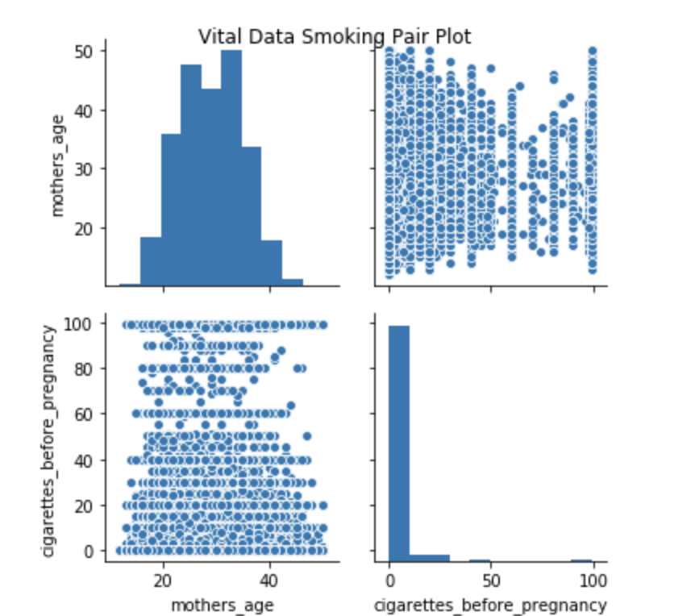
One more interesting thing we found from our dataset was that smoking before pregnancy is a common phenomenon in different age groups.
Infant live | Count
Y | 3224846
N | 2213
Notes:
The table On the left corner shows our final record numbers, as you can see, our dataset exists class imbalance, we will fix this issue later; On the left, the pair plots show the relationship between mother’s age and smoking before pregnancy, it is interesting to see that smoking before pregnancy is a common phenomenon in different age groups.

Slide 9

PREDICTIONS AND INFERENCES
Predictions:
We are interested in three following target variables: Infant living at time of report, Abnormal conditions of the newborn, Congenital anomalies of the newborn
Inferences:
- Determine which predictors are important for a live birth
- Determine which features are important to predict if newborns have abnormal conditions
- Determine which features are important to predict if newborns have congenital anomalies
Notes:
Determine which features are important to predict if newborns have congenital anomalies后翻页

Slide 10
WORKFLOW
Data cleaning
Collinearity test
Significant differences test
Fix classes imbalance
Standardize numerical data and convert categorical data
Build model pipelines
Overfitting test
Model evaluation and hyperparameter tunning
Notes:
On this page, we are showing our project’s workflow for theWe first performed several data cleaning steps, such as check duplicate values, check missing values, cast data types, create dummy variables; Then we performed a collinearity analysis on all numerical data, and remove any features that scored close to 1; Next we performed significant difference analysis on categorical variables and remove any features with P-value greater than 0.05; we tried some strategie to solve the class imbalance; then we build pipelines to train our models and check if there existing overfitting; last, we selected the best model based on the performance and applied hyperparameter tuning.

Slide 11
METHODS
For predicting the important features that impact infant live, we decided to use the logistic regression and random forest models.
Reasons: both of them provide feature importance to interpret the results and have low complexity
Evaluation metrics: PR and ROC
Hyperparameter tuning: cross-validation + grid search and train-validation split.
Notes:
hyperparameter tunning 读完翻

Slide 12
RESULTS SUMMARY
 | Logistic Regression | Random Forest | CV + Grid search | Train – validation
PR of testing set | 0.99951693446094 | 0.99966072625540 | 0.99931826773898 | 0.99950473195739
ROC of testing set | 0.60830303302806 | 0.50682574377833 | 0.5 | 0.60265517984795
Overall performance | 0.60830620596608 | 0.50682574377833
Notes:
On this page we are showing the summary of our models; as you can see, the lr has better performance than rf in general, so we decided set the lr as our model final model; then we build the cv+ grid search on our lr model, the best parameters setting returned a poor result, therefore we applied the tv model as well to find the top 7 features. Finally, our tv model had a good performance.

Slide 13
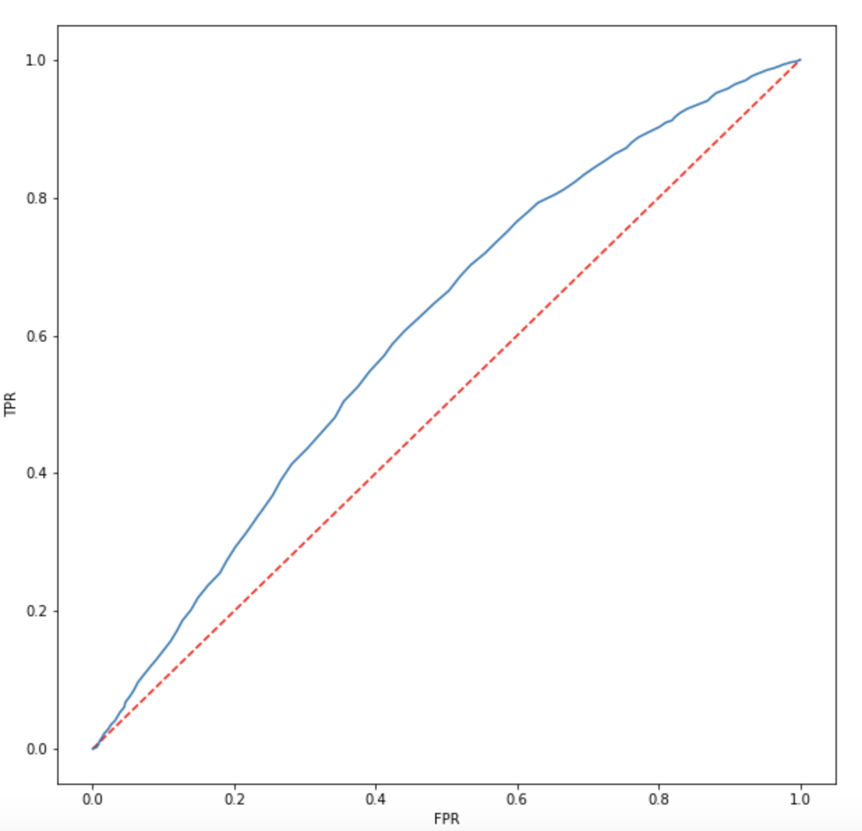
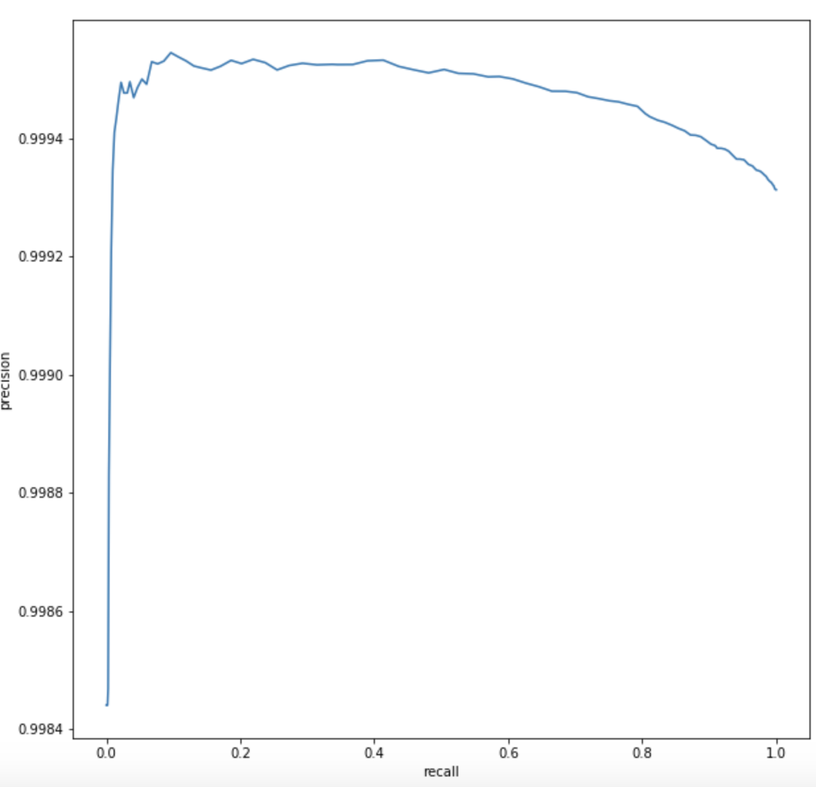
ROC AND PR CURVE
ROC curve:
LR model that predicts at chance will has an ROC curve that looks like the diagonal red line. That is not a discriminating model.
The further the curve is from the diagonal line, the better the model is at discriminating between positives and negatives in general.
PR curve:
summarize the trade-off between the true positive rate and the positive predictive value for a predictive model using different probability thresholds.
Notes:
ROC curve:
LR model that predicts at chance will has an ROC curve that looks like the diagonal red line. That is not a discriminating model.
The further the curve is from the diagonal line, the better the model is at discriminating between positives and negatives in general.
PR curve:
summarize the trade-off between the true positive rate and the positive predictive value for a predictive model using different probability thresholds.

Slide 14
Why not MSE?
For MSE, it is not an appropriate cost function for our project. There are two main reasons that MSE is a bad choice for binary classification problems: first, using MSE means that we assume that the underlying data has been generated from a normal distribution, but the reality is our dataset is not following normal distribution; Secondly, the MSE loss function is non-convex for binary classification. In simple terms, if our model was trained with MSE , we were no longer building a logistic regression model but some other kind of linear classifier.
Notes:
For MSE, it is not an appropriate cost function for our project. There are two main reasons that MSE is a bad choice for binary classification problems: first, using MSE means that we assume that the underlying data has been generated from a normal distribution, but the reality is our dataset is not following normal distribution; Secondly, the MSE loss function is non-convex for binary classification. In simple terms, if our model was trained with MSE , we were no longer building a logistic regression model but some other kind of linear classifier.

Slide 15
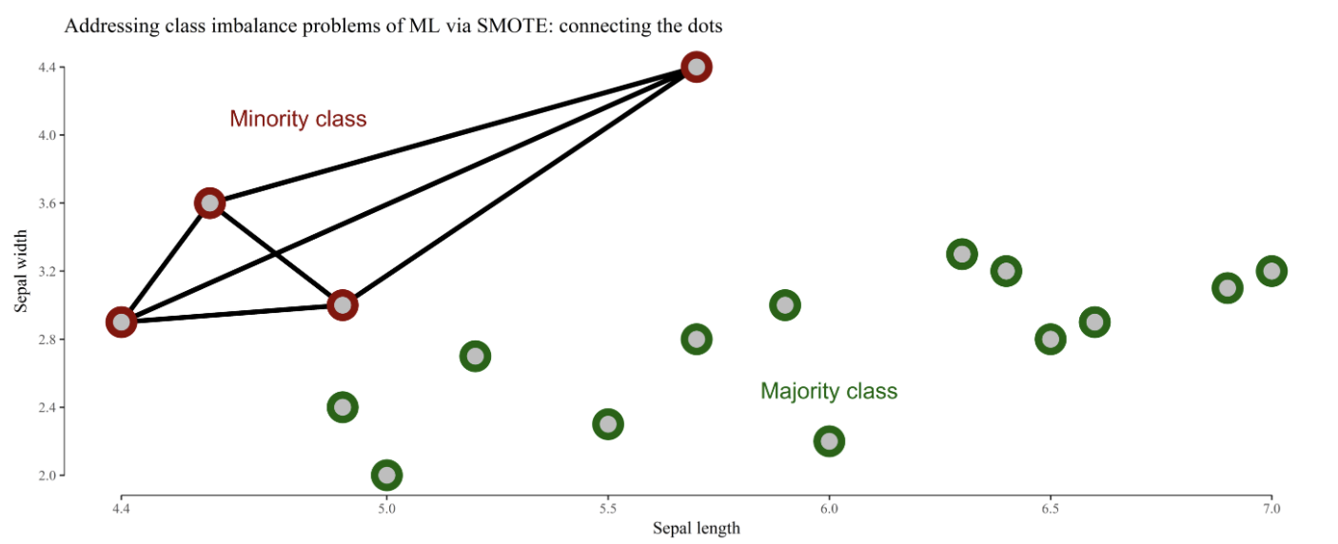
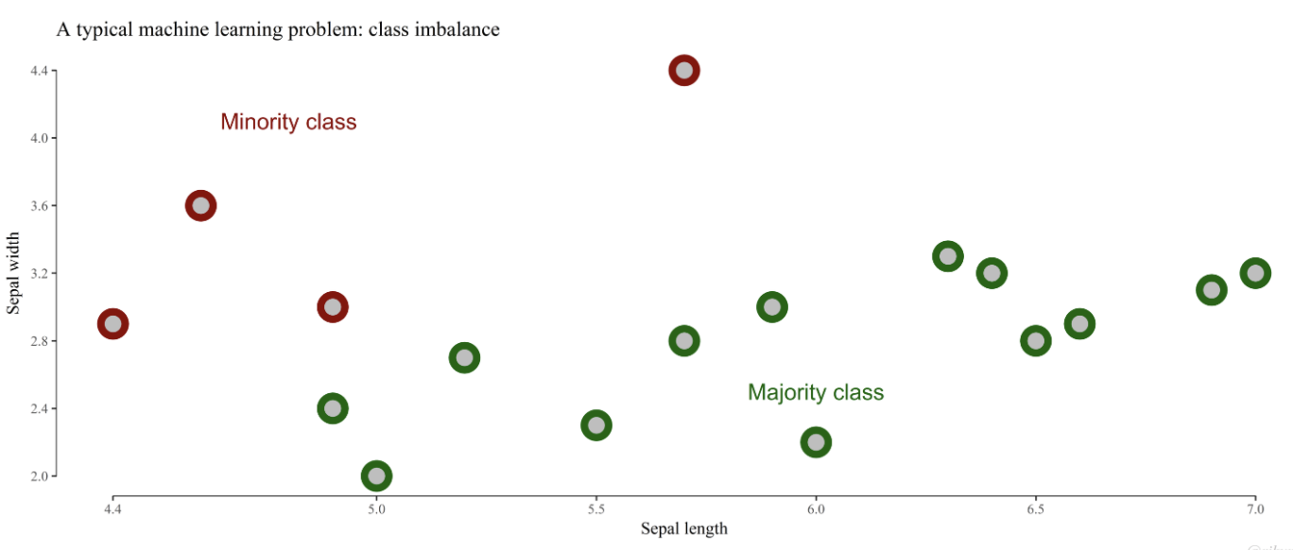
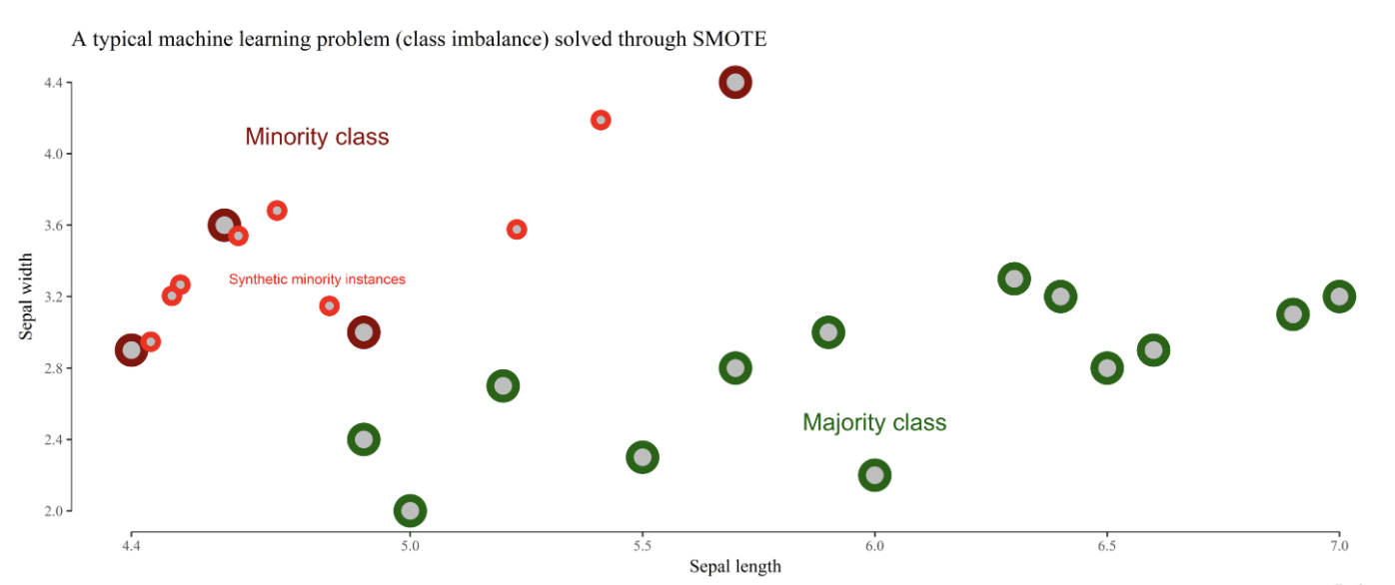
PROBLEM AND SOLUTIONS
Target Variable | Yes | No
No abnormal condition | 3376738 | 421343
No congenital anomalies | 3782113 | 13314
infant alive | 3224846 | 2213
Large dataset: 3M records and 240 features
Feature engineering: Chi Square Test
Dimensionality reduction: Principal Component Analysis(PCA)
Imbalanced Class
Oversample the rare class
Undersampling the majority class
Synthesize minority oversampling technique(SMOTE)
Specify class weight
Notes:
During the project, we mainly encountered 2 problems. One is that the dataset is very large, with 380k records and 240 features. Even though we’ve manually filtered features which we thought are irrelevant, we still need to fit more than 200 features into models after encoding categorical features. With 380k records, the procedure of model fitting was very time consuming. Sometimes even unsuccessful with limited memory. To deal with it, we tried PCA first, but we were running out of memory. Then, we implemented chi-square test. Chi-square test basically compares two variables in a contingency table to see if they are related. In our case, we are able to filter out those features which are less related to target variables. By doing that, we reduced the number of features down to less than 100. The running speed of model fitting decreased significantly. We may also try to use PCA again based on those selected features.
The other challenge in this project is that we are dealing with an extremely imbalanced dataset. The class of infant alive versus not alive is 300k versus 2000. It can result in a serious bias towards the majority class. In fact, when we ran random forest model to predict congenital anomalies, the model directly predicted all the testing data as the majority class, which is no congenital anomalies. we used several data manipulation methods to balance the dataset. We tried oversample the rare class and undersample the majority class. Both achieve good performance. But those two methods does not provide any additional information to the model and we even lose some information with undersampling. During the research, we found another method which is to synthesize new examples from the minority class. The most widely used approach is called the Synthetic Minority Oversampling Technique, or SMOTE for short. The algorith work like this. In this plot, green data points reprensent majority class and red points are minority class. Smote algorithm works by selecting examples that are close in the feature space (using a distance measure), drawing a line between the examples and drawing a new sample at a point along that line. However, this method could be computationally expensive. We will try it but it’s possible that we can’t run it with our computer. The last method is to specify class weight. The weighting can penalize the model less for errors from the majority class and penalize the model more for errors from the minority class. It can be implemented in logistic regression model. We are playing around with those methods and find the one with the best performance.

Slide 16
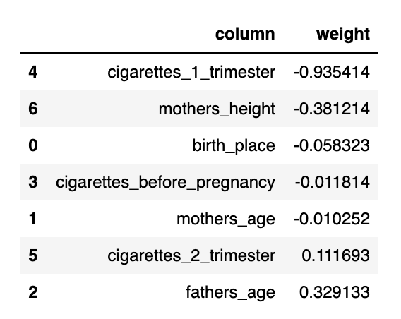
SUMMARY OF INFERENCES
TRAIN-VALIDATION SPLIT (LR) FEATURE IMPORTANCE:
Notes:
For now, we found that logistic regression achieved the best performance on predicting newborns’ livability. In our model, 1 refers to alive and 0 refers to death. So the features with negative weight are factors that may lead to newborns death. According to feature importance, we can infer that mother’s smoking habit is the most important predictor on newborns livability. Maternal age is also a predictor. It’s hard to explain mothers height and birth place. But we are still trying to improve the model and we may get a result with better interpretability. This is all about our current project progress. Thank you for listening.

Slide 17
Thank you!
Any Questions?
Notes:
For now, we found that logistic regression achieved the best performance on predicting newborns’ livability. In our model, 1 refers to alive and 0 refer to death. So we’ll look at the negative weight. means that it’s related to According to feature importance, mother’s age and if she smoke contribute the most when predicting if newborns alive or not. This is all about our current project progress. Thank you.

