Slide 1
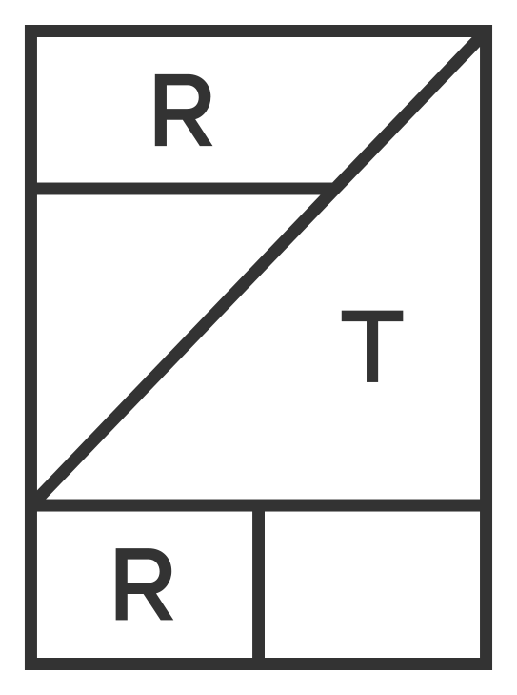
customer feedback analysis for rent the runway
Presented by Group 4
Liya Zhou, Yibo Feng, Wenyi Xiong

Slide 2

Agenda
Project Overview
Data Exploration
Predictions and Inference
Prediction 1: Sentiment Analysis
Prediction 2: Products with High Rating Analysis
Prediction 3: Recommendation Analysis
Prediction 4: Customer Rating Preference Analysis
Problems and Evaluation
Contributions

Slide 3
Project overview
To figure out how the clothes brand, Rent the Runway, should focus on utilizing the factors that can affect customer feedback and predicting which kinds of clothes should be promoted to a unique customer.

Slide 4
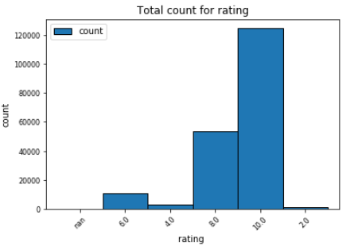
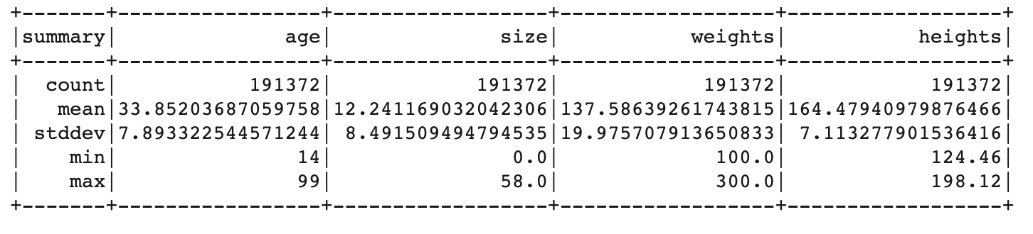
Data exploration
Extracted from .json file into .csv file with 15 columns and 192544 rows
1
Each raw in the data records one transaction. There are 105508 customers and 5850 kinds of product are included.
2
Filled missing values in numeric variables with means , eliminated outliers in age, filled missing category values with the most common ones.
3
The “review_date” won’t make sense in our analysis, so we removed it from the original dataset.
4
The format of height doesn’t work well in data processing. We extracted numbers and transformed them into integer with units of centimeter.
5
The “weight” contains “lbs” in the value, so we removed “lbs” from the values and only kept its number.
Add a new column named “attitude” with logical value 0 and set rating that lower than or equal 5 to logical value 0, rating that greater than 5 to logical value 1.

Slide 5
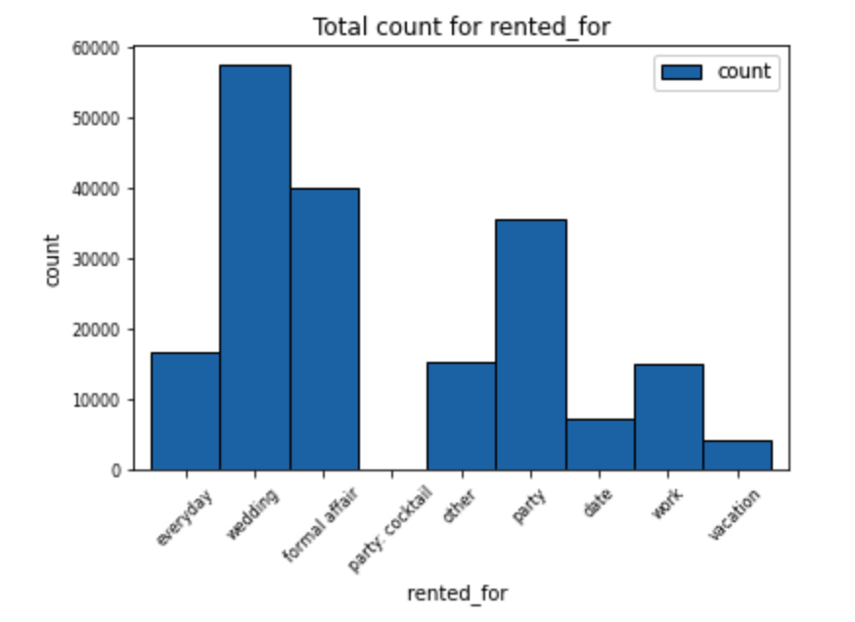
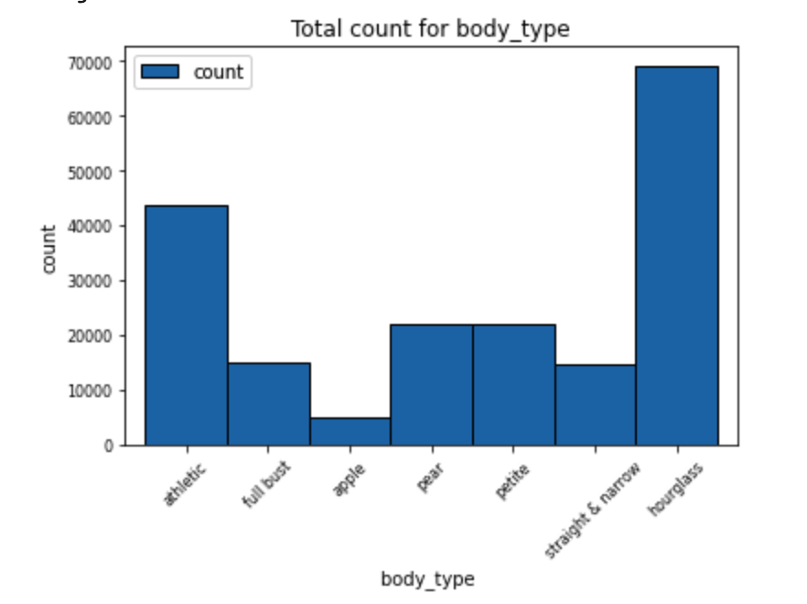
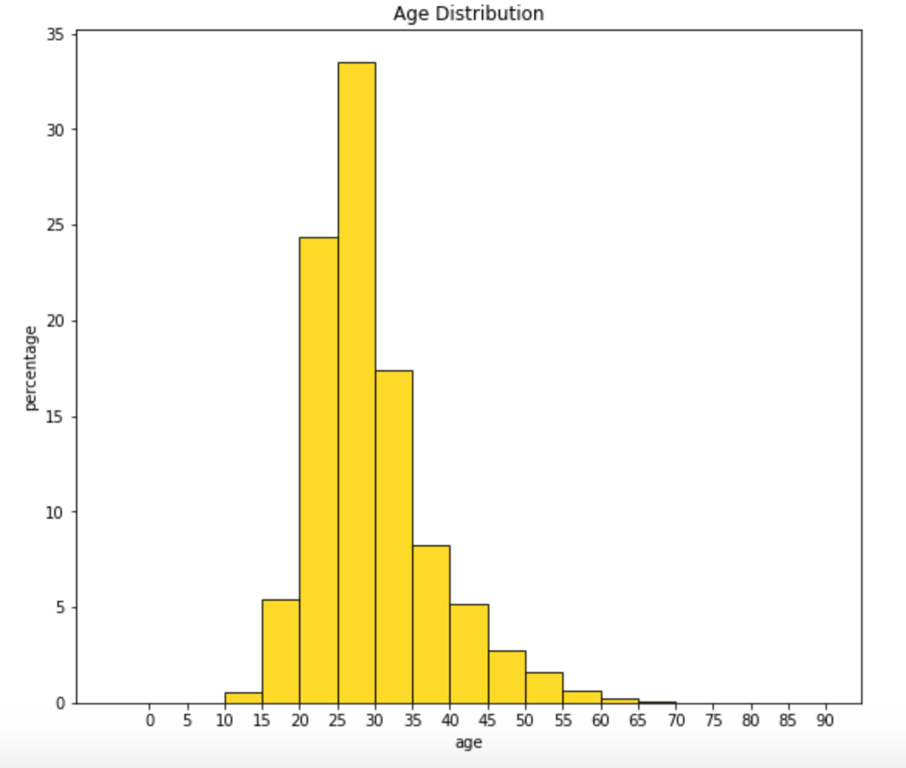
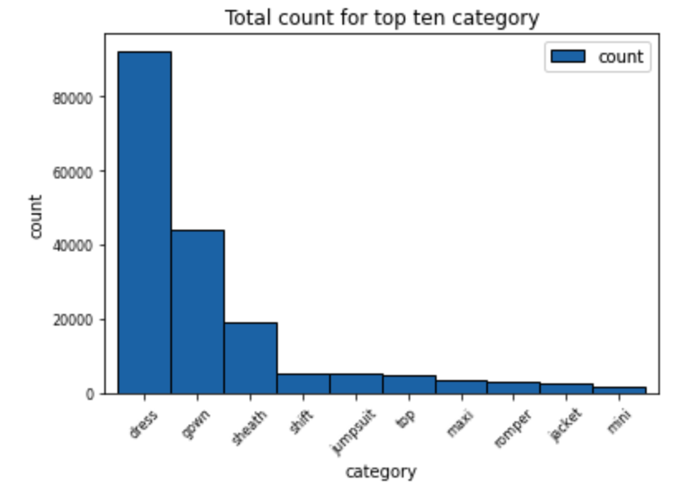
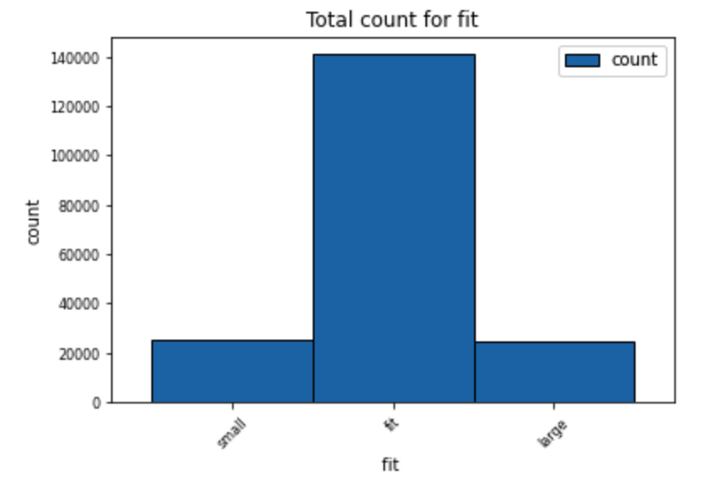
Data exploration

Slide 6
Prediction
inference
Prediction 1
Predict the sentiment of reviews in each transaction for the purposes of finding out important factors influencing customers attitudes and preparing for the prediction of rating.
Prediction 2
Predict the situation where customers are likely to give different ratings for the purpose of judging whether the customer would like to provide a high rating or not.
Prediction 3
Predict what kinds product will get high ratings for the purpose of helping RentTheRunWay keep them stocked.
Prediction 4
Predict what kinds of product will fit different customers for the purpose of recommending appropriate product to customer.
We plan to measure the prediction of customer’s sentiment in each transaction:
Words in review_text that weighs the most in illustrating the emotion of customers
Attitude: which directly shows feedback (positive or negative) from customers.
We make hypothesis those predictors are important when we try to predict whether a customer would like to give a high rating:
Rating: existing rating customer gave to the product. This is an important parameter in training stage. A further rating hierarchy can also be made to determine the rating scores in which range could be described as a high rating.
Fit
We are willing to see those predictors work well in predicting what kinds of product will fit a special customer:
Fit, weight, height, age, bust_size, body_type: to show the measurements of the customer.
Rating
Category, size: to show the measurements of the product.
From data exploration, we plan to test following predictors for a prediction of what kinds of items customers would like to give a high rating:
Category
Customer features to reflect products, such as rented_for and body_type.

Slide 7
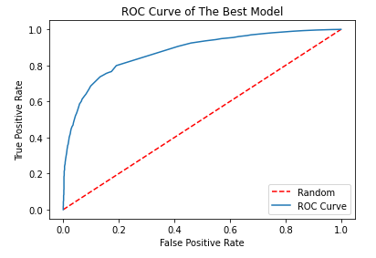
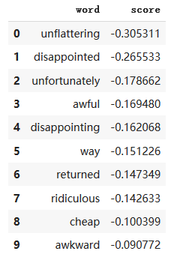
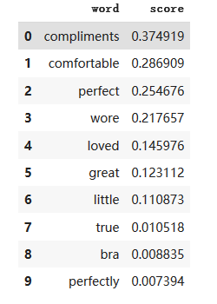
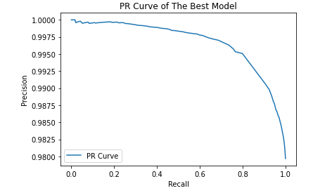
Summary of Sentiment analysis
NOTE: The best model is picked via grid search method
The 10 most negative words (factors) selected by the best pipeline model
The 10 most positive words (factors) selected by the best pipeline model
The ROC Curve and PR Curve of the best pipeline model

Slide 8

Summary of Sentiment analysis
For sentiment analysis: The best model is picked via grid search method
AUC score of original model and the best model

Slide 9
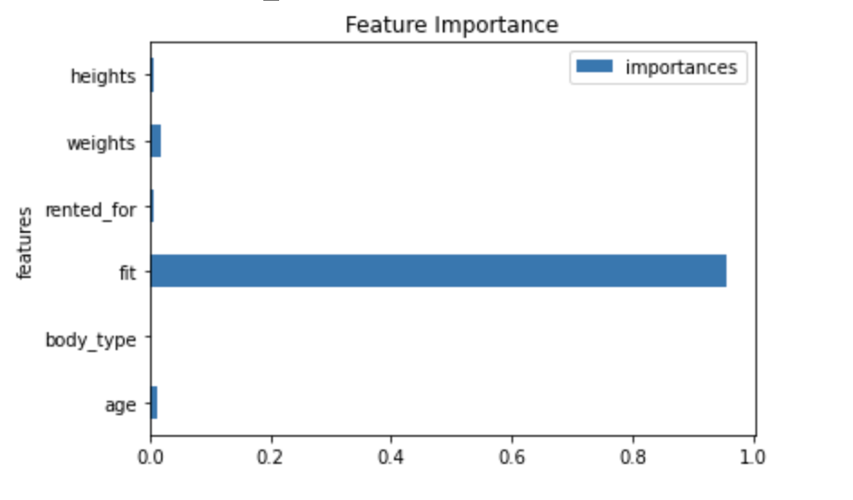
summary of Customer Rating Preference Analysis
Models and Methods:
Transform 'body_type’, ’bust_size’, 'category’, 'rented_for’, ‘fit’, ‘size’, 'age’ into vectors.
Random Forest to classify rating preference
Experiments :
First time: use rating number as prediction. Accuracy: 0.65
Second time: use rating level as prediction. Accuracy: 0.92

Slide 10
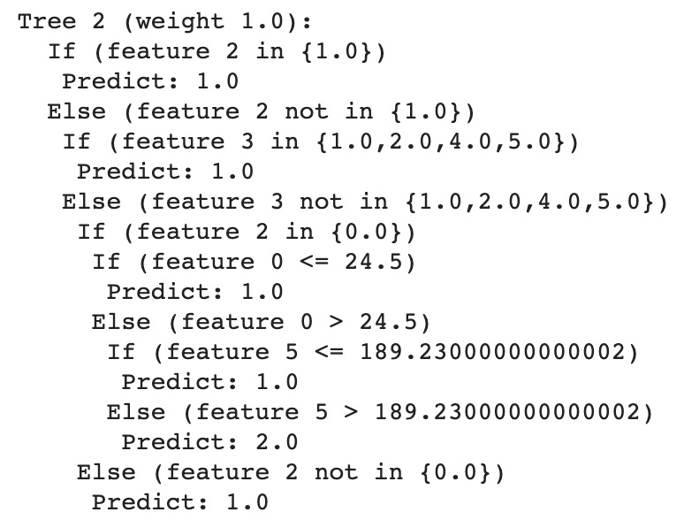
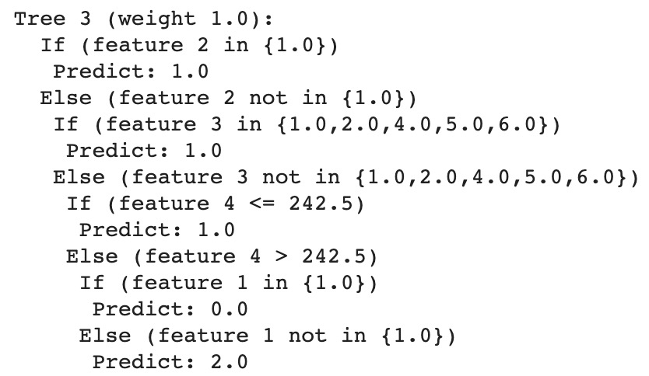
summary of Customer Rating Preference Analysis
For tree 2- it could conclude that if female is under 24 or her height is less than 189cm with fit comment. she will give high rating. Otherwise, she will give medium rating.
For tree 3- it could conclude that if the female's weight is less than 242.5 lbs she will give high rating. Otherwise, she will give low rating when her body type is full bust and medium rating when her body type is not full bust.

Slide 11
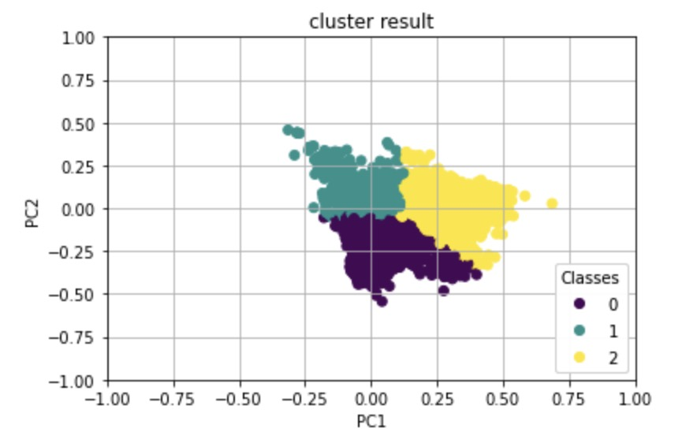
summary of Recommendation Analysis
Models and Methods:
PCA to filter features
K-means clustering to divide bodytype/bustsize–category into multiple groups.
Accuracy：
0.748 (highest when k=3)

Slide 12
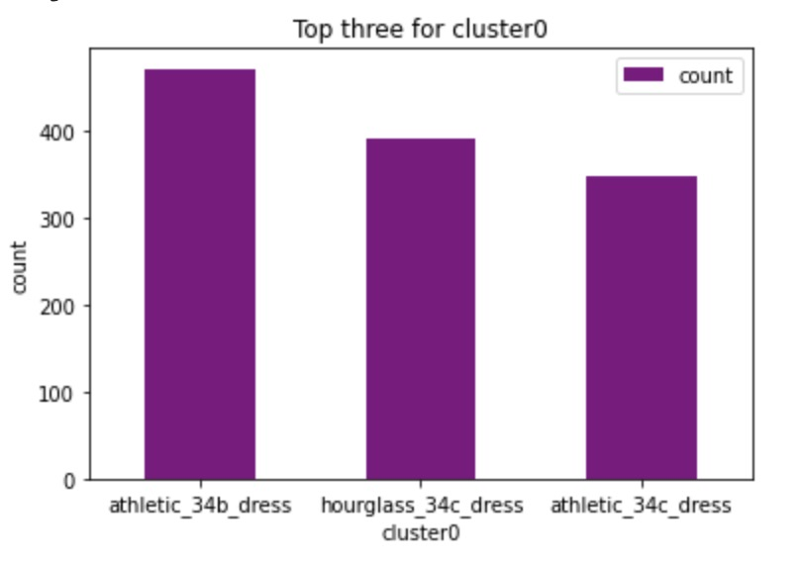
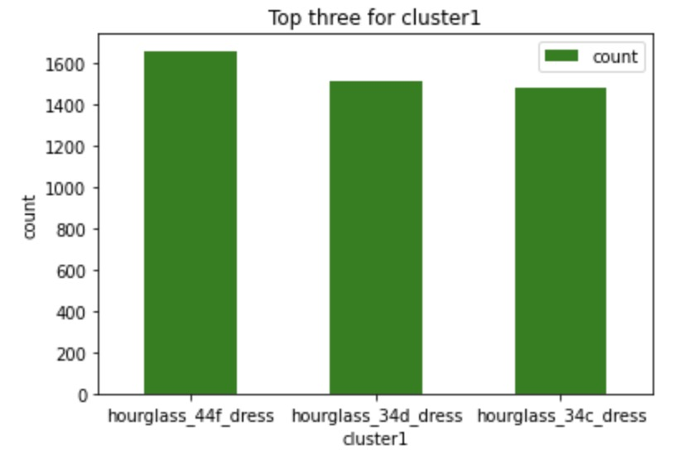
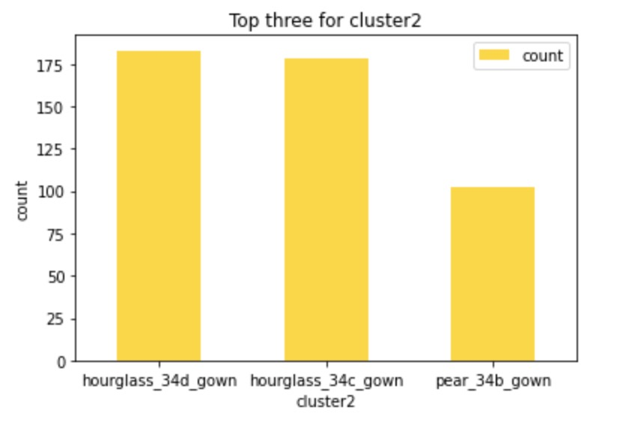
summary of Recommendation Analysis

Slide 13
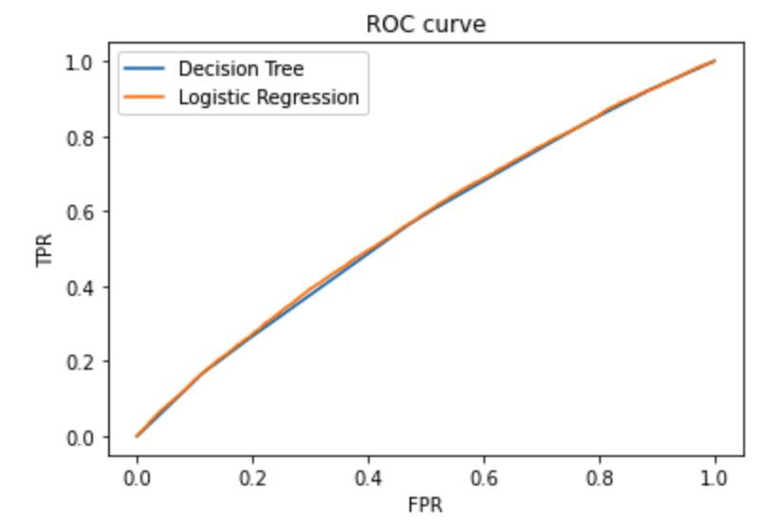
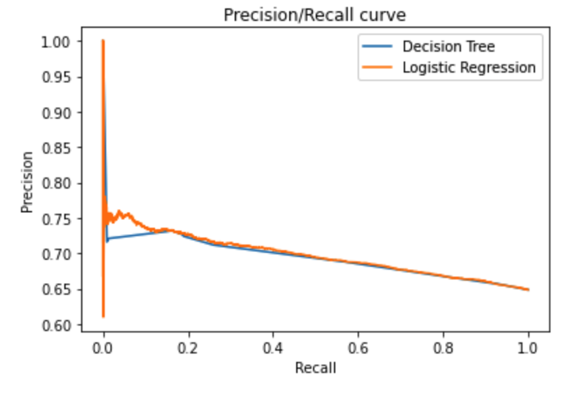
summary of Products with High Rating Analysis
Models and Methods:
Set ‘rating’ = 10 as the high rating.
Transform 'body_type’, 'category’, 'rented_for’, into vectors separately.
Assembled three vectors and ‘size’, ‘age’ into feature vector.
Decision Tree to classify rating preference through 3-fold cross validation.
Logistic Regression to be the comparison with decision tree
AUC:
Decision Tree: 0.53
Logistic Regression: 0.56

Slide 14
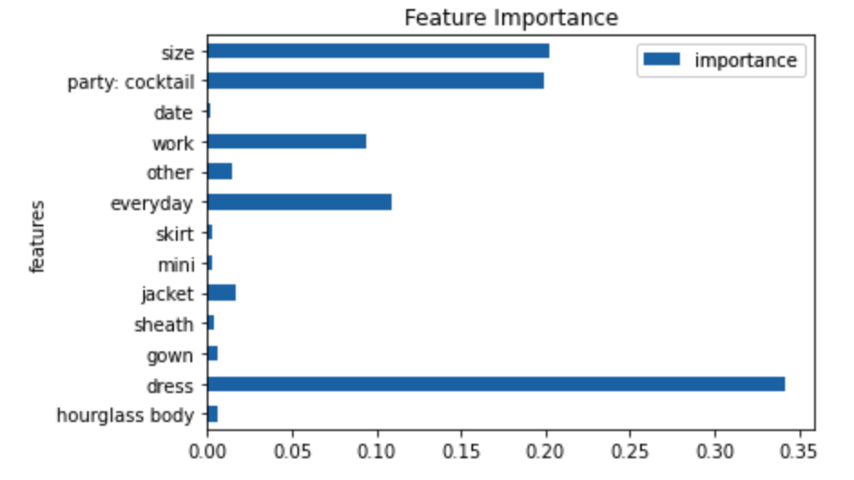
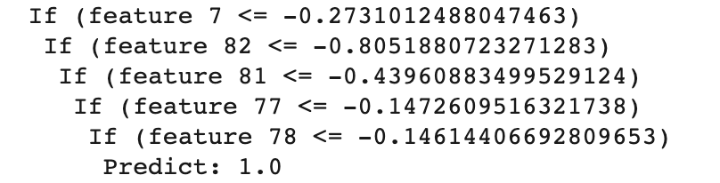
summary of Products with High Rating Analysis
Decision Tree:
Depth = 6
Nodes Num = 57
Classes Num = 2
Features Num = 83

Slide 15
Problems encountered
Difficult to convert emoji to text when text processing with pyspark.
The trees are difficult to do visualization.
The accuracy of decision tree and logistic regression didn’t perform very well when predicting products with high ratings.

Slide 16
Prediction Evaluation
Prediction 1: Sentiment Analysis
Get a sentiment analysis model with 88% accuracy and 10 most negative words (factors) and 10 positive words (factors).
Prediction 2: Customer Rating Preference Analysis
Get different situations that contribute to different rating levels.
Prediction 3: Recommendation Analysis
Get multiple background of customers to find most suitable category of clothes.
Prediction 4: Products with High Rating Analysis
Get specific kinds of products that contribute to getting high ratings using predictors in Inference.

Slide 17

Group task assignment
Wenyi Xiong:
Prediction 1 Sentiment Analysis:
PowerPoint making
Liya Zhou:
Data preprocessing
Prediction 4: Products with High Rating Analysis
Yibo Feng:
Prediction 2: Customer Rating Preference Analysis
Prediction 3: Recommendation Analysis

Slide 18

Thank You!
Any question?

