Slide 1
IST256 : Applications Programming for Information Systems
Spring 2019
Mondays 3:45-5:05 Prof. Michael Fudge
Course Introduction

Slide 2
Agenda
Introduction
How this course is organized?
Goals of This Course
Let's Go Over The Syllabus
How Does Large Group Lecture Work?
Your To-Do List For Next Class

Slide 3
How is this course organized?

Slide 4
Everyone is enrolled in 2 sections
Lecture Section
Recitation Section
Combined.
I'm your lecture Professor
Meet Mondays
We cover new course material in lecture.
Don’t need your laptop, but you do need your smartphone.
You don't write code in Lecture. Too chaotic to try, just watch and most importantly ask and answer questions.
Breakout. Smaller groups.
Your recitation professor is of: Ferger, Kadaji, Nosky, Rieks, or Stringer.
Meeting times vary Wed-Fri
We enforce lecture material in recitation.
You must bring your laptop!
You will write code in Recitation. Easier to do because you've seen it in lecture.

Slide 5

We are all your professors, but…
Only your recitation instructor grades your work.
The rest of us are here to help only.

Slide 6
Resources we will use in this course
Course Website: http://ist256.syr.edu
All Content is on the website. PowerPoints, Syllabus, What’s due, Setup instructions.
Content is searchable.
GitHub Classroom
All the code samples, demos, labs, and homework assignments are here.
We will learn to code using the tools of real coders.
Blackboard
For taking the diagnostic quizzes; grades posted here.

Slide 7
Goals of This Course

Slide 8
We Want You Become a "Modern Programmer"

Slide 9
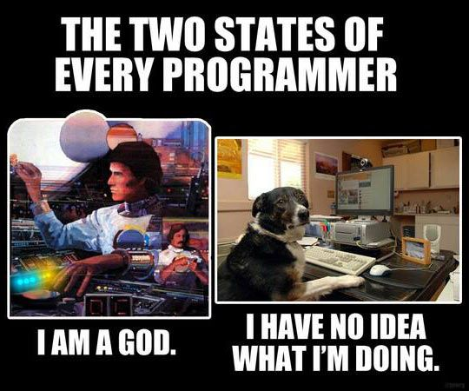
To program in the Python computer programming language.

Slide 10
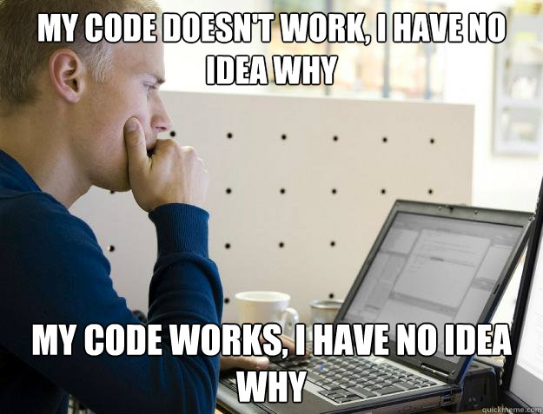
To solve complex real-world, data-oriented problems by writing code.

Slide 11
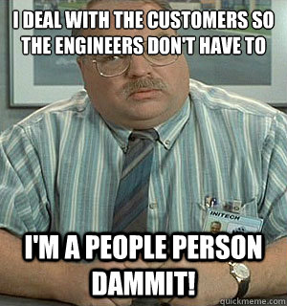
To read, write and discuss code and documentation with confidence.

Slide 12
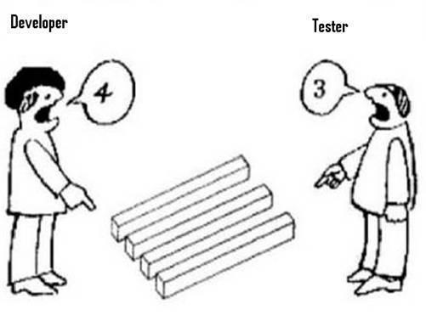
To code in teams, collaborate with others and manage your source code.

Slide 13
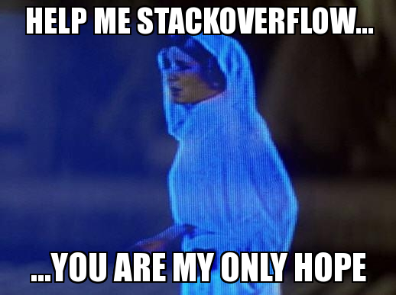
The skills necessary to acquire new programming knowledge independently.

Slide 14
Why Learn To Program?
“TEDxSMU: You Should Learn to Program”, by Christian Genco
https://www.youtube.com/watch?v=xfBWk4nw440

Slide 15
Programming:
Is
Difficult
Time Consuming
Frustrating
Rewarding
Requires:
Practice (lots of it)
Precision
Patience
Persistence
The Key to success is Practice

Slide 16
Let's Go Over The Syllabus!
http://ist256.syr.edu/syllabus/

Slide 17
Textbooks
2 Required.
All are digital
One is not Free… It’s $58
http://ist256.syr.edu/syllabus/#textbooks

Slide 18
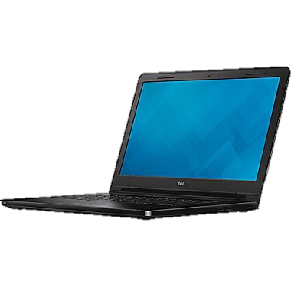

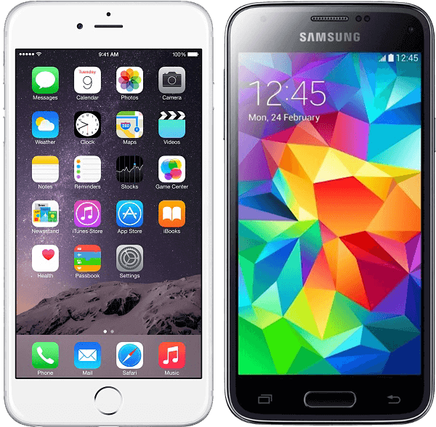
This Class Is BYOD
During lecture
You need your laptop or smartphone to Participate in Class (answer and ask questions)
During Recitation
You will need your laptop to write code, of course!

Slide 19
Methods of Evaluation
http://ist256.syr.edu/syllabus/#methods-of-evaluation

Slide 20
Exams (E1, E2, E3)
Three exams in the course. Your best two exam scores count towards your final grade.
Exams are delivered in class on the dates posted on the syllabus and class schedule.
Exams are 30 minutes in length, at the beginning of class recitation.
There are no re-issues or make-ups, but you may request in advance to take an exam at an alternate time at 50% penalty.
Exams are issues on paper as multiple choice questions.

Slide 21
Project (P1-P3)
Your chance to show us what you've learned.
Do whatever you like, but run your idea by your instructors first.
Showcase it on Demo Day (posted on Syllabus).
You are expected to work in groups of 2-3 people. Each person on the team should contribute equally.
Create something useful. Think big and follow your passion.
Delivered in three phases, details on website.
http://ist256.syr.edu/project/

Slide 22
Project Demo Day!
https://youtu.be/XSs4yC1TJg0
During final exam block.

Slide 23
Diagnostic Quizzes (Q01 – Q13)
Designed to ensure you are keeping pace with your studies.
Issued weekly online in Blackboard. Work alone.
You are issued a subset of questions from a pool of question in the lesson.
You must complete before Wednesday.
5 points each. 2 Attempts, best attempt counts.
Each attempt could have different questions.
You are given one “Free Pass” – Lowest score dropped.

Slide 24
Class Coding Labs (L01 – L13)
Labs are your first opportunity to apply the programming concepts we’ve learned.
Labs walk you through the process, step by step.
Complete between lecture and recitation, commit lab to Github BEFORE recitation.
Ask questions about the lab at the beginning of recitation
5 points for a completed lab.
You are given one “Free Pass”, meaning you have one incomplete lab without penalty.

Slide 25
Homework (H01- H13)
Weekly homework. Due at end of lesson week.
Must commit your code to GitHub before class on due date.
A evaluator will check ONE of your assigned homework at random in the beginning of class.
You will know your evaluation at the time your homework is checked, pending verification of what on GitHub.
You are given one “Free Pass”, meaning your lowest homework score is dropped.

Slide 26
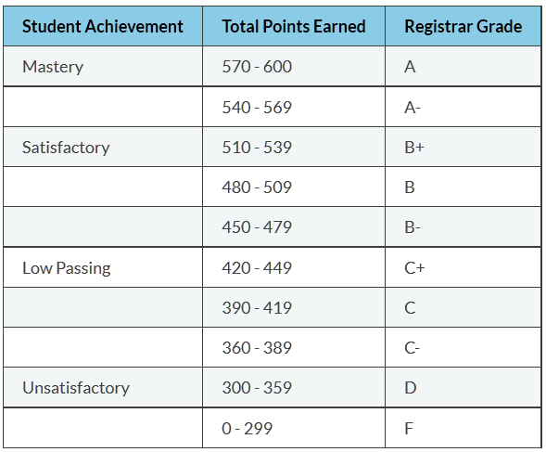
Grading Scale

Slide 27
Class Participation
You are expected to be engaged in every class
Large group: asking and answering questions.
Recitation: writing code, asking / answering questions, demonstrating code.
Attendance is part of participation. If you’re not there you cannot possibly participate.
At the discretion of your recitation instructor, your final grade may be moved up or down based on exemplary or poor participation throughout the semester.
http://ist256.syr.edu/syllabus/#final-grades

Slide 28
Honor Code & Academic Integrity
My work is my own
I will not share answers
I will not falsely represent my ability to code
I will give credit to others & attribute sources of code
I accept the consequences of violating Academic Integrity
When in doubt. Ask us!

Slide 29
How Does Large Group Lecture Work?

Slide 30

How do *I* ask *YOU* questions?
Each Lecture you will be required to sign-in with your NetID.
During lecture, I ask questions and provide a link where you can answer.
I use your responses to guide lecture.
Your participation is not graded, but is monitored.
Excellent participation can positively impact your final grade in the course at our discretion.

Slide 31
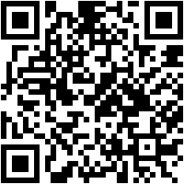
Example Participoll
http://ist256.participoll.com/
How many exams are issued in this course?
One
Two
Three
Four
http://ist256.participoll.com/
0
A
B
C
D
vote at ist256.participoll.com

Slide 32

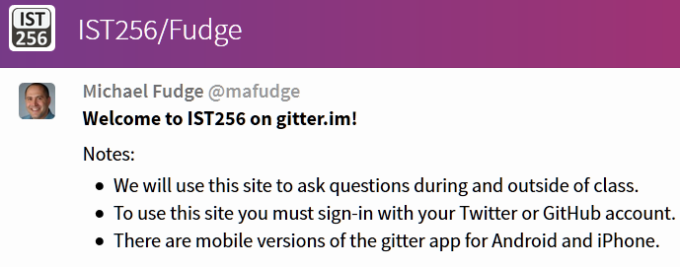
How do *YOU* ask *ME* Questions?
Ask Questions in Class, a Moderator brings them up during lecture
Ask questions, and discuss outside of class, too.
Supports Web, iPhone & Android

Slide 33
Attendance!
Each Lecture you will be required to sign-in with your SU Google Account.
Create your SU Google account here: https://g.syr.edu
A Pin Code appears on title slide
The link to form where you enter the pin code appears in gitter.im
This way you’re ready to start class!
Try to get to class a few minutes early!
After 5 minutes you are late. After 15 minutes you are absent.

Slide 34

Lesson XX: Sample Title Slide
Attendance:
Link: In Gitter.im | Code: ????
Class Chat:
https://gitter.im/IST256/Fudge
Participation
http://ist256.participoll.com/

Slide 35
To Do Before Your 1st Recitation
(Ahem… that’s next class!)

Slide 36
To-Do List
Read through the syllabus
Purchase your Zybook online or through the bookstore
Complete the course setup checklist

Slide 37

Course Setup Checklist
http://ist256.syr.edu/content/setup/overview/
Install required software on your laptop
Sign up for the required accounts
Setup github classroom on your laptop

Slide 38
Why Not Get a Head Start On Next Week?

Slide 39

To-Do for lesson 01
Next week is lesson 01.
Everything you need is on the website.
There’s a section What’s Due which outlines all the work you must complete for the lesson.
http://ist256.syr.edu/content/toc/#lesson-01-introduction-to-programming

Slide 40
Thank You!

