Slide 1
IST256 : Applications Programming for Information Systems
Wed – Fri 8-9:20AM
Course Introduction

Slide 2
Agenda
Meet the Team
Goals of This Course
Let's Go Over The Syllabus
How IST256 Works
Next Class

Slide 3
Meet The Team
http://ist256.syr.edu/staff/

Slide 4
Goals of This Course

Slide 5
We Want You Become a "Modern Programmer"

Slide 6
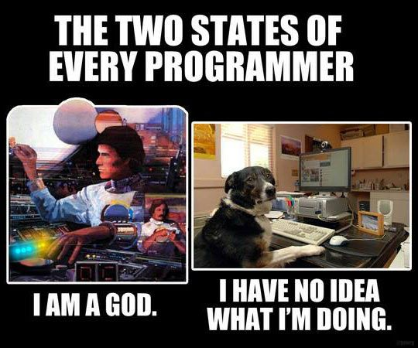
To program in the Python computer programming language.

Slide 7
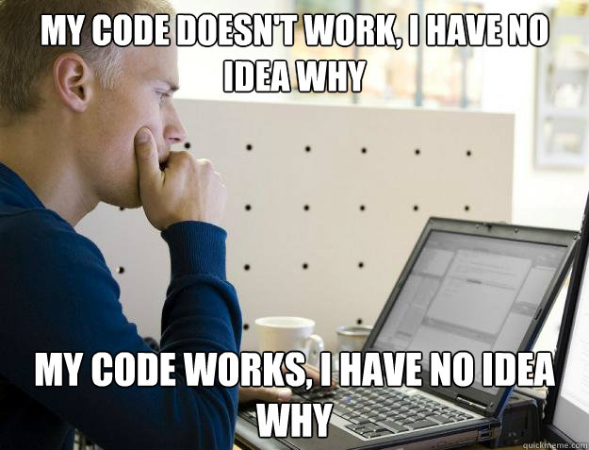
To solve complex real-world, data-oriented problems by writing code.

Slide 8
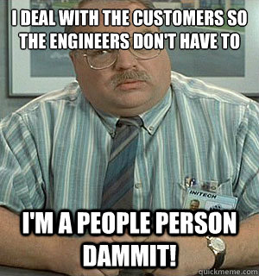
To read, write and discuss code and documentation with confidence.

Slide 9
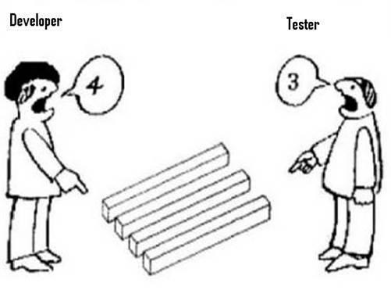
To code in teams, collaborate with others and manage your source code.

Slide 10
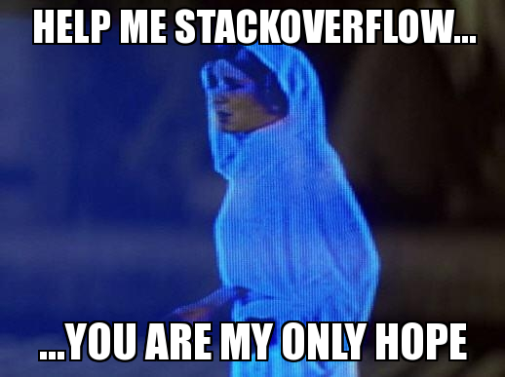
The skills necessary to acquire new programming knowledge independently.

Slide 11
Why Learn To Program?
“TEDxSMU: You Should Learn to Program”, by Christian Genco
https://www.youtube.com/watch?v=xfBWk4nw440

Slide 12
Course Website Quick Tour
http://ist256.syr.edu

Slide 13
Let's Go Over The Syllabus!
http://ist256.syr.edu/syllabus/

Slide 14
Textbooks
3 Required.
One is not Free… It's $48
http://ist256.syr.edu/syllabus/#textbooks

Slide 15
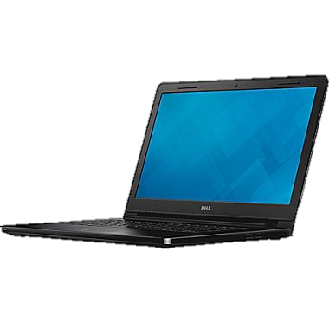

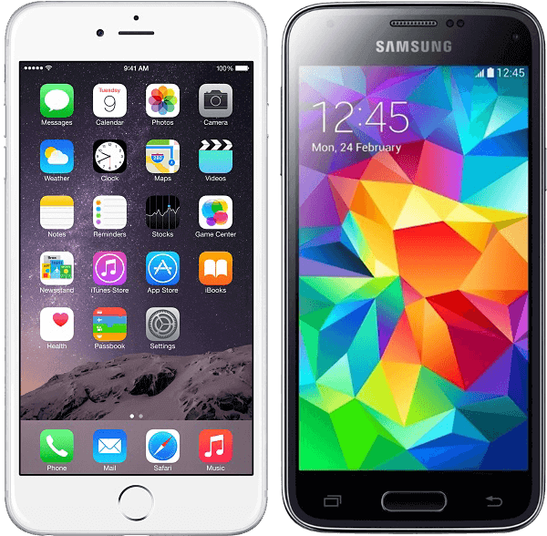
This Class Is BYOD
You will need your Laptop. Every Class.
Write Code
Participate in Class
You are also encouraged to use your iOS or Android Phone for participation.

Slide 16
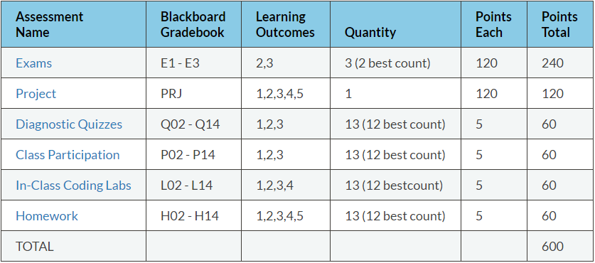
Methods of Evaluation

Slide 17
Exams (E1, E2, E3)
Three exams in the course. Your best two exam scores count towards your final grade.
Exams are delivered in class on the dates posted on the syllabus and class schedule.
Exams are 30 minutes in length, at the beginning of class.
There are no re-issues or make-ups.
Exams are issues on paper as multiple choice questions. Scan-tron forms.

Slide 18
Project (PRJ)
Your chance to show us what you've learned.
Do whatever you like, but run your idea by your instructors first.
Showcase it on Demo Day (posted on Syllabus).
You are expected to work in groups of 2-3 people. Each person on the team should contribute equally.
Create something useful. Think big and follow your passion.
Details on Syllabus and Website!

Slide 19
Demo Day!
https://youtu.be/XSs4yC1TJg0

Slide 20
Diagnostic Quizzes (Q02 – Q14)
Designed to ensure you are keeping pace with your studies.
Issued weekly online in Blackboard. Work alone.
You are issued a subset of questions from a pool of question in the lesson.
You must complete before Wednesday.
5 points each. 2 Attempts, best attempt counts.
Each attempt could have different questions.
You are given one “Free Pass” – Lowest score dropped.

Slide 21
Class Participation (P02 – P14)
Class participation is a measure of engagement during lecture.
A mix of attendance and interactive activities offered through the TopHat platform.
If you cannot attend class for any reason you will not receive credit for participation.
Each week of lecture your participation is evaluated.
5 points. No partial points will be given.
You are given one “Free Pass” which means you may miss one without penalty.

Slide 22
In-Class Coding Labs (L02 – L14)
An in-class programming activity.
This activity must be completed during the class period and will be checked by a grader.
If you are not in class, you will not receive credit for the in-class coding lab.
5 points for a completed lab, no Partial credit.
It is your responsibility to ensure your lab is checked.
You are given one “Free Pass”, meaning you have one incomplete lab without penalty.

Slide 23
Homework (H02- H14)
Weekly homework. Due 1 week after it is assigned.
Must commit your code to GitHub before class on due date.
A evaluator will check ONE of your assigned homework at random in the beginning of class.
You will know your evaluation at the time your homework is checked, pending verification of what on GitHub.
You are given one “Free Pass”, meaning your lowest homework score is dropped.

Slide 24
Homework: How In-Class Grading Works
Professor asks you: Does it work? Then you execute it.
Then professor asks you to explain a part of your code.
You are graded on the “Stack Scale”:
Attempted on time? + 1
And Does it execute? + 1
And Does it solve the intended problem? + 1
And Was it explained? + 1
And It is well written? + 1 (Variable names make sense, no unnecessary code)
Code evaluated must match what was checked-in to GitHub

Slide 25
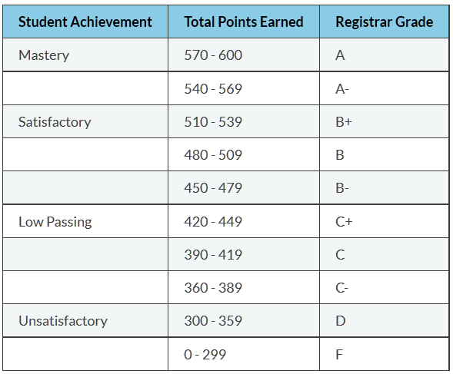
Grading Scale

Slide 26
The 5 "No's"
No excused absences.
No late work.
No make-up exams.
No extra credit.
No rounding up final grades.

Slide 27
Honor Code & Academic Integrity
My work is my own
I will not share answers
I will not misrepresent my ability
I will give credit & attribute sources
I accept the consequences
When in doubt. Ask!

Slide 28
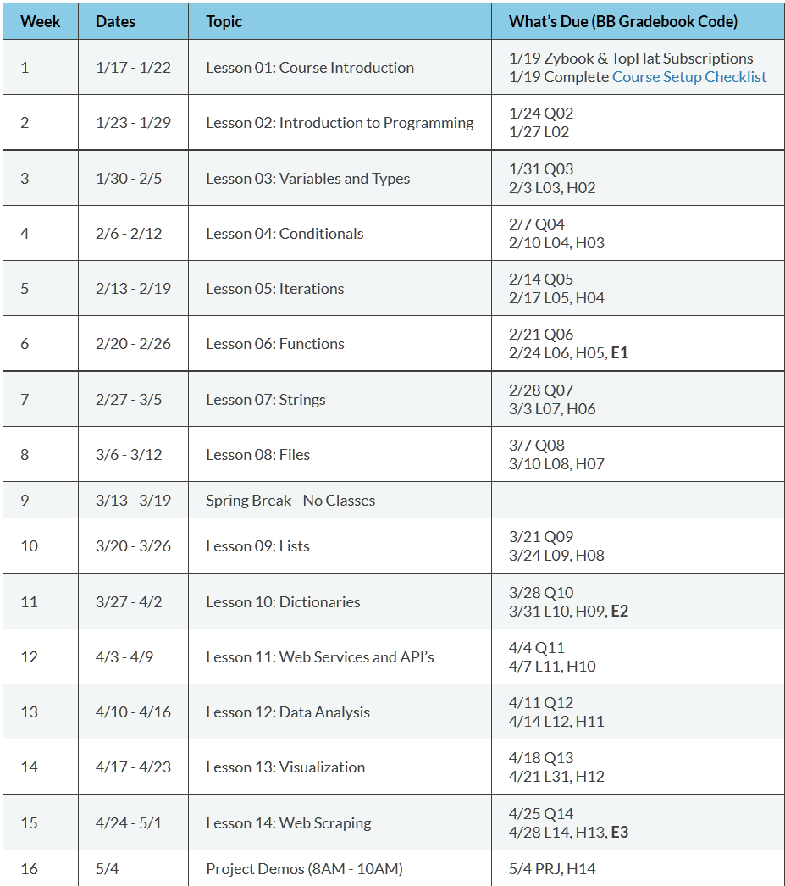
Course Calendar

Slide 29
How IST256 Works

Slide 30
The Course is Divided Into Teams
Each of you is assigned a Team Instructor and a Team Mike group Letter.
Check these in Blackboard under My Grades
On Lecture Days, sit wherever you like.
On Programming Days (Friday) you sit with your team.
…Unless you’re on Team Mike that week, of course.
More on this Friday.

Slide 31

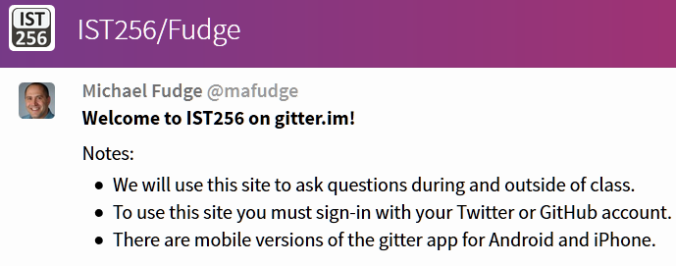
Course Chat:
Ask Questions in Class, a Moderator brings them up during lecture
Ask questions, and discuss outside of class, too.
Supports Web, iPhone & Android

Slide 32
Our Weekly Routine
Before Class On Wednesday:
Complete assigned readings
Complete Diagnostic Quiz
In-Class Wednesday:
Lecture w/TopHat for Engagement
Watch Me Code Demos
End To End Examples
Sit where you want!
Before Class On Friday:
Complete last week's homework, commit it to GitHub
In-Class Friday:
Check 1 random HW.
Complete In-Class Coding Lab, checked in Class.
Start homework.
Sit with your Team!

Slide 33
Our Weekly Routine – Exam Weeks
Before Class On Wednesday:
Complete assigned readings
Complete Diagnostic Quiz
In-Class Wednesday:
Lecture w/TopHat for Engagement
Watch Me Code Demos
End To End Examples
Sit where you want!
Before Class On Friday:
Complete last week's homework, commit it to GitHub
In-Class Friday:
Exam (30 Minutes)
Complete In-Class Coding Lab, checked in Class.
Homework check outside class on GitHub.
Sit with your team!

Slide 34
3 Things To Do Before Next Class

Slide 35
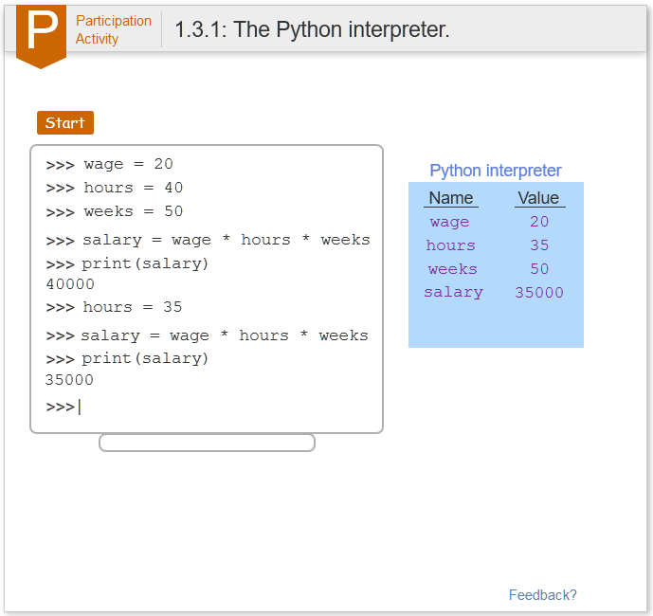
1. Activate Your Zybook
Go to: https://zybooks.zyante.com/
Create Your Account. Use your @syr.edu email address.
Code: SYRIST256FudgeSpring2017
You can purchase the Zybook online with a credit card, or purchase through the bookstore and receive a access code.

Slide 36
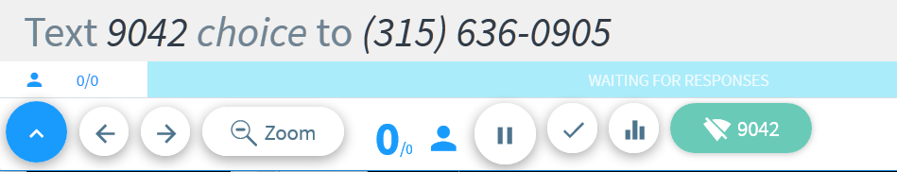
2. Activate Your TopHat Account
Sign up as a student at: https://tophat.com/
Enter join code 148039
Follow the remaining on-screen prompts
At some point you will have to purchase a subscription. This must be done with a credit card or through the bookstore.

Slide 37
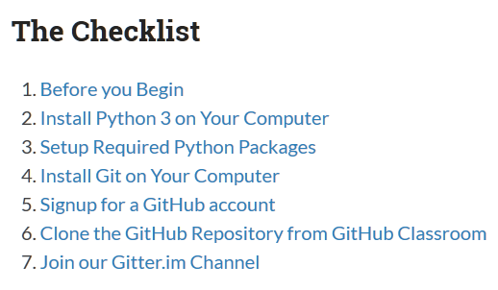
3. Setup your Laptop
Follow the instruction at http://ist256.syr.edu/content/setup/
You need your laptop ready, we start coding next week.

Slide 38
Agenda For Next Class
Let's Talk teams. Meet and Greet!
Weekly Opening Slide
Show "What The Prof Sees" in Zybooks.
Play Around with TopHat & Gitter.im
Open Q&A and Support to make sure you're ready to code next week!

Slide 39
Thank You!
IST256 Spring 2017

