Slide 1

IST256: Applications Programming for Information Systems
Monday 5:15pm – 8:15pm
Course Introduction

Slide 2
Agenda
Meet the Team
Goals of This Course
Let's Go Over The Syllabus
How IST256 Works
Next Class

Slide 3
Instructor and Teaching Assistants
Nick Lyga
Adjunct Professor
Web Specialist at the iSchool
Programming for the last 10 Years
TA - 1
TA - 2

Slide 4
Goals of This Course

Slide 5
We Want You To Learn…

Slide 6
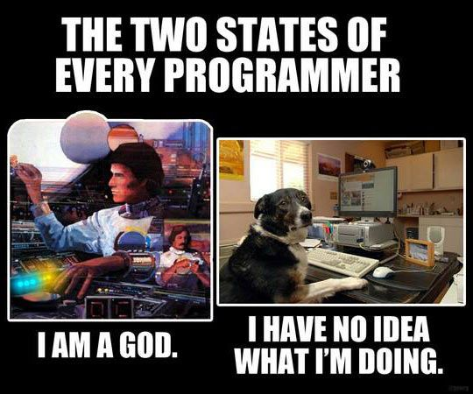
To program in the Python computer programming language.

Slide 7
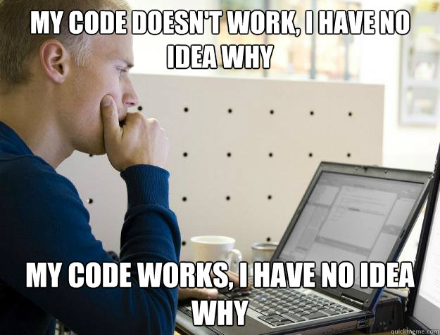
To solve complex real-world, data-oriented problems by writing code.

Slide 8

To read, write and discuss code and documentation with confidence.

Slide 9
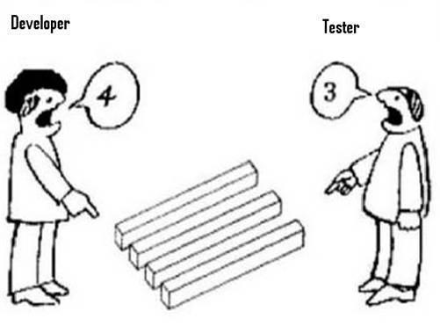
To code in teams, collaborate with others and manage your source code.

Slide 10
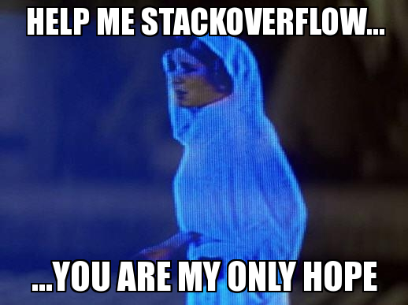
The skills necessary to acquire new programming knowledge independently.

Slide 11
Why Learn To Program?
“TEDxSMU: You Should Learn to Program”, by Christian Genco
https://www.youtube.com/watch?v=xfBWk4nw440

Slide 12
Course Website Quick Tour
http://ist256.syr.edu

Slide 13
Let's Go Over The Syllabus!

Slide 14
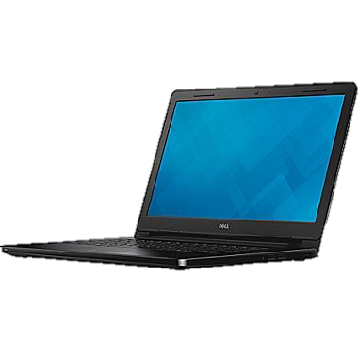

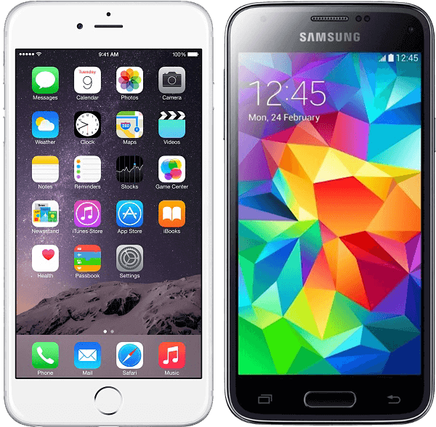
This Class Is BYOD
You will need your Laptop Every Class
Write Code
Participate in Class
MAKE SURE ITS CHARGED!
You can also use your iOS or Android Phone for participation.

Slide 15
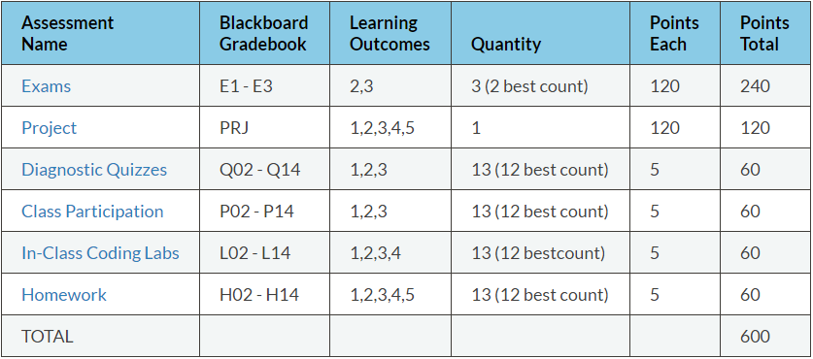
Methods of Evaluation

Slide 16
Exams (E1, E2, E3)
Three exams in the course. Your best two exam scores count towards your final grade.
Exams are delivered in class on the dates posted on the syllabus and class schedule.
Exams are 30 minutes in length, at the beginning of class.
There are no re-issues or make-ups.
Exams are issued on Blackboard as multiple choice questions.

Slide 17
Project (PRJ)
Your chance to show us what you've learned.
Do whatever you like, but run your idea by your instructors first.
Showcase it on Demo Day (posted on Syllabus).
You are expected to work in groups of 2-3 people. Each person on the team should contribute equally.
Create something useful. Think big and follow your passion.
Details on Syllabus and Website!

Slide 18
Demo Day!
https://youtu.be/XSs4yC1TJg0

Slide 19
Diagnostic Quizzes (Q02 – Q14)
Designed to ensure you are keeping pace with your studies.
Issued weekly online in Blackboard.
You are issued a subset of questions from a pool of question in the lesson.
You must complete the Quiz before each class on Monday.
5 points each. 2 Attempts, best attempt counts.
Each attempt could have different questions.
You are given one “Free Pass” – Lowest score dropped.

Slide 20
Class Participation (P01 – P14)
Class participation is a measure of engagement during lecture.
A mix of attendance and engagement during each class.
If you cannot attend class for any reason you will not receive credit for participation.
Each week of lecture your participation is evaluated.
5 points. No partial points will be given.
You are given one “Free Pass” which means you may miss one without penalty.

Slide 21
In-Class Coding Labs (L02 – L14)
An in-class programming activity.
This activity must be completed during the class period and will be checked by a grader.
If you are not in class, you will not receive credit for the in-class coding lab.
5 points for a completed lab, no Partial credit.
It is your responsibility to ensure your lab is checked.
You are given one “Free Pass”, meaning you have one incomplete lab without penalty.

Slide 22
Homework (H02- H13)
Weekly homework. Due 1 week after it is assigned.
Must commit your code to GitHub before class on due date.
A grader will check ONE of your assigned homework at random in the beginning of class.
Homework is graded based on criteria outlined on the syllabus:
You will know your grade at the time your homework is checked.
You are given one “Free Pass”, meaning your lowest homework score is dropped.

Slide 23
Homework: How In-Class Grading Works
Professor asks you: Does it work? Then you execute it.
Then professor asks you to explain a part of your code.
You are graded on the “Stack Scale”:
Attempted on time? + 1
And Does it execute? + 1
And Does it solve the intended problem? + 1
And Was it explained? + 1
And It is well written? + 1 (Variable names make sense, no unnecessary code)
Code evaluated must match what was checked-in to GitHub

Slide 24
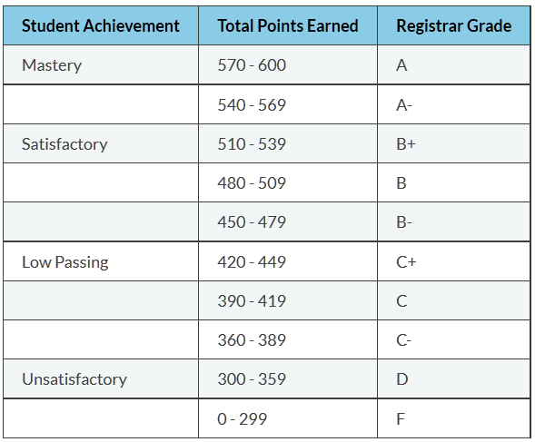
Grading Scale

Slide 25
Course Policies:
No excused absences.
No late work.
No make-up exams.
No extra credit.
No rounding up final grades.

Slide 26
Honor Code & Academic Integrity
My work is my own
I will not share answers
I will not represent my ability
I will give credit & attribute sources
I accept the consequences
When in doubt. Ask!

Slide 27
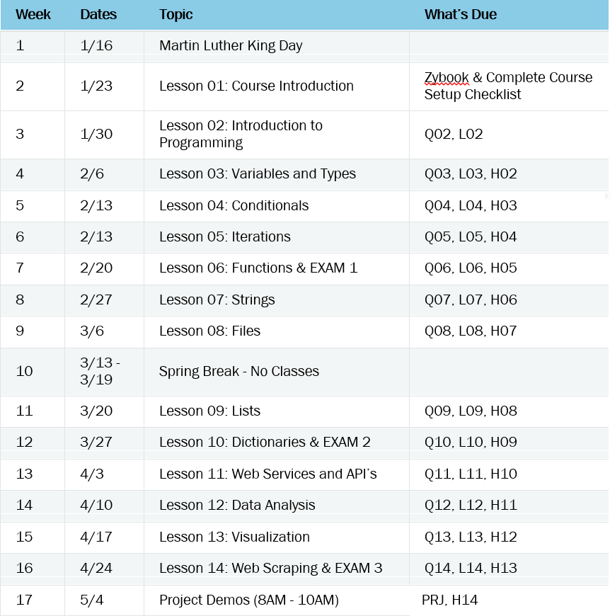
Course Calendar

Slide 28
How IST256 Works

Slide 29

Slack:
Please use this platform for communication and asking questions.
Ask questions, and discuss outside of class, too.
Supports Web, iPhone & Android
DO NOT POST ENTIRE SOLUTIONS! One or two lines of code for help are ok, you will immediately lose credit for the assignment if your post your entire solution.

Slide 30
Our Weekly Routine
Before Class On Monday:
Complete assigned readings
Complete Diagnostic Quiz
Complete last week's homework, commit it to GitHub
Exam Weeks:
Exam (30 Minutes)
In-Class Monday:
Lecture
Help Them Code Demos
End To End Examples
Check 1 random HW.
Complete In-Class Coding Lab, checked in Class.
Start homework.

Slide 31
Let’s get you setup!

Slide 32
1. Activate Your Slack Account
You should have received an email with an invitation.
Follow the instructions in the email to activate your account
Either use the website, or download the applications to you device.
Slack will give you a quick overview on how to use it
Set up your avatar!

Slide 33
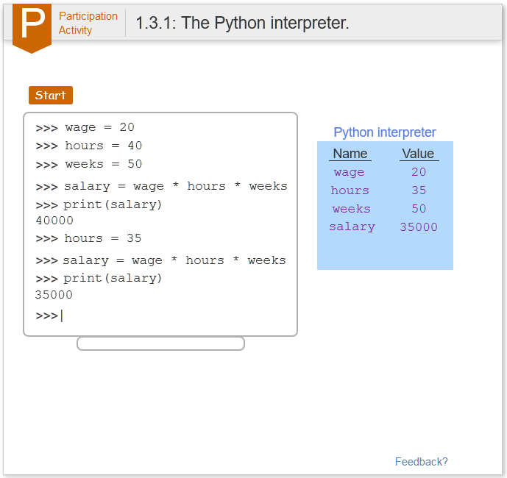
2. Activate Your Zybook
Go to: https://zybooks.zyante.com/
Create Your Account. Use your @syr.edu email address.
Code: SYRIST256FudgeSpring2017
You can purchase the Zybook online with a credit card, or purchase through the bookstore and receive a access code.

Slide 34
Zybook: Let's See Who's Activated It
Zybooks reports student usage.
I will demonstrate these reports now.
I will track your usage weekly and flag you in Orange Success if you are not participating.
It's hard to pass the diagnostic quizzes without reading first!
Demo Time!

Slide 35
3. Setup your Laptop
Follow the instruction at http://ist256.syr.edu/content/setup/
The Checklist
Before you Begin
Install Python 3 on Your Computer
Setup Required Python Packages
Install Git on Your Computer
Signup for a GitHub account
Clone the GitHub Repository from GitHub Classroom

Slide 36
GitHub Classroom: Submit Homework!
Install Git
Create a GitHub Account
Setup Your Avatar!
Setup GitHub Classroom
Turning in your work is easy! See FAQ!
Demo Time!

Slide 37
Is Your Laptop Ready for Next Week?
Install Python 3 on Your Computer?
Setup Required Python Packages?
Install Git on Your Computer?
Signup for a GitHub account?
Clone course code the from GitHub Classroom?
If so, see you next week. If not stick around for help!

Slide 38
Thank You!
IST256 Spring 2017

