Slide 1
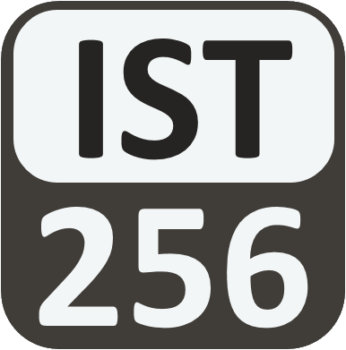
Lesson 03: Variables and Types
Attendance:
Link: In Gitter.im | Code: ????
Class Chat:
https://gitter.im/IST256/Fudge
Participation
http://ist256.participoll.com/

Slide 2

Agenda
What is a variable? What is its purpose?
Different data types for variables.
Type checks and conversions.
Print types with formatting
Arithmetic expressions, arithmetic operators, and operands.
You’ve Read:
Zybook Ch2
P4E Ch2
Questions? Ask in Our Course Chat!
https://gitter.im/IST256/Fudge

Slide 3
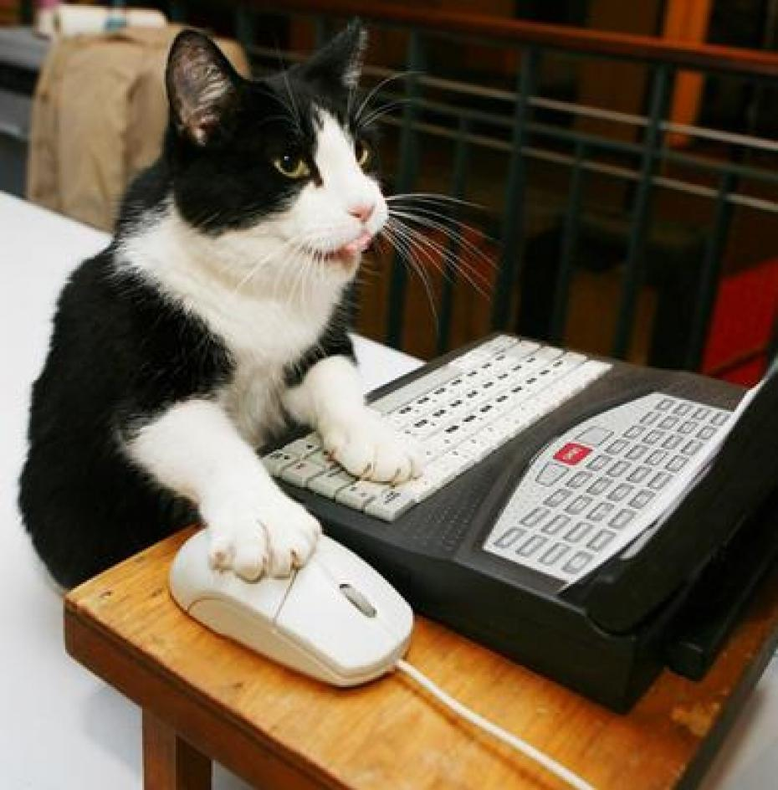
Before We start: Where Is The Code!?
Today I Will Write Code In Class.
Please DO NOT Try To Type Along With Me!
Watch Me Code. You’ll Learn More That Way. Trust Us.
You Have The Code Already.
YOURS: Content\lessons\03\
MINE: https://github.com/IST256-classroom/fall2018-learn-python-mafudge

Slide 4

Connect Activity
These statements are out of sequence, which letter represents the 3rd step in this program?:
print("Hello", name)
fn=input("Enter First Name:")
name = fn + " " + ln
ln=input("Enter Last Name:")
73%
(74)
17%
(17)
3% (3)
8% (8)
A
B
C
D
102
vote at ist256.participoll.com

Slide 5
Variables
Variables are named areas of computer memory for storing data.
The name can be anything but should make symbolic sense to the programmer.
We write to the variable’s memory location with the assignment statement (=)
We read from the variable by calling its name.
Variable names must begin with a letter or _ and must only contain letters, numbers or _.

Slide 6
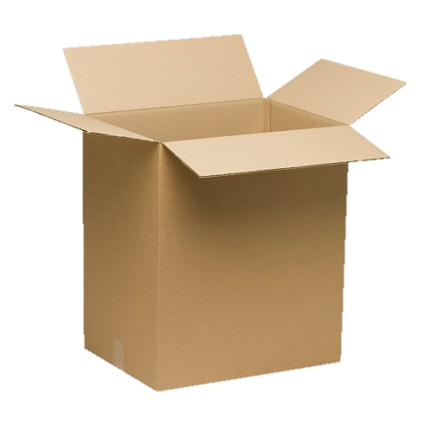
Variables, Types and Assignment
Python Code
What’s Happening
Name = "mike"
Age = 45
"mike"
Name
45
Age

Slide 7
Variables are of a Specific Type
Type | Purpose | Example
int | Numeric type integers only | 45
float | Numeric type floating point numbers | 3.14
bool | True or False values | True
str | Characters and text | 'Mike'

Slide 8
Type Detection and Conversion
Function | What it does | Example
type(n) | Get the type of n | type(13) ➔ int
int(n) | Convert n to type int | int("45") ➔ 45
float(n) | Convert n to type float | float(45) ➔ 45.0
str(n) | Convert n to type str | str(4.0) ➔ '4.0'

Slide 9

Watch Me Code 1
Understanding Variables and Types!
Assignment
Variables of Different Types
Switching types
Using type()
Notes:
Write this code in a Jupyter Notebook to demonstrate variables and types
name = "Tony"
age = 43
wage = 12.50
happy_employee = True
print ("my name is",name," I am", age, "years old. I make ", wage, "Am I happy? ", happy_employee)
GROK TYPES
type(wage) etc…
EXPLAIN THAT YOU CAN ALSO SWITCH TYPES OF VARIABLES
Happy_employee = “You betcha!”

Slide 10

Check Yourself: Matching Types
Match each Python code sample to its value.
Python Code Sample
Value
type(34)
str(34)
float(34)
int(34)
34
"34"
int
"34.0"

Slide 11
Check Yourself: Which Type 1?
Match the Python code sample to its value.
Python Code Sample
Value
str(34)
34
"34"
int
"34.0"
73%
(77)
7% (7)
10% (10)
10% (11)
A
B
C
D
105
vote at ist256.participoll.com

Slide 12
Check Yourself: Which Type 2?
Match the Python code sample to its value.
Python Code Sample
Value
type(34)
34
"34"
int
"34.0"
A
B
C
D
4
vote at ist256.participoll.com

Slide 13
Python String Formatting
Code | Type | Example | Output
%d | int | print("%d" % 50) | 50
%f | float | print("$%.2f" % 4.5) | $4.50
%s | str | print("[%s]" % "mike") | [mike]
You can put an integer between the % and code for spacing:
%5d ➔ Use 5 spaces for the int, align right
%-5d ➔ Use 5 spaces for the int, align left

Slide 14
Watch Me Code 2
Python String Formatting
Format codes
Spacing
Alignment
Notes:
Write this code in a Jupyter Notebook to demonstrate variables and types
name = "Tony"
age = 43
wage = 12.50
happy_employee = True
print ("my name is",name," I am", age, "years old. I make ", wage, "Am I happy? ", happy_employee)
GROK TYPES
type(wage) etc…
EXPLAIN THAT YOU CAN ALSO SWITCH TYPES OF VARIABLES
Happy_employee = “You betcha!”

Slide 15
Check Yourself: Formatting
Match each print() statement to its output
Python Print Statement
Output
print("$%s" % 34)
print("%.1f" % 34)
print("%d" % 34 )
34
34.0
$34

Slide 16
Check Yourself: Formatting 1
Match each print() statement with formatting to its output
Python Print Statement
Output
100%
(1)
print("$%s" % 34)
34
34.0
$34
$34.0
A
B
C
D
1
vote at ist256.participoll.com

Slide 17
Check Yourself: Formatting 2
Match each print() statement with formatting to its output
Python Print Statement
Output
95%
(81)
print("%.1f" % 34)
34
34.0
$34
$34.0
1% (1)
2% (2)
1% (1)
85
A
B
C
D
vote at ist256.participoll.com

Slide 18
Programmatic Expressions
Programmatic Expressions contain operators and operands. They evaluate to a value, preserving type:
Examples: Value of X
X = 2 + 2 4
X = 2.0 + 2 4.0
X = "sh" + 'ip' “ship”
X = 'hi' + 2 TypeError

Slide 19
Arithmetic Operators
Symbol | What it does | Example
+ | Adds two numbers or concatenates two strings | 3 + 4 ➔ 7
- | Subtracts two numbers. | 4 – 3 ➔ 1
* | Multiplies two numbers | 4 * 3 ➔ 12
/ | Divides two numbers. Result is float | 4 / 3 ➔ 1.3333
// | Divides two numbers. Given quotient as int. | 13 // 3 ➔ 4
% | Divides two numbers. Gives remainder as int. | 13 % 3 ➔ 1
() | Force an order of operations | 2 * (1 + 4) ➔ 10

Slide 20

End-To-End Example
The Pay-Rate Calculator:
Write a program to prompt for hourly rate, and hours worked for the week as inputs
Then calculates the total pay as output.
Then prompts for tax rate as input, and outputs net pay.

Slide 21

Conclusion Activity
"1 Question Challenge"
What is the value of:
type(int("1"+"4")/2)
Place your response on gitter.im !!! I’ll post the correct answer a few minutes after class!

