Slide 1

Lesson 04: Conditionals
Attendance:
Link: In Gitter.im | Code: ????
Class Chat:
https://gitter.im/IST256/Fudge
Participation
http://ist256.participoll.com/

Slide 2

Agenda
Non-Linear Code Execution
Relational and Logical Operators
Different types of non-linear execution.
Run-Time error handling
You’ve Read:
Zybook Ch3
P4E Ch3
Questions? Ask in Our Course Chat!
https://gitter.im/IST256/Fudge

Slide 3

Connect Activity
A Boolean value is a/an ______?
True or False value
Zero-based value
Non-Negative value
Alphanumeric value
A
B
C
D
0

Slide 4
What is a Boolean Expression?
A Boolean expression evaluates to a Boolean value of True or False.
Boolean expressions ask questions.
GPA >3.2 ➔ Is GPA greater than 3.2?
The result of which is True or False based on the evaluation of the expression:
GPA = 4.0 ➔ GPA > 3.2 ➔ True
GPA = 2.0 ➔ GPA > 3.2 ➔ False

Slide 5
Program Flow Control with IF
The IF statement is used to branch your code based on a Boolean expression.
if boolean-expression:
statements-when-true
else:
statements-when-false

Slide 6
Python’s Relational Operators
Operator | What is does | Example
> | Greater than | 4 > 2 (True)
< | Less than | 4 < 2 (False)
== | Equal To | 4 == 2 (False)
!= | Not Equal To | 4 != 2 (True)
>= | Greater Than or Equal To | 4 >=2 (True)
<= | Less Than or Equal To | 4 <=2 (True)
Expressions consisting of relational operators evaluate to a Boolean value

Slide 7

Watch Me Code 1
Do you need more milk?
When the Fudge family has less than 1 gallon of milk, we need more!

Slide 8
Python’s Logical Operators
Operator | What is does | Example
and | True only when both are True. | 4>2 and 4<5 (True)
or | False only when both are False | 4<2 or 4==4 (True)
not | Negation (Opposite) | not 4 == 2 (True)
in | Set Operator | 4 in [2,4,7] (True)

Slide 9

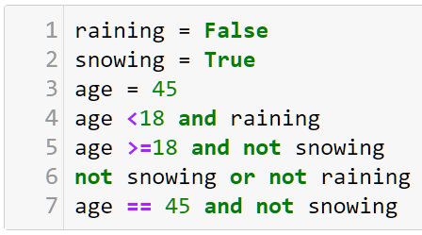
Check Yourself: Logical Operators
On Which line number in which the Boolean expression is True?
4
5
6
7
A
B
C
D
0

Slide 10
Multiple Decisions: IF ladder
if boolean-expression1:
statements-when-exp1-true
elif boolean-expression2:
statements-when-exp2-true
else:
statements-when-false
Use elif to make more than one decision in your if statement

Slide 11

End-To-End Example, Part 1
Tax Calculations!
The country of “Fudgebonia” determines your tax rate from the number of dependents:
0 ➔ 30%
1 ➔ 25%
2 ➔ 18%
3 or more➔ 10%
Write a program to prompt for number of dependents (0-3) and annual income.
It should then calculate your tax rate and tax bill. Format numbers properly!

Slide 12
Handle Bad Input with Exceptions
Exceptions represent a class of errors which occur at run-time.
We’ve seen these before when run a program and it crashes due to bad input. And we get a TypeError or ValueError.
Python provides a mechanism try .. except to catch these errors at run-time and prevent your program from crashing.
Exceptions are exceptional. They should ONLY be used to handle unforeseen errors in program input.

Slide 13
Watch Me Code 2
The need for an exception handling:
Bad input
try except finally
Good practice of catching the specific error

Slide 14
Try…Except…Finally
try:
statements-which-might throw-a-runtime-error
except exceptionType:
code-to-run-when-error-occurs
finally:
code-to-run-after-try-or-except
Optional

Slide 15
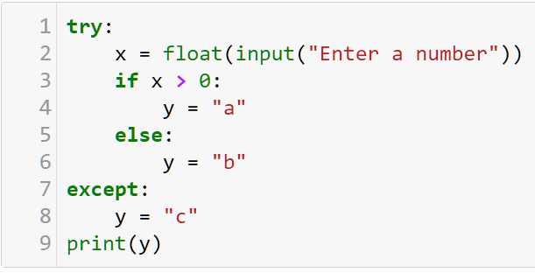
Check Yourself: Conditionals
What prints on line 9 when you input the value '-45s'?
'a'
'b'
'c'
A
B
C
0

Slide 16
End-To-End Example, Part 2
Tax Calculations!
Modify “Fudgebonia” tax calculations to handle bad inputs so that it will not generate run-time errors.

Slide 17

Conclusion Activity
"1 Question Challenge"
When x = 12, y = 20 ?
What is the value of this Boolean expression:
x < y and not y==20
Post your response on gitter.im and I’ll post the solution a few minutes after class!

