Slide 1

Lesson 07: Strings
Attendance:
Link: In Gitter.im | Code: ????
Class Chat:
https://gitter.im/IST256/Fudge
Participation
http://ist256.participoll.com/

Slide 2

Agenda
Strings are immutable sequence of characters.
Index and Slice notation for retrieving sub-strings.
Built-in string functions to perform operations on strings.
Techniques for parsing and tokenizing string data.
How to sanitize input with string functions.
You’ve Read:
Zybook Ch6
P4E Ch6
Questions? Ask in Our Course Chat!
https://gitter.im/IST256/Fudge

Slide 3
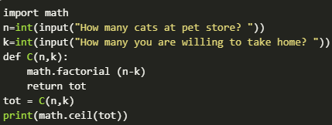
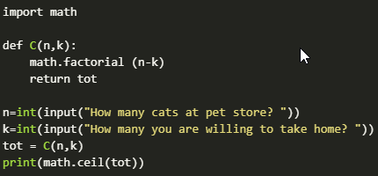
TANGENT RANT: Code is for People, too!
Both of these code samples are the same, but which of these is easier for a human to read?
A. Top One
B. Bottom One
A
B
0

Slide 4

Connect Activity
To get a substring from an existing Python string we use?
A built in function
Slice notation
A
B
0

Slide 5

Strings are Sequences of Characters
Strings are index able sequences of characters.
The characters inside the string are immutable.
Example:
Name = ‘Fudge’
len(Name) == 5
Immutable means we can’t change part of it:
Name[1] = ‘u’

Slide 6
Slice Notation
Slice Notation is used to extract a substring.
Examples:
Name[0:2] == 'Fu'
Name[2:5] == 'dge'
Name[:4] == 'Fudg'
Name[:] == 'Fudge'
Name[1:-1] == 'udg

Slide 7

Check Yourself: String Slices 1
Match each string slice to its value for this string: x ='orange'
x[1:6]
x[2:-1]
x[1:]
'ang'
'rang'
'range'
A
B
C
0

Slide 8
Check Yourself: String Slices 2
Match each string slice to its value for this string: x ='orange'
x[1:6]
x[2:-1]
x[1:]
'ang'
'rang'
'range'
A
B
C
0

Slide 9
String functions:
Built In String Functions: https://docs.python.org/3/library/stdtypes.html#text-sequence-type-str
dir(str)
help(str.upper)
The Python String Library: https://docs.python.org/3/library/string.html
You must import String before you can use them.

Slide 10

Watch Me Code 1
Yes or No?
write a function to accept a variety of inputs as "yes" or "no"
"yes" → "y", "Y", "YES", "Yes" etc…
"no" → "n", "N", "NO", "No", etc…

Slide 11

Check Yourself: Code Trace 1
What is the value of the variable y on line 2?
'Miie'
'MKKE'
'MIIE'
'Mkke'
A
B
C
D
0

Slide 12
String Tokenization and Parsing
Tokenization is the process of breaking up a string into words, phrases, or symbols.
Tokenize a sentence into words.
"mike is here" ➔ ['mike','is','here']
Parsing is the process of extracting meaning from a string.
Parse text to a numerical value or date.
int('45') ➔ 45

Slide 13
Watch Me Code 2
Given a string of digits: e.g. '12 45 90'
Tokenize into individual strings
Parse into integers
Add them up!

Slide 14
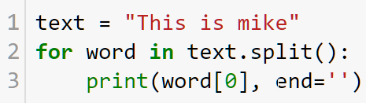
Check Yourself: Code Trace 2
What is the output of this program?
This
T
Tim
mike
A
B
C
D
0

Slide 15

End-To-End Example
Write a function percentage() to input a percentage.
0.3 == 0.3
30% == 0.3
String parsing, finding '%'

Slide 16

Conclusion Activity
"1 Question Challenge"
What is the value of:
x[4:8]
When x = 'Syracuse'?

