Slide 1
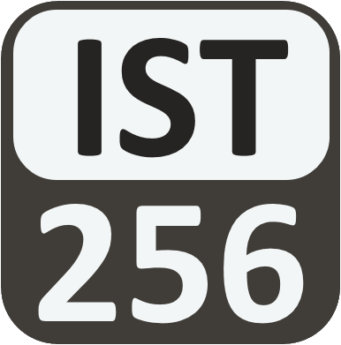
Lesson 08: Files
Attendance:
Link: Gitter.im | Code: ????
Class Chat:
https://gitter.im/IST256/Fudge
Participation
http://ist256.participoll.com/

Slide 2

Agenda
The importance of a persistence layer in programming.
How to read and write from files.
Techniques for reading a file a line at a time.
Using exception handling with files.
You’ve Read:
Zybook Ch7
P4E Ch7
Questions? Ask in Our Course Chat!
https://gitter.im/IST256/Fudge

Slide 3

Connect Activity
Which of the following is not an example of secondary (persistent) memory?
Flash Memory
Hard Disk
Random-Access Memory
DVD-ROM
A
B
C
D
0

Slide 4
Files == Persistence
Files add a Persistence Layer to our computing environment where we can store our data after the program completes.
Think: Saving a game or saving your work!
When our program Stores data, we open the file for writing.
When our program Reads data, we open the file for reading.
To read or write a file we must first open it, which gives us a special variable called a file handle.
We then use the file handle to read or write from the file.
The read() function reads from the write() function writes to the file through the file handle.

Slide 5
Reading From a File
filename – String name
of file as found by the
operating system
handle – A Python object
representing the filename.
Only available under with open.
When you write to a file,
whatever contents were there
get overwritten.
with open(filename,'r') as handle:
string-text = handle.read()
Writing a To File
with open(filename,'w') as handle:
handle.write(string-text)

Slide 6

Watch Me Code 1
Let’s Write two programs.
Save a text message to a file.
Retrieve the text message from the file.
Notes:
# Input Password from user and write it to a file.
password = input("Enter your new password:")
with open ("password.txt","w") as file:
file.write(password)
print("Password Saved!")
def readpassword():
with open("password.txt","r") as file:
password = file.read()
return password
password = readpassword()
print (password)

Slide 7

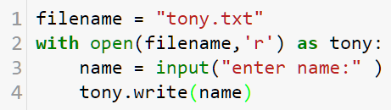
Check Yourself: Which line 1
Which line number creates the file handle?
A. 1 B. 2 C. 3 D. 4
A
B
C
D
0

Slide 8
Watch Me Code 2
Common patterns for reading and writing more than one item to a file.
Input a series of grades, write them to a file one line at a time.
Read in that file one line at a time, print average.
Notes:
# Input Password from user and write it to a file.
password = input("Enter your new password:")
with open ("password.txt","w") as file:
file.write(password)
print("Password Saved!")
def readpassword():
with open("password.txt","r") as file:
password = file.read()
return password
password = readpassword()
print (password)

Slide 9
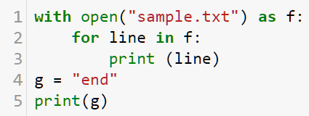
Check Yourself: Which line 2
On which line number does the file handle no longer exist?
A. 1 B. 2 C. 3 D. 4
A
B
C
D
0

Slide 10
Your Operating System and You
Files are stored in your secondary memory in folders.
When the python program is in the same folder as the file, no path is required.
When the file is in a different folder not, a path is required.
Absolute paths point to a file starting at the root of the hard disk.
Relative paths point to a file starting at the current place on the hard disk.

Slide 11
Python Path Examples
What | Windows | Mac / Linux
File in current folder | "file.txt" | "file.txt"
File up one folder from the current folder | "../file.txt" | "../file.txt"
File in a folder from the current folder | "folder1/file.txt" | "folder1/file.txt"
Absolute path to file in a folder | "C:/folder1/file.txt" | "/folder1/file.txt"

Slide 12
Check Yourself: Path
Is this path relative or absolute? "/path/to/folder/file.txt"

Slide 13
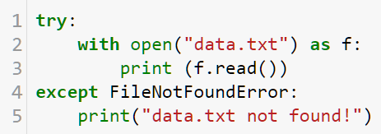
Handling Errors with Try…Except
Don't assume you can read a file!
Use try… except!

Slide 14

End-To-End Example
How Many Calories in that Beer?
Let's write a program to search a data file of 254 popular beers. Given the name of the beer the program will return the number of calories.

Slide 15

Conclusion Activity
"Confusion Says…"
Share something you're still confused about from class today!

