Slide 1
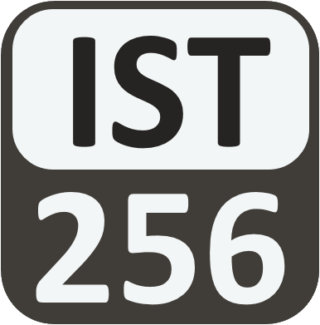
Lesson 10: Dictionaries
Attendance:
Link: Gitter.im | Code: ????
Class Chat:
https://gitter.im/IST256/Fudge
Participation
http://ist256.participoll.com/

Slide 2

Agenda
Dictionaries as key-value pairs.
Basic dictionary operations such as getting/setting keys and values
Common dictionary use cases, such as representing complex objects.
List of dictionary as an in-memory database of objects.
Using the json library to load and save dictionaries to files.
You’ve Read:
Zybook Ch9
P4E Ch9
Questions? Ask in Our Course Chat!
https://gitter.im/IST256/Fudge

Slide 3

Connect Activity
Question: A Python Dictionary is a
Immutable Sequence Type
Mutable Mapping Type
Mutable Sequence Type
Immutable Mapping Type
A
B
C
D
0

Slide 4
Dictionaries
The dict type is designed to store key-value pairs. In Python this is known as a mapping type.
font={‘Name’:’Arial’,’Size’: 8}
Python dictionaries are mutable which means you can change the values.
Dictionary values are accessed by key not by index.
font[‘Name’] = “Courier”

Slide 5

Watch Me Code 1
Dictionary Basics:
Create a dictionary
Update its value
Print it out
Notes:
Short and sweet demo

Slide 6
Dictionary Methods
Like str and list, the dict type has its own set of built-in functions.
https://docs.python.org/3/library/stdtypes.html#mapping-types-dict

Slide 7
Watch Me Code 2
Dictionary Methods:
Handling KeyError
using get() to avoid KeyError
values()
keys()
delete a key
Notes:
Short and sweet demo

Slide 8


Check Yourself: Dictionaries
What is the output on line 2?
2
'2'
6
KeyError
A
B
C
D
0

Slide 9
Dictionaries or Lists?
When do you use a Python list versus a dict?
Lists are for multiple versions of the same type.
Ex: Student GPA's
[3.4,2.8,4.0]
Dictionaries are for single versions of different types.
Ex: One Student's Name, GPA and Major
{ 'Name' : 'bob', 'GPA' : 3.4 }

Slide 10
Python's List of Dictionary
For representing complex data structures…
List
students = [
{ 'Name':'bob','GPA':3.4 },
{ 'Name':'sue','GPA':2.8 },
{ 'Name':'kent','GPA':4.0 }
]
Dictionary

Slide 11
Watch Me Code 3
List of Dictionary:
Using type()
Method chaining to access values
Notes:
Short and sweet demo

Slide 12
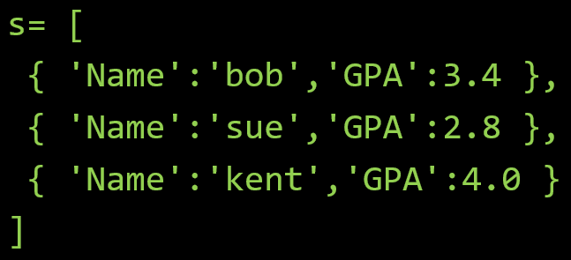
Check Yourself: Matching
Question
s[0]['GPA']
s[3]['Name']
s[1]['name']
Answers
3.4
KeyError
IndexError
'sue'
Given the following Python code,
match the Python Expression to it's answer
A
B
C
D
0

Slide 13
Check Yourself: Matching
Question
s[0]['GPA']
s[3]['Name']
s[1]['name']
Answers
3.4
KeyError
IndexError
'sue'
Given the following Python code,
match the Python Expression to it's answer
A
B
C
D
0

Slide 14
JSON and Python Dictionaries
JSON (JavaScript Object Notation) is a standard, human-readable data format. It's a popular format for data on the web.
JSON Can be easily converted to lists of dictionaries using Python's json module.
Transferring JSON to Python is decoding.
Transferring Python to JSON is encoding.
This is easy to do in Python but challenging to do in most other languages.

Slide 15
Watch Me Code 4
Decode JSON Data
Load into List of Dictionary
Access data to obtain output
Notes:
Short and sweet demo

Slide 16

End-To-End Example
European Country Locator
Load JSON data for Countries in Europe
Input a country
Output
Region (Southern Europe)
Neighboring Countries

Slide 17

Conclusion Activity
"One Important Thing"
Share one important thing you learned in class today!

