Slide 1

Lesson 10: Dictionaries
Topic: Introduction to Programming, Zybook Ch 9, P4E Ch 9. Slides on website.

Slide 2
Exam #2 – Good Luck!
The exam is closed book, closed computer and no phones or any other devices!
You will have 30 mins to complete the exam. When time is up exam will auto submit.
Do not leave the blackboard window! you will automatically receive a 0 no exceptions!
The password is: Jyan73oP

Slide 3
Agenda
Dictionaries as key-value pairs.
Basic dictionary operations such as getting/setting keys and values
Common dictionary use cases, such as representing complex objects.
List of dictionary as an in-memory database of objects.
Using the json library to load and save dictionaries to files.
You’ve Read:
Zybook Ch9
P4E Ch9

Slide 4

Connect Activity
Question: A Python Dictionary is a
Immutable Sequence Type
Mutable Mapping Type
Mutable Sequence Type
Immutable Mapping Type

Slide 5
Dictionaries
The dict type is designed to store key-value pairs. In Python this is known as a mapping type.
font={‘Name’:’Arial’,’Size’: 8}
Python dictionaries are mutable which means you can change the values.
Dictionary values are accessed by key not by index.
font[‘Name’] = “Courier”

Slide 6

Watch Me Code 1
Dictionary Basics:
Create a dictionary
Update its value
Print it out
Notes:
Short and sweet demo

Slide 7
Dictionary Methods
Like str and list, the dict type has its own set of built-in functions.
https://docs.python.org/3/library/stdtypes.html#mapping-types-dict

Slide 8
Watch Me Code 2
Dictionary Methods:
Handling KeyError
using get() to avoid KeyError
values()
keys()
delete a key
Notes:
Short and sweet demo

Slide 9


Check Yourself: Dictionaries
What is the output on line 2?
2
'2'
6
KeyError

Slide 10
Dictionaries or Lists?
When do you use a Python list versus a dict?
Lists are for multiple versions of the same type.
Ex: Student GPA's
[3.4,2.8,4.0]
Dictionaries are for single versions of different types.
Ex: One Student's Name, GPA and Major
{ 'Name' : 'bob', 'GPA' : 3.4 }

Slide 11
Python's List of Dictionary
For representing complex data structures…
List
students = [
{ 'Name':'bob','GPA':3.4 },
{ 'Name':'sue','GPA':2.8 },
{ 'Name':'kent','GPA':4.0 }
]
Dictionary

Slide 12
Watch Me Code 3
List of Dictionary:
Using type()
Method chaining to access values
Notes:
Short and sweet demo

Slide 13
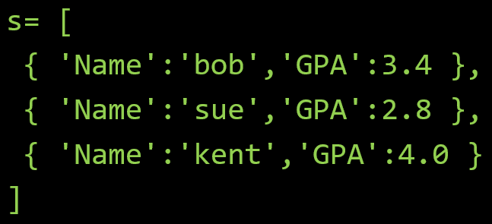
Check Yourself: Matching
Question
s[0]['GPA']
s[3]['Name']
s[1]['name']
Answers
3.4
KeyError
IndexError
'sue'
Given the following Python code,
match the Python Expression to it's answer

Slide 14
JSON and Python Dictionaries
JSON (JavaScript Object Notation) is a standard, human-readable data format. It's a popular format for data on the web.
JSON Can be easily converted to lists of dictionaries using Python's json module.
Transferring JSON to Python is decoding.
Transferring Python to JSON is encoding.
This is easy to do in Python but challenging to do in most other languages.

Slide 15
Watch Me Code 4
Decode JSON Data
Load into List of Dictionary
Access data to obtain output
Notes:
Short and sweet demo

Slide 16

End-To-End Example
European Country Locator
Load JSON data for Countries in Europe
Input a country
Output
Region (Southern Europe)
Neighboring Countries

Slide 17
Advanced Topic.
The following topic will not be on any exam or quiz, and it is not part of any homework assignments.
There is an optional lesson in the Zybook about Object Oriented Programming.
I am showing you this because I think its important. Those of you looking at more advanced projects will run into this when using other modules!
If you don’t want to listen, feel free to start your ICCL.

Slide 18
Objects and Object Oriented Programming
Everything in Python is and object.
Objects are instances of classes, classes are object definitions, like function definitions.
Objects can have properties, like variables but are for the object
Objects can have their own functions. These are called methods. The first argument in a method is always self.
Classes can inherit other classes. This allows for the new class to inherit properties and methods of the parent class.

Slide 19
Watch Me Code 5
Classes and Objects
Defining methods on classes and using them for objects
Class inheritence
Notes:
Short and sweet demo

