Slide 1

Lesson 11: Web Services and API's
Attendance:
Link: https://here.ist256.syr.edu Code: 44119
Class Chat:
Microsoft Teams
Participation
http://ist256.participoll.com/

Slide 2

Agenda
You’ve Read:
Assigned Readings From http://ist256.syr.edu/content/toc/#lesson-11-web-services-and-apis
How the Web Works
Making HTTP requests using the Python requests module
Parsing json responses into Python objects
Procedure for calling API's
How to read API documentation
Questions? Ask in Our Course Chat!
https://gitter.im/IST256/Fudge

Slide 3

Connect Activity
Question: The Python module to consume Web API's is called:
api
requests
http
urllibrary
49%
(31)
24%
(15)
17%
(11)
10% (6)
A
B
C
D
63
vote at ist256.participoll.com

Slide 4
HTTP: The Protocol of The Web
When you type a URL into your browser you’re making a request.
The site processing your request sends a response.
Part of the response is the status code. This indicates “what happened”
The other part of the response is content (this is usually HTML) which is rendered by the browser.
HTTP is a text based protocol. It is stateless meaning each request in independent of the other.

Slide 5

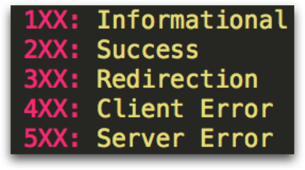
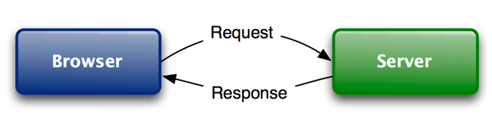
Watch Me Code 1
A Non-Python Demo of HTTP
What happens when you request a site? Like http://www.syr.edu ?
Chrome Developer tools
Now using requests.
Request Verbs
GET
POST
PUT
DELETE
Response Status Codes
Notes:
Short and sweet demo

Slide 6

Check Yourself: Response Codes
The HTTP Response code for success is
404
501
200
301
87%
(60)
4% (3)
7% (5)
A
B
C
1% (1)
69
D
vote at ist256.participoll.com

Slide 7
The Web Has Evolved….
From User-Consumption
To Device-Consumption
Check the news / weather in your browser
Search the web for "George Washington's birthday"
Internet is for people.
Get news/ weather alerts on your Phone
Ask Alexa “When is George Washingon's Birthday?"
"Internet of Things"

Slide 8
Web API: The Programmable Web!
An API is short for Application Programming Interface.
A Web API uses the HTTP Protocol to communicate with your program.
Web API’s can return data in many formats. We’ll focus on the JSON (JavaScript Object Notation) format which we've seen can be converted easily to Python objects.
Thanks to APIs' we can write programs to interact with a variety of services.

Slide 9
Web API’s in Python: The Steps
Call the API with Requests
Use the Right Method, URL, etc. based on the Docs.
If it works, the response is code will be 200 and the output is JSON-Formatted text.
De-Serialize the JSON text into a Python object
Extract what you need from the Python List of Dict

Slide 10
Watch Me Code 2
Open Street Maps Geocoding API
Get a GPS coordinate (Latitude and Longitude) for a City or Street Address
What you do with the response data is up to you!
Get Lat/Long for address
Get city / state for zipcode
Example:
https://nominatim.openstreetmap.org/search?q=address&format=json
Notes:
Short and sweet demo

Slide 11
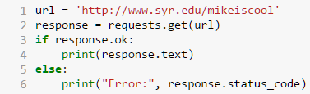
Check Yourself: Line of Code?
Click on the line number which connects to the url.
A. 1 B. 2 C. 3 D. 4 E. 5 F. 6
A
B
C
D
E
F
0
vote at ist256.participoll.com

Slide 12
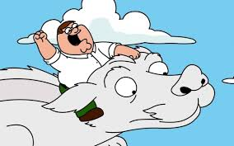
API’s R Awesum!
The only limitation is your imagination!
Leverage the power of the Internet to do almost anything!
If you can USE it on a web page or mobile phone It probably has an API!
Whether or not you can access the API is up to the provider.
Not all API’s are free.
Some require registration + authentication

Slide 13
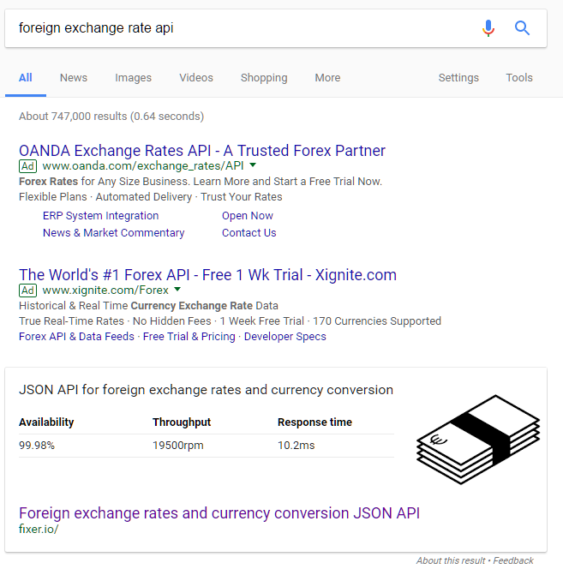
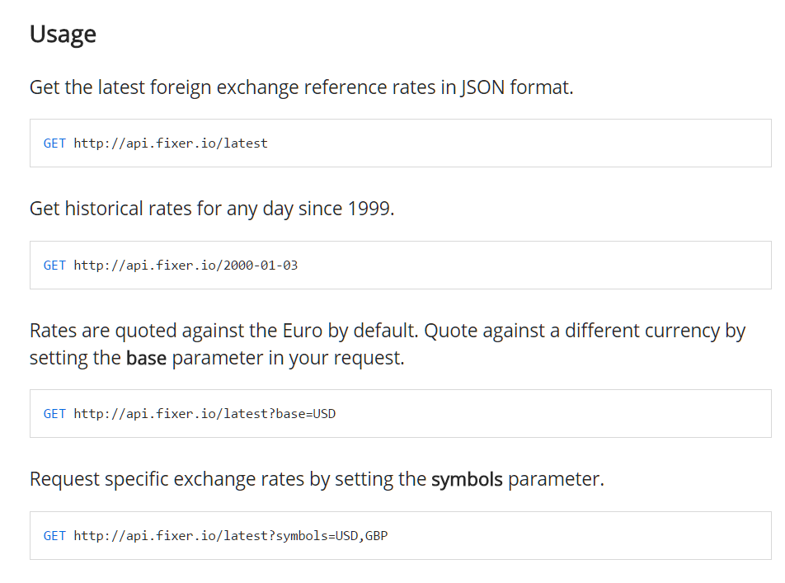
Finding API's requires research…
Start googling… "foreign exchange rate api"
Then start reading the documentation on fixer.io …

Slide 14
API Registries
http://www.programmableweb.com/
https://market.mashape.com/
https://github.com/toddmotto/public-apis
1,000's of APIs to search through
Examples of how to use them and where to find documentation.
Most require user registration and a API security through a key
Again: Not all these services are free.

Slide 15
The Big Cloud Providers have API’s
https://aws.amazon.com/education/awseducate/
https://azure.microsoft.com/en-us/free/students/
https://cloud.google.com Need a Credit Card
Google, Facebook, Twitter, Spotify, Instagram, Reddit, Etc.
Most are free and/or have a Free Tier.
If it’s a mobile app, it has an API. Question: is it available?

Slide 16
API Research… No Magic Bullet Here.
Expect to spend hours doing research
Expect to read a lot of documentation
Expect to write a lot of "throw away code" just to learn how to use the API.
Expect to hit a lot of dead ends
Expect to get frustrated in the process
Do not Expect your professors to learn your API for you.
Sounds a lot like everything we do in this course…
… do you see the pattern? Start Small. Start Simple.

Slide 17
Watch Me Code 3
No Magic Bullets Here
Text Translator API
Write a program to translate input text from English to another Language.
No Magic Bullets Here
Notes:
Short and sweet demo

Slide 18
Web API: Weather Forecasting
https://darksky.net/dev
Darksky.net / Forecast IO
You must sign up for an API key
1000 free requests per day

Slide 19

End-To-End Example:
Today's Weather
Understand how to use Dark Sky API
Let's write a program to input a city / state combination like "Syracuse, NY"
Then outputs the weather forecast at that location!

Slide 20

Conclusion Activity
"Cleared Up"
What confused you in the assigned readings but now after lecture has been cleared up?

