Slide 1

Lesson 13: Visualizations
Topic: Introduction to Data Visualization, Readings on website.
TopHat Attendance

Slide 2
Agenda
Introduction to Data Visualization
Matplotlib Basics
Plot.ly Basics
Folium Basics
You’ve Read:
Zybook Ch11
P4E Ch17

Slide 3


Connect Activity
Question:
What is the purpose of a data visualization?

Slide 4
Information Visualization?
The study of visual representations of data to reinforce human cognition. “Help people understand the, structure, relationships meaning in data.”
Techniques: Charts, Graphs, Maps

Slide 5
Anatomy of A Visualization
1
Title
X-Axis
Y-Axis
Series
Data Points
4
3
5
2

Slide 6
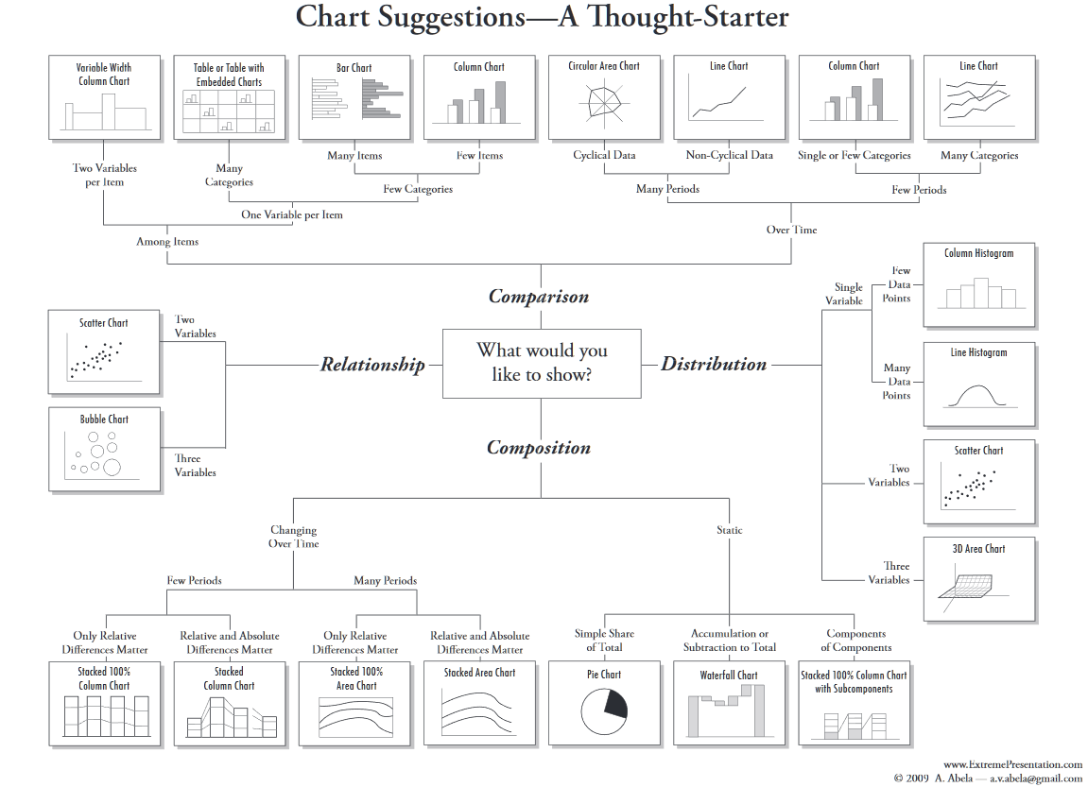

Slide 7
Check Yourself: Anatomy of A Visualization
1
Match to the number:
Series
Data Points
X-Axis
Y-Axis
Title
4
3
5
2

Slide 8
3 Python Packages 4 Data Viz
Matplotlib – Python’s Visualization Library
Docs: http://matplotlib.org/contents.html
Plot.ly – Cloud Plotting Service based on D3.js
Jupyter: https://plot.ly/ipython-notebooks/
Pandas / Cufflinks: https://plot.ly/pandas
Folium – Python Wrapper for OpenStreetMap / Leaflet.js
Docs: http://python-visualization.github.io/folium/

Slide 9

Watch Me Code!
Matplotlib basics
Standalone
With Pandas
Notes:
Short and sweet demo:

Slide 10
Watch Me Code!
Plot.ly basics
Sign-Up
Normal Plotting
With Cufflinks (Pandas-like)
Notes:
Short and sweet demo:
Import pandas as pd
Quarters = Series( [ "Q1","Q2","Q3","Q4" ])
Sales = Series( [100, 120, 90, 150] )
Sales_df = DataFrame ( { "Quarter" : Quarters, "Sold" : Sales } )
students= [ {'Name':'Tom', 'GPA':3.4 }, {'Name':'Dick', 'GPA':3.0 }, {'Name':'Harry', 'GPA':4.0 }]
Students_df = DataFrame(students)

Slide 11
Watch Me Code!
Folium basics
Maps, Map
Pin Markers
Circle Markers
Notes:
Short and sweet demo:
Import pandas as pd
Quarters = Series( [ "Q1","Q2","Q3","Q4" ])
Sales = Series( [100, 120, 90, 150] )
Sales_df = DataFrame ( { "Quarter" : Quarters, "Sold" : Sales } )
students= [ {'Name':'Tom', 'GPA':3.4 }, {'Name':'Dick', 'GPA':3.0 }, {'Name':'Harry', 'GPA':4.0 }]
Students_df = DataFrame(students)

Slide 12

End-To-End Example:
Mapping Potholes
This example uses Folium and the data from the civic hackathon
https://cityofsyracuse.github.io/RoadsChallenge/
to plot potholes on a map!

Slide 13
In Class Coding Lab
Exit Notes:
Homework is only #4 is lesson 13!
Work on your projects!
Next week is Web Scraping

