Slide 1

Lesson 14: Web Scraping
Today is WEDNESDAY! It's A Lecture Day!
Sit anywhere you like.
Topic: Web Scraping
Participation. Sign-In to TopHat to participate in the class lecture! →
Class Q&A: https://gitter.im/IST256/Fudge
TopHat Attendance

Slide 2

Agenda
You’ve Read:
https://automatetheboringstuff.com/chapter11/
https://developer.mozilla.org/en-US/docs/Learn/HTML/Introduction_to_HTML
HTML Crash Course
Opening webpages with webbrowser module
Using requests to retrieve the html of a webpage.
Using BeautifulSoup to parse a webpage and extract data from the HTML.
Use selenium to browse the web from code.
Questions? Ask in Our Course Chat!
https://gitter.im/IST256/Fudge

Slide 3

Connect Activity
What is 'Web Scraping'? :
Digging up Dirt on Social Media
Extracting Content From a Webpage programmatically
Finding deals online
Cleaning up cobwebs in the garage

Slide 4
Opening a webpage: webbrowser
The webbrowser module is a simple way to open the users browser and display a webpage.
To display a page we use the open method:
Ex: webbrowser.open(“https://ischool.syr.edu”)
You can't to much beyond that… ☹

Slide 5
HTML – The structure of a webpage
Web browsers use HTML (HyperText Markup Language) to display webpages.
Composed of elements (tags). Elements are composed of a start tag <element> and a closing tag </element>
Ids: Are unique on a page. There will only be one element with the id “awesome”.
<element id=“awesome”></element>
Classes: Used for categorizing elements. There can be many elements with the class “not-as-cool”
<element class=“not-as-cool”></element>

Slide 6
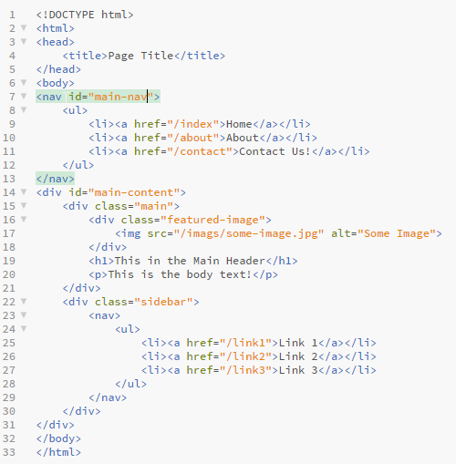
Navigating HTML
We can navigate through HTML by using a combination of tags, ids, and classes.
Using Selectors
http://www.w3schools.com/cssref/css_selectors.asp
To find the links in the main navigation:
nav#main-nav > ul > li
To get the featured image:
div#main-content > div.featured-image > img[src]

Slide 7

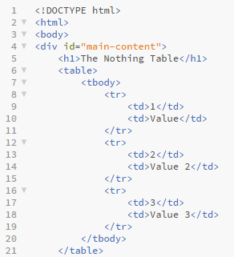
Check Yourself: HTML Selectors 1
How to we get the text "The Nothing Table":
div#main-content > h1
table > tbody
div#main-content
table tr

Slide 8
Check Yourself: HTML Selectors 2
How to we get the rows in the table:
div#main-content
table > tbody
table td
table tr

Slide 9
Browser developer tools:
Most modern web browsers have developer tools:
Recommended Browsers:
Google Chrome (F12) – Menu > More Tools > Developer Tools
Mozilla Firefox (F12) – Menu > Developer > Toggle Tools
Others: Not Recommended
Internet Explorer (F12) – Gear icon > Developer Tools
Safari – Don’t use (Sorry mac people)
When looking at a page make sure you DISABLE JAVASCRIPT!
JavaScript is what makes the web dynamic, it is executed in the browser but not when you request the webpage from code.

Slide 10

Watch Me Code 1
Harvest Faculty Emails with BeautifulSoup4
See how to user developer tools
Download the HTML of a webpage using requests
Parse HTML with BeautifulSoup4
Extract HTML data

Slide 11
Manipulate the browser with Selenium
Selenium is known as a "web driver".
Selenium works with the browser just like a person is manipulating it.
It can click buttons and links, navigate forward and backward in the browser.
Fill out forms, such and login information or perform a search on a website.

Slide 12
Watch Me Code 2
Using the Selenium Webdriver
Open google
Perform a search
Find results with bs4 and open the links in the users browser

Slide 13

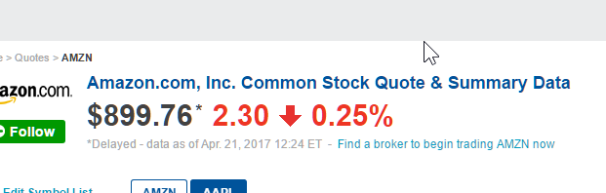
End-To-End Example:
Get Stock Data From NASDAQ Page
Ask user for NASDAQ Symbol
Go to Page, Extract Stock Name, Price, and Chg
Print Results

Slide 14
Solution
from bs4 import BeautifulSoup
import requests
def extract_info(html):
# take html extract faculty info return list of dictionaries
soup = BeautifulSoup(html, "lxml")
stock = {
"name": soup.select("div#qwidget_pageheader h1")[0].text,
"price": soup.select("div#qwidget_lastsale")[0].text,
"change": soup.select("div#qwidget_percent")[0].text,
}
return stock
def get_html(url):
# Get html from url
response = requests.get(url)
return response.text
# MAIN PROGRAM
symbol = input("Enter Stock Symbol: ")
url = 'http://www.nasdaq.com/symbol/' + symbol
html = get_html(url)
result = extract_info(html)
print("Name: %s" % result["name"])
print("Price: %s" % result["price"])
print("Change: %s" % result["change"])

Slide 15

Conclusion Activity
“What is the value of p ?”
html = """
<body>
<div class=“content”>
<h1>Beautifulsoup</h1>
</div>
</body>
"""
p = BeautifulSoup(html, “lxml”)
.select(“body > div.content > h1”)[0].text

