Slide 1

Lesson 14: Web Scraping
Topic: Web Scraping

Slide 2
Agenda
You’ve Read:
https://automatetheboringstuff.com/chapter11/
https://developer.mozilla.org/en-US/docs/Learn/HTML/Introduction_to_HTML
HTML Crash Course
Opening webpages with webbrowser module
Using requests to retrieve the html of a webpage.
Using BeautifulSoup to parse a webpage and extract data from the HTML.
Use selenium to browse the web from code.

Slide 3
Opening a webpage: webbrowser
The webbrowser module is a simple way to open the users browser and display a webpage.
To display a page we use the open method:
Ex: webbrowser.open(“https://ischool.syr.edu”)

Slide 4
HTML – The structure of a webpage
Web browsers use HTML (HyperText Markup Language) to display webpages.
Composed of elements (tags). Elements are composed of a start tag <element> and a closing tag </element>
Ids: Are unique on a page. There will only be one element with the id “awesome”.
<element id=“awesome”></element>
Classes: Used for categorizing elements. There can be many elements with the class “not-as-cool”
<element class=“not-as-cool”></element>

Slide 5
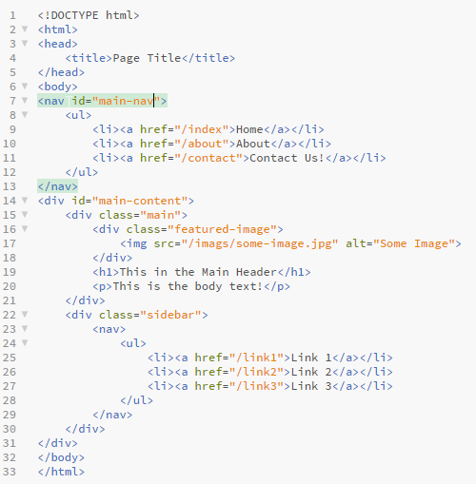
Navigating HTML
We can navigate through HTML by using a combination of tags, ids, and classes.
Using Selectors
http://www.w3schools.com/cssref/css_selectors.asp
To find the links in the main navigation:
nav#main-nav > ul > li
To get the featured image:
div#main-content > div.featured-image > img[src]

Slide 6

Check Yourself: What is p
html = “””
<body>
<div class=“content”><h1>Beautiful Soup</h1></div>
</body>
”””
p = BeautifulSoup(html, “lxml”).select(“body > div.content > h1”)[0].text

Slide 7
Browser developer tools:
Most modern web browsers have developer tools:
Recommended Browsers:
Google Chrome (F12) – Menu > More Tools > Developer Tools
Mozilla Firefox (F12) – Menu > Developer > Toggle Tools
Others
Internet Explorer (F12) – Gear icon > Developer Tools
Safari – Don’t use (Sorry mac people)
When looking at a page make sure you DISABLE JAVASCRIPT!
JavaScript is what makes the web dynamic, it is executed in the browser but not when you request the webpage from code.

Slide 8

Watch Me Code
Using the requests and BeautifulSoup4 modules.
See how to use developer tools
Download the HTML of a webpage using requests
Parse HTML with BeautifulSoup4
Extract HTML data

Slide 9

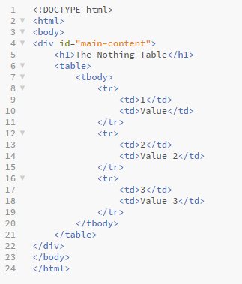
Connect Activity
How to we get the rows in the table:
div#main-content
table > tbody
table td
table tr

Slide 10
Manipulate the browser with Selenium
Selenium works with the browser just like a person is manipulating it.
It can click buttons and links, navigate forward and backward in the browser.
Fill out forms, such and login information or perform a search on a website.

Slide 11
Watch Me Code
Using the Selenium Webdriver
Open google
Perform a search
Find results with bs4 and open the links in the users browser

Slide 12

End-To-End Example:
Tweets of Twits!
Get a search term from a user
Search Twitter for the term
Scrape the results and save to a csv

Slide 13
In Class Coding Lab:
The goals for this lab:
To seach a webpage for a term and download the results using selenium
To parse each page of results using BeautifulSoup and retrieve the results
To navigate to the next page(s)
rinse and repeat

