Slide 1
IST256 : Applications Programming for Information Systems
Fall 2019
Mondays 3:45-5:05 Prof. Michael Fudge
Course Introduction

Slide 2
Agenda
Introduction
How this course is organized?
Goals of This Course
Let's Go Over The Syllabus
How Does Large Group Lecture Work?
Your To-Do List For Next Class

Slide 3
How is this course organized?

Slide 4
Everyone is enrolled in 2 sections
Lecture Section
Recitation Section
Combined.
I'm your lecture Professor
Meet Mondays
We cover new course material in lecture.
Don’t need your laptop, but you do need your smartphone.
You don't write code in Lecture. Too chaotic to try, just watch and most importantly ask and answer questions.
Breakout. Smaller groups.
Your recitation professor is of: Ferger, Kadaji, Nosky, Rieks, Lyga or Stringer.
Meeting times vary Wed-Fri
We enforce lecture material in recitation.
You must bring your laptop!
You will write code in Recitation. Easier to do because you've seen it in lecture.

Slide 5

We are all your professors, but…
Only your recitation instructor grades your work.
The rest of us are here to help only.

Slide 6
Resources we will use in this course
Course Website: http://ist256.github.io
All Content is on the website. PowerPoints, Syllabus, What’s due, Setup instructions. Searchable.
GitHub Classroom
All the code samples, demos, labs, and homework assignments are here.
We will learn to code using the tools of real coders.
Blackboard
For taking the diagnostic quizzes; grades posted here.
Microsoft Teams
For taking asking and answering questions in and out of class.

Slide 7
Goals of This Course

Slide 8
We Want You Become a "Modern Programmer"

Slide 9
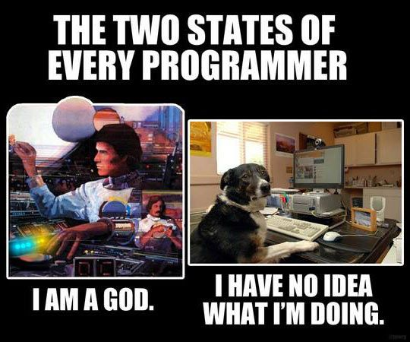
To program in the Python computer programming language.

Slide 10
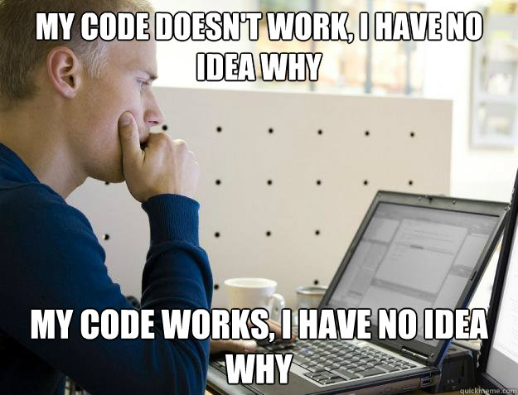
To solve complex real-world, data-oriented problems by writing code.

Slide 11
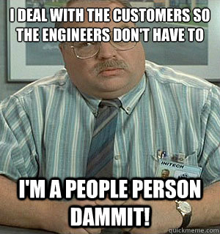
To read, write and discuss code and documentation with confidence.

Slide 12
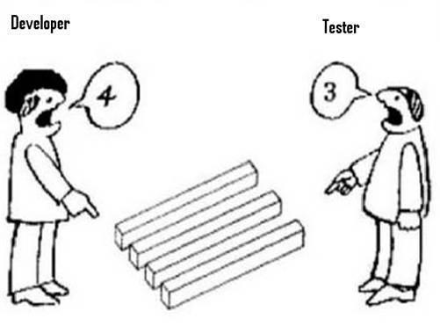
To code in teams, collaborate with others and manage your source code.

Slide 13
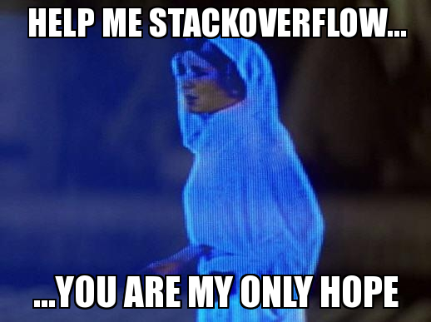
The skills necessary to acquire new programming knowledge independently.

Slide 14
Why Learn To Program?
“TEDxSMU: You Should Learn to Program”, by Christian Genco
https://www.youtube.com/watch?v=xfBWk4nw440

Slide 15
Programming:
Is
Difficult
Time Consuming
Frustrating
Rewarding
Requires:
Practice (lots of it)
Precision
Patience
Persistence
The Key to success is Practice

Slide 16
Let's Go Over The Syllabus!
http://ist256.github.io/syllabus/

Slide 17
Textbooks
2 Required.
All are digital
One is not Free… It’s $58
https://zyBooks.zyante.com
https://www.py4e.com/book

Slide 18
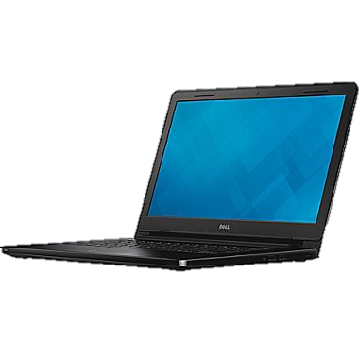

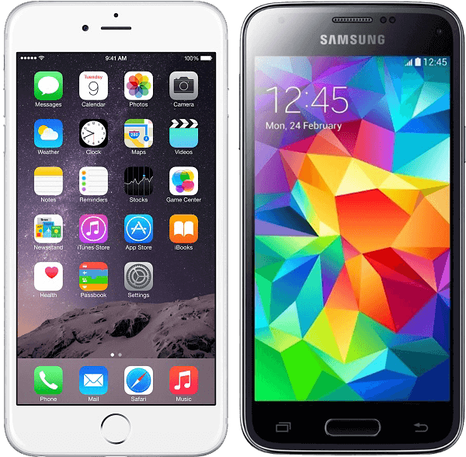
This Class Is BYOD
During lecture
You need your laptop or smartphone to Participate in Class (answer and ask questions)
During Recitation
You will need your laptop to write code, of course!

Slide 19
Methods of Evaluation
http://ist256.github.io/syllabus/#methods-of-evaluation
Exams
Project
ZyBook
Labs
Homework

Slide 20
Project Demo Day!
https://youtu.be/XSs4yC1TJg0
During final exam block. Friday Dec 13 8-10am Hinds.

Slide 21
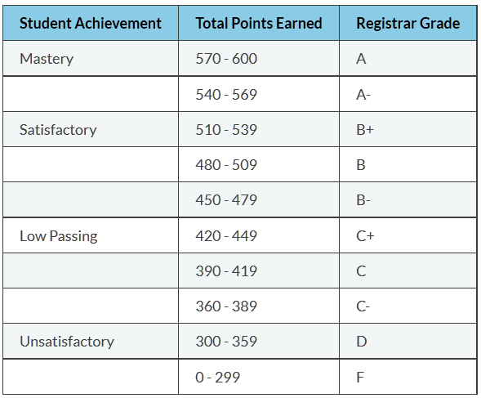
Grading Scale

Slide 22
Honor Code & Academic Integrity
My work is my own
I will not share answers
I will not falsely represent my ability to code
I will give credit to others & attribute sources of code
I accept the consequences of violating Academic Integrity
Sanction for AI Violation is F in the course. When in doubt. Ask us!

Slide 23
How Does Large Group Lecture Work?

Slide 24
Attendance!
https://here.ist256.syr.edu
A Pin Code appears on title slide
Try to get to class a few minutes early!
After 5 minutes you are late. After 15 minutes you are absent.

Slide 25
Example: Attendance
https://here.ist256.syr.edu
Code: 201908
NOTE: Code changes every week!

Slide 26

How do *I* ask *YOU* questions?
Each Lecture you will be required to sign-in with your NetID.
During lecture, I ask questions and provide a link where you can answer.
I use your responses to guide lecture.
Your participation is not graded, but is monitored.
Excellent participation can positively impact your final grade in the course at our discretion.

Slide 27
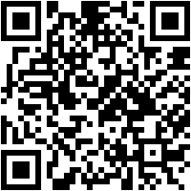
Example: Participoll
http://ist256.participoll.com/
How many exams are issued in this course?
One
Two
Three
Four
http://ist256.participoll.com/
0
A
B
C
D
vote at ist256.participoll.com

Slide 28

How do *YOU* ask *ME* Questions?
Microsoft Teams https://teams.microsoft.com
Ask Questions in the Large Group Chat channel. A Moderator brings them up during lecture.
Ask questions in the General, and discuss outside of class, too. Answer each other’s questions!
Supports Web, iPhone & Android

Slide 29
Example: Microsoft Teams Chat
uwmpyld
uwmpyld
https://teams.Microsoft.com
Sign-in with your SU Email address and NetId Password
Click Create And Join Team → With a Code
Code: uwmpyld
Post to Large Group Chat

Slide 30

Lesson XX: Sample Title Slide
Attendance:
https://here.ist256.syr.edu | Code: 201908
Class Chat:
https://teams.microsoft.com Channel: Large Group Chat
Participation
http://ist256.participoll.com/

Slide 31
To Do Before Your 1st Recitation
(Ahem… that’s next class!)

Slide 32
To-Do List – Complete by Recitation.
Read through the syllabus
Purchase your Zybook online or through the bookstore
Complete the course setup checklist.

Slide 33

Course Setup Checklist
http://ist256.github.io/content/setup/overview/

Slide 34
Why Not Get a Head Start On Next Week?

Slide 35

To-Do for lesson 01
Next week is lesson 01.
Everything you need is on the website.
There’s a section What’s Due which outlines all the work you must complete for the lesson.
http://ist256.github.io/content/toc/#lesson-01-introduction-to-programming

Slide 36
Thank You!

