Slide 1

Lesson 02: Introduction to Python
Attendance:
SU Connect | Code: ????
Class Chat:
https://gitter.im/IST256/Fudge
Participation
http://ist256.participoll.com/

Slide 2

Agenda
Programming: What, How and Why
Thinking Like a Programmer
The Python Programming Language
DEMO: How we code in this course
You’ve Read:
Zybook Ch1
P4E Ch1
Questions? Ask in Our Course Chat!
https://gitter.im/IST256/Fudge

Slide 3
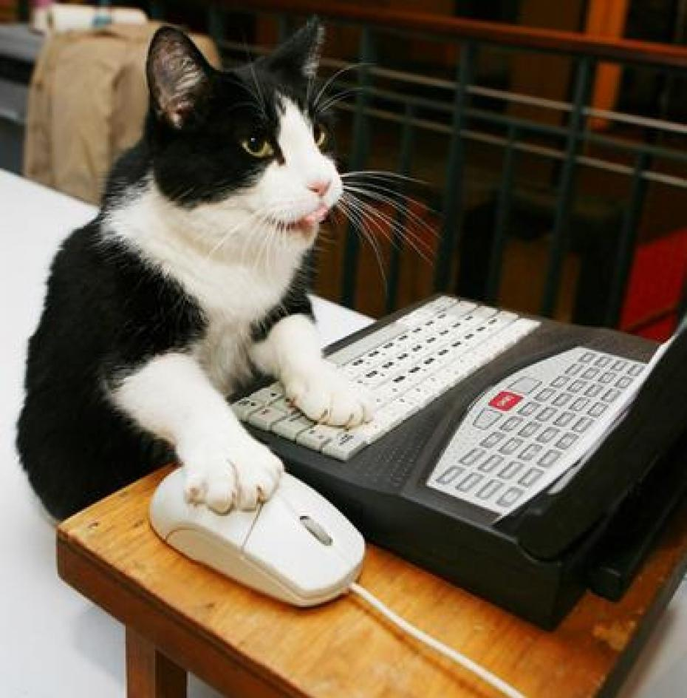
Before We start: Where Is The Code!?
Today I Will Write Code In Class.
Please DO NOT Try To Type Along With Me!
Watch Me Code. You’ll Learn More That Way. Trust Us.
You Have The Code Already.
https://github.com/IST256-classroom/fall2018-learn-python-mafudge

Slide 4

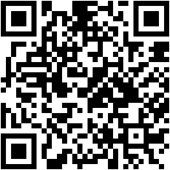
Connect Activity
The python command to output information to the is:
print
output
input
get
http://ist256.participoll.com/
A
B
C
D
0

Slide 5
Recall:Computers & Algorithmic Thinking
Most computer problems follow the input → Process → output model
Data: raw unprocessed facts
Information: meaningful, useful data
Input (Data)
Process (Program)
Output (Information)

Slide 6
Learning Any Programming Language
Input (Data)
Process (Program)
Output (Information)
Learn how to output…
Learn how to input…
Learn how to process (transform input to output)

Slide 7
Output
The built in function print() is used to display output.
It takes one argument in single or double quotes known as a string literal.
The string literal is enclosed in single or double quotes.
Multiple string literals may be separated by a comma.

Slide 8

Watch Me Code 1
The built in print() function
String literals
Single and double quotes
More than one argument
Notes:
Write this code in a Jupyter Notebook to demonstrate variables and types
name = "Tony"
age = 43
wage = 12.50
happy_employee = True
print ("my name is",name," I am", age, "years old. I make ", wage, "Am I happy? ", happy_employee)
GROK TYPES
type(wage) etc…
EXPLAIN THAT YOU CAN ALSO SWITCH TYPES OF VARIABLES
Happy_employee = “You betcha!”

Slide 9

Activity: printing welcome
Which statement prints welcome?
print(welcome)
print('welcome')
print("welcome")
Print([welcome])
A
B
C
D
0

Slide 10
Input
The built in function input() accepts input from the user.
It takes one argument a string literal which prompts (provides instructions to the user).
Input is commonly assigned to a variable so that the input can be used later on.

Slide 11
Watch Me Code 2
The built in input() function
Using a prompt
Storing into a variable
Printing the variable
Notes:
Write this code in a Jupyter Notebook to demonstrate variables and types
name = "Tony"
age = 43
wage = 12.50
happy_employee = True
print ("my name is",name," I am", age, "years old. I make ", wage, "Am I happy? ", happy_employee)
GROK TYPES
type(wage) etc…
EXPLAIN THAT YOU CAN ALSO SWITCH TYPES OF VARIABLES
Happy_employee = “You betcha!”

Slide 12
Activity: printing welcome
For the following code, which is the prompt? x = input('y’)
input
'y’
=
x
A
B
C
D
0

Slide 13
Variables
Variables are named areas of computer memory for storing data.
The name can be anything but should make symbolic sense to the programmer.
We write to the variable’s memory location with the assignment statement (=)
We read from the variable by calling its name.
Variable names must begin with a letter or _ and must only contain letters, numbers or _.

Slide 14
Watch Me Code 3
The built in inputs and outputs together
Inputs and outputs into a program
Prompts that change based on input, end=“”
Notes:
Write this code in a Jupyter Notebook to demonstrate variables and types
name = "Tony"
age = 43
wage = 12.50
happy_employee = True
print ("my name is",name," I am", age, "years old. I make ", wage, "Am I happy? ", happy_employee)
GROK TYPES
type(wage) etc…
EXPLAIN THAT YOU CAN ALSO SWITCH TYPES OF VARIABLES
Happy_employee = “You betcha!”

Slide 15

End-To-End Example
Mad-Libs!:
Write a program to prompt to create a mad-libs type story generator in Python.

Slide 16

Conclusion Activity
"One Important Thing"
Name one important thing you learned in class today!
Share it on Gitter.im chat now!

