Slide 1
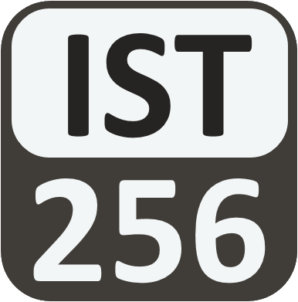
Lesson 03: Variables And Types
Topic: Introduction to Programming, Zybook Ch 2, P4E Ch 2. Slides on website.

Slide 2
Agenda
What is a variable? What is its purpose?
Different data types for variables.
Type checks and conversions.
Print types with formatting
Arithmetic expressions, arithmetic operators, and operands.
Diagnostc Quiz Review!
You’ve Read:
Zybook Ch2
P4E Ch2

Slide 3

Connect Activity
Re-Order this program in correct sequence to say hello to you:
print("Hello", name)
fn=input("Enter First Name:")
name = fn + " " + ln
ln=input("Enter Last Name:")

Slide 4
Variables
Variables are named areas of computer memory for storing data.
The name can be anything but should make symbolic sense to the programmer.
We write to the variable’s memory location with the assignment statement (=)
We read from the variable by calling its name.
Variable names must begin with a letter or _ and must only contain letters, numbers or _.

Slide 5
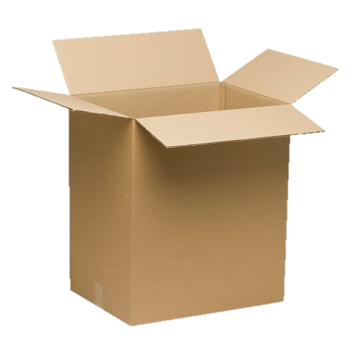
Variables, Types and Assignment
Python Code
What’s Happening
Name = “nick"
Age = 36
“nick"
Name
36
Age

Slide 6
Variables are of a Specific Type
Type | Purpose | Example
int | Numeric type integers only | 45
float | Numeric type floating point numbers | 3.14
bool | True or False values | True
str | Characters and text | ‘Nick'

Slide 7
Type Detection and Conversion
Function | What it does | Example
type(n) | Get the type of n | type(13) ➔ int
int(n) | Convert n to type int | int("45") ➔ 45
float(n) | Convert n to type float | float(45) ➔ 45.0
str(n) | Convert n to type str | str(4.0) ➔ '4.0'

Slide 8

Watch Me Code 1
Understanding Variables and Types!
Assignment
Variables of Different Types
Switching types
Using type()
Notes:
Write this code in a Jupyter Notebook to demonstrate variables and types
name = "Tony"
age = 43
wage = 12.50
happy_employee = True
print ("my name is",name," I am", age, "years old. I make ", wage, "Am I happy? ", happy_employee)
GROK TYPES
type(wage) etc…
EXPLAIN THAT YOU CAN ALSO SWITCH TYPES OF VARIABLES
Happy_employee = “You betcha!”

Slide 9

Check Yourself: Matching Types
Match each Python code sample to its value.
Python Code Sample
Value
type(34)
str(34)
float(34)
int(34)
34
"34"
int
34.0

Slide 10
Python String Formatting
Code | Type | Example | Output
%d | int | print("%d" % 50) | 50
%f | float | print("$%.2f" % 4.5) | $4.50
%s | str | print("[%s]" % "mike") | [mike]
You can put an integer between the % and code for spacing:
%5d ➔ Use 5 spaces for the int, align right
%-5d ➔ Use 5 spaces for the int, align left
https://pyformat.info

Slide 11
Watch Me Code 2
Python String Formatting
Format codes
Spacing
Alignment
Notes:
Write this code in a Jupyter Notebook to demonstrate variables and types
name = "Tony"
age = 43
wage = 12.50
happy_employee = True
print ("my name is",name," I am", age, "years old. I make ", wage, "Am I happy? ", happy_employee)
GROK TYPES
type(wage) etc…
EXPLAIN THAT YOU CAN ALSO SWITCH TYPES OF VARIABLES
Happy_employee = “You betcha!”

Slide 12
Check Yourself: Formatting
Match each print() statement to its output
Python Print Statement
Output
print("$%s" % 34)
print("%.1f" % 34)
print("%d" % 34 )
34
34.0
$34

Slide 13
Programmatic Expressions
Programmatic Expressions contain operators and operands. They evaluate to a value, preserving type:
Examples: Value of X
X = 2 + 2 4
X = 2.0 + 2 4.0
X = "sh" + 'ip' “ship”
X = 'hi' + 2 TypeError

Slide 14
Arithmetic Operators
Symbol | What it does | Example
+ | Adds two numbers or concatenates two strings | 3 + 4 ➔ 7
- | Subtracts two numbers. | 4 – 3 ➔ 1
* | Multiplies two numbers | 4 * 3 ➔ 12
/ | Divides two numbers. Result is float | 4 / 3 ➔ 1.3333
// | Divides two numbers. Given quotient as int. | 13 // 3 ➔ 4
% | Divides two numbers. Gives remainder as int. | 13 % 3 ➔ 1
() | Force an order of operations | 2 * (1 + 4) ➔ 10

Slide 15

End-To-End Example
The Pay-Rate Calculator:
Write a program to prompt for hourly rate, and hours worked for the week as inputs
Then calculates the total pay as output.
Then prompts for tax rate as input, and outputs net pay.

Slide 16
Diagnostic Quiz Review

Slide 17
In Class Coding Lab:
The goals of this lab are to help you to understand:
Python data types
Getting input as different types
Formatting output as different types
Basic arithmetic operators
How to create a program from an idea.

