Slide 1

Lesson 05: Iterations
Attendance:
Link: In Gitter.im | Code: ????
Class Chat:
https://gitter.im/IST256/Fudge
Participation
http://ist256.participoll.com/

Slide 2

Agenda
Make our code execute in a non linear fashion.
Definite loops (for loops) and iterators.
Indefinite looping, infinite loops, and the break and continue statements
How to build complex loops easily.
You’ve Read:
Zybook Ch4
P4E Ch5
Questions? Ask in Our Course Chat!
https://gitter.im/IST256/Fudge

Slide 3
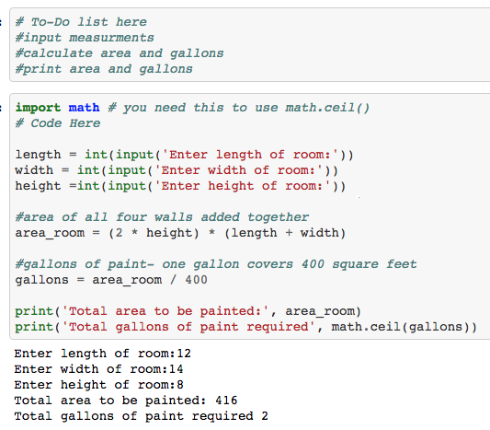
Homework 3 Debrief: What a “5 Looks like…”
To-Do list shows student “thought” about the program before coding it.
Code is well commented and easy to read. Variable names make sense. “Math Explained.”
Used same inputs as example to demonstrate it works correctly.

Slide 4

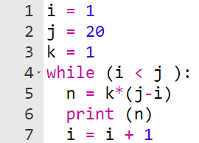
Connect Activity
Select the line number where the increment occurs:
4
5
6
7
A
B
C
D
0

Slide 5
Increment and Decrement
Increment means to add a value to a variable. X = X + 1
Decrement means to subtract a value from a variable. X = X - 1
These are common patterns in iteration statements which you will see today.

Slide 6

Anatomy of a loop
A Loop is a sequence of code that repeats as long as a Boolean expression is True.
The sequence of code that repeats is known as the Body.
The Boolean expression which is tested is known as the Test Condition or Exit Condition.
Variables which are part of the Test condition are called Loop Control Variables or Iteration Variables.
Our goal is to make the Test condition False so that the loop stops. This is accomplished through changing the loop control variable.

Slide 7

Watch Me Code 1
Say My Name:
This program will say you name a number of times.
This is an example of a Definite loop because the number of iterations are pre-determined.

Slide 8
For Loop
The For Loop iterates over a python list, string, or range of numbers.
It is the preferred statement for Definite loops, where the number of iterations are pre-determined. Definite loops do not require an exit condition.
The for loop uses an iterator to select each item from the list or range and take action in the loop body.
The range() function is useful for getting an iterator.

Slide 9
Watch Me Code 2
Say My Name:
Range() function
Refactored as a For Loop.

Slide 10

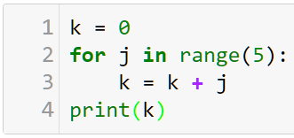
Check Yourself: For Range
What is the value of k on line 4?
2
3
6
10
j | 0 | 1 | 2 | ? | ?
k | 0 | 1 | ? | ? | ?
A
B
C
D
0

Slide 11
Watch Me Code 3
Count the "i"'s
Definite Loop

Slide 12
Indefinite,Infinite Loops and Break
The Indefinite Loop has no pre-determined exit condition. There are no guarantees an indefinite loop will end, as it is typically based on user input.
Infinite Loops are loops which can never reach their exit condition. These should be avoided at all costs.
The break statement is used to exit a loop immediately.It is often used to force an exit condition in the body of the loop.

Slide 13
Indefinite Loops The Easy Way
Determine the code to repeat
Determine the loop control variables & exit conditions
Write exit conditions as if statements with break
Wrap the code in a while True: loop!

Slide 14
Watch Me Code 4
Guess My Name:
This program will execute until you guess my name.
Uses the indefinite loop approach

Slide 15
Check Yourself: Loop Matching
Match the Definition…
To its term.
Add one to a variable
A look where the test condition is never false
Statement to exit the loop
Statement for definite looping
break
Infinite
for
Increment

Slide 16

End-To-End Example
Password Program:
5 attempts for the password
On correct password, print: “Access Granted”, then end the program
On incorrect password “Invalid Password Attempt #” and give the user another try
After 5 attempts, print “You are locked out”. Then end the program.

Slide 17

Conclusion Activity
"One Important Thing"
Share one important thing you learned in class today on Gitter.im!!!

