Slide 1

Lesson 06: Functions
Attendance:
Link: In Gitter.im | Code: ????
Class Chat:
https://gitter.im/IST256/Fudge
Participation
http://ist256.participoll.com/

Slide 2

Agenda
Using import for functions from a module.
How to inspect module contents and get help on functions.
User-defined functions: arguments, named arguments, return values
How to modularize our code with user-defined functions.
You’ve Read:
Zybook Ch 5
P4E Ch 4
Questions? Ask in Our Course Chat!
https://gitter.im/IST256/Fudge

Slide 3
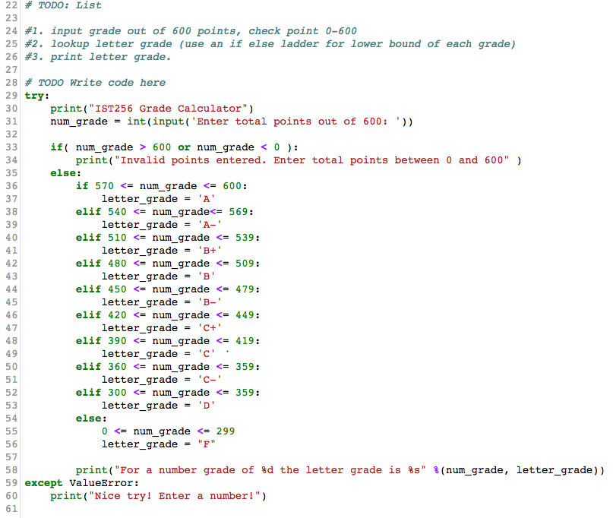
Student submission of the week
What we liked about it:
Student came up with a plan.
Used if to catch grades outside 0-600 range
Used if else ladder to bucket number grades to letter grades
Knows how to use format codes
Used try except to catch bad input!

Slide 4

Connect Activity
The act of invoking a function is known as a:
run
call
definition
parameter
A
B
C
D
0

Slide 5
Functions
A Function is a named sequence of statements which accomplish a task. They promote modularity, making our code less complex, easier to understand and encourage code-reuse.
When you “run” a defined function it’s known as a function call. Functions are designed to be written once, but called many times.
We've seen functions before:
input("Enter Name: ")
random.randint(1,10)
int("9")

Slide 6
Functions, continued
Functions are like their own little programs. They take input, which we call the function arguments (or parameters) and give us back output that we refer to as return values.
x = input("Enter Name: ")
y = random.randint(1,10)
z = int("9")
Arguments
Function
Return Value

Slide 7

Check Yourself 1: Functions
Match the concept to its object name in the example.
x = y(z)
Function Name?
x
y
z
A
B
C
0

Slide 8
Check Yourself 2: Functions
Match the concept to its object name in the example.
x = y(z)
Function Name?
Argument?
x
y
z
A
B
C
0

Slide 9
Check Yourself 3: Functions
Match the concept to its object name in the example.
x = y(z)
Function Name?
Argument?
Return Value?
x
y
z
A
B
C
0

Slide 10
Functions & Python Modules
Python modules are separate files of Python functions.
In an object-oriented context functions are called Methods.
When you import a module, Python executes the and all the variables and methods/ functions module become available to your program.
The dir() function will display the names defined by the module.
You can get help() on any function name to see how to use it.

Slide 11
Built in Modules vs. External
The Python language has several modules which are included with the base language: Python Standard Library
https://docs.python.org/3/library/
In addition you can import other libraries found on the Internet.
More on this in a few weeks.

Slide 12

Watch Me Code 1
Import Modules:
Import sys, math and random
dir()
help()
Notes:
Short and sweet demo

Slide 13
User-Defined Functions
We can create out own functions with the def statement.
Functions should return a value.
def function-name(arguments):
statements-in-function return expression

Slide 14
Watch Me Code 2
Area and Perimeter of a rectangle.
Functions make code readable
Concept: Named Arguments
Notes:
Introduce named arguments.

Slide 15
Function Variable Scope
Variables defined outside any function are Global Variables. These are accessible from everywhere including inside function definitions.
Variables defined inside a function are Local Variables, and are only accessible inside the function definition.
Local variables with the same name take precedence over global variables
Best Practice: Avoid Global Variable Use In Functions!!!

Slide 16
Watch Me Code 3
Area and Perimeter of a rectangle.
Understanding global variables
Avoid their use in functions, use arguments instead.
Notes:
Introduce named arguments.

Slide 17
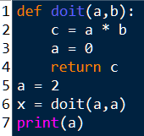
Check Yourself: Understanding Scope
What is the value of the variable a as printed on line 7?
2
0
No Idea!?!?
A
B
C
0

Slide 18

End-To-End Example:
Temperature Conversions as functions
Two functions f2c and c2f:
Write program similar to a previous homework

Slide 19

Conclusion Activity
"One Important Thing"
Share one important thing you learned in class today!

