Slide 1

Lesson 11: Web Services & API's
Topic: Web Services and API's, Readings on Website.

Slide 2
Agenda
You’ve Read:
Assigned Readings From http://ist256.syr.edu/content/toc/#lesson-11-web-services-and-apis
How the Web Works
Making HTTP requests using the Python requests module
Parsing json responses into Python objects
Procedure for calling API's
How to read API documentation

Slide 3

Connect Activity
Question: The Python module to consume Web API's is called:
api
requests
http
urllibrary

Slide 4
HTTP: The Protocol of The Web
When you type a URL into your browser you’re making a request.
The site processing your request sends a response.
Part of the response is the status code. This indicates “what happened”
The other part of the response is content (this is usually HTML) which is rendered by the browser.
HTTP is a text based protocol. It is stateless meaning each request in independent of the other.

Slide 5
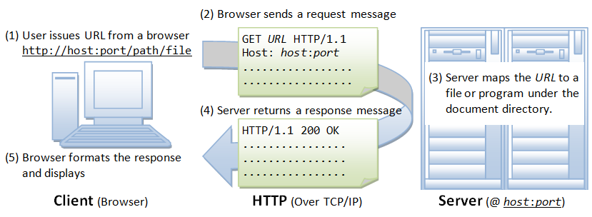
The basics of a request

Slide 6
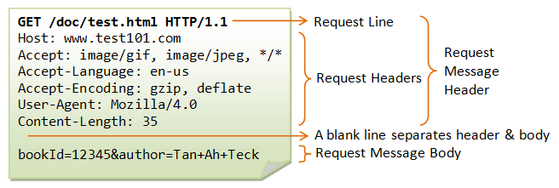
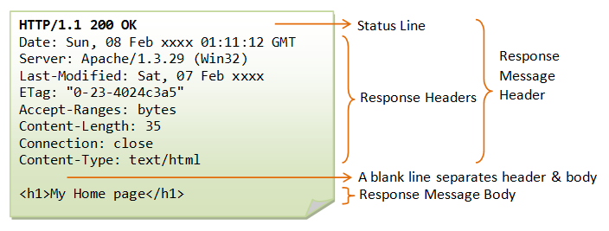
The basics of a request/response
Client’s Request
Servers
Response

Slide 7

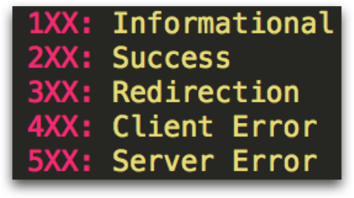
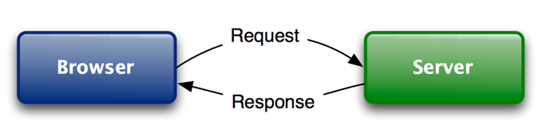
Watch Me Code 1
A Non-Python Demo of HTTP
What happens when you request a site? Like http://www.syr.edu ?
Chrome Developer tools
Now using requests.
Request Verbs
GET
POST
PUT
DELETE
Response Status Codes
Notes:
Short and sweet demo

Slide 8

Check Yourself: Response Codes
The HTTP Response code for success is
404
501
200
301

Slide 9
The Web Has Evolved….
From User-Consumption
To Device-Consumption
Check the news / weather in your browser
Search the web for "George Washington's birthday"
Internet is for people.
Get news/ weather alerts on your Phone
Ask Alexa "What is George Washingon's Birthday"
"Internet of Things"

Slide 10
Web API: The Programmable Web!
An API is short for Application Programming Interface.
A Web API uses the HTTP Protocol to communicate with your program.
Web API’s can return data in many formats. We’ll focus on the JSON (JavaScript Object Notation) format which we've seen can be converted easily to Python objects.
Thanks to APIs' we can write programs to interact with a variety of services.

Slide 11
Watch Me Code 2
Google’s Geocoding API
Get a GPS coordinate (Latitude and Longitude) for a City or Street Address
Parameters
What you do with the response data is up to you!
http://maps.googleapis.com/maps/api/geocode/json?address=addr
Notes:
Short and sweet demo

Slide 12
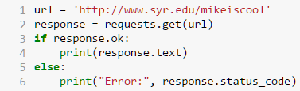
Check Yourself: Line of Code?
What line number connects to url.

Slide 13
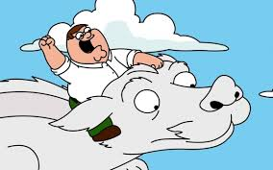
API’s R Awesum!
The only limitation is your imagination!
Leverage the power of the Internet to do almost anything!
If you can USE it on a web page or mobile phone It probably has an API!
Whether or not you can access the API is up to the provider.
Not all API’s are free.
Some require registration + authentication

Slide 14
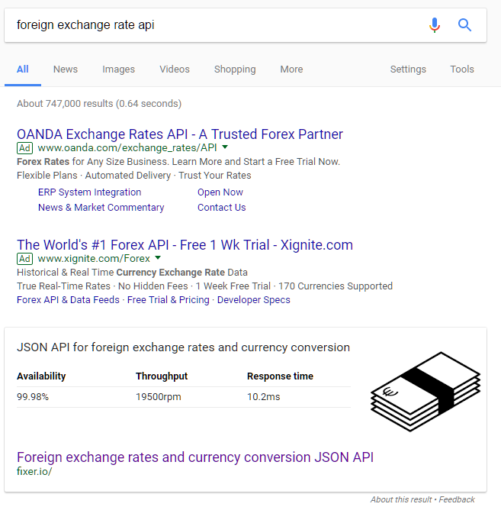
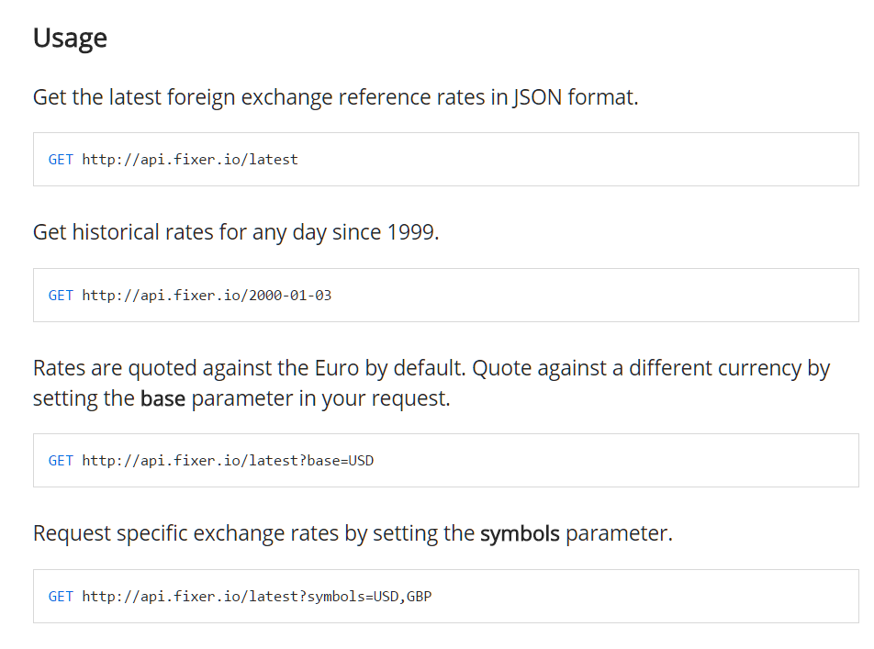
Finding API's requires research…
Start googling… "foreign exchange rate api"
Then start reading the documentation on fixer.io …

Slide 15
API Registries
http://www.programmableweb.com/
https://market.mashape.com/
1,000's of APIs to search through
Examples of how to use them and where to find documentation
Not all are free.

Slide 16
API Research… No Magic Bullet Here.
Expect to spend hours doing research
Expect to read a lot of documentation
Expect to write a lot of "throw away code" just to learn how to use the API.
Expect to hit a lot of dead ends
Expect to get frustrated in the process
Sounds a lot like everything we do in this course

Slide 17
Web API: Weather Forecasting
https://darksky.net/dev
Darksky.net / Forecast IO
You must sign up for an API key
1000 free requests per day

Slide 18

End-To-End Example:
Today's Weather
Understand how to use Dark Sky API
Let's write a program to input a city / state combination like "Syracuse, NY"
Then outputs the weather forecast at that location!

Slide 19
In Class Coding Lab
Don’t forget the bonus points are no longer available until after the 19th. NO EXCEPTIONS!!
IF YOU MISS THE OPPORTUNITY FOR THE POINTS I DON’T WANT TO HEAR ABOUT IT.
My office hours are from 3-4 on Thursday, I expect to leave a little after 4. If this doesn’t work with your schedule contact me for a time to meet.

