Slide 1

Lesson 13: Visualizations
Attendance:
Link: Gitter.im | Code: ????
Class Chat:
https://gitter.im/IST256/Fudge
Participation
http://ist256.participoll.com/

Slide 2

Agenda
Introduction to Data Visualization
Matplotlib Basics
Plot.ly Basics
Folium Basics
You’ve Read:
Zybook Ch11
Online Readings
Questions? Ask in Our Course Chat!
https://gitter.im/IST256/Fudge

Slide 3

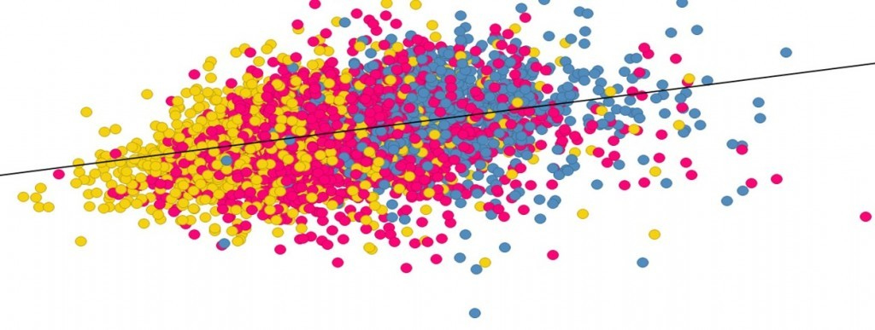
Connect Activity
Question:
What is the purpose of a data visualization?
Find relationships in data
Find patterns in data
Discover meaning in data
All of the above
A
B
C
D
0

Slide 4
Information Visualization?
The study of visual representations of data to reinforce human cognition. “Help people understand the, structure, relationships meaning in data.”
Techniques: Charts, Graphs, Maps

Slide 5
Anatomy of A Visualization
1
Title
X-Axis
Y-Axis
Series
Data Points
4
3
5
2

Slide 6
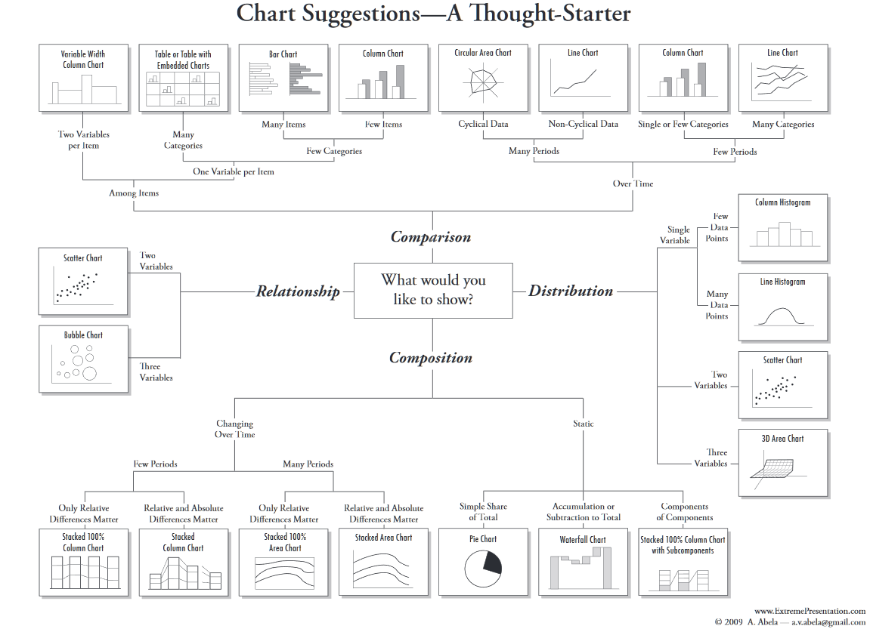

Slide 7
Check Yourself: Anatomy of A Visualization
A
Which letter corresponds to the X-Axis ?
B
E
C
D
A
B
C
D
E
0

Slide 8
Check Yourself: Anatomy of A Visualization
A
Which letter corresponds to a data point?
B
E
C
D
A
B
C
D
E
0

Slide 9
Check Yourself: Anatomy of A Visualization
A
Which letter corresponds to a data series?
B
E
C
D
A
B
C
D
E
0

Slide 10
3 Python Packages for Visualization
Matplotlib – Python’s Visualization Library, based on MATLAB
Docs: http://matplotlib.org/contents.html
Plot.ly – Cloud Plotting Service uses D3.js
Jupyter: https://plot.ly/ipython-notebooks/
Pandas / Cufflinks: https://plot.ly/pandas
Folium – Python Wrapper for OpenStreetMap / Leaflet.js Overlays and Choropleths
Docs: http://python-visualization.github.io/folium/

Slide 11

Watch Me Code 1!
Matplotlib basics
Standalone
With Pandas
Notes:
Short and sweet demo:

Slide 12
Watch Me Code 2!
Plot.ly basics
Sign-Up
Normal Plotting
With Cufflinks (Pandas-like)
Notes:
Short and sweet demo:
Import pandas as pd
Quarters = Series( [ "Q1","Q2","Q3","Q4" ])
Sales = Series( [100, 120, 90, 150] )
Sales_df = DataFrame ( { "Quarter" : Quarters, "Sold" : Sales } )
students= [ {'Name':'Tom', 'GPA':3.4 }, {'Name':'Dick', 'GPA':3.0 }, {'Name':'Harry', 'GPA':4.0 }]
Students_df = DataFrame(students)

Slide 13
Watch Me Code 3!
Folium basics
Maps, Map
Pin Markers
Circle Markers
Choropleths
Notes:
Short and sweet demo:
Import pandas as pd
Quarters = Series( [ "Q1","Q2","Q3","Q4" ])
Sales = Series( [100, 120, 90, 150] )
Sales_df = DataFrame ( { "Quarter" : Quarters, "Sold" : Sales } )
students= [ {'Name':'Tom', 'GPA':3.4 }, {'Name':'Dick', 'GPA':3.0 }, {'Name':'Harry', 'GPA':4.0 }]
Students_df = DataFrame(students)

Slide 14

End-To-End Example:
Mapping Potholes
This example uses Folium and the data from the civic hackathon
https://cityofsyracuse.github.io/RoadsChallenge/
to plot potholes on a map!

Slide 15

Conclusion Activity
"1 Important thing"
Explain one important thing you learned today!

