Slide 1
IST 707
M004 Week 10

Slide 2
Administrata
Homework 5 (Clustering) is due today with grace period that goes to next class.
Checkpoint 2 is due next class (no grace period for this)
Checkpoint 1 is returned and graded.

Slide 3
Artificial Neural Networks

Slide 4
ANN
Artificial Neural Network (ANN): inspired by networks of biological neurons found in organic brains.
Gradually ANNs have become less and less similar to organic neurons.
Core unit of deep-learning

Slide 5
History
First introduced in 1943 by Warren McCulloch and Walter Pitts “A logical calculus of ideas immanent in nervous activity”.
Suggested a simplified computational model for biological neurons based on propositional logic.
Early success led to wide-spread belief we would soon be talking with truly intelligent computers.
A long funding winter followed a book called “Perceptrons” that pointed out limits of the ANNs. No one at the time new how to train complex networks.

Slide 6
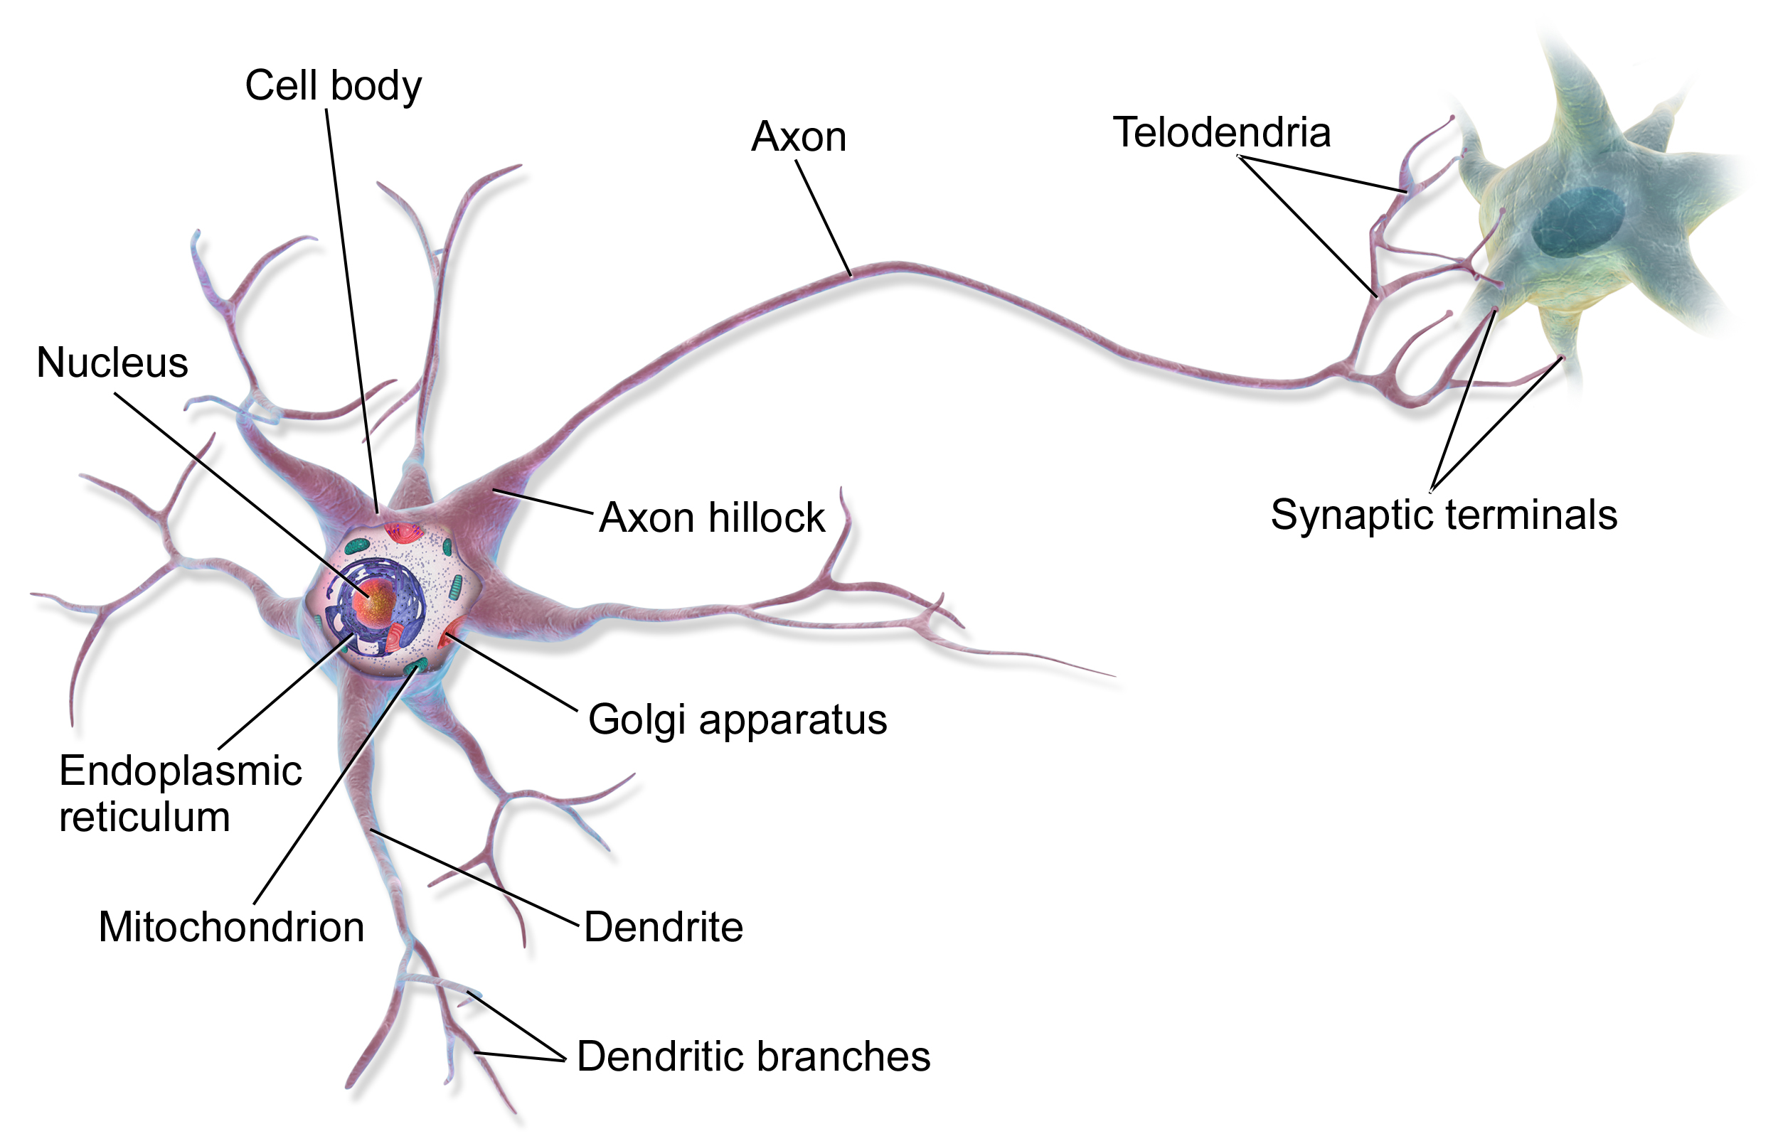
Biological Neurons
A biological neuron is composed of
a cell-body (contains nucleus)
many branches called dendrites
a long extension called the axon
The axon can be tens of thousands of times longer than the cell body.
Axon splits into telodendria, at the tip of the branches are synaptic terminals (synapses) connected to the dendrites of other neurons.
Produce electrical impulses called action potentials (signals)
These signals travel along the axon and make synapses release chemical signals called neurotransmitters.
When a neuron receives a sufficient amount of neurotransmitters in given short period of time it fires its own electrical impulse. (Some neurotransmitters impeded the signal).

Slide 7
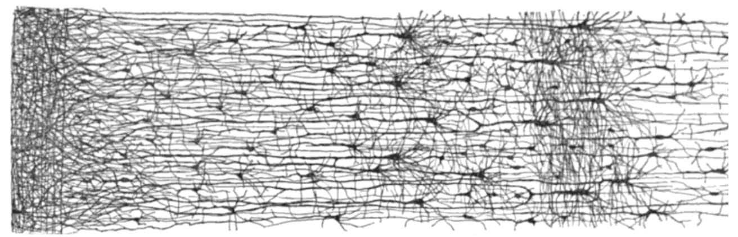
Biological Neurons
Individual neurons behavior in a somewhat simple way
But organized in a network of billions in multiple layers.
Each neuron is connected to thousands of other neurons.
Humans have 86 Billion neurons
African Elephant has 257 billion
Pilot whale has 128 billion
Chimpanzee has 28 billion
Dogs have around 2 billion
Cats have about 760 million
Painted turtle has 12 million
Ant has 250 thousand

Slide 8
ANN Model
Early model was very simple
It has one or more binary (on/off)
A single binary output
The neuron activates when more than a certain number of its inputs are active.
Neurons can impede consumer as well
Using this simple model we can build a network of any logical proposition.

Slide 9
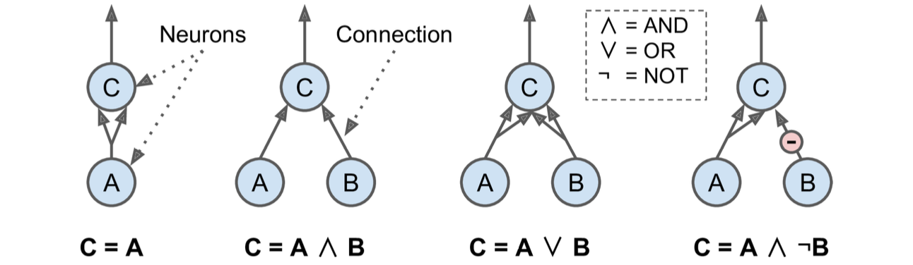
Calculus of ANNs
First is the identity function: If neuron A is activated then neuron C gets activated as well.
Conjunction (AND): C is only on if A and B are both on.
Disjunction (OR): Neuron C is activated if either A or B are activated (or both).
A and ~B: Only if A is activated and not B is activated (assuming B can impede).
These can be combined to create complex logical expressions.

Slide 10
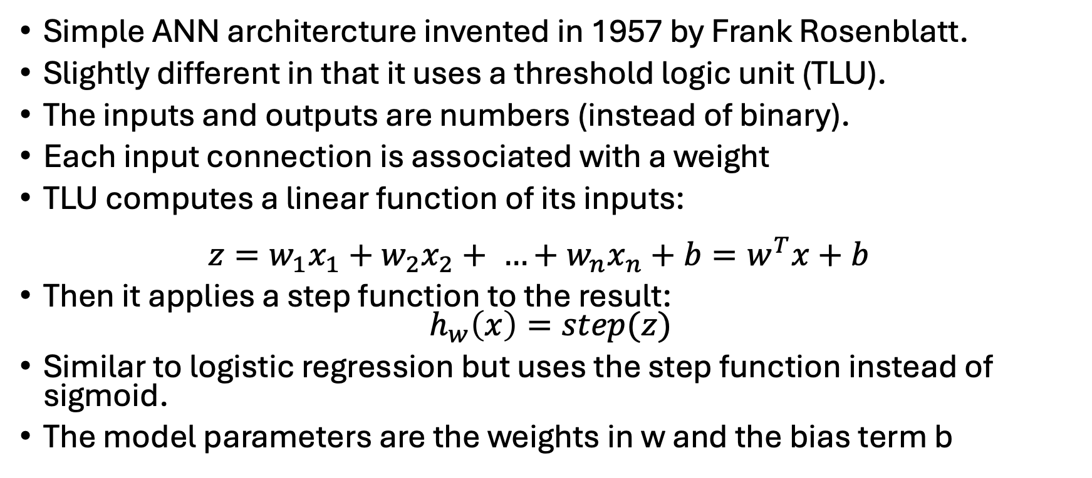
Perceptron
Simple ANN architercture invented in 1957 by Frank Rosenblatt.
Slightly different in that it uses a threshold logic unit (TLU).
The inputs and outputs are numbers (instead of binary).
Each input connection is associated with a weight
TLU computes a linear function of its inputs: $z=w_{1}x_{1}+w_{2}x_{2}+ …+w_{n}x_{n}+b=w^{T}x+b$
Then it applies a step function to the result: $h_{w}\left(x\right)=step(z)$
Similar to logistic regression but uses the step function instead of sigmoid.
The model parameters are the weights in w and the bias term b

Slide 11
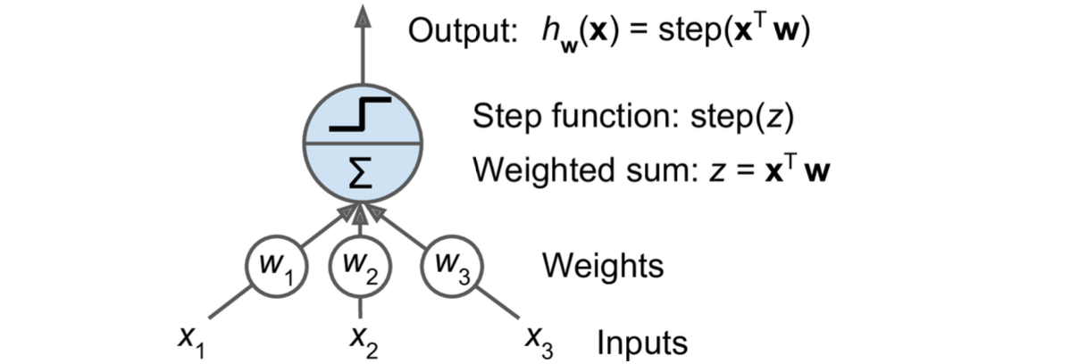
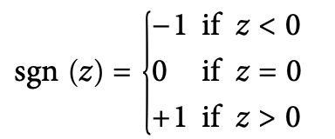
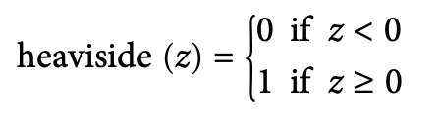
Perceptron
Most common step function is the Heaviside step and sign functions

Slide 12
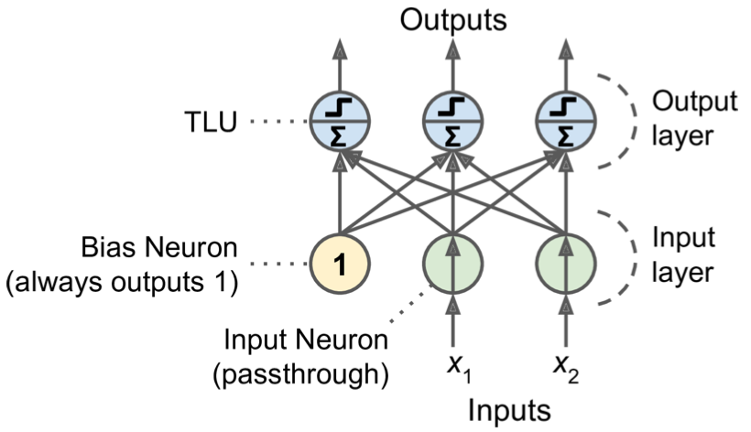
TLU
A single TLU can be used for simple linear binary classification.
It computes a linear function of its inputs and can emit a 1 (positive label) / -1 (negative label)
A perceptron is composed of one of more TLUs in a single layer where every TLU is connected to every input. (Fully-connected)
Inputs are in the input layer.
Outputs rare in the output layer
Perceptron has 2 inputs and 3 outputs.
Can classify 2D data into three classes (multi-label)

Slide 13

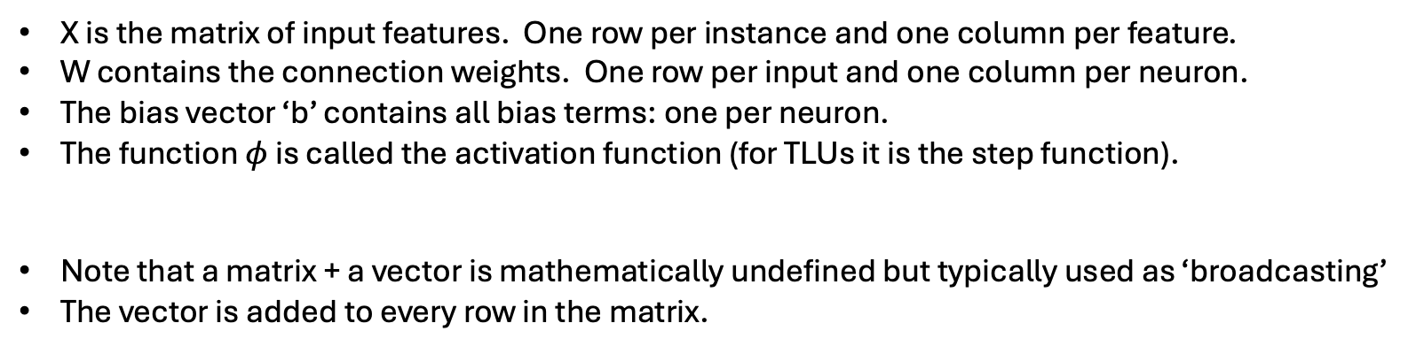
Computing Outputs
X is the matrix of input features. One row per instance and one column per feature.
W contains the connection weights. One row per input and one column per neuron.
The bias vector ‘b’ contains all bias terms: one per neuron.
The function $φ$ is called the activation function (for TLUs it is the step function).
Note that a matrix + a vector is mathematically undefined but typically used as ‘broadcasting’
The vector is added to every row in the matrix.

Slide 14

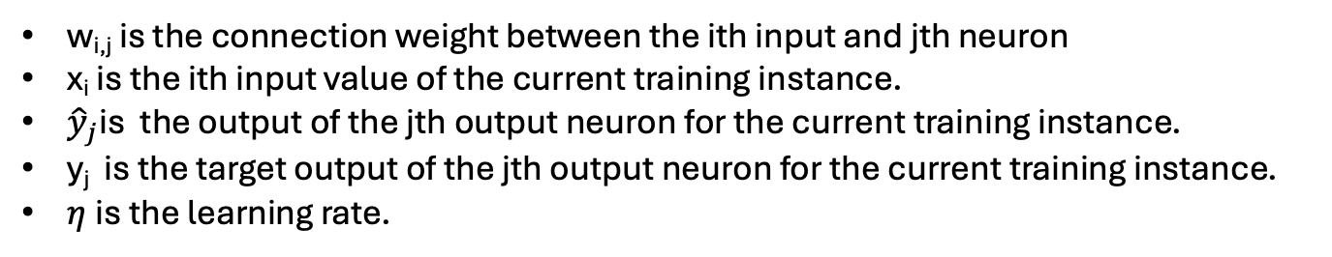
Hebbs Rule
When one biological neuron triggers another the connection between these two neurons becomes stronger.
“Cells that fire together, wire together”
Perceptrons use a variant of this, for every output neuron that produced a wrong prediction it reinforces the connection weights from the inputs that would have contributed to the correct prediction:
w_{i,j} is the connection weight between the ith input and jth neuron
x_{i} is the ith input value of the current training instance.
${\hat{y}}_{j}$is the output of the jth output neuron for the current training instance.
y_{j} is the target output of the jth output neuron for the current training instance.
$η$is the learning rate.

Slide 15
Hebbs Rule
Is shown to converge when the training instances are linearly separable.
Is very similar to stochastic gradient descent.
Was demonstrated it is incapable of solving the XOR classification problem (which any truly linear classifier is also incapable of solving).
This led to decades where ANN research was not heavily funded.

Slide 16
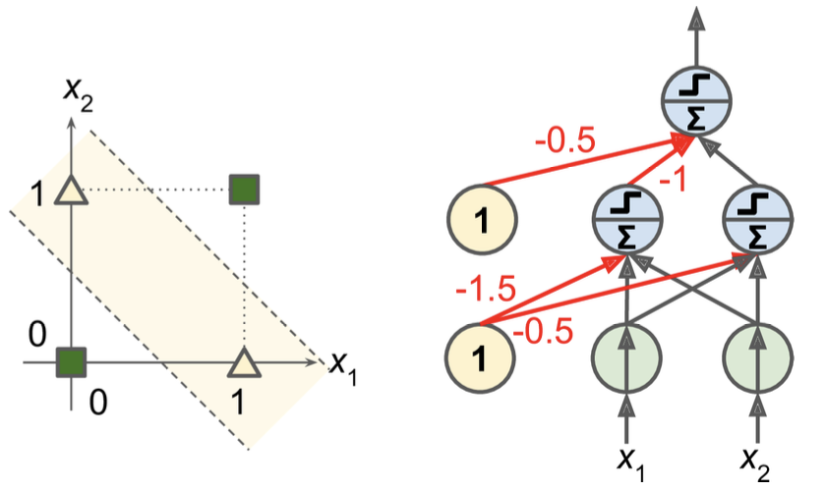
Multilayer Perceptron
You can stack multiple perceptrons into a MLP.
An MLP can solve the XOR problem

Slide 17
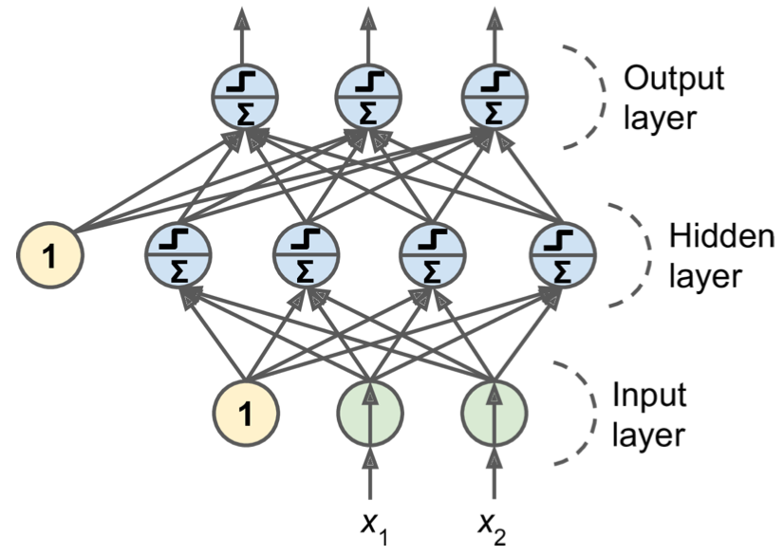
MLPs
An MLP is composed of:
one input layer
one or more layers of TLUs, called hidden layers
one final layer of TLUs, called the output layer
The layers close to the input layer are usually called the lower layers, and the ones close to the outputs are usually called the upper layers.
Every layer except the output layer includes a bias neuron and is fully connected to the next layer.
Signals flow in only one direction (feedforward neural network).
When there are many hidden layers, it is called a Deep neural network (DNN)

Slide 18
Training MLPs
In 1970 Seppo Linnainmaa created the algorithm reverse-mode automatic differentiation.
In two passes through the network (one forward, one backwards) it is able to compute the gradients of the NN error with regard to a ALL model parameters.
These gradients can be used in a gradient descent step.
Combining this gradient step and reverse-mode algorithm gives us backpropagation.
Wasn’t applied to NN until 1985!

Slide 19
Back propagation Forward Pass
Takes a mini-batch at a time, but goes through full training set multiple times. Each pass through full training set is an epoch.
Each mini-batch enters the network through the input layer.
Then passed to first hidden layer, and the next layer and so on.
Algorithm computes the output of every instance in the minibatch.
This is the forward pass. Records all intermediary computations.
This is the same way that predictions are made (except we don’t need to record intermediate values)

Slide 20
Backpropagation Backward pass
The algorithm measures the networks output error.
Computes how much each output bias and each connection ot the output layer contributed to the error.
This is done via the chain rule from calculus.
Then it measures how much of these error contrbituions came from the layer below again using the chain rule, working backwards until it reaches the input layer.
Finally, the gradient descent step is used to tweak all of the connection weights in the network using the error gradients it just computed.

Slide 21


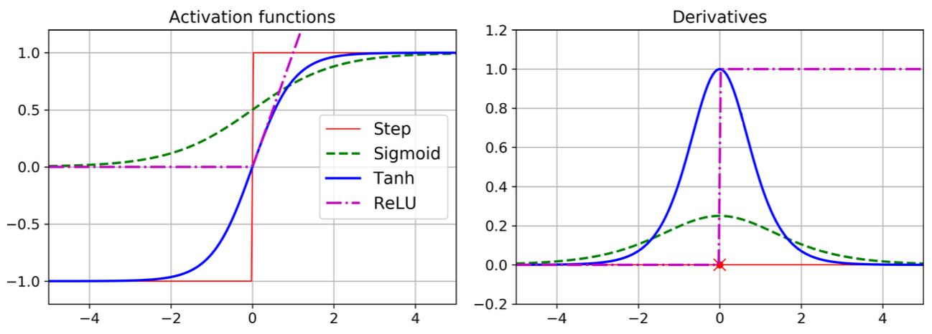
Back Propagation
Hidden layers connection weights have to be initialized randomly.
Step function must be replaced with the logistic function (sigmoid).
Step function has no gradients (for gradient descent).
Many popular activation functions:
tanh (hyperbolic tangent function):
ReLU (rectified linear unit):

Slide 22
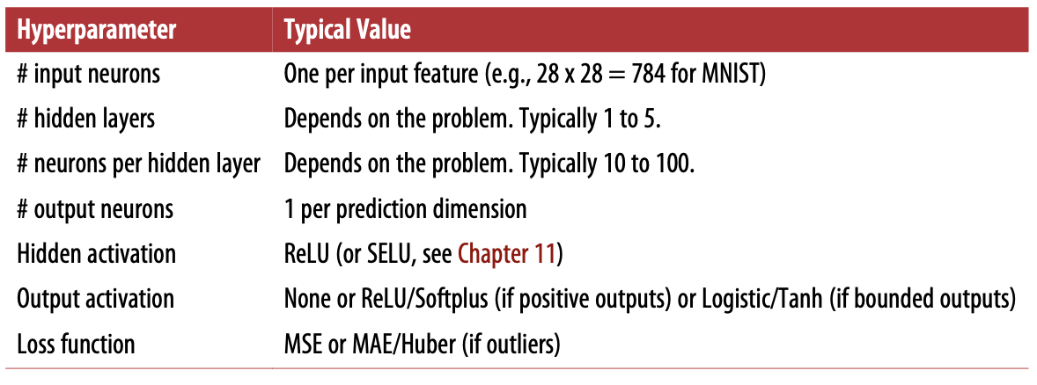
NN for Regression
You need one output neuron per prediction. For example, to locate the center of an object on an image, you need to predict 2D coordinates, so you need two output neurons. If you also want to place a bounding box around the object, then you need two more numbers: the width and the height of the object.
Do not want to use any activation function for the output neurons, unless you want to guarantee that the output will always be positive, then you can use the ReLU activation function, or the softplus activation function in the output layer.
To guarantee that the predictions will fall within a given range of values, then use the logistic function or the hyperbolic tangent, and scale the labels to the appropriate range: 0 to 1 for the logistic function, or –1 to 1 for the hyperbolic tangent.
Regression typically uses mean squared error, but if you have a lot of outliers in the training set, you may prefer to use the mean absolute error instead. Alternatively, you can use the Huber loss, which is a combination of both.

Slide 23
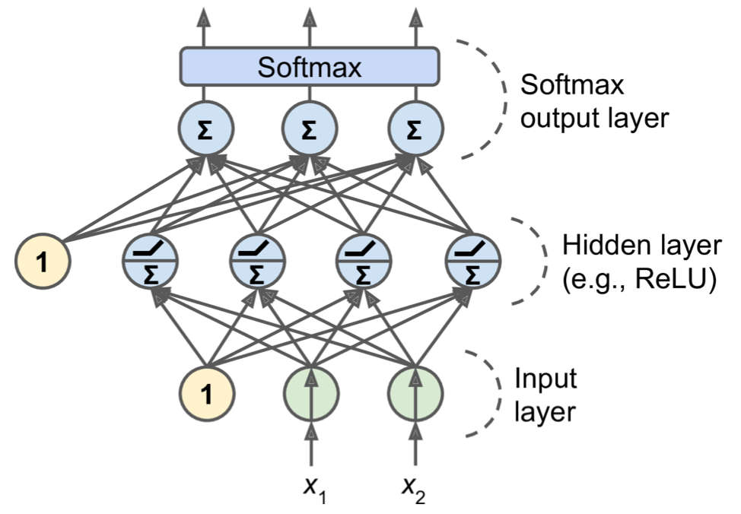
NN for Classification
Binary Classification: You just need a single output neuron using the logistic activation function: the output will be a number between 0 and 1
Multi-label Classification: One output neuron for each positive class. Note that the output probabilities do not necessarily add up to one.
Multi-class: each instance can belong only to a single class, out of 3 or more possible classes (e.g., classes 0 through 9 for digit image classification), then you need to have one output neuron per class, and you should use the softmax activation function for the whole output.
The softmax function will ensure that all the estimated probabilities are between 0 and 1 and that they add up to one (which is required if the classes are exclusive).
Notes:
MLPs can also be used for classification tasks. For a binary classification problem, you just need a single output neuron using the logistic activation function: the output will be a number between 0 and 1, which you can interpret as the estimated probabil‐ ity of the positive class. Obviously, the estimated probability of the negative class is equal to one minus that number.
MLPs can also easily handle multilabel binary classification tasks (see Chapter 3). For example, you could have an email classification system that predicts whether each incoming email is ham or spam, and simultaneously predicts whether it is an urgent nor non-urgent email. In this case, you would need two output neurons, both using the logistic activation function: the first would output the probability that the email is spam and the second would output the probability that it is urgent. More generally, you would dedicate one output neuron for each positive class. Note that the output probabilities do not necessarily add up to one. This lets the model output any combination of labels: you can have non-urgent ham, urgent ham, non-urgent spam, and perhaps even urgent spam (although that would probably be an error).
If each instance can belong only to a single class, out of 3 or more possible classes (e.g., classes 0 through 9 for digit image classification), then you need to have one output neuron per class, and you should use the softmax activation function for the whole output layer (see Figure 10-9). The softmax function (introduced in Chapter 4) will ensure that all the estimated probabilities are between 0 and 1 and that they add up to one (which is required if the classes are exclusive). This is called multiclass clas‐ sification.

Slide 24
Hidden Layers
A single hidden layer can get reasonable results for most problems, given enough neurons.
For complex problems deeper networks have much better parameter efficiency than shallow ones: they can model complex problems with exponentially fewer neurons.
Real world data is often structured hierarchically.
Lower hidden layers model low-level structures (e.g. line segments)
Intermediate hidden layers combine these low-level structures to model intermediate level structures (e.g. circles, squares)
High hidden layers combine intermediate structures to model high-level structures (e.g. faces).

Slide 25
Transfer Learning
This hierarchical natural also improves NN’s ability to generalize to new datasets.
We can kickstart training by reusing the lower layers of an existing network!
Instead of randomly initializing the weights and biases of the first few layers of the new neural network, we can initialize them to the value of the weights and biases of the lower layers of the first network.
This way the network will not have to learn from scratch all the low-level structures that occur in most pictures; it will only have to learn the higher-level structures (e.g., hairstyles).
This is called transfer learning.
Notes:
For example, if you have already trained a model to recognize faces in pictures, and you now want to train a new neural network to recognize hairstyles, then you can kickstart training by reusing the lower layers of the

Slide 26
Neurons per Layer
The number of neurons in the input and output layers is determined by the type of input and output your task requires.
Hidden layers, it used to be a common practice to size them to form a pyramid, with fewer and fewer neurons at each layer the rationale being that many low-level features can coalesce into far fewer high-level features.
The pyramid practice has been largely abandoned now. Using the same number of neurons in all hidden layers performs just as well in most cases, or even better,.
There is just one hyperparameter to tune instead of one per layer
Try increasing the number of neurons gradually until the network starts overfitting.
Notes:
** For example, the MNIST task requires 28 x 28 = 784 input neurons and 10 output neurons.
** For example, a typical neural network for MNIST may have three hidden layers, the first with 300 neurons, the second with 200, and the third with 100.
** For example, all hidden layers could simply have 150 neurons. However, depending on the dataset, it can sometimes help to make the first hidden layer bigger than the others.
In general you will get more bang for the buck by increasing the number of layers than the number of neurons per layer. Unfortunately, as you can see, finding the perfect amount of neurons is still somewhat of a dark art.

Slide 27
Learning Rate
In general, the optimal learning rate is about half of the maximum learning rate (i.e., the learnng rate above which the training algorithm diverges).
A simple approach for tuning the learning rate is to start with a large value that makes the training algorithm diverge, then divide this value by 3 and try again, and repeat until the training algorithm stops diverging.
At that point, you generally won’t be too far from the optimal learning rate. That said, it is sometimes useful .

