Slide 1
IST 707
Week 12

Slide 2
Administrative
Today’s last quiz

Slide 3
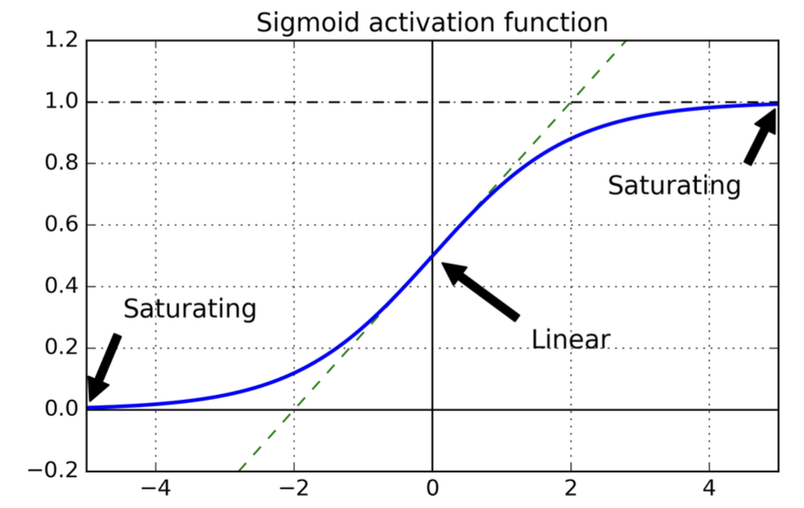
Week 11 Review
Vanishing gradients limit the depth of our networks.
Gradients get smaller as backpropagation progresses back to the earliest layers.
The Gradient Descent update leaves the lower layer connection weights virtually unchanged, and training never converges to a good solution.

Slide 4
Sigmoid Wide Adoption
When Backpropagation came out in the 80’s it led to the wide adoption of Sigma, as it followed the observations in biological neuron activation but was differentiable.

Slide 5
Fast Optimizers

Slide 6
Ways of Speeding up Training
Applying a good initialization strategy for the connection weights
Using a good activation function
Using Batch Normalization
Reusing parts of a pretrained network
We can also revisit the optimizer used in place of Gradient Descent:
Momentum optimization
Nesterov Accelerated Gradient
AdaGrad
RMSProp
Adam and Nadam optimization.

Slide 7
Momentum Optimization
Imagine a bowling ball rolling down a gentle slope on a smooth surface:
it will start out slowly
but it will quickly pick up momentum until it eventually reaches terminal velocity (if there is some friction or air resistance).
This is the very simple idea behind Momentum optimization
Regular Gradient Descent will take small regular steps down the slope, so it will take much more time to reach the bottom.
Recall that Gradient Descent simply updates the weights θ by directly subtracting the gradient of the cost function J(θ) with regards to the weights (∇θJ(θ)) multiplied by the learning rate η.
The gradient update step: : θ ← θ – η ∇θ J(θ)
It does not care about what the earlier gradients were. If the local gradient is tiny, it goes very slowly.

Slide 8
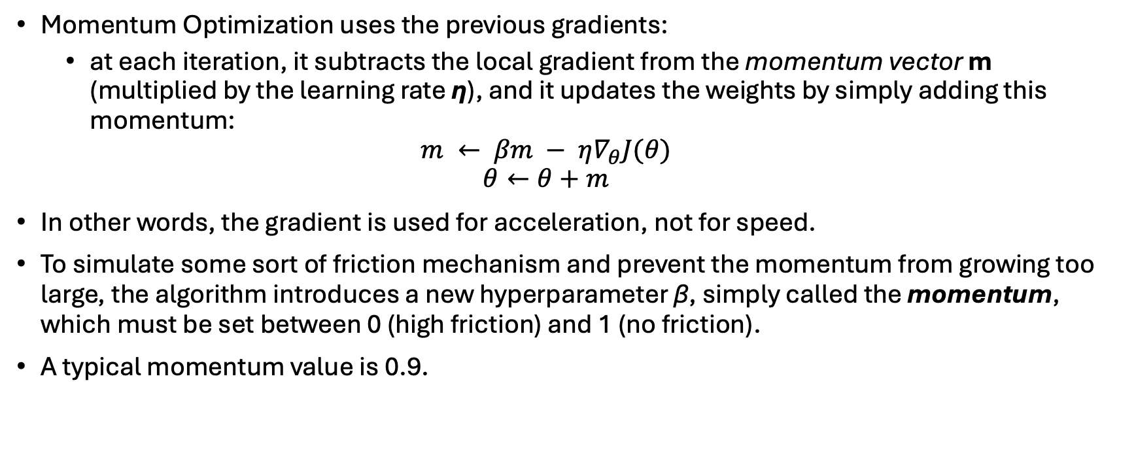
Momentum Optimization
Momentum Optimization uses the previous gradients:
at each iteration, it subtracts the local gradient from the momentum vector m (multiplied by the learning rate η), and it updates the weights by simply adding this momentum:
$$m ← βm − η∇_{θ}J(θ)$$
$$θ←θ+m$$
In other words, the gradient is used for acceleration, not for speed.
To simulate some sort of friction mechanism and prevent the momentum from growing too large, the algorithm introduces a new hyperparameter β, simply called the momentum, which must be set between 0 (high friction) and 1 (no friction).
A typical momentum value is 0.9.

Slide 9
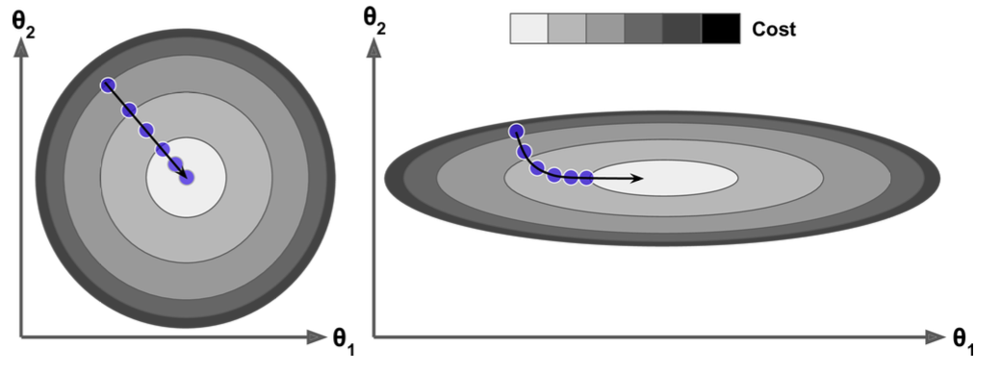
Terminal Velocity
If the gradient remains constant, the terminal velocity (i.e., the maximum size of the weight updates) is equal to that gradient multiplied by the learning rate η multiplied by 1/(1- β).
For example, if β = 0.9, then the terminal velocity is equal to 10 times the gradient times the learning rate.
Momentum optimization ends up going 10 times faster than Gradient Descent!
This allows Momentum optimization to escape from plateaus much faster than Gradient Descent.
When the inputs have very different scales the cost function will look like an elongated bowl).
Gradient Descent goes down the steep slope quite fast, but then it takes a very long time to go down the valley.
In contrast, Momentum optimization will roll down the valley faster and faster until it reaches the bottom (the optimum). In deep neural networks that don’t use Batch Normalization, the upper layers will often end up having inputs with very different scales, so using Momentum optimization helps a lot.
It can help roll past local optima.

Slide 10
Friction
Due to the momentum, the optimizer may overshoot a bit, then come back, overshoot again, and oscillate like this many times before stabilizing at the minimum.
This is one of the reasons why it is good to have a bit of friction in the system: it gets rid of these oscillations and thus speeds up convergence.
To use in Keras use the SGD optimizer and set its momentum hyperparameter:
optimizer = keras.optimizers.SGD(lr=0.001, momentum=0.9)
The one drawback of Momentum optimization is that it adds yet another hyperparameter to tune.
However, the momentum value of 0.9 usually works well in practice and almost always goes faster than regular Gradient Descent.

Slide 11
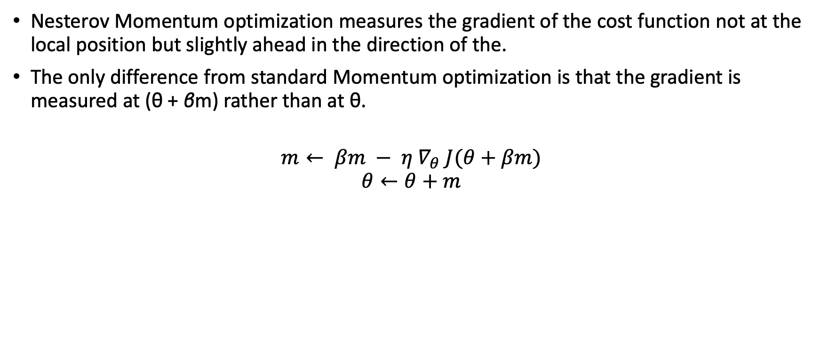
Nesterov Accelerated Gradient
Nesterov Momentum optimization measures the gradient of the cost function not at the local position but slightly ahead in the direction of the.
The only difference from standard Momentum optimization is that the gradient is measured at (θ + βm) rather than at θ.
$$m← βm − η ∇_{θ} J(θ+βm)$$
$$θ←θ+m$$

Slide 12
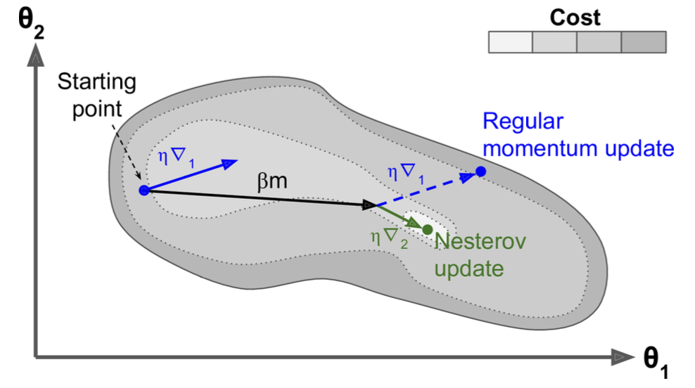
Nesterov Accelerated Gradient
The momentum vector will be pointing in the right direction, its more accurate to use the gradient measured a bit farther in that direction rather than using the gradient at the current position.
This helps reduce oscillations and thus converges faster.
Notes:
as you can see in Figure 11-6 (where ∇1 represents the gradient of the cost function measured at the starting point θ, and ∇2 represents the gradient at the point located at θ + βm). As you can see, the Nesterov update ends up slightly closer to the optimum. After a while, these small improvements add up and NAG ends up being significantly faster than regular Momentum optimization. Moreover, note that when the momentum pushes the weights across a valley, ∇1 continues to push further across the valley, while ∇2 pushes back toward the bottom of the valley. This helps reduce oscillations and thus converges faster.

Slide 13
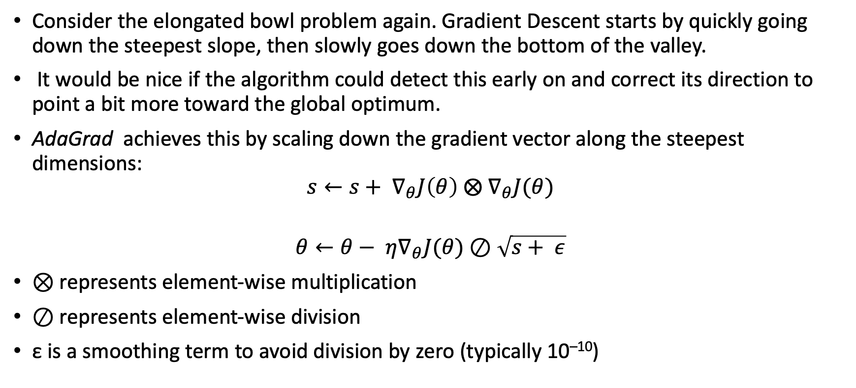
AdaGrad
Consider the elongated bowl problem again. Gradient Descent starts by quickly going down the steepest slope, then slowly goes down the bottom of the valley.
It would be nice if the algorithm could detect this early on and correct its direction to point a bit more toward the global optimum.
AdaGrad achieves this by scaling down the gradient vector along the steepest dimensions:
$$s←s+ ∇_{θ}J\left(θ\right) ⨂{ ∇}_{θ}J(θ)$$
$$θ←θ− η∇_{θ}J(θ)⊘\sqrt{s+ ε}$$
⊗ represents element-wise multiplication
⊘ represents element-wise division
ε is a smoothing term to avoid division by zero (typically 10^{–10})

Slide 14
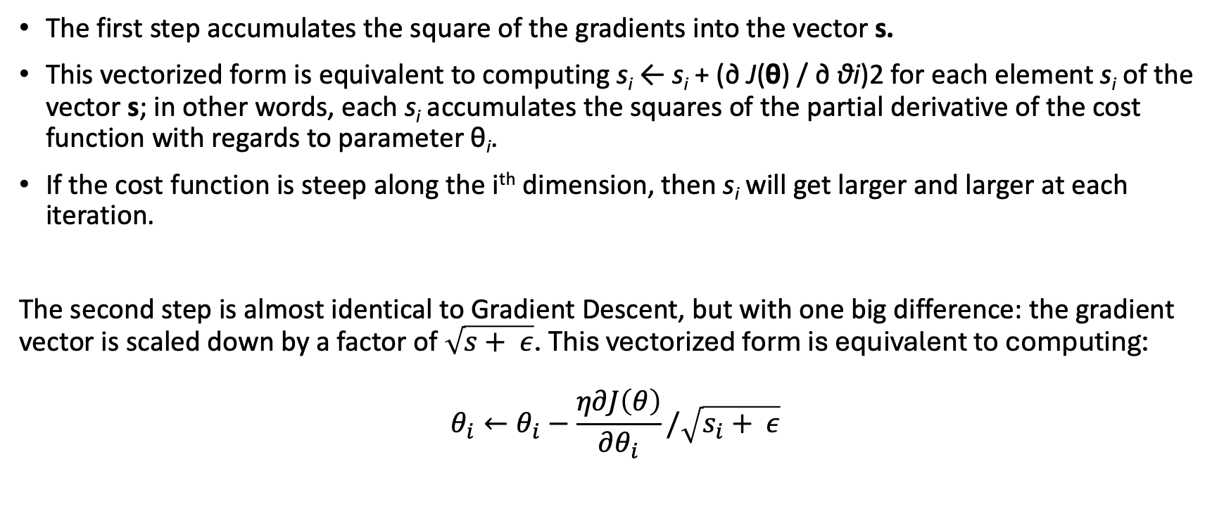
AdaGrad
The first step accumulates the square of the gradients into the vector s.
This vectorized form is equivalent to computing s_{i} ← s_{i} + (∂ J(θ) / ∂ θi)2 for each element s_{i} of the vector s; in other words, each s_{i} accumulates the squares of the partial derivative of the cost function with regards to parameter θ_{i}.
If the cost function is steep along the i^{th} dimension, then s_{i} will get larger and larger at each iteration.
The second step is almost identical to Gradient Descent, but with one big difference: the gradient vector is scaled down by a factor of $\sqrt{s+ ε}$. This vectorized form is equivalent to computing:
$$θ_{i}←θ_{i}−\frac{η∂J\left(θ\right)}{∂θ_{i}}/\sqrt{s_{i}+ ε}$$

Slide 15
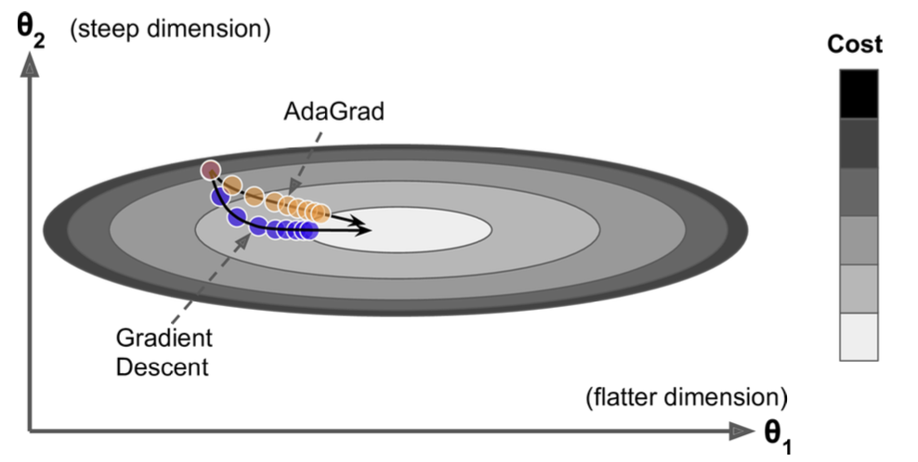
AdaGrad
AdaGrad decays the learning rate, but it does so faster for steep dimensions than for dimensions with gentler slopes.
Performs well for simple quadratic problems.
Often stops too early when training neural networks.
The learning rate gets scaled down so much that the algorithm ends up stopping entirely before reaching the global optimum.
Even though Keras has an AdaGrad optimizer, you should not use it to train deep neural networks
Helpful to grasp the other adaptive learning rate optimizers.
Notes:
In short, this algorithm decays the learning rate, but it does so faster for steep dimen‐ sions than for dimensions with gentler slopes. This is called an adaptive learning rate. It helps point the resulting updates more directly toward the global optimum (see Figure 11-7). One additional benefit is that it requires much less tuning of the learning rate hyperparameter η.
AdaGrad often performs well for simple quadratic problems, but unfortunately it often stops too early when training neural networks. The learning rate gets scaled down so much that the algorithm ends up stopping entirely before reaching the global optimum. So even though Keras has an Adagrad optimizer, you should not use it to train deep neural networks (it may be efficient for simpler tasks such as Linear Regression, though). However, understanding Adagrad is helpful to grasp the other adaptive learning rate optimizers.

Slide 16
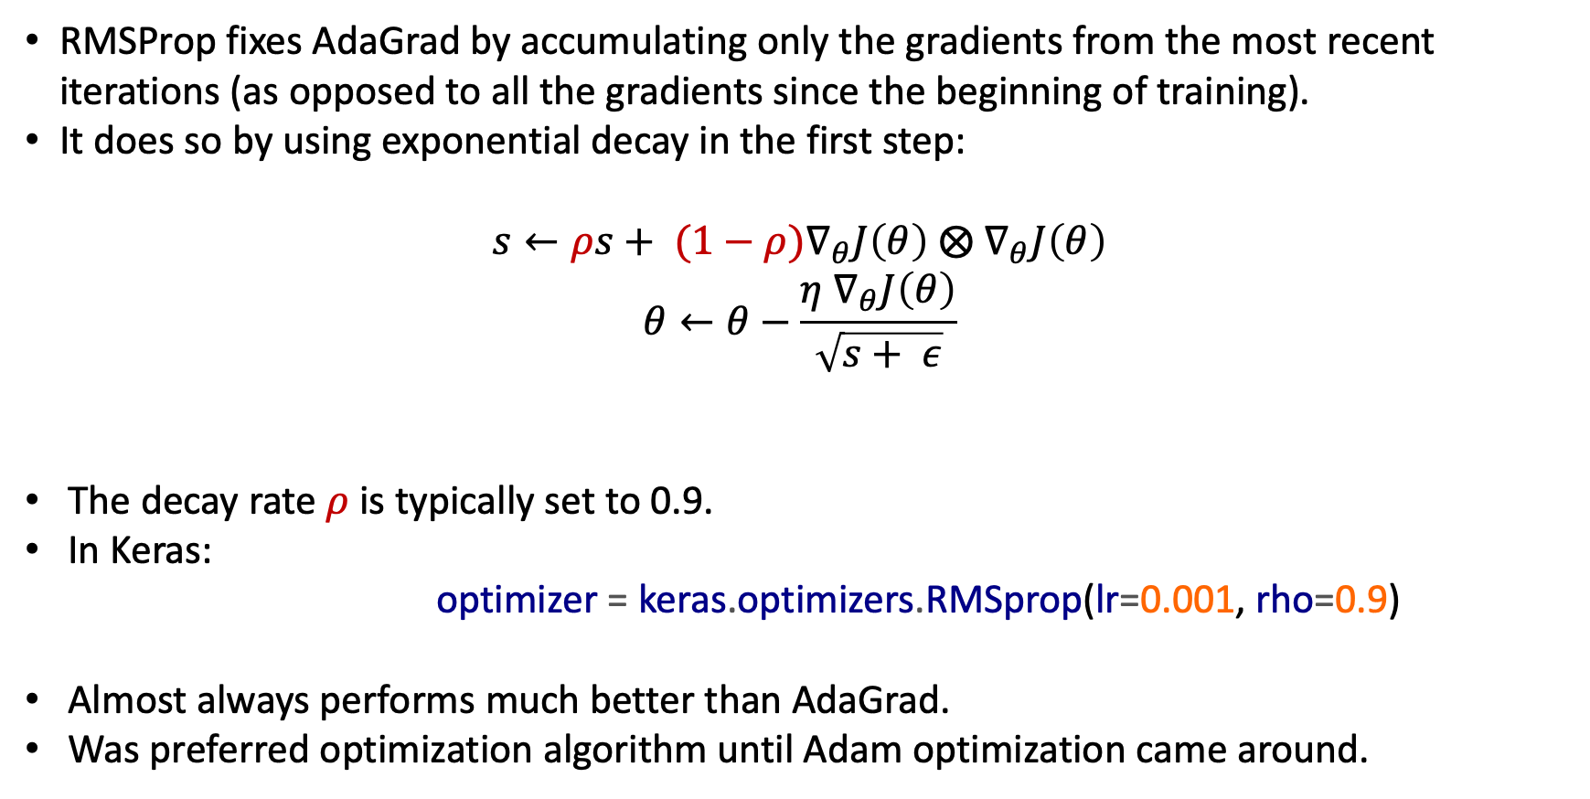
RMSProp
RMSProp fixes AdaGrad by accumulating only the gradients from the most recent iterations (as opposed to all the gradients since the beginning of training).
It does so by using exponential decay in the first step:
$$s←ρs+ {(1−ρ)∇}_{θ}J\left(θ\right) ⨂{ ∇}_{θ}J\left(θ\right)$$
$$θ←θ−\frac{η{ ∇}_{θ}J\left(θ\right)}{\sqrt{s+ ε}}$$
The decay rate $ρ$ is typically set to 0.9.
In Keras: optimizer = keras.optimizers.RMSprop(lr=0.001, rho=0.9)
Almost always performs much better than AdaGrad.
Was preferred optimization algorithm until Adam optimization came around.
Notes:
Another hyperparameter, but default value often works well.

Slide 17
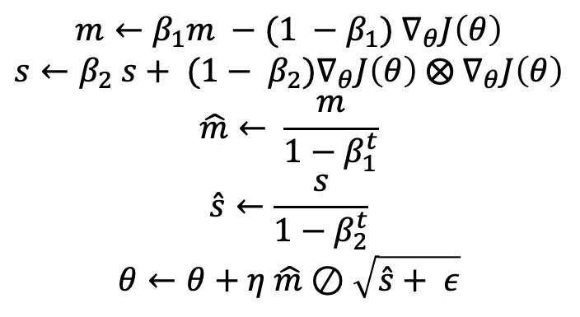
Adam and Nadam Optimization
Adam (adaptive moment estimation), combines the ideas of Momentum optimization and RMSProp.
It keeps track of an exponentially decaying average of past gradients
It keeps track of an exponentially decaying average of past squared gradients
t represents the iteration number (starting at 1).
$$m←β_{1}m −(1 −β_{1}){ ∇}_{θ}J\left(θ\right)$$
$$s←β_{2} s+ {(1− β_{2})∇}_{θ}J\left(θ\right) ⨂{ ∇}_{θ}J\left(θ\right)$$
$$\hat{m}← \frac{m}{1−β_{1}^{t}}$$
$$\hat{s}←\frac{s}{1−β_{2}^{t}}$$
$$θ←θ+η \hat{m}⊘\sqrt{\hat{s}+ ε}$$

Slide 18
Adam
Notice Adam’s close similarity to both Momentum optimization and RMSProp.
The only difference is that step 1 computes an exponentially decaying average rather than an exponentially decaying sum, but these are actually equivalent except for a constant factor (the decaying average is just 1 – β1 times the decaying sum).
Steps 3 and 4 are somewhat of a technical detail: since m and s are initialized at 0, they will be biased toward 0 at the beginning of training, so these two steps will help boost m and s at the beginning of training.
The momentum decay hyperparameter β1 is typically initialized to 0.9.
The scaling decay hyperparameter β2 is often initialized to 0.999.
As earlier, the smoothing term ε is usually initialized to a tiny number such as 10^{–7}.
These are the default values for the Adam class in Keras
optimizer = keras.optimizers.Adam(lr=0.001, beta_1=0.9, beta_2=0.999)

Slide 19
Nadam Optimization
Nadam optimization is simply Adam optimization plus the Nesterov trick.
Nadam generally outperforms Adam but is sometimes outperformed by RMSProp.

Slide 20
Optimization Techniques
All the optimization techniques discussed so far only rely on the first-order partial derivatives (Jacobians).
The optimization literature contains amazing algorithms based on the second-order partial derivatives (the Hessians, which are the partial derivatives of the Jacobians).
Unfortunately, these algorithms are very hard to apply to deep neural networks because there are n² Hessians per output (where n is the number of parameters).
As opposed to just n Jacobians per output. Since DNNs typically have tens of thousands of parameters, the second-order optimization algorithms often don’t even fit in memory, and even when they do, computing the Hessians is just too slow.
All the optimization algorithms just presented produce dense models, meaning that most parameters will be nonzero. If you need a blazingly fast model at runtime, or if you need it to take up less memory, you may prefer to end up with a sparse model instead.
A better option is to apply strong l1 regularization during training, as it pushes the optimizer to zero out as many weights as it can.

Slide 21
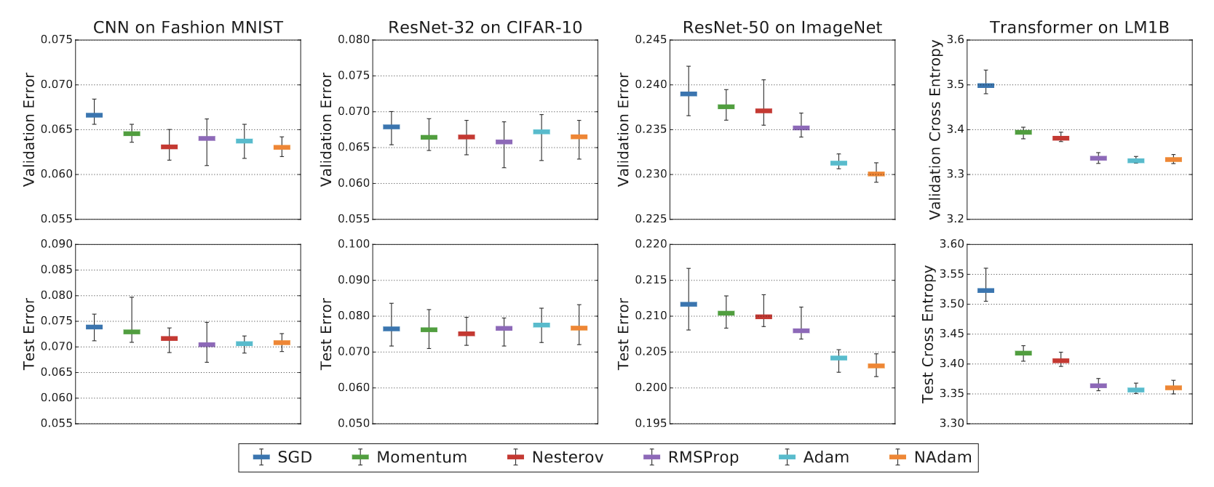
Performance of Optimizers
On Empirical Comparisons of Optimizers for Deep Learning

Slide 22
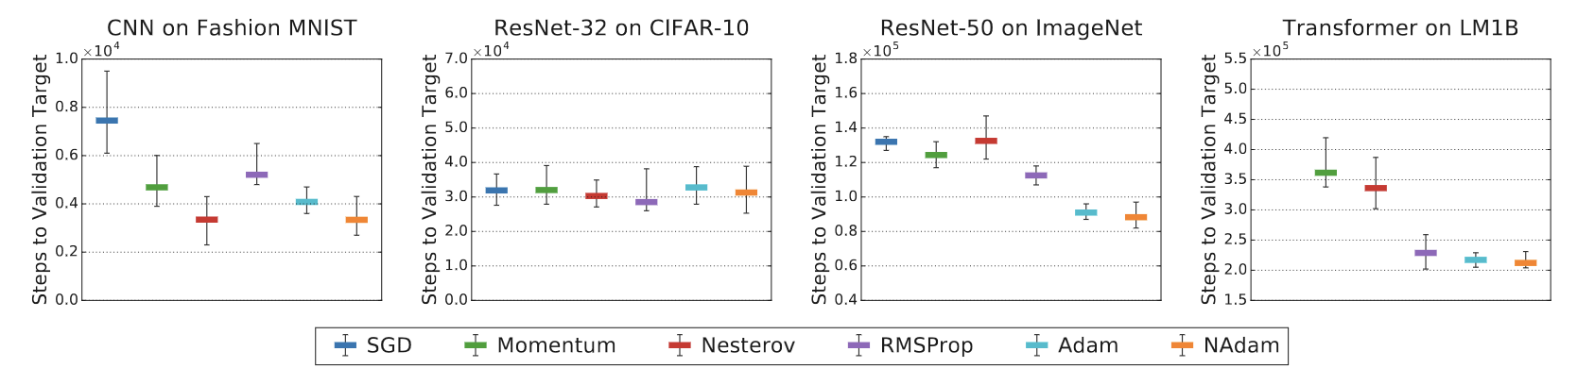
Speed of Algorithms

Slide 23
Learning Schedules

Slide 24
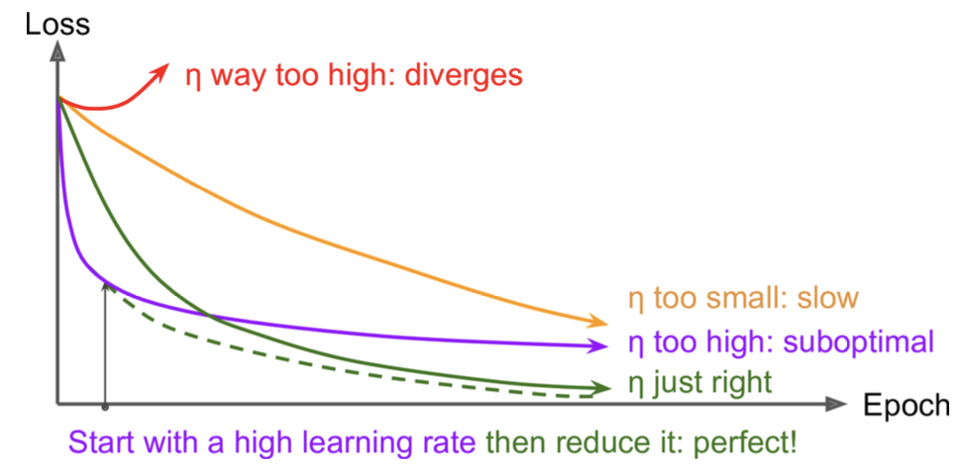
Learning Rate Scheduling
Finding a good learning rate can be tricky.
If you set it way too high, training may diverge.
If you set it too low, training will eventually converge to the optimum, but it will take a very long time.
If you set it slightly too high, it will make progress very quickly at first, but it will end up dancing around the optimum, never really settling down.
If you have a limited computing budget, you may have to interrupt training before it has converged properly, yielding a suboptimal solution.

Slide 25
Learning Rate Scheduling
One approach is to start with a large learning rate and divide it by 3 until the training algorithm stops diverging. You will not be too far from the optimal learning rate, which will learn quickly and converge to good solution.
Can do better than a constant learning rate: if you start with a high learning rate and then reduce it once it stops making fast progress, you can reach a good solution faster than with the optimal constant learning rate.
There are many different strategies to reduce the learning rate during training. These strategies are called learning schedules, the most common of which are:
Power scheduling
Exponential scheduling
Piecewise constant scheduling
Performance scheduling

Slide 26
Power Scheduling
Set the learning rate to a function of the iteration number t: η(t) = η₀ / (1 + t/k)^{c}.
The initial learning rate η₀, the power c (typically set to 1) and the steps s are hyperparameters.
The learning rate drops at each step, and after s steps it is down to η₀ / 2.
After s more steps, it is down to η₀ / 3.
Then down to η₀ / 4, then η₀ / 5, and so on.
This schedule first drops quickly, then more and more slowly.

Slide 27
Exponential Scheduling
Set the learning rate to: η(t) = η₀ 0.1^{t/s}.
The learning rate will gradually drop by a factor of 10 every s steps.
While power scheduling reduces the learning rate more and more slowly, exponential scheduling keeps slashing it by a factor of 10 every s steps.

Slide 28
Piecewise constant scheduling
Use a constant learning rate for a number of epochs (e.g., η₀ = 0.1 for 5 epochs), then a smaller learning rate for another number of epochs (e.g., η₁ = 0.001 for 50 epochs), and so on.
Although this solution can work very well, it requires fiddling around to figure out the right sequence of learning rates, and how long to use each of them.

Slide 29
Performance scheduling
Measure the validation error every N steps (just like for early stopping) and reduce the learning rate by a factor of λ when the error stops dropping.

