Slide 1
HTTP SERVERS
Adapted from Linux Foundation

Slide 2
7.1 Objective
By the end of this session, you should be able to:
Install and configure an Apache web server supporting:
Default configuration.
IP-based virtual hosts.
Name-based virtual hosts.
Directory-level security.
SSL encryption for a host.

Slide 3
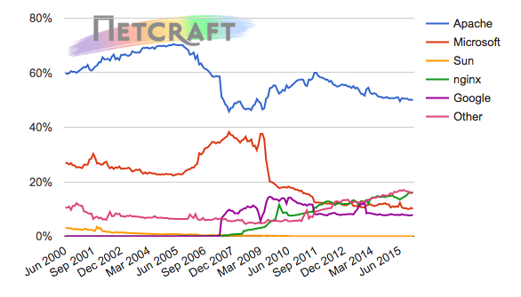
7.2 Apache History
Apache was originally based on the NSCA HTTPd server:
It is the most popular HTTP server today.
It is extensible, using modules.
As you can see in Figure 7.1, the NetCraft January 2016 web server survey shows that Apache runs on nearly 40% of all active web servers. You can learn more about the survey on the Internet: http://news.netcraft.com/archives/2016/01/26/january-2016-web-server-survey.html
Fig. 7.1: Web Server Developers: Market Share of Active Sites (Retrieved from netcraft.com)

Slide 4
7.2.1 Install Apache
Apache is available within Ubuntu's default software repositories, so we will install it using conventional package management tools.
We will begin by updating the local package index to reflect the latest upstream changes. Afterwards, we can install the apache2 package:
• sudo apt-get update
• sudo apt-get install apache2
After confirming the installation, apt-get will install Apache and all required dependencies.

Slide 5
7.2.2 Install Apache
Modify our firewall to allow outside access to the default web ports.
sudo ufw enable
vagrant@vagrant:~$ sudo ufw app list
Available applications:
Apache
Apache Full
Apache Secure
Dovecot IMAP
Dovecot POP3
Dovecot Secure IMAP
Dovecot Secure POP3
OpenSSH
Postfix
Postfix SMTPS
Postfix Submission
We can list the ufw application profiles by typing:
• sudo ufw app list
You should get a listing of the application profiles:

Slide 6
7.2.3 Install Apache
As you can see, there are three profiles available for Apache:
• Apache: This profile opens only port 80 (normal, unencrypted web traffic)
• Apache Full: This profile opens both port 80 (normal, unencrypted web traffic) and port 443 (TLS/SSL encrypted traffic)
• Apache Secure: This profile opens only port 443 (TLS/SSL encrypted traffic)

Slide 7
7.2.4 Install Apache
sudo ufw enable
vagrant@vagrant:~$ sudo ufw status
Status: active
To Action From
-- ------ ----
Apache Full ALLOW Anywhere
22 ALLOW Anywhere
80 ALLOW Anywhere
443 ALLOW Anywhere
Apache Full (v6) ALLOW Anywhere (v6)
22 (v6) ALLOW Anywhere (v6)
80 (v6) ALLOW Anywhere (v6)
443 (v6) ALLOW Anywhere (v6)

Slide 8
7.2.4 Install Apache
sudo ufw enable
For our purposes, we will allow incoming traffic for the Apache Full profile by typing:
• sudo ufw allow 'Apache Full'
You can verify the change by typing:
• sudo ufw status

Slide 9
7.2.5 Install Apache
We can check with the systemd init system to make sure the service is running by typing:
• sudo systemctl status apache2
vagrant@vagrant:~$ sudo systemctl status apache2
● apache2.service - LSB: Apache2 web server
Loaded: loaded (/etc/init.d/apache2; bad; vendor preset: enabled)
Drop-In: /lib/systemd/system/apache2.service.d
└─apache2-systemd.conf
Active: inactive (dead) since Tue 2018-02-27 19:19:48 UTC; 8min ago
Docs: man:systemd-sysv-generator(8)
Process: 13267 ExecStop=/etc/init.d/apache2 stop (code=exited, status=0/SUCCESS)
Process: 16298 ExecReload=/etc/init.d/apache2 reload (code=exited, status=0/SUCCESS)
Process: 1344 ExecStart=/etc/init.d/apache2 start (code=exited, status=0/SUCCESS)
Feb 26 06:25:02 vagrant systemd[1]: Reloading LSB: Apache2 web server.
Feb 26 06:25:02 vagrant apache2[16298]: * Reloading Apache httpd web server apache2
Feb 26 06:25:02 vagrant apache2[16298]: *
Feb 26 06:25:02 vagrant systemd[1]: Reloaded LSB: Apache2 web server.
Feb 27 19:19:47 vagrant systemd[1]: Stopping LSB: Apache2 web server...
Feb 27 19:19:47 vagrant apache2[13267]: * Stopping Apache httpd web server apache2
Feb 27 19:19:48 vagrant apache2[13267]: *
Feb 27 19:19:48 vagrant systemd[1]: Stopped LSB: Apache2 web server.
Warning: Journal has been rotated since unit was started. Log output is incomplete or unavailable.

Slide 10
7.2.6 Install Apache
sudo systemctl stop apache2
sudo systemctl start apache2
sudo systemctl restart apache2
If you are simply making configuration changes:
sudo systemctl reload apache2
By default, Apache is configured to start automatically when the server boots. If this is not what you want, you can disable default config:
sudo systemctl disable apache2
To re-enable the service to start up at boot, you can type:
sudo systemctl enable apache2
Apache should now start automatically when the server boots again.

Slide 11
7.3.1 Main Configuration Files
To access the main configuration file for Apache, which has a simple SGML-like format, use the following:
On CentOS:
/etc/httpd/conf/httpd.conf
On OpenSUSE:
/etc/apache2/httpd.conf
On Ubuntu:
/etc/apache2/apache2.conf
which includes
/etc/apache2/mods-enabled/
/etc/apache2/conf-enabled/
/etc/apache2/sites-enabled/
# /etc/apache2/
# |-- apache2.conf
# | `-- ports.conf
# |-- mods-enabled
# | |-- *.load
# | `-- *.conf
# |-- conf-enabled
# | `-- *.conf
# `-- sites-enabled
# `-- *.conf

Slide 12
7.3.2 Main Configuration Files
Some of the more important configuration options are:
The address and port to serve traffic from:
Listen 12.34.56.78:80
Number of processes to start, maximum number of threads or forks (depending on the MPM module used):
MPM Config
<IfModule prefork.c>
StartServers 8
MinSpareServers 5
MaxSpareServers 20
ServerLimit 256
MaxClients 256
MaxRequestsPerChild 4000
</IfModule>
The location on the filesystem where the served documents reside:
DocumentRoot "/var/www/html"

Slide 13
7.4 Include Configuration Files
To allow for modification and flexibility in the apache configuration file, you can include other files and directories. This allows you to avoid one large configuration file and is useful for servers with multiple sites. Many distributions use this feature to enable or disable web server configurations by installing or removing packages.
The OpenSUSE distribution also allows for easy creation of additional include files and directories. To learn more, check out the /etc/sysconfig/apache2 file.
Some of the default include directories are:
CentOS:
/etc/httpd/conf.d/*.conf
OpenSUSE:
/etc/apache2/conf.d/
Ubuntu:
/etc/apache2/conf-enabled/
/etc/apache2/sites-enabled/
/etc/apache2/sites-available/
charset.conf@ --> /etc/apache2/conf-available/charset.conf
javascript-common.conf@ --> /etc/apache2/conf-available/javascript-common.conf
localized-error-pages.conf@ --> /etc/apache2/conf-available/localized-error-pages.conf
other-vhosts-access-log.conf@ --> /etc/apache2/conf-available/other-vhosts-access-log.conf
security.conf@ --> /etc/apache2/conf-available/security.conf
serve-cgi-bin.conf@ --> /etc/apache2/conf-available/serve-cgi-bin.conf

Slide 14
7.5 Other files
Other important files include the document root, log file locations, and module locations (enabled in the configuration file).
The default document root is:
CentOS:
/var/www/html/
OpenSUSE:
/srv/www/htdocs/
Ubuntu:
/var/www/html/
The default log file location is:
CentOS:
/var/log/httpd/
OpenSUSE:
/var/log/apache2/
Ubuntu:
/var/log/apache2/
To load a module, use the following syntax:
LoadModule alias_module modules/mod_alias.so
access.log
error.log
error.log.1
error.log.2.gz
nbox-ssl_access.log
nbox-ssl_error.log
nbox-ssl_error.log.1
nbox-ssl_error.log.2.gz
other_vhosts_access.log

Slide 15
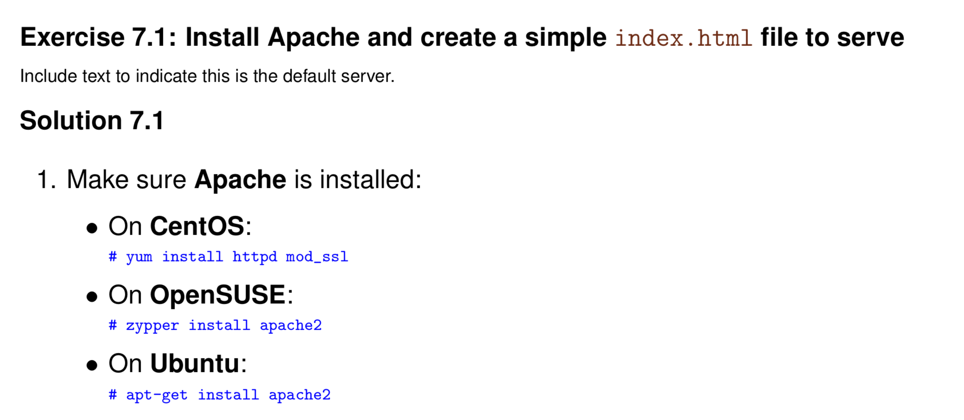

Slide 16
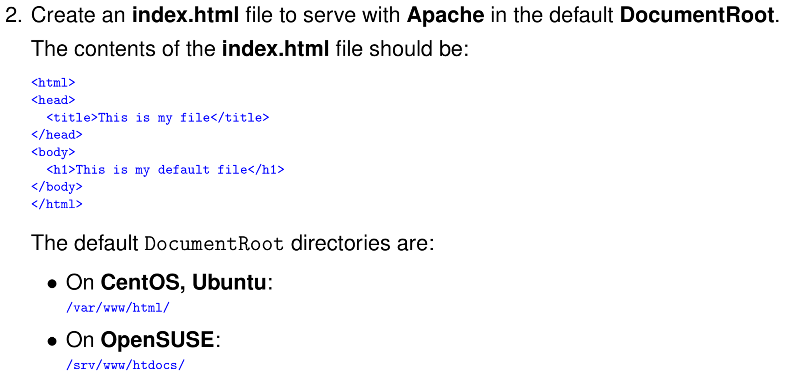

Slide 17
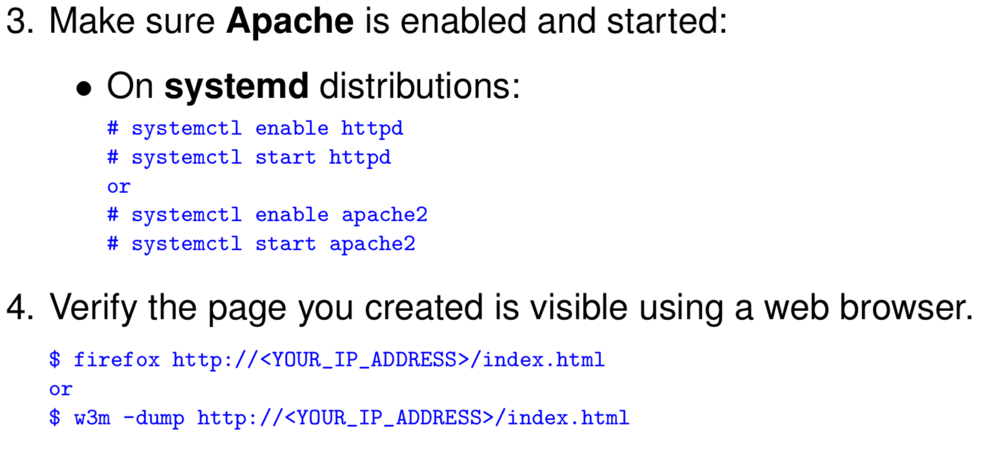

Slide 18
5 Labs in total in later classes
You should now be able to
Install and configure an Apache web server supporting:
- Default configuration.
- IP-based virtual hosts.
- Name-based virtual hosts.
- Directory-level security.
- SSL encryption for a host.

