Slide 1

Progress Report
24/06/26
Alexandre Mendonça

Slide 2
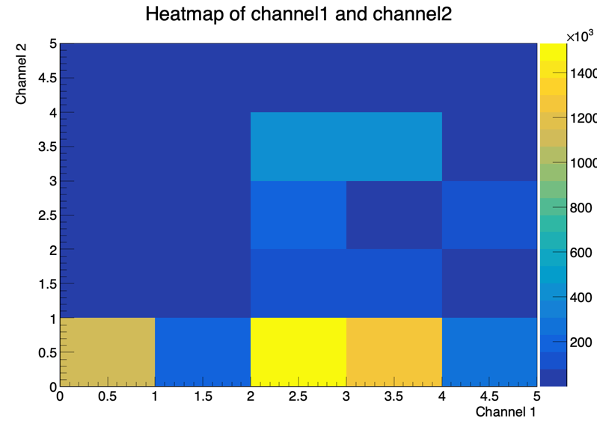
Dataset and Labelling
~5.85M labeled jet splittings from CMS Open Data (pT > 700 GeV);
Two-vertex labels: primary (intermediate parton) and secondary (measured splitting);
1 = g→qq, 2 = q→qg, 3 = g→gg, 4 = rest; unmatched = 0.

Slide 3
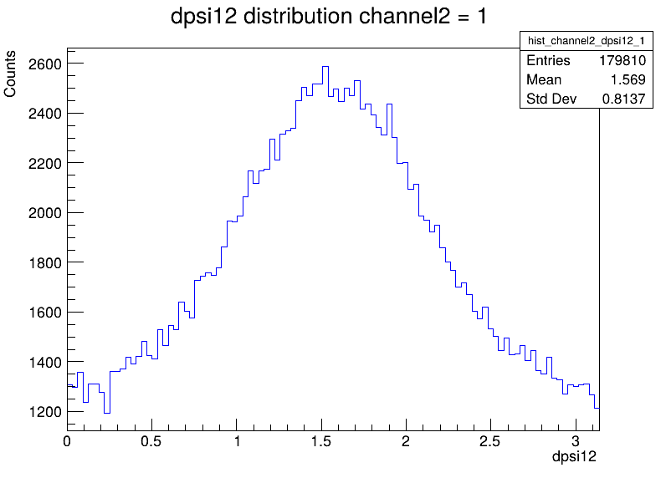
Spin Signal per Channel2
⟨cos2ψ₁₂⟩ measured per secondary channel:
g→qq: −0.167;
q→qg: −0.091;
g→gg: −0.077;
g→qq̄ ψ₁₂ distribution peaks at π/2.

Slide 4
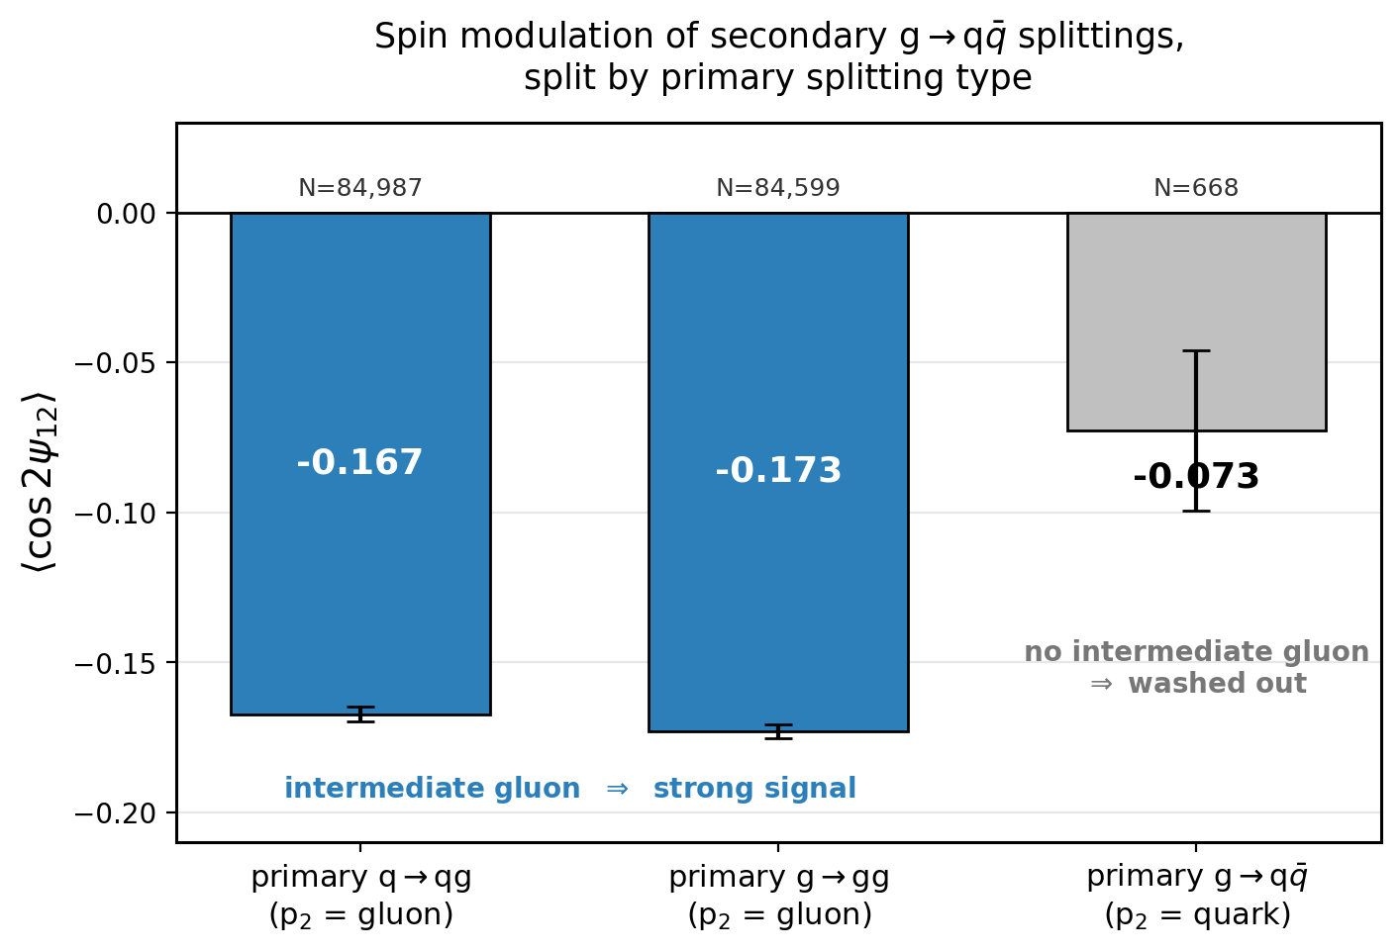
Two-Vertex Structure
Focusing on secondary g→qq split by primary label:
primary q→qg ⟨cos2ψ₁₂⟩: −0.167;
primary g→gg ⟨cos2ψ₁₂⟩: −0.173;
primary g→qq ⟨cos2ψ₁₂⟩ ≈ 0.

Slide 5
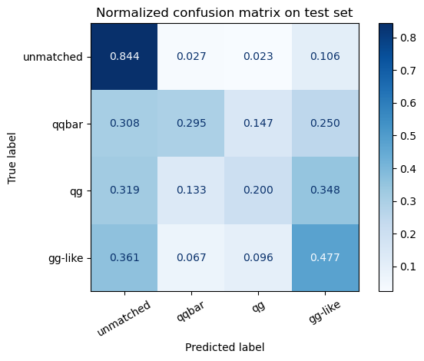
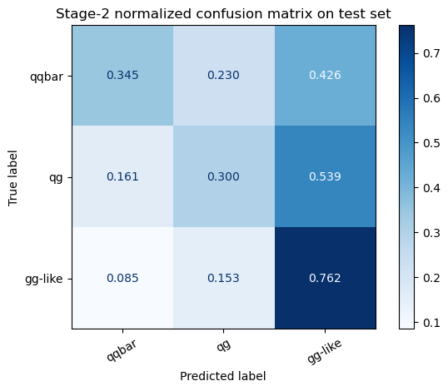
4-Class and 3-Class DNNs
4-class (unmatched/qq̄/qg/gg): test accuracy 0.73 but macro F1 = 0.44 (unmatched dominates);
3-class matched (qq̄/qg/gg): macro F1 = 0.47; qq̄ purity 53% at score ≥ 0.6;
Multi-class diluted by imbalance of classes so we switch to binary.

Slide 6
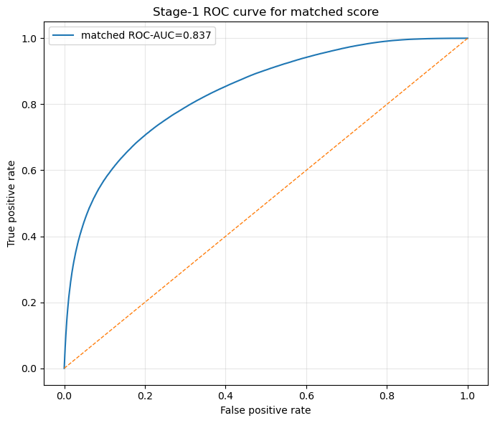
Stage-1: Binary Matched vs Unmatched
Binary filter to remove unmatched jets before channel classification;
Test ROC-AUC = 0.84, PR-AUC = 0.66, macro F1 = 0.74;
Up to 89% matched purity at tight threshold.

Slide 7
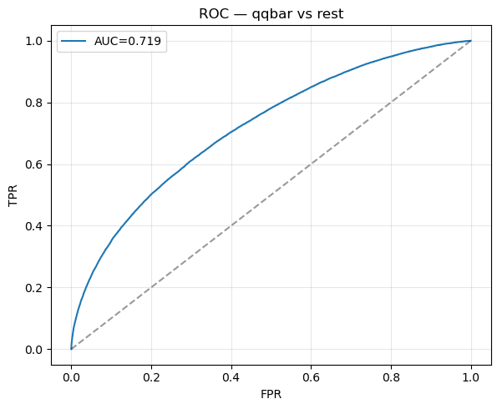
Stage-2: Binary qq vs Rest
Signal = g→qq, background = qg+gg; focal loss, balanced weights;
Test ROC-AUC = 0.72, PR-AUC = 0.32;
AUC saturates ~0.72 even with 5.8M rows meaning physics ceiling and not data-limited.

Slide 8
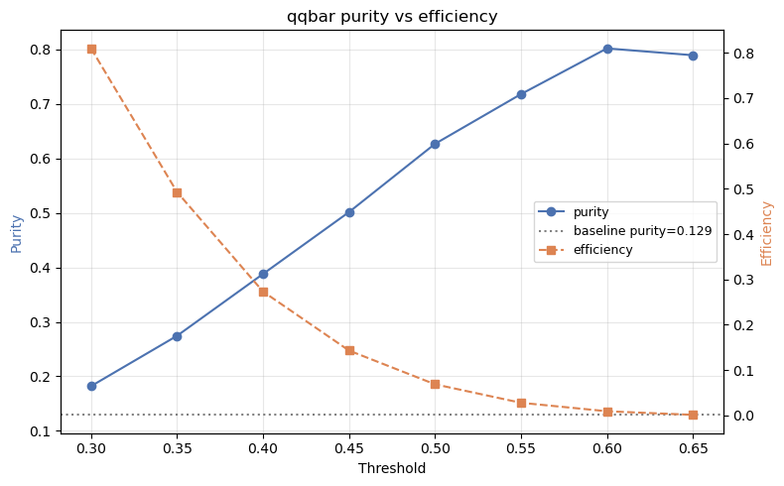
Purity vs Efficiency
Tightening the qq score trades efficiency for purity;
thr 0.45, purity 50%, N=7719;
thr 0.55, purity 72%, N=1043;
thr 0.60, purity 80%, N=303.

Slide 9
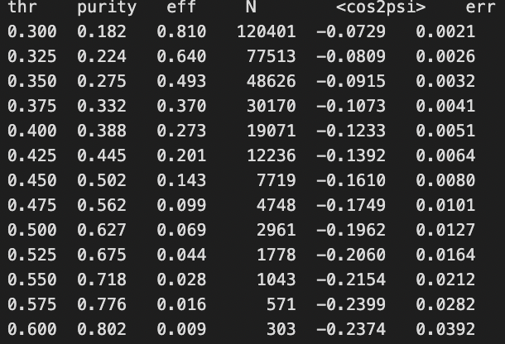
Selection Deepens the Modulation
⟨cos2ψ₁₂⟩ deepens monotonically as qq̄ purity rises;
Background (qg+gg) stays at −0.080.

Slide 10
Conclusions
Pipeline reproduces expected g→qq̄ signal: −0.167, ψ peaks at π/2;
Binary classifier enriches signal: modulation deepens to −0.24 at 80% purity;
AUC ceiling (~0.72) is a physics limit, confirmed by 5.8M-row test;
Limiting factor is statistics in the high-purity tail which motivates more high-pT data;

