Slide 1

Progress Report
08/07/26
Alexandre Mendonça

Slide 2
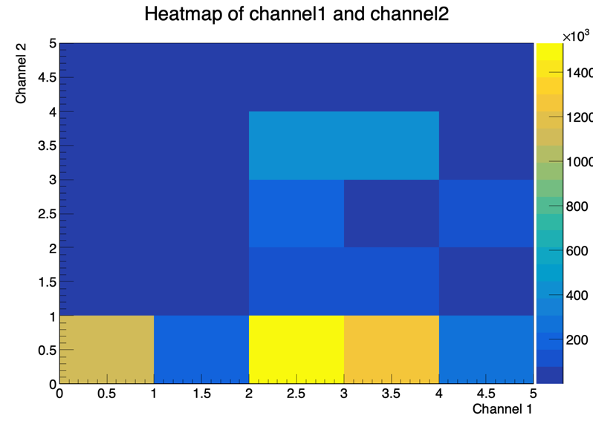
Spin Signal per Channel2 pp 600to800
⟨cos2ψ₁₂⟩ measured per secondary channel:
g→qq: −0.167;
q→qg: −0.091;
g→gg: −0.077;
g→qq̄ ψ₁₂ distribution peaks at π/2.

Slide 3
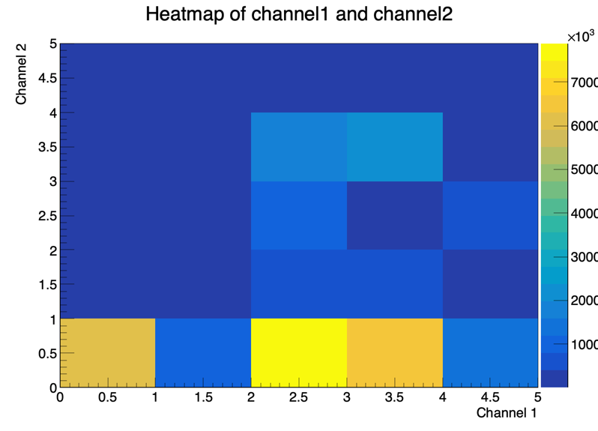
Spin Signal per Channel2 pp 800to1000
⟨cos2ψ₁₂⟩ measured per secondary channel:
g→qq: −0.1731;
q→qg: −0.0861;
g→gg: −0.0701;
g→qq̄ ψ₁₂ distribution peaks at π/2.

Slide 4
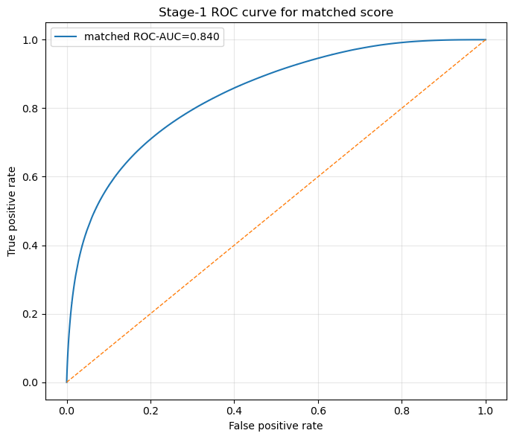
Stage-1: Binary Matched vs Unmatched
Binary filter to remove unmatched jets before channel classification;
Test ROC-AUC = 0.84, PR-AUC = 0.66, macro F1 = 0.743;
Up to 91% matched purity at tight threshold.

Slide 5
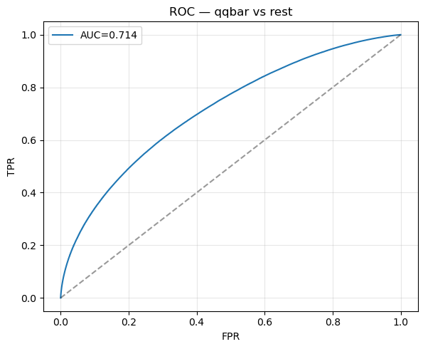
Stage-2: Binary qq vs Rest
Signal = g→qq, background = qg+gg; focal loss, balanced weights;
Test ROC-AUC = 0.714, PR-AUC = 0.314;
AUC saturates ~0.71 even with ~5M rows meaning physics ceiling and not data-limited.

Slide 6
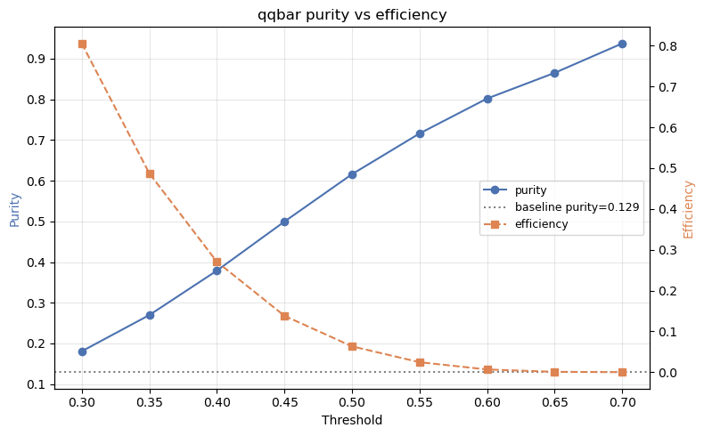
Purity vs Efficiency
Tightening the qq score trades efficiency for purity;
thr 0.45, purity 50%, N=81911;
thr 0.55, purity 72%, N=10111;
thr 0.60, purity 80%, N=2455.

Slide 7
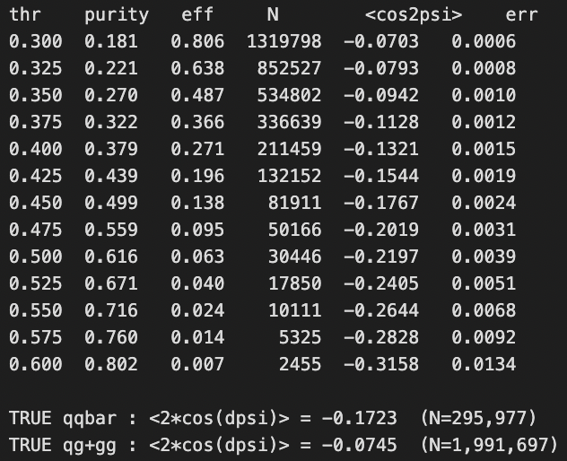
Selection Deepens the Modulation
⟨cos2ψ₁₂⟩ deepens monotonically as qq purity rises;
Background (qg+gg) stays at −0.075.

Slide 8
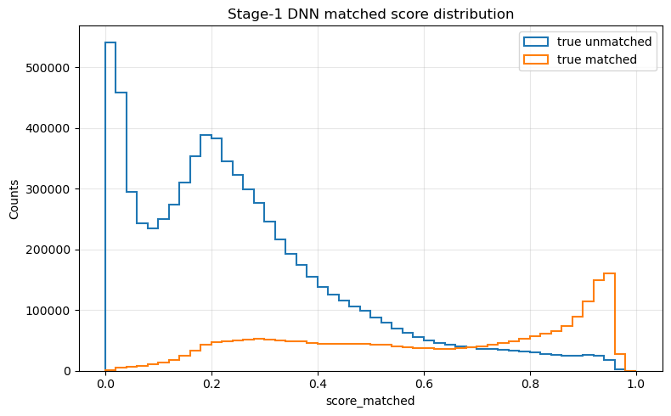
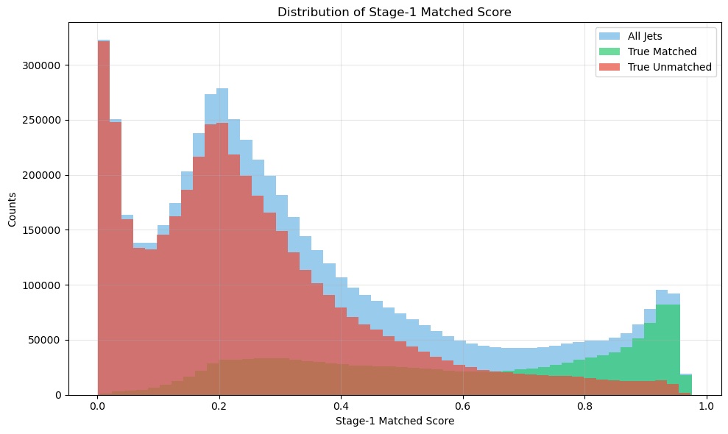
Applying stage-1 on pp-600to800 MC
Stage-1 transfers across pT bins: model trained on 800to1000 works on 600to800;
Clean separation at the extremes: matched jets peak high, unmatched peak low;
Middle overlap sets the purity–efficiency trade-off;
Chose a threshold of 0.85.
Fig 1: Stage-1 DNN on test pp-800to1000 MC
Fig 2: Stage-1 DNN on test pp-600to800 MC

Slide 9
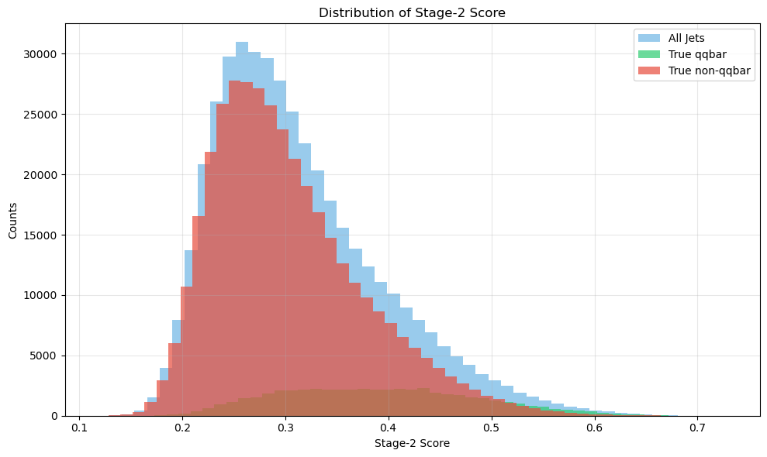
Applying stage-2 on pp-600to800 MC
Stage-2 is much harder than stage-1;
True qq overlaps non-qq almost entirely;
Reflects AUC ~0.72 physics limit.

Slide 10
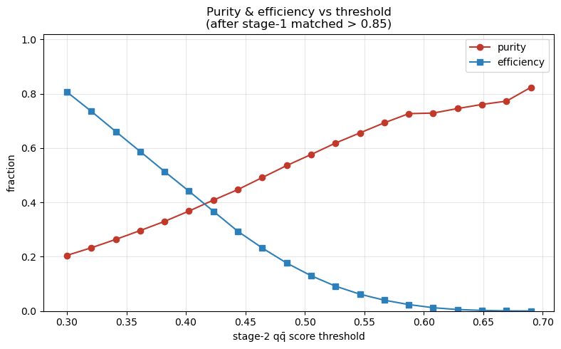
Stage-1 and Stage-2 on pp600to800 MC result
Tightening the cut raises purity (0.2 → 0.82), lowers efficiency;
Purity–efficiency cross near threshold ~0.40;
High purity (>0.8) reachable, but at low efficiency.

Slide 11
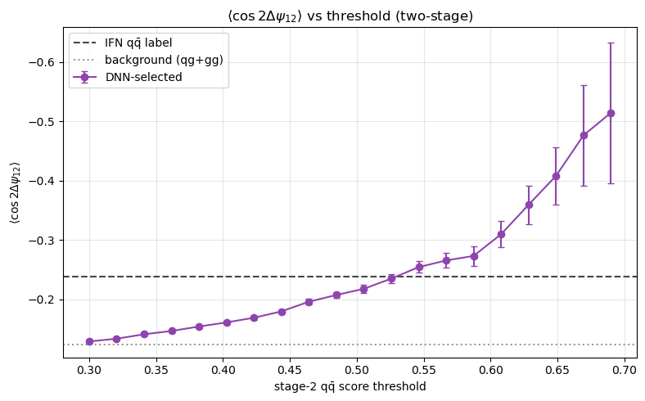
Stage-1 and Stage-2 on pp600to800 MC result
⟨cos2ψ₁₂⟩ deepens monotonically as the qq cut tightens;
Selection surpasses the IFN qq label (with stage-1 threshold >0.85) above threshold ~0.55;
Reaches ~−0.5 at tightest cuts, approaching theory but error bars grow.

Slide 12
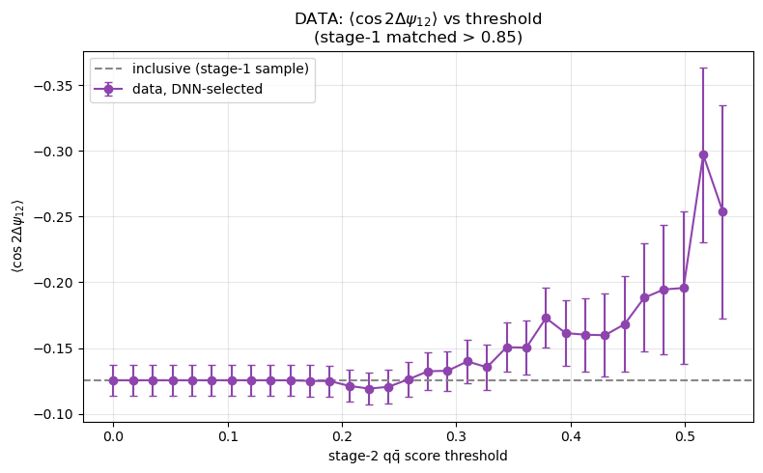
Stage-1 and Stage-2 on pp data
Two-stage selection applied to real pp data;
⟨cos2ψ₁₂⟩ deepens from the inclusive ~−0.125 to ~−0.25 as the cut tightens;
Same enrichment trend as MC.
Evidence the selection works on data, though statistics-limited at high cuts.

Slide 13
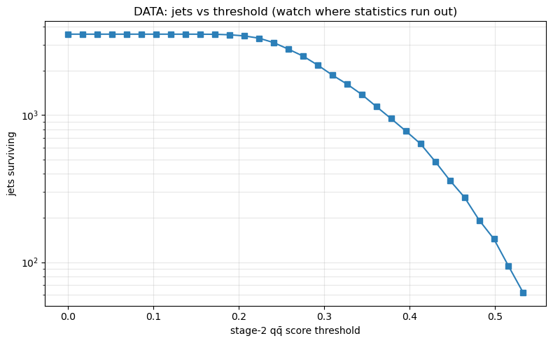
Conclusions
Spin signal validated: g→qq̄ shows a clear negative modulation.
Selection works: the two-stage DNN enriches qq purity and deepens the modulation monotonically with an AUC ceiling ~0.72 that is a physics limit, not a data limit.
Confirmed in real data: the same deepening trend appears in pp collision data, validating the method end-to-end, howver statistics-limited at high purity.

