Slide 1

Progress Report
24/10/25
Alexandre Mendonça

Slide 2
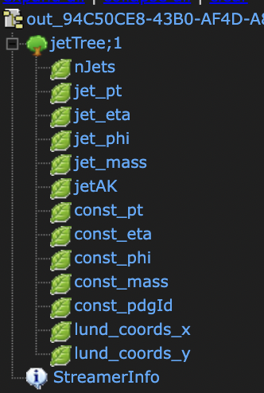
CERN’s Open Data: CMS JetHT MiniAOD 2016
CMS MiniAOD data format contains jet constituents;
In this data (JetHT) selected events contain the presence of a high scalar sum of the jet transverse momenta (HT), or at least one or two energetic jets;
Required using CMS Open data docker container to analyze MiniAOD data;
Made a python2 script able to retrieve required jet and jet’s constituent variables and store them in a .root tree file.

Slide 3
Fastjet and LundPlane
Used Fastjet and LundPlane C++ libraries to perform a recluster of the jet’s constituents;
LundPlane library is based on [1807.04758] The Lund Jet Plane;
About the recluster used C/A algorithm with R = 0.4 or R = 0.8 depending on the labeled jet type in the CMS open data file (ak4 or ak8);
Was able to create a C++ script capable of storing LundPlane variables in the same .root file.
Note: Was able retrieve Lund variables without using LundPlane library.

