Slide 1
Over-the-air update strategies via 5G
Binary Buds
Notes:
gtg

Slide 2
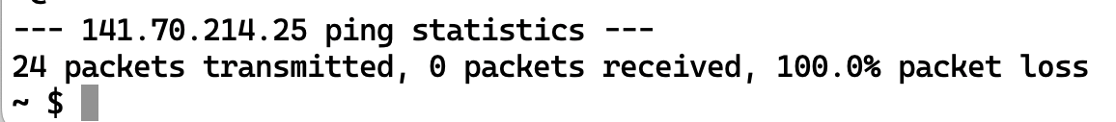
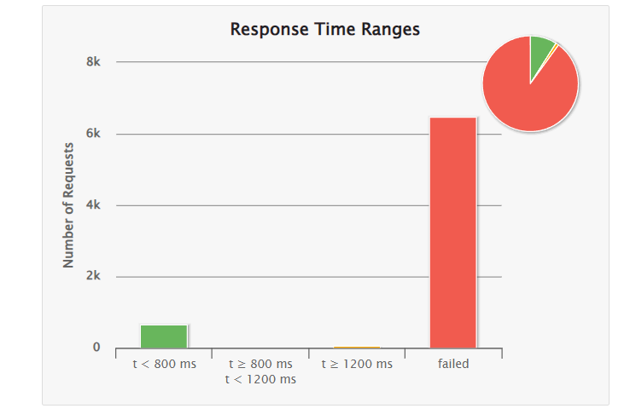

Enganging Introduction!
Notes:
How did we start?
1st we tried to connect the clients in the 5G
What happened? Well we got Errors
(click)
While fixing our errors we were setting up our clients and our server in ordert to start the simulation. Here we run in the next errors,
(Click) - failed packages.
But was is our topic about?

Slide 3


Initital State
Client
Client
Server
Notes:
This work is based on a bachelor thesis of a student.
He deployed some clients and server in the cloud via docker container and made some research about different OTA techniques. He tried to find out about their characteristics, to identify which properties were especially important for updating a car fleet and their QoS aspects.

Slide 4
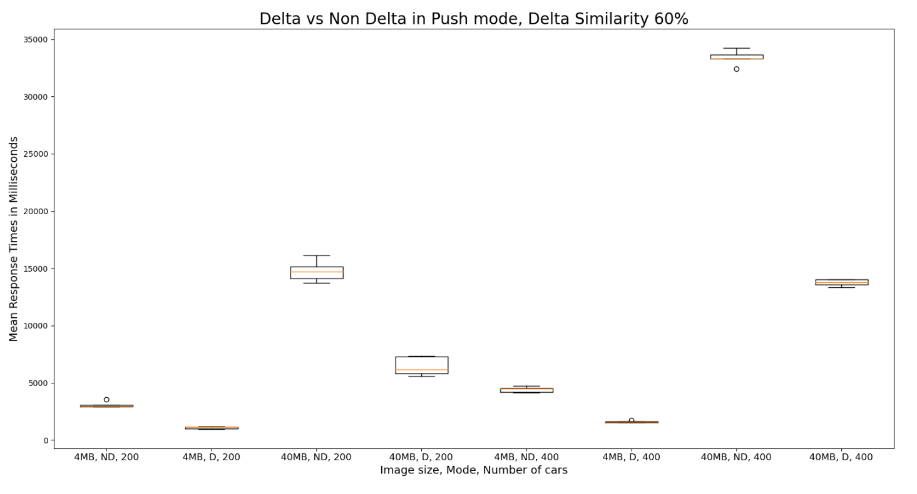
Previous Results
Source: Bachelor Thesis, Measurement-based QoS Trade-off Analysis for Over the Air Software by Ingo Schwendiger 23
Notes:
In his Simulation he compared different approaches and different sizes of updates for the vehicles. As we see in the graphic the approaches differ in the time needed to get the whole update.

Slide 5


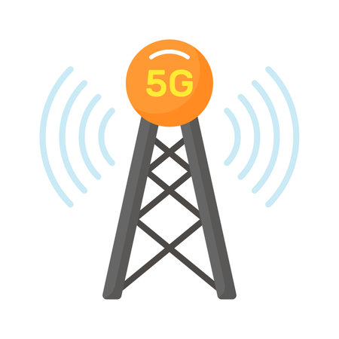
Our Approach
Client
Client
Server
Client
Notes:
In Our Approach we wanted to test out the 5G devices and see what the actual limits of the 5G Network are
What are potential Capacities we can send or with which data chunks sizes should we use to receive the best results

Slide 6
Expectations
Bottlenecks: clients + hardware – not the actual band width
Improve the speed of the connection via 5G

Slide 7
Results

Slide 8
Conclusion
Network did not utilize max. Bandwidth
From 10 Gbit/s we achieved

Slide 9
Questions
What are the actual bottlenecks?
Network?
Hardware?
How much load is in the network?

Slide 10
Future Work
More Clients
Investigating the modules
Real Updates
Create an intuitive UI

Slide 11
e-mail
phone +49 (0) 711 685-
www.
University of Stuttgart

