Slide 1

Kotlin
A modern programming language that makes developers happier

Slide 2
What is Kotlin?
Modern - It combines all the best bits of imperative, object-oriented, and functional programming.
Pragmatic - It combines object-oriented and functional features and is focused on interoperability, safety, clarity, and tooling support.

Slide 3
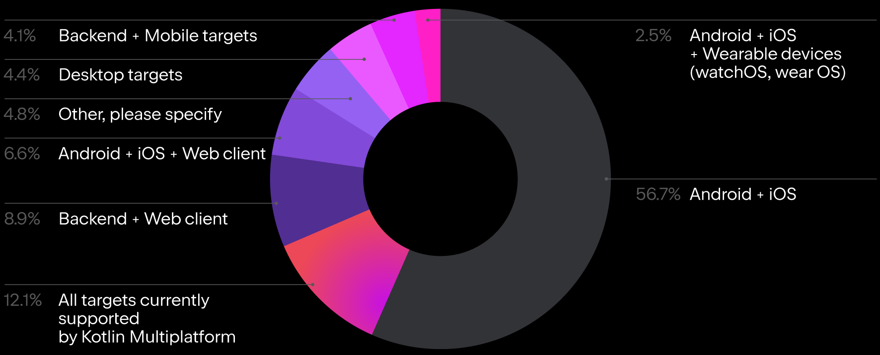
Features of Kotlin
Concise
Interoperable
Open source
Null safety
Familiar Syntax
Data Classes

Slide 4

How is Kotlin better than Java?
Coroutines
Extension Functions
Null Safety

Slide 5
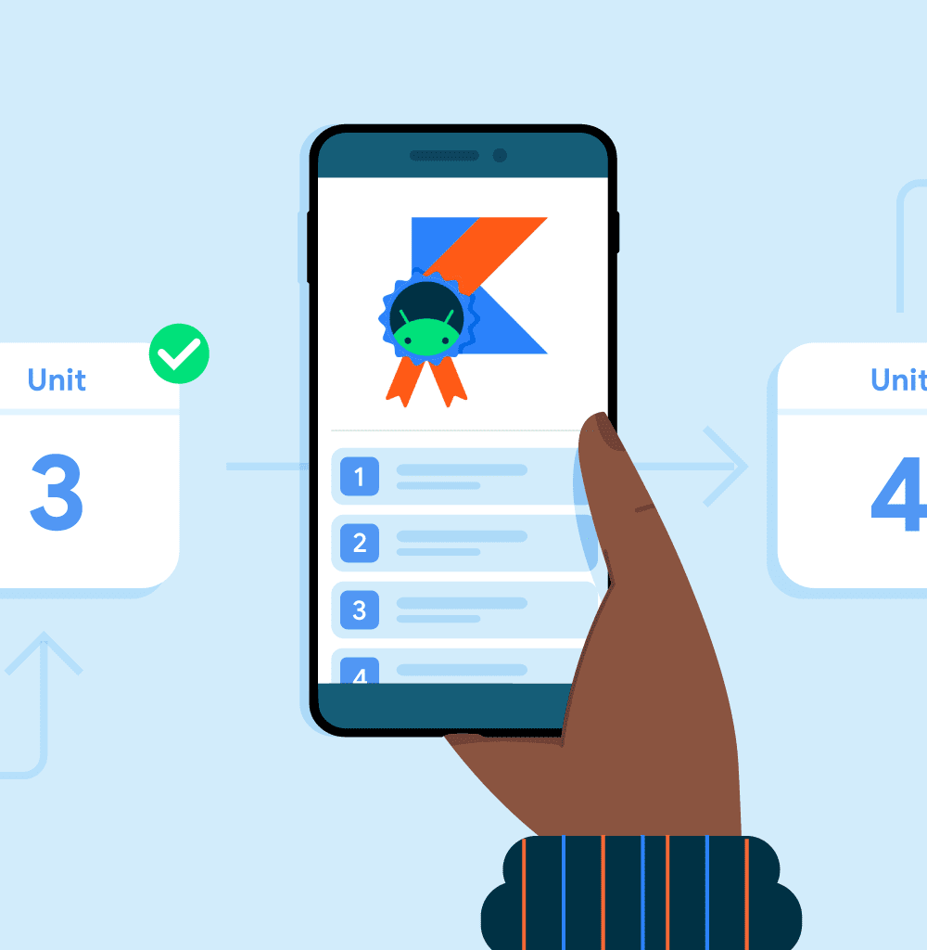
Why is Kotlin primary language for android?
Data Classes
Co-routines
Immutability
Null Safety

Slide 6
What are Coroutines?
Unlike many other languages with similar capabilities, async and await are not keywords in Kotlin and are not even part of its standard library. Moreover, Kotlin's concept of suspending function provides a safer and less error-prone abstraction for asynchronous operations than futures and promises.
Coroutines can be thought of as light-weight threads, but there is a number of important differences that make their real-life usage very different from threads.

Slide 7
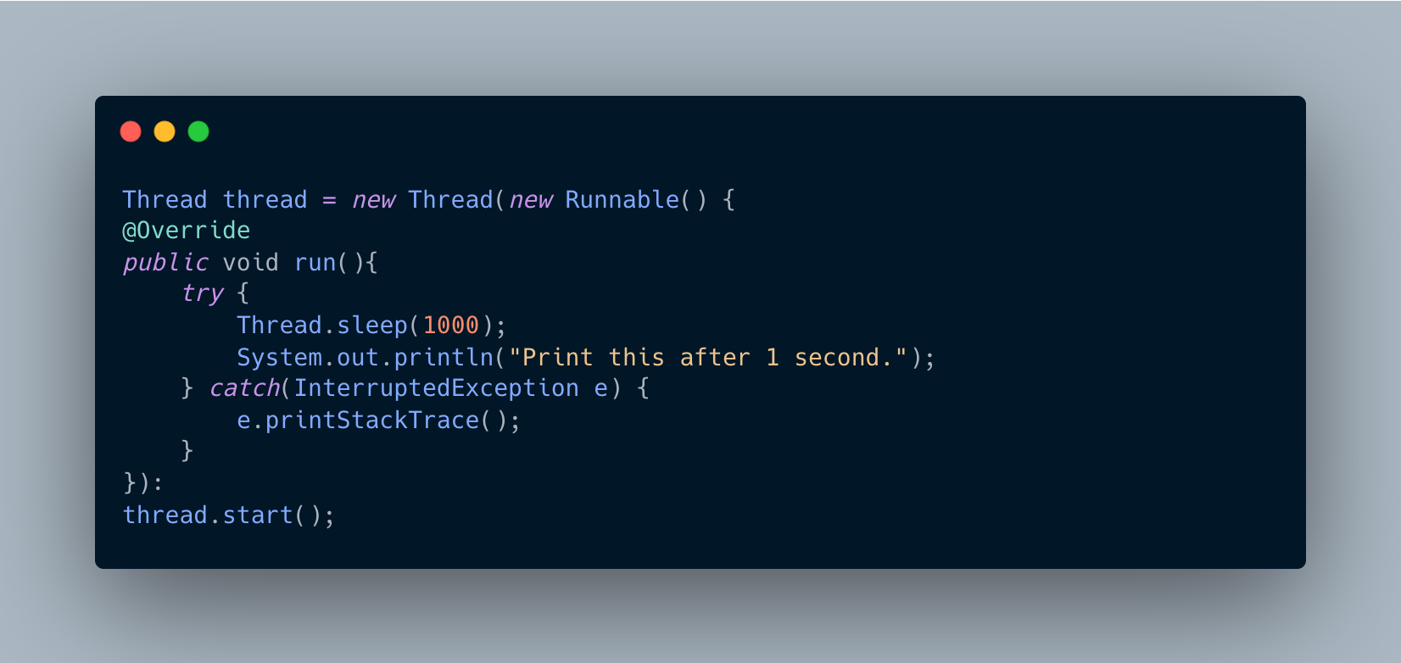
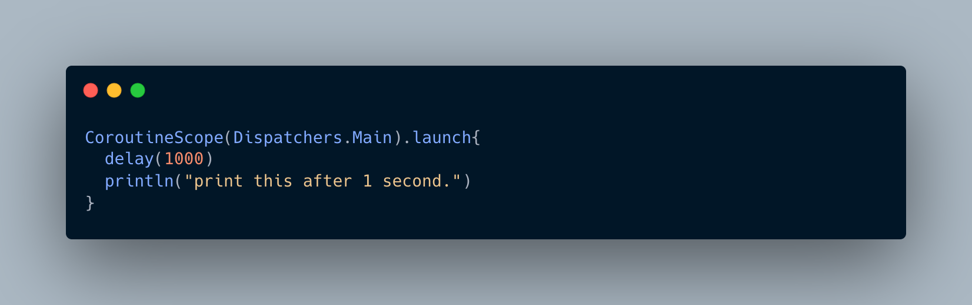
What are Coroutines?
JAVA:
Kotlin:

Slide 8
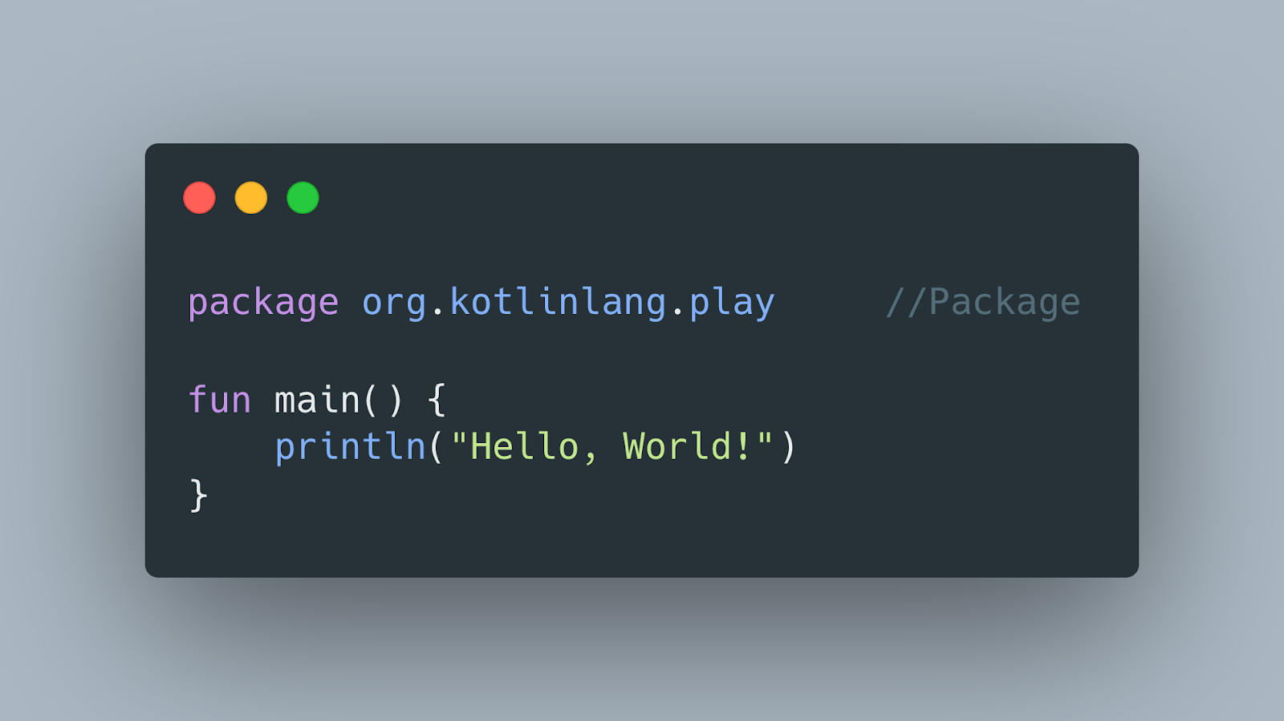
Syntax

Slide 9
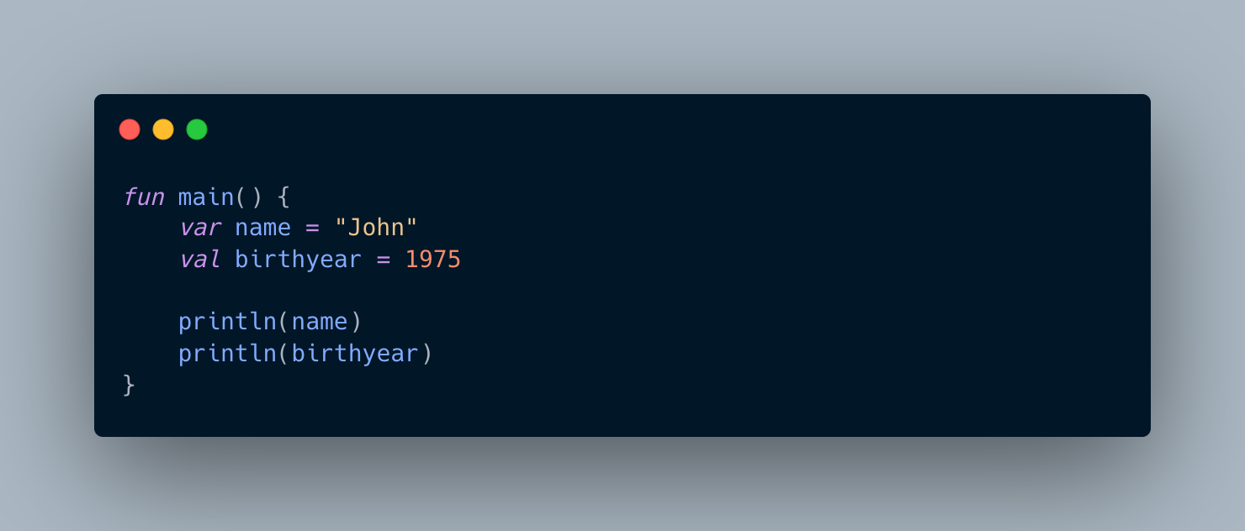
Variables
The difference between var and val is that variables declared with the var keyword can be changed/modified, while val variables cannot.

Slide 10
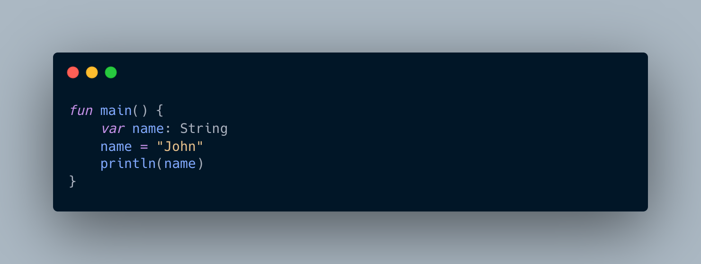
Variables
You can also declare a variable without assigning the value, and assign the value later. However, this is only possible when you specify the type.

Slide 11
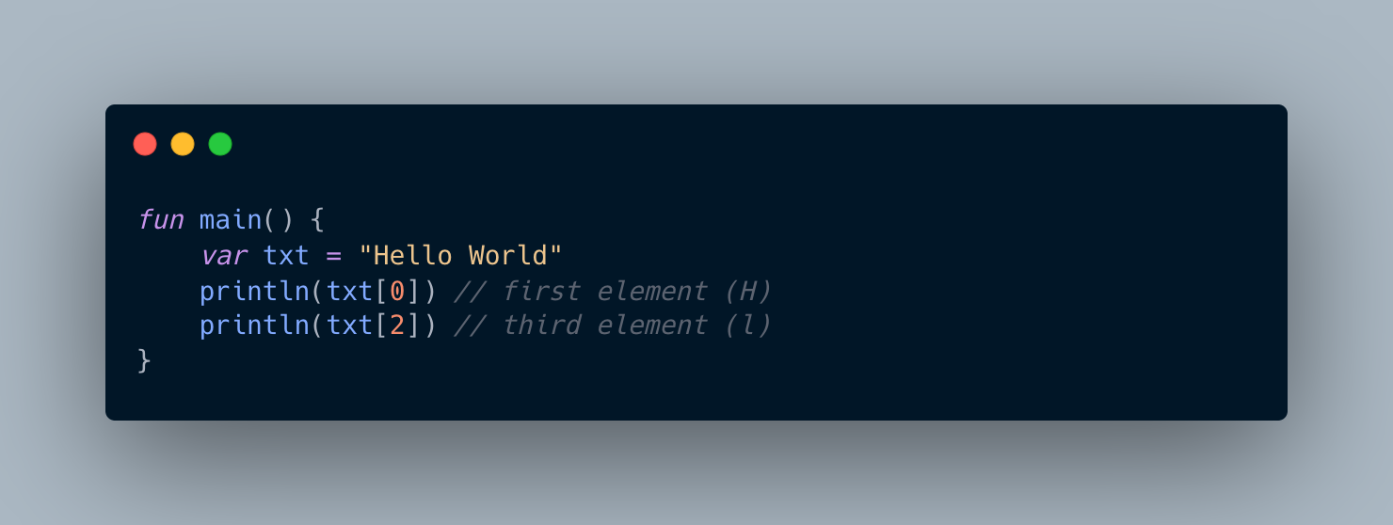
String
To access the characters (elements) of a string, you must refer to the index number inside square brackets.

Slide 12
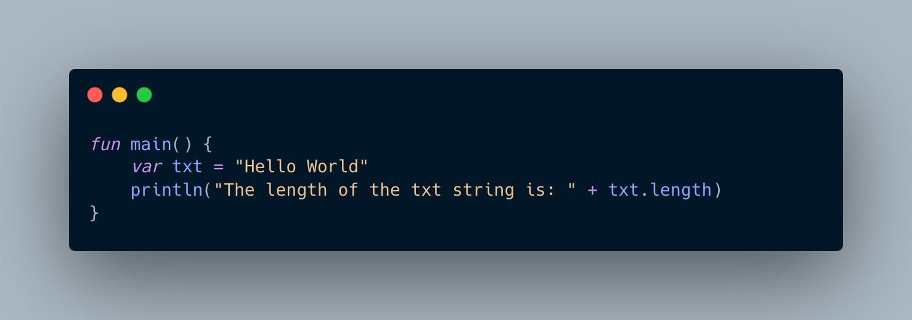
String
A String in Kotlin is an object, which contain properties and functions that can perform certain operations on strings, by writing a dot character (.) after the specific string variable. For example, the length of a string can be found with the length property

Slide 13
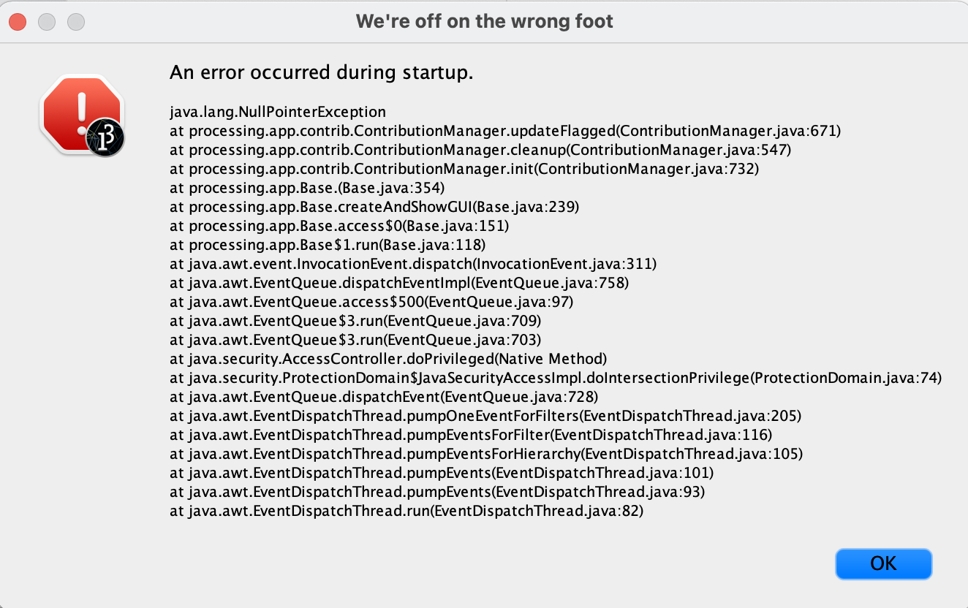
Billion Dollar Mistake

Slide 14
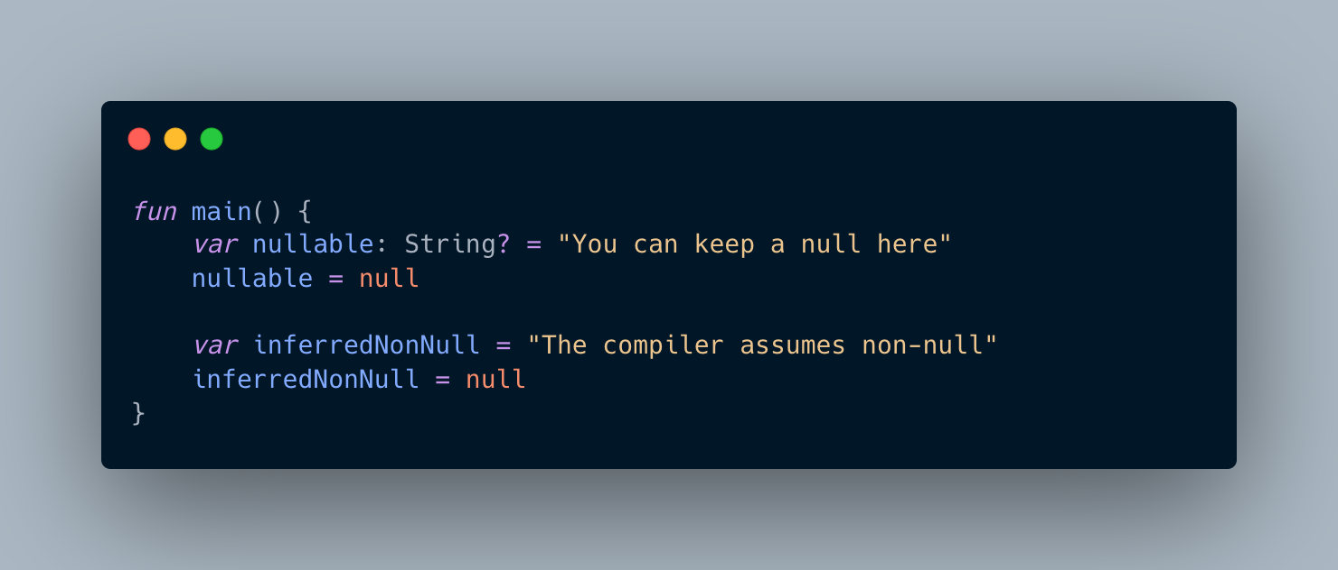
Null Safety
It’s a modern approach to make Null Pointer Exception Compile-time error, not Run-time error

Slide 15
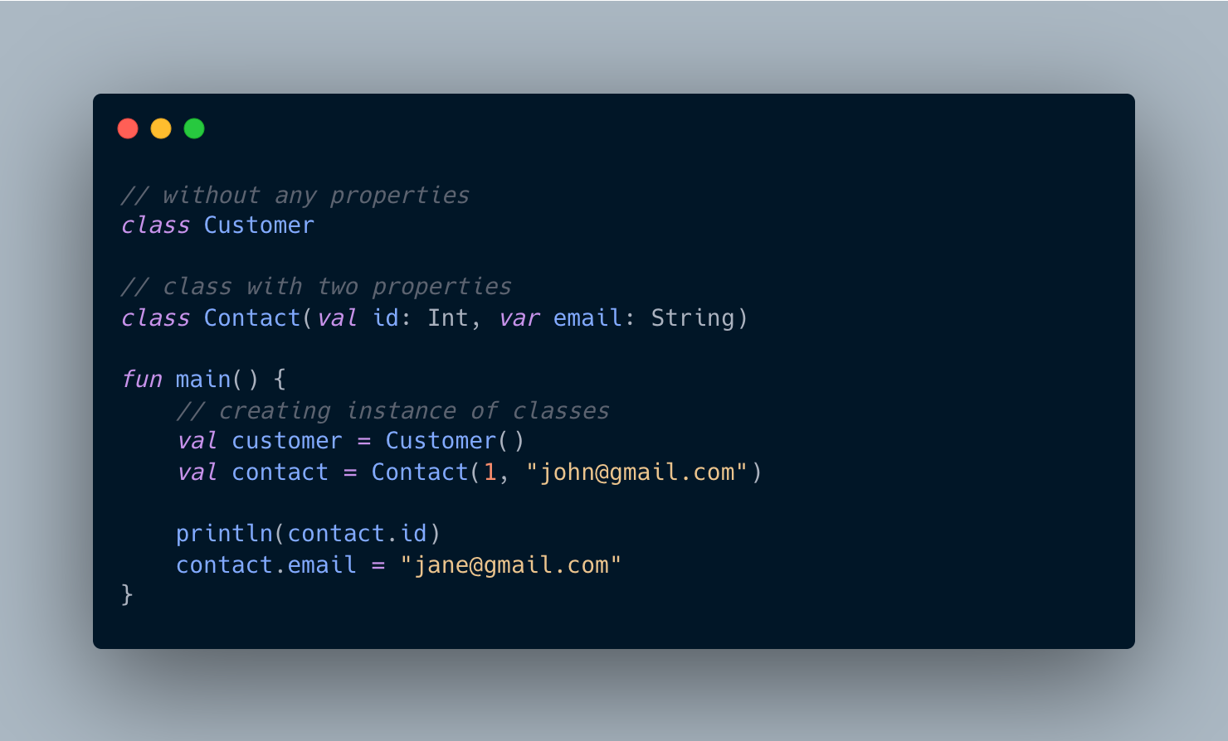
Classes

Slide 16
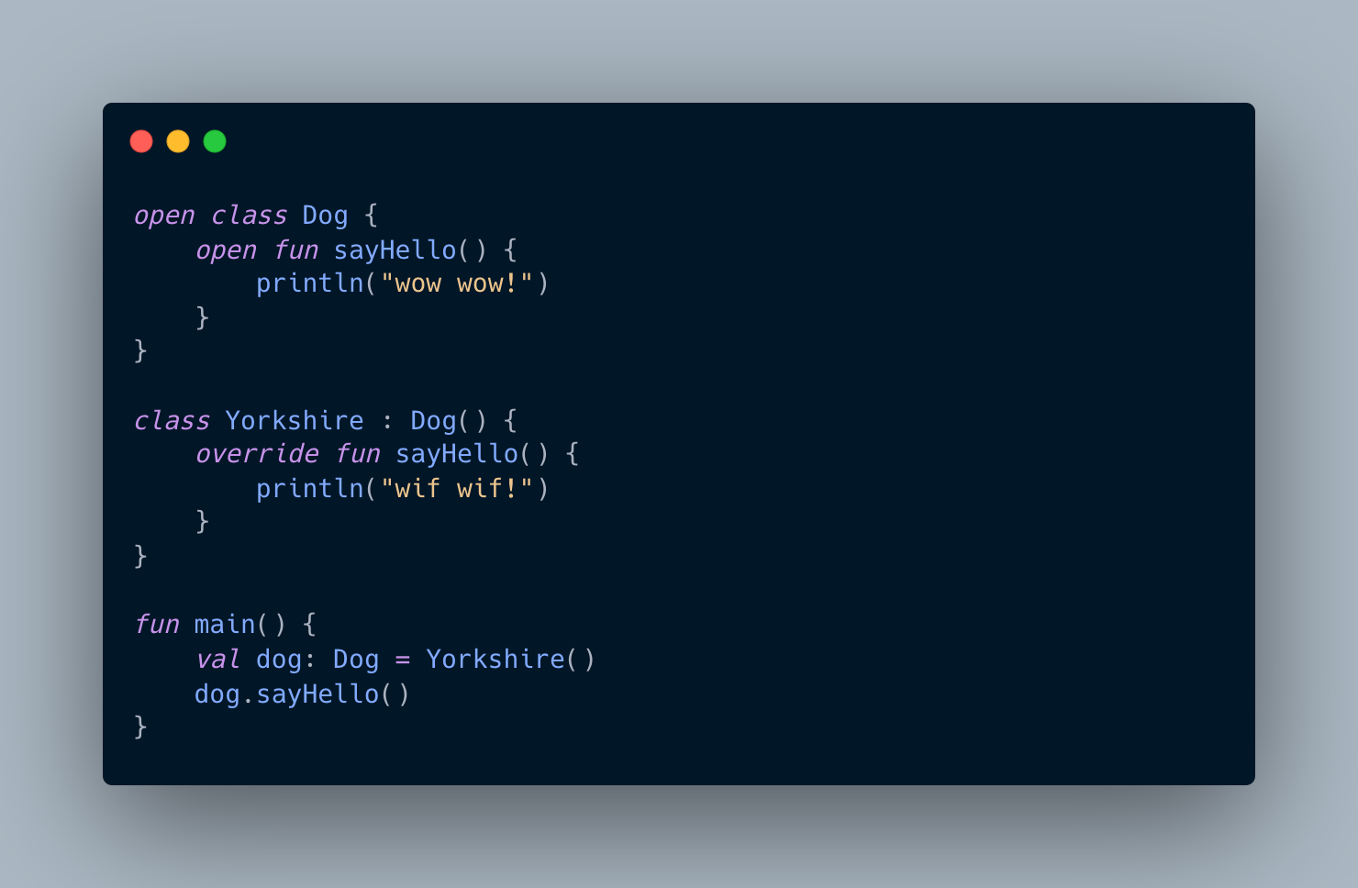
Inheritance

Slide 17
Control Flow

Slide 18
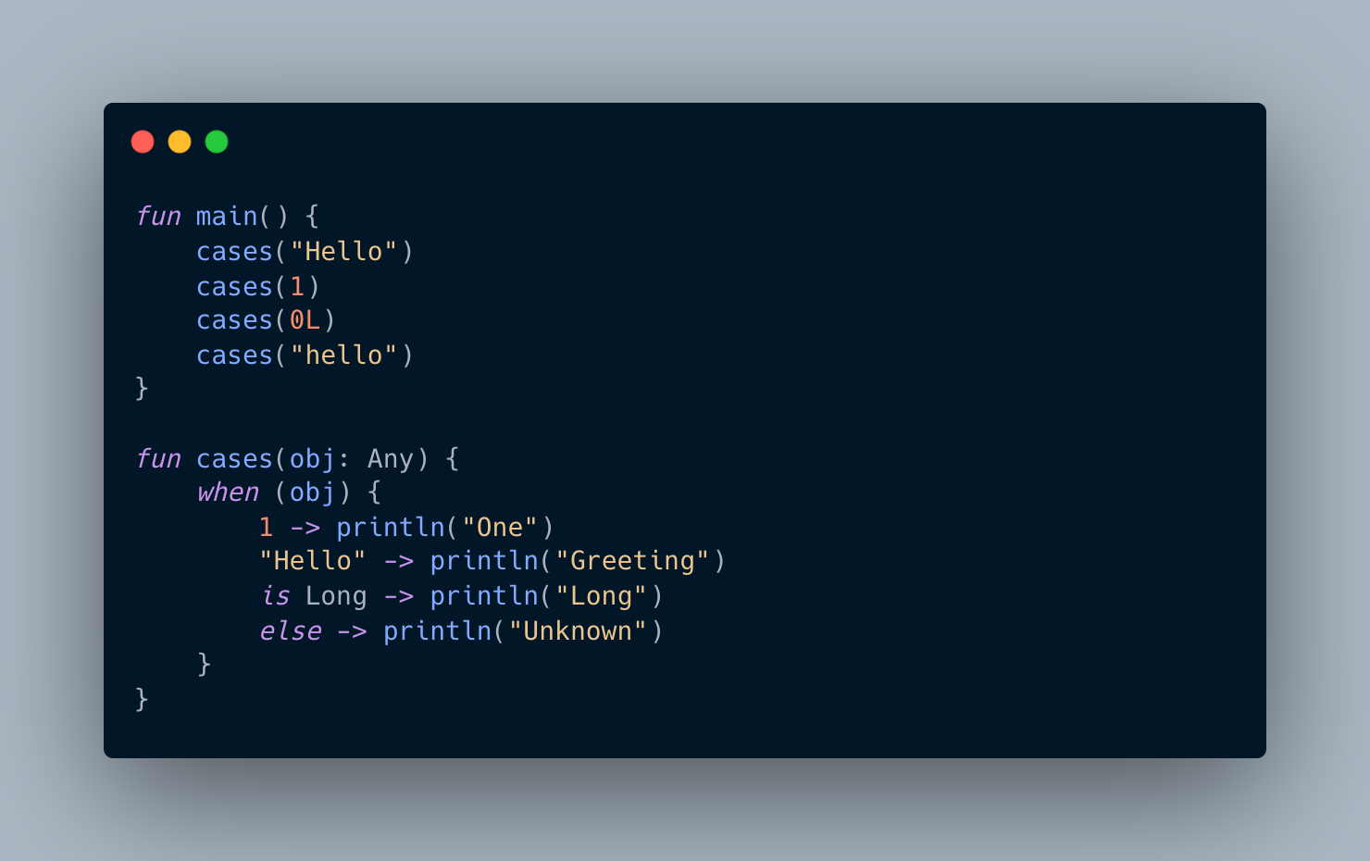
When
Instead of the widely used switch statement, Kotlin provides a more flexible and clear ‘when’ construction. It can be used either as a statement or as an expression.

Slide 19
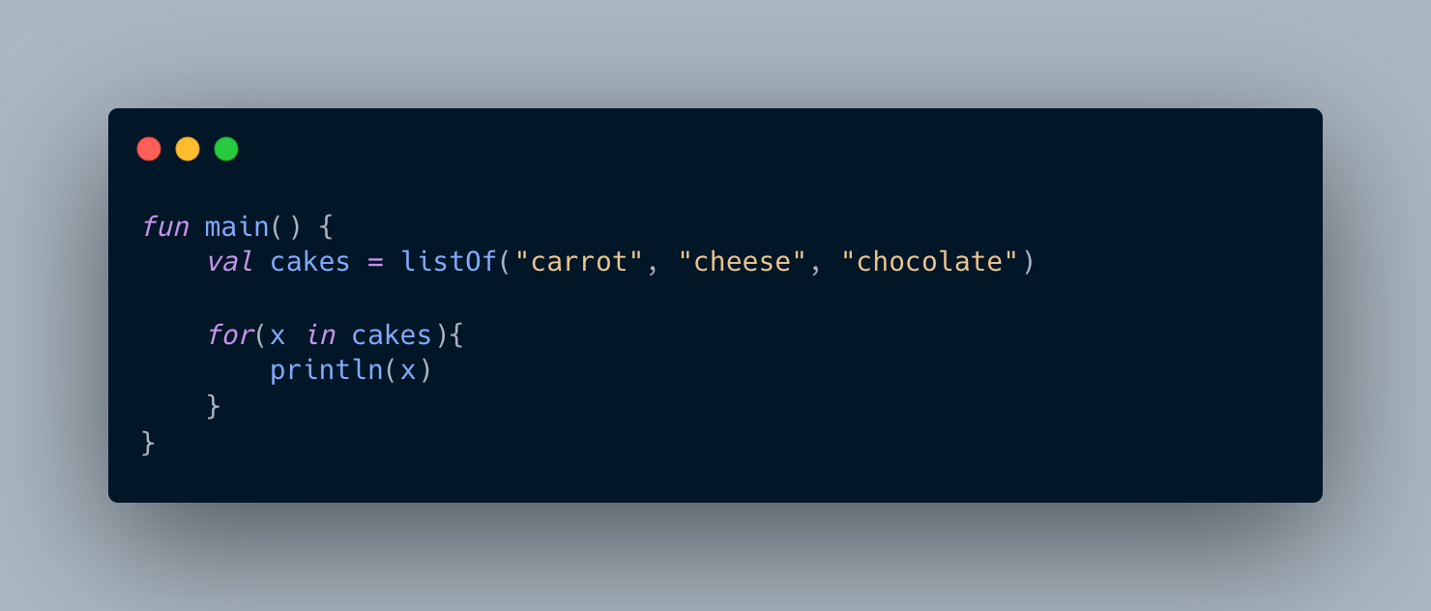
For-loop
for in Kotlin works the same way as in most languages.

Slide 20
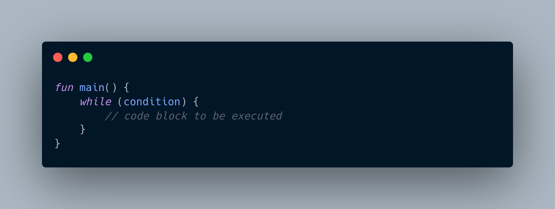
While-loop
while construct works similarly to most languages as well

Slide 21
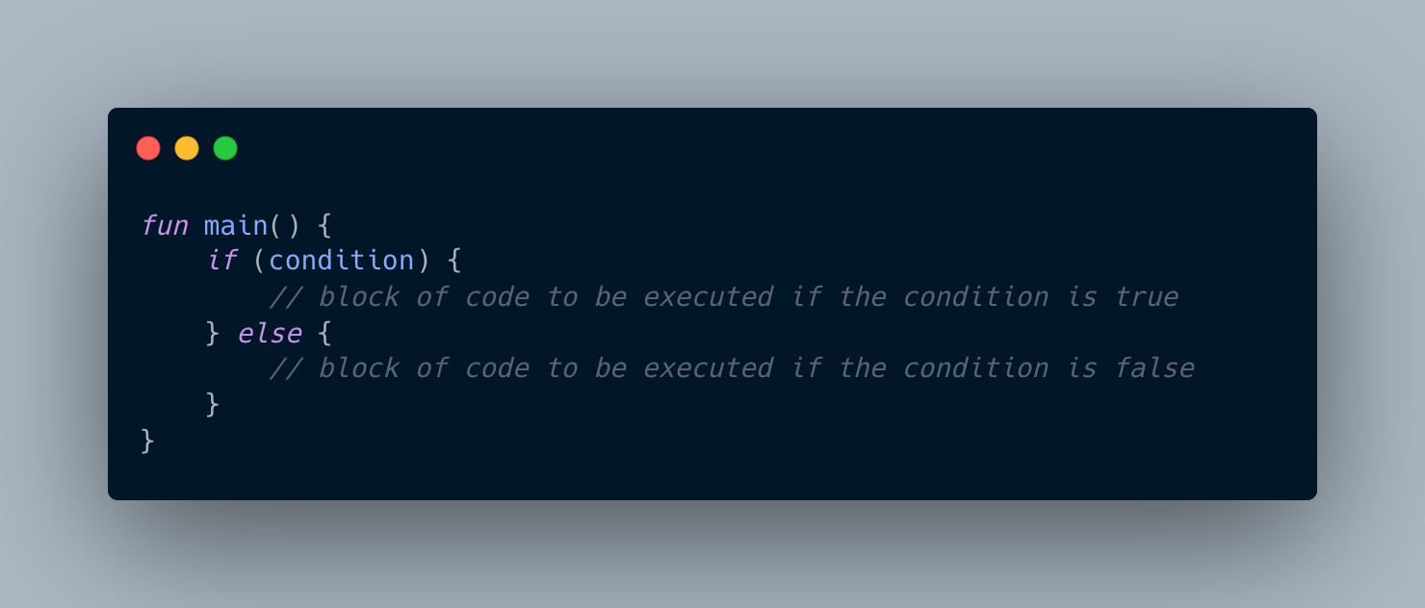
Conditionals

Slide 22
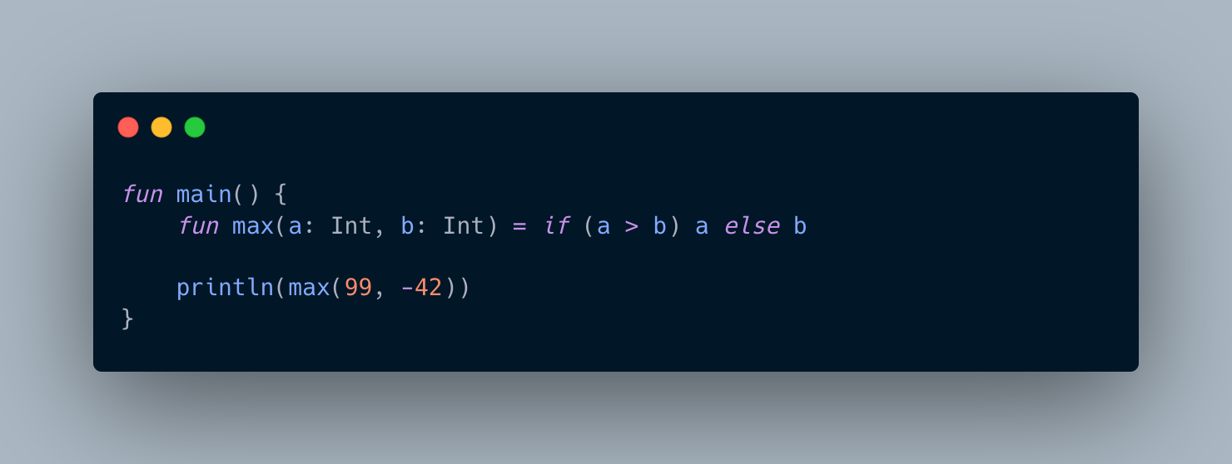
Ternary Operator
There is no ternary operator condition ? then : else in Kotlin. Instead, if may be used as an expression

Slide 23
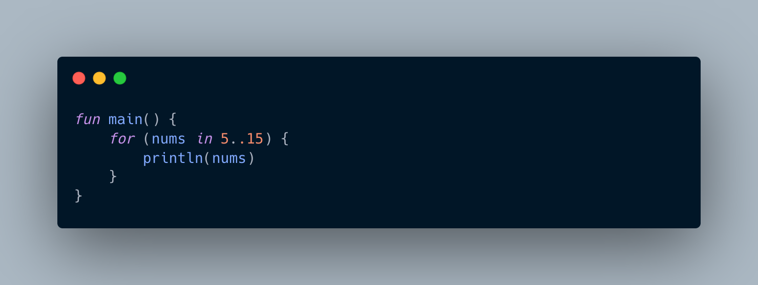
Ranges
With the for loop, you can also create ranges of values with ".."

Slide 24
Special Classes

Slide 25
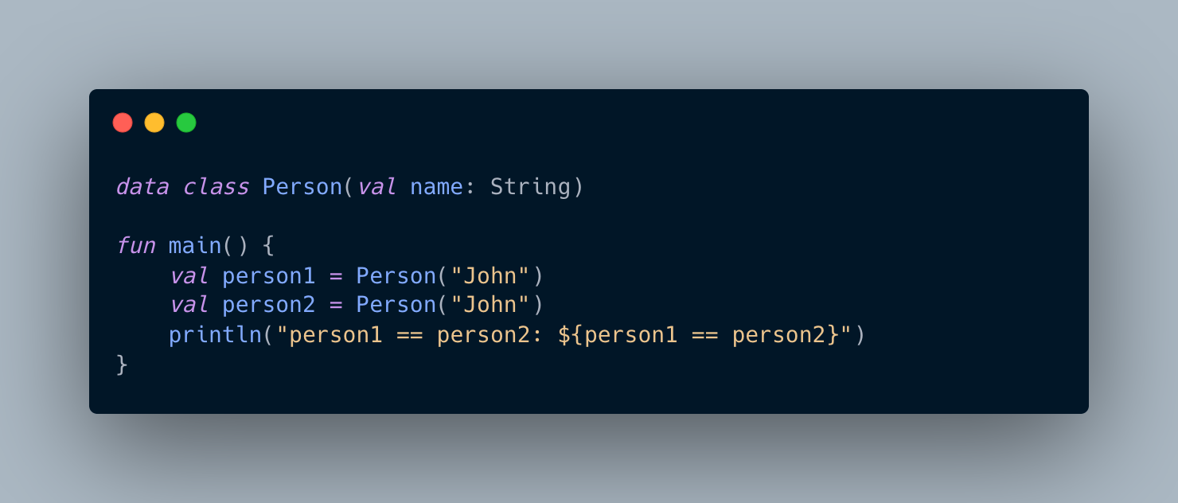
Data classes
Data Classes make it easy to create classes that are used to store values.

Slide 26
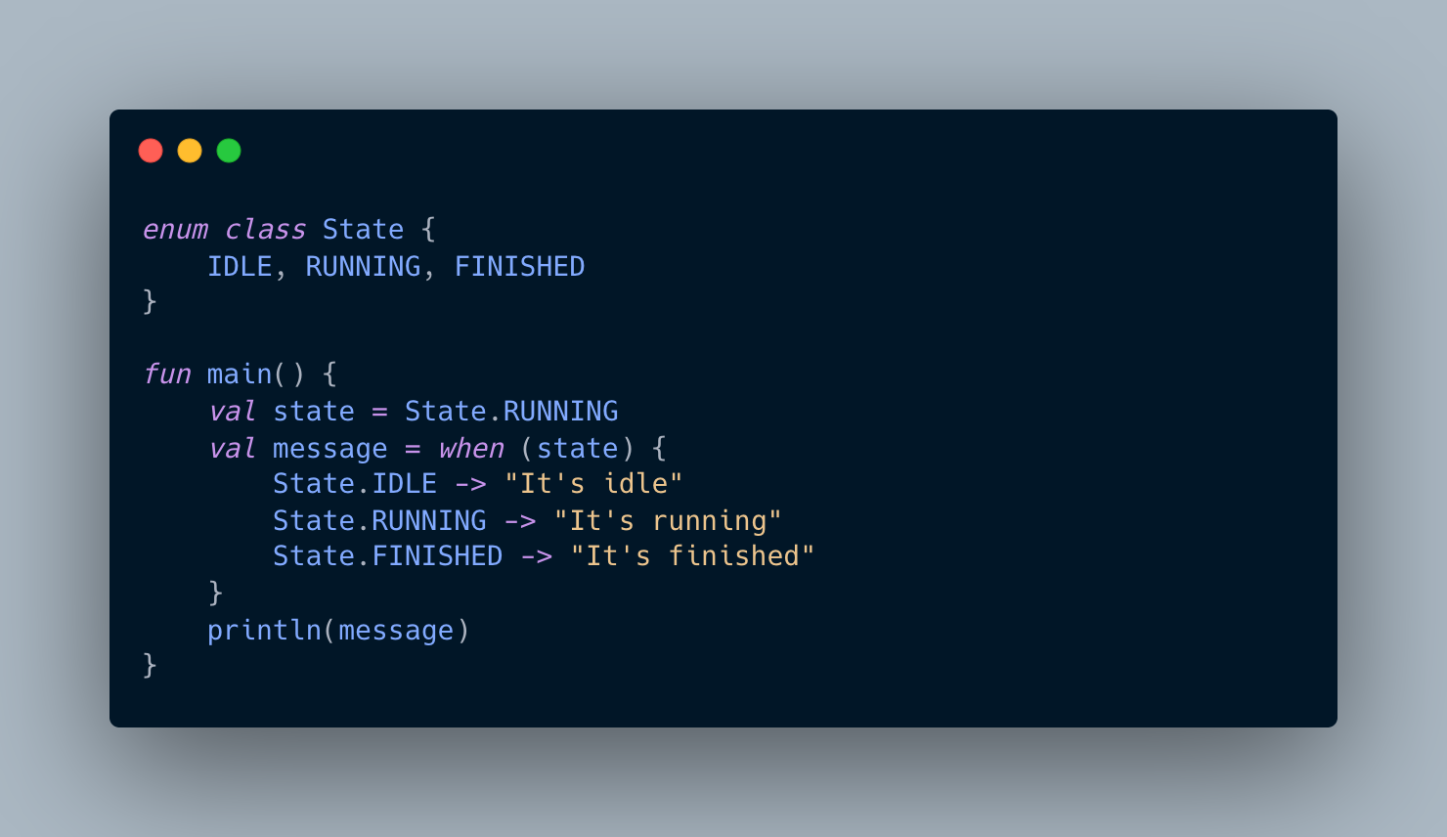
Enum
Enum classes are used to model types that represent a finite set of distinct values, such as directions, states, modes, and so forth.

Slide 27
Collections

Slide 28
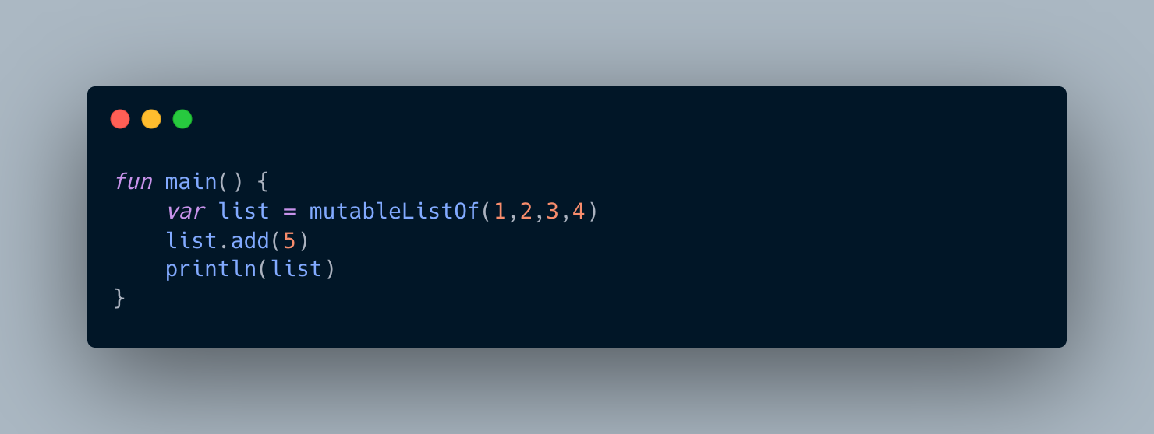
List
List is an ordered collection with access to elements by indices

Slide 29
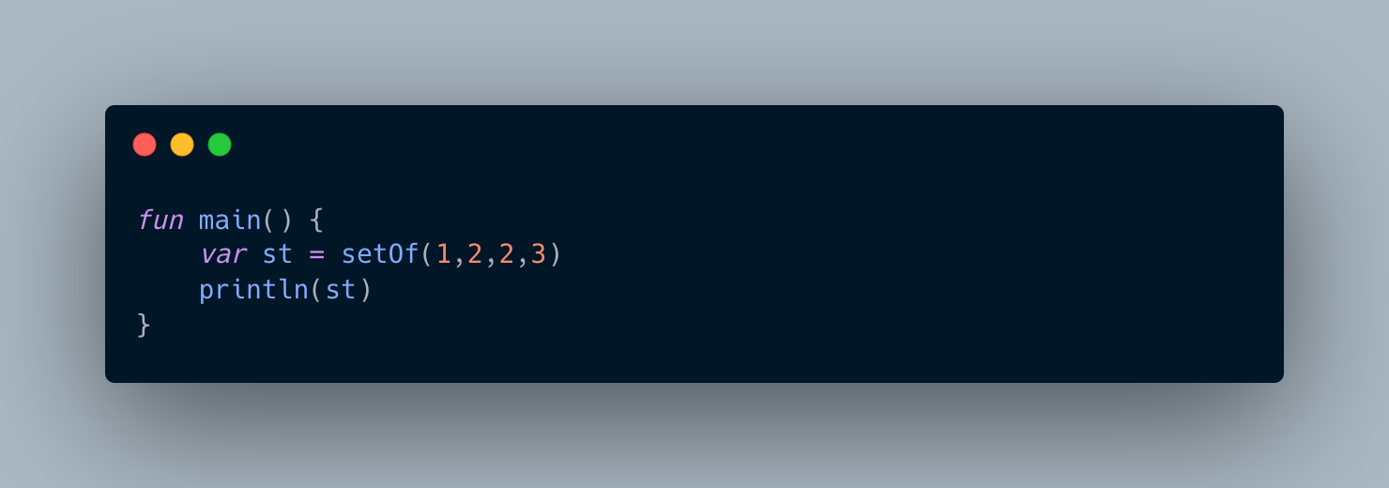
Set
Set is a collection of objects without repetitions

Slide 30
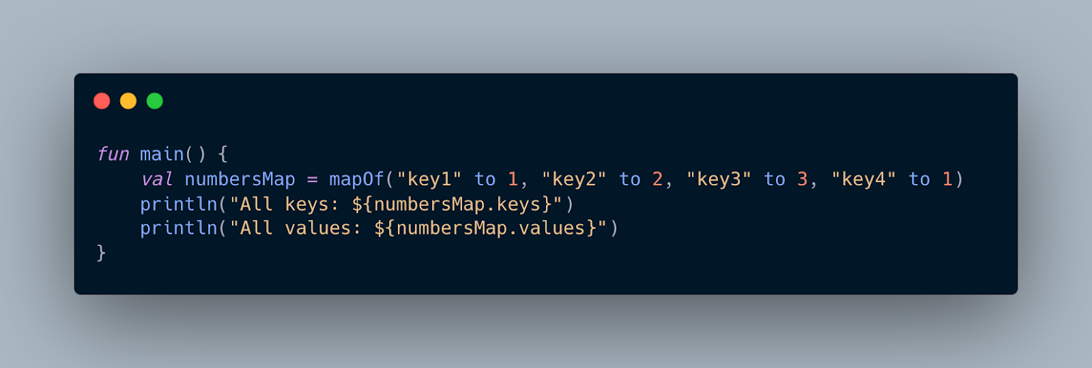
Map
Map (or dictionary) is a set of key-value pairs. Keys are unique, and each of them maps to exactly one value. The values can be duplicates.

Slide 31
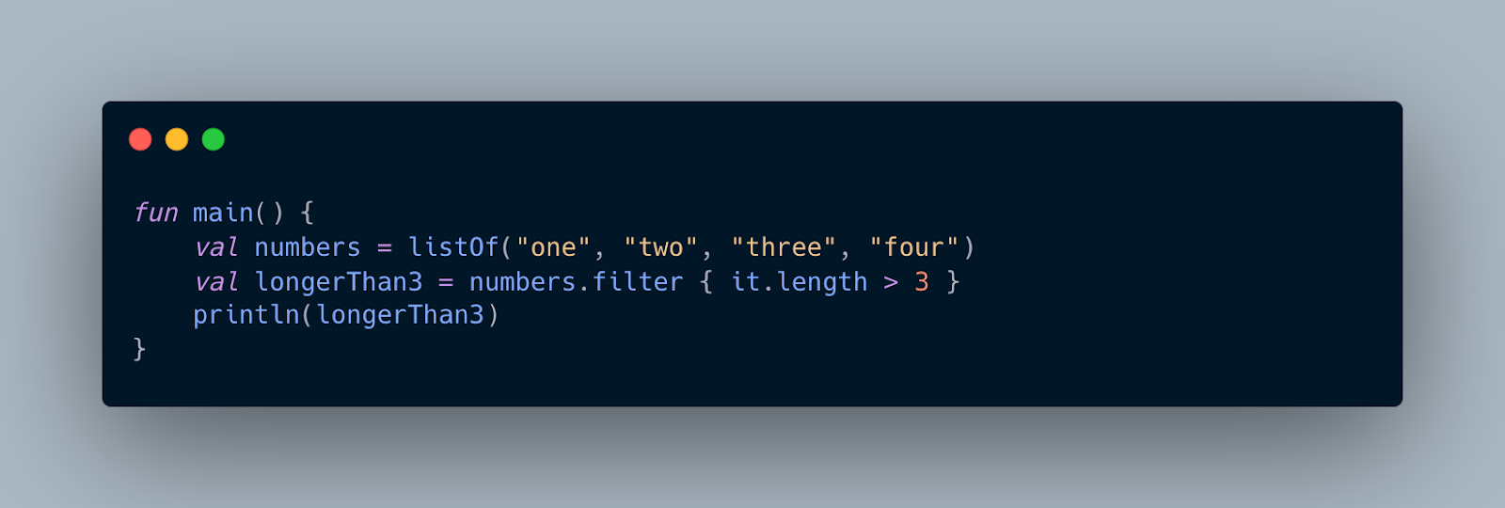
Filter
filter function enables you to filter collections.

Slide 32
Scope Functions

Slide 33
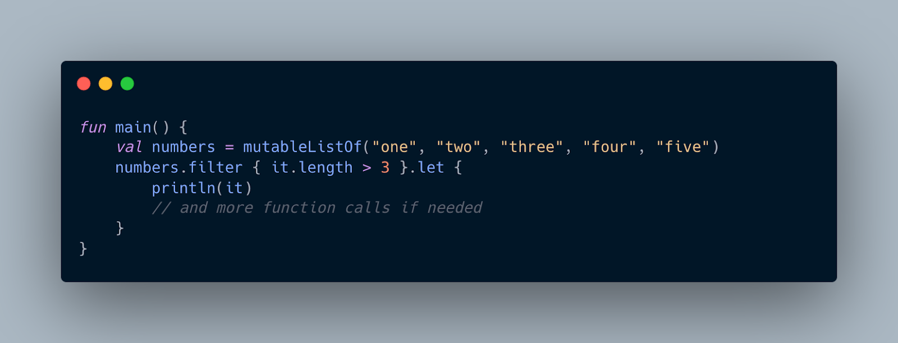
Let
let can be used to invoke one or more functions on results of call chains.

Slide 34
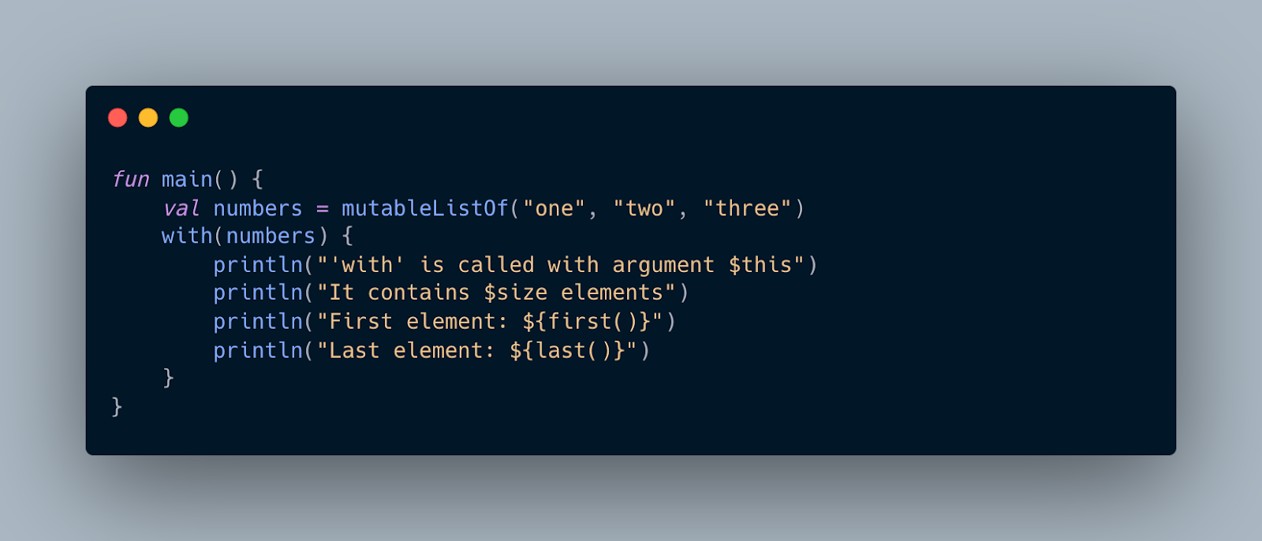
With
with is a non-extension function that can access members of its argument concisely.

Slide 35
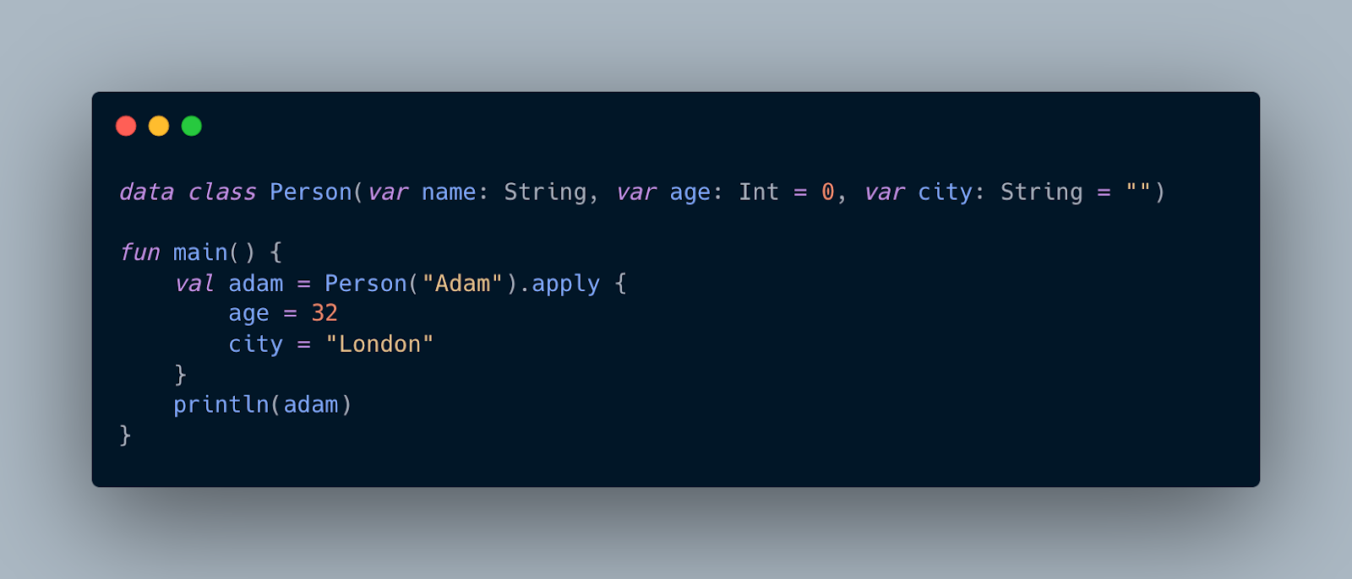
Apply
apply executes a block of code on an object and returns the object itself. Inside the block, the object is referenced by this. This function is handy for initializing objects.

Slide 36
About Me
LinkedIn: https://www.linkedin.com/in/vandit-vasa-bb506317a/

Slide 37
ISTE.VIT
ISTE_VIT_VELLORE
INDIAN SOCIETY FOR
TECHNICAL EDUCATION
ISTE-VIT

