Slide 1
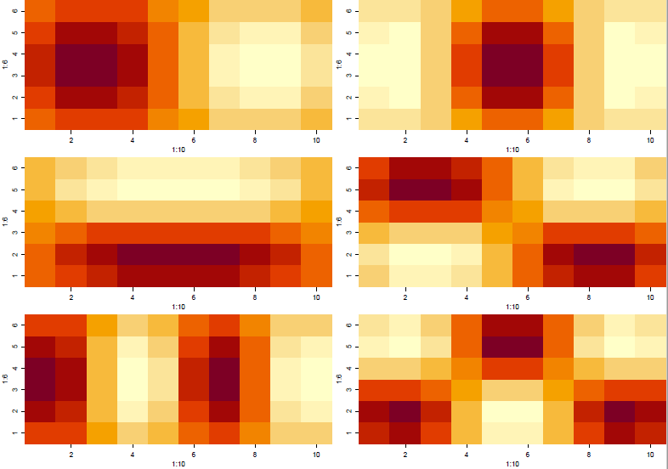
RDA-PCNM: a method to parse out spatial and temporal structure in data
Lunchinators – Dec 6, 2019
Tyler Butts

Slide 2
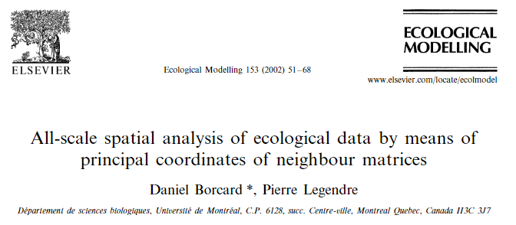
OUTLINE
What is “Principle Components of Neighborhood Matrices”?

Slide 3
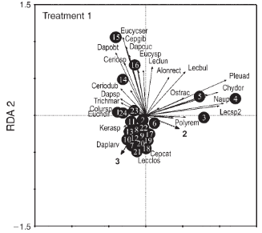
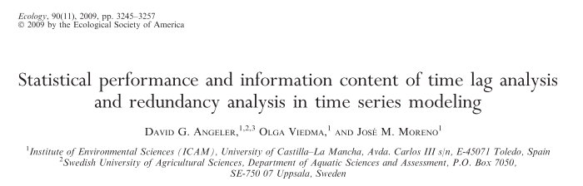

OUTLINE
What is “Principle Components of Neighborhood Matrices”?
Case study using RDA-PCNM in time-series modeling

Slide 4

OUTLINE
What is “Principle Components of Neighborhood Matrices”?
Case study using RDA-PCNM in time-series modeling
Throughout the presentation I’ll hop to R for further demonstration
Proof of concept
From Dr. Dixon’s EEB698 Species Composition Analysis seminar
Incorporating PCNM in variation partitioning

Slide 5
PRINCIPLE COMPONENTS OF NEIGHBORHOOD MATRICES
Principle coordinates of neighborhood matrices (PCNM) is a statistical method used to assess spatial (or temporal) structure in response data
Spatial variables can be utilized to determine the distance between sites -- focus on neighboring sites
Distances are then decomposed into orthogonal spatial variables
Variables may then be used as explanatory variables in an appropriate constrained analysis (e.g. Redundancy analysis, RDA)
Strengths
Incorporating spatial variables as explanatory variables in RDA
Preferable to partial mantel testing
Borcard & Legendre 2002; Borcard et al. 2004; Dray et al. 2006

Slide 6
Y
W
Response
Spatial
Gusta Me – Spatial Analysis

Slide 7
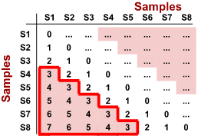
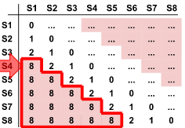

W
Calculate Distance Matrix
Y
Euclidean Distance Matrix
Distance Threshold: T=2
All values >2 set to 4T
Neighbor Matrix
PCoA
Gusta Me – Spatial Analysis
Notes:
DM calculated from longitutde/latitude data represents the sample locations. Must set a Threshold distance above which distances are simply considered ‘Large’ – lets you decide what scale you want to investigate. Any distances greater than this will be set to four times the threshold value (Borcard and Legendre 2002). The modified distance matrix is then subject to Principle coordinates analysis.

Slide 8
W
Calculate Distance Matrix
Y
Euclidean Distance Matrix
Distance Threshold: T=2
All values >2 set to 4T
Neighbor Matrix
PCoA
Select all positive eigenvectors
Each positive eigenvector models a different spatial scale
PCoA eigenvectors
Gusta Me – Spatial Analysis
Notes:
Since the original distance matrix is modified to create a neighbor matrix, a PCoA on that neighbor matrix will produce more eigenvectors relative to the same analysis on a normal distance matrix. All of the resulting eigenvectors with positive eigenvlaues may be used as a new set of explanatory, spatial variables that can be used for multiple regression (univariate response data) or multivariate constrained analysis.
The positive eigenvectors generated in this step provide a spectral decomposition of any spatial relationships between sample locations. Each eigenvector models a different spatial scale and the response variables’ relationship to non-spatial explanatory variables may be scrutinized independently at each scale. Each PCoA axis is orthogonal (as normal) and thus independent

Slide 9
Visualization of the eigenvectors PCNM creates

Slide 10
W
Calculate Distance Matrix
Y
Euclidean Distance Matrix
Distance Threshold: T=2
All values >2 set to 4T
Neighbor Matrix
Constrained analysis
PCoA
Select all positive eigenvectors
Each positive eigenvector models a different spatial scale
PCoA eigenvectors
Gusta Me – Spatial Analysis
Notes:
Since the original distance matrix is modified to create a neighbor matrix, a PCoA on that neighbor matrix will produce more eigenvectors relative to the same analysis on a normal distance matrix. All of the resulting eigenvectors with positive eigenvlaues may be used as a new set of explanatory, spatial variables that can be used for multiple regression (univariate response data) or multivariate constrained analysis.
The positive eigenvectors generated in this step provide a spectral decomposition of any spatial relationships between sample locations. Each eigenvector models a different spatial scale and the response variables’ relationship to non-spatial explanatory variables may be scrutinized independently at each scale. Each PCoA axis is orthogonal (as normal) and thus independent

Slide 11
W
Calculate Distance Matrix
Y
Euclidean Distance Matrix
Distance Threshold: T=2
All values >2 set to 4T
Neighbor Matrix
Constrained analysis
Significant PCNM variables
PCoA
Select all positive eigenvectors
Spatial variables representing significant spatial structures
W*
PCoA eigenvectors
Gusta Me – Spatial Analysis

Slide 12
TEMPORAL STRUCTURE
CASE STUDY
THE STUDY
Data comes from a temporary pond study in central Spain during three hydroperiods 2003-2005
Used multiple before-after, control-impact design
Zooplankton were sampled in replicated artificial ponds
Treatment = fire-retardant chemical contamination
Control: Uncontaminated
Treatment 1: fire-retardant contamination in grasslands
Treatment 2: fire-retardant contamination in scrublands
Ponds were sampled in monthly intervals totaling 24 samplings
Angeler & Moreno 2007; Angeler et al. 2009

Slide 13
TEMPORAL STRUCTURE
CASE STUDY
THE ANALYSIS
Raw abundance data was Hellinger-transformed (species identities retained)
Used PCNM to ID different patterns of temporal change
Took the resulting matrices and used them as explanatory variables in an RDA (as we discussed previously)
Used forward selection to collect significant PCNM variables
Process is an automatic selection procedure to objectively select a subset of explanatory variables and remove those that don’t really explain that much
PCNM produces a TON of variables
Angeler & Moreno 2007; Angeler et al. 2009

Slide 14
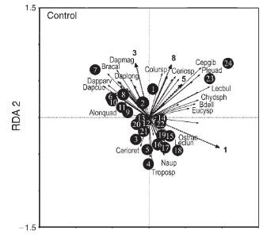
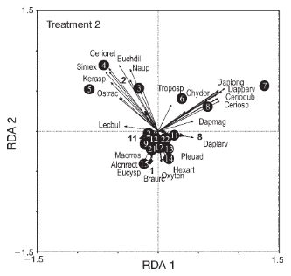
TEMPORAL STRUCTURE
CASE STUDY
RDA-PCNM Performance
The RDA-PCNM approach provided information not available in traditional distance-based tests
Highlighted which species or groups of species contribute to significant temporal change
Notes:
PCNM variables are the dotted arrows and boldface numbers at the ends of arrows.
Contribution of dominant zooplankton taxa to the observed time trends is indicated by solid arrows
Monthly sampling data are also shown (number within circles)

Slide 15
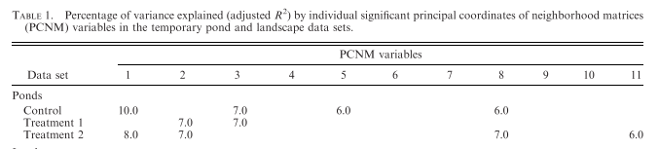
TEMPORAL STRUCTURE
CASE STUDY
RDA-PCNM Performance
The RDA-PCNM approach provided information not available in traditional distance-based tests
Importance of each PCNM variable in terms of adjusted variance explained can be evaluated, and thus the strength and components of temporal patterns can be assessed
Low-frequency fluctuation
High-frequency fluctuation
Notes:
PCNM variables are the dotted arrows and boldface numbers at the ends of arrows.
Contribution of dominant zooplankton taxa to the observed time trends is indicated by solid arrows
Monthly sampling data are also shown (number within circles)

Slide 16
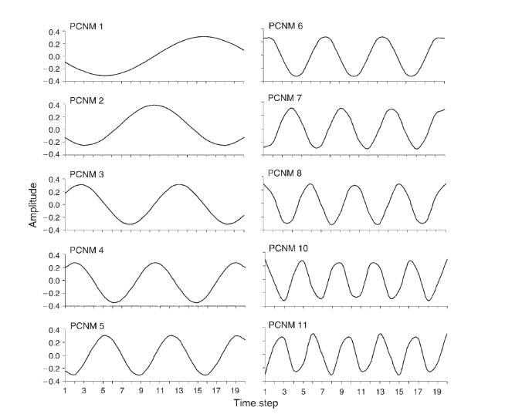
Notes:
PCNM variables are the dotted arrows and boldface numbers at the ends of arrows.
Contribution of dominant zooplankton taxa to the observed time trends is indicated by solid arrows
Monthly sampling data are also shown (number within circles)

Slide 17
TEMPORAL STRUCTURE
CASE STUDY
INTERPRETATION
Control ponds showed two temporal structures
a directional component of change (PCNM 1; very low frequency and incomplete cyclic change = directional temporal change)
Second component of change was a cyclic behavior (PCNMs 3,5,8)
PCNM 3 = long frequencies
PCNM 5, 8 = short frequencies
Notes:
PCNM variables are the dotted arrows and boldface numbers at the ends of arrows.
Contribution of dominant zooplankton taxa to the observed time trends is indicated by solid arrows
Monthly sampling data are also shown (number within circles)

Slide 18
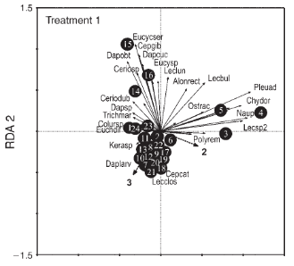
TEMPORAL STRUCTURE
CASE STUDY
INTERPRETATION
Treatment 1 (fire-retardant contamination in grasslands) showed less directional change but was defined by unimodal patterns (PCNM 2) and long fluctuation frequencies (PCNM 3)
Notes:
PCNM variables are the dotted arrows and boldface numbers at the ends of arrows.
Contribution of dominant zooplankton taxa to the observed time trends is indicated by solid arrows
Monthly sampling data are also shown (number within circles)

Slide 19

TEMPORAL STRUCTURE
CASE STUDY
INTERPRETATION
Treatment 2 (fire-retardant contamination in scrublands) had both a directional change (PCNM 1), a unimodal change (PCNM 2), and a cyclic fluctuation (PCNM 8, 11)

Slide 20
TEMPORAL STRUCTURE
CASE STUDY
INTERPRETATION
The stressor disrupted the natural fluctuation of the pond communities by increasing the magnitudes of fluctuation in disturbed communities
Notes:
The stressor disrupted the natural fluctuation of the pond communities by increasing the magnitudes of fluctuation in disturbed communities

Slide 21
W
Calculate Distance Matrix
Y
Euclidean Distance Matrix
Constrained analysis
Distance Threshold: T=2
All values >2 set to 4T
Neighbor Matrix
Significant PCNM variables
PCoA
Spatial variables representing significant spatial structures
Other explanatory variables
W*
X
Select all positive eigenvectors
Further analysis (Variation partitioning)
PCoA eigenvectors
Gusta Me – Spatial Analysis

Slide 22
Variation partitioning using PCNM

