Slide 1

Fluxweb The R package that fluxes webs
Package by Gauzens et al. 2018 -Methods in Ecology & Evolution

Slide 2
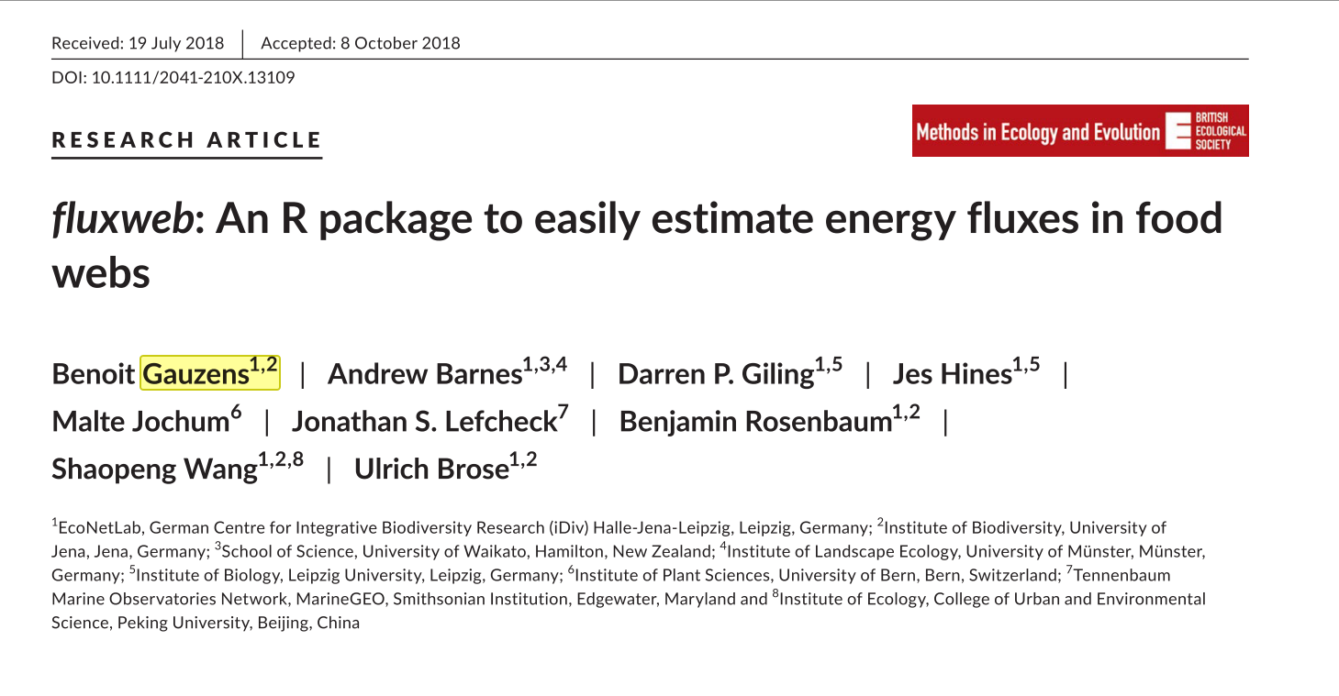

Slide 3
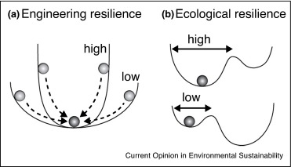
What Does this package do?
Estimate energy flux in the food web (food web ‘energetics’)
e.g. how much of the energy in the food web is coming from detritivory?
Underlying model
steady state, sum fluxes, assess pattern of fluxes
Estimate community stability
Notes:
Underlying model
Assumes a steady state
Sum ingoing fluxes
individual fluxes for each pair-wise predator-prey interaction are calculated
Assess patterning of fluxes in a ‘Jacobian’ matrix

Slide 4

Why is it useful?
Previous ‘food web energetics’ approaches become quickly become mathematically intensive
Partial derivative of a Lotka-Volterra model for each interaction
Lots and lots of matrix math

Slide 5
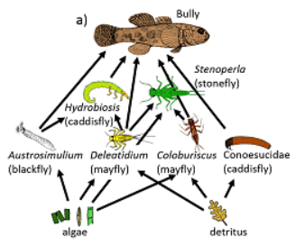
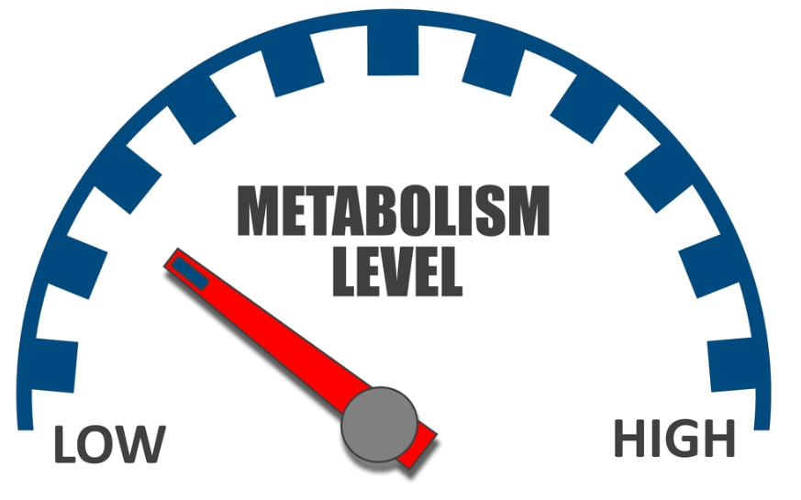
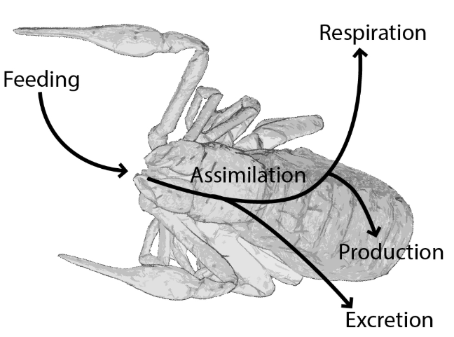
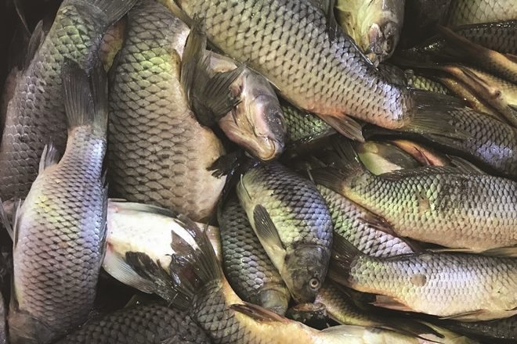
What do you need?
Food web
Matrix
Value at the intersection of line i and column j
Physiological losses
Metabolic rates (Brown et al. 2004)
Body masses
Death rates (Rossetto et al. 2012)
More complex allometric functions (Carbone et al. 2007)
Efficiencies
Assimilation efficiency
proportion of consumed energy that is assimilated for respiration and biomass production
Biomass
Density
Overall

Slide 6
