Slide 1

Fluxweb The R package that fluxes webs
Package by Gauzens et al. 2018 -Methods in Ecology & Evolution

Slide 2
What does this package do?
Uses energy flux as a way of characterizing ecological processes driven by trophic interactions
Previous ‘food web energetics’ approaches manually calculate the fluxes which becomes exceedingly unmanageable
Underlying model
Assumes a steady state
Sum ingoing fluxes
then individual fluxes for each pair-wise predator-prey interaction are calculated
Depends on assimilation efficiencies

Slide 3
Parameters
Food web
Matrix
non-zero value at the intersection of line i and column j
Physiological losses
Metabolic rates (Brown et al. 2004)
Body masses
Death rates (Rossetto et al. 2012)
More complex allometric functions (Carbone et al. 2007)
Efficiencies
Assimilation efficiency
proportion of consumed energy that is assimilated for respiration and biomass production
pred, prey, link.specific
Biomasses

Slide 4
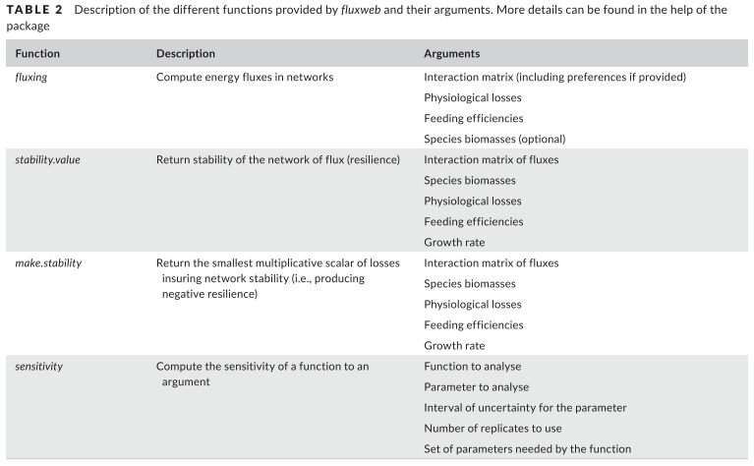

Slide 5
