Slide 1
Ivanovo State University of Chemistry and Technology Presentation on the discipline : “English language” On the theme “isuct”
Student: Пухова Кристина 1 course group №1/42 Teacher : Малкова Юлия Леонидовна
Ivanovo, 2020

Slide 2
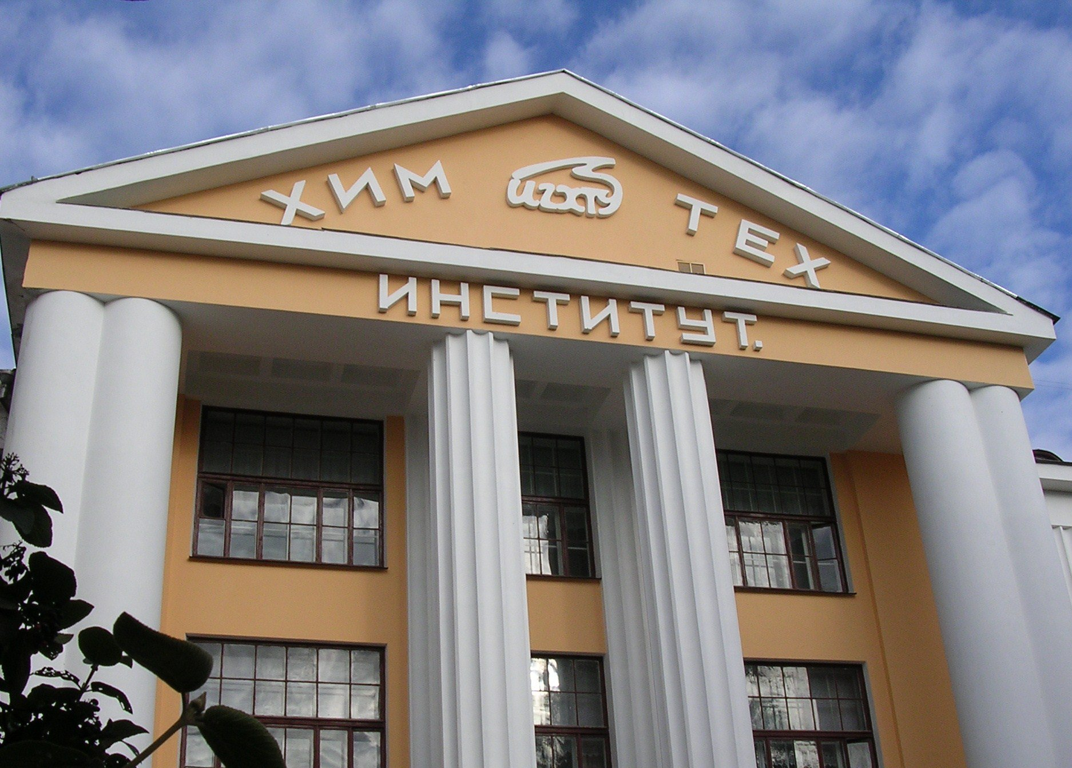
Ivanovo State University of Chemistry and Technology

Slide 3
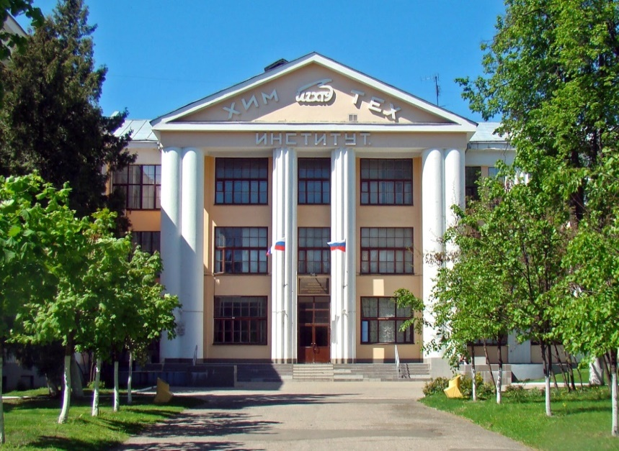
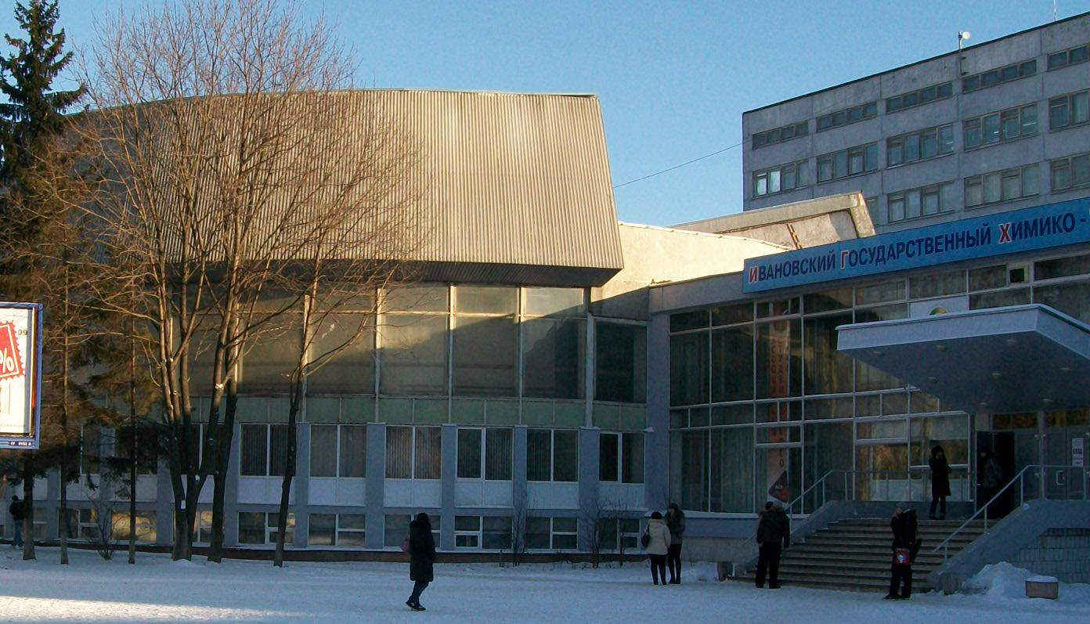
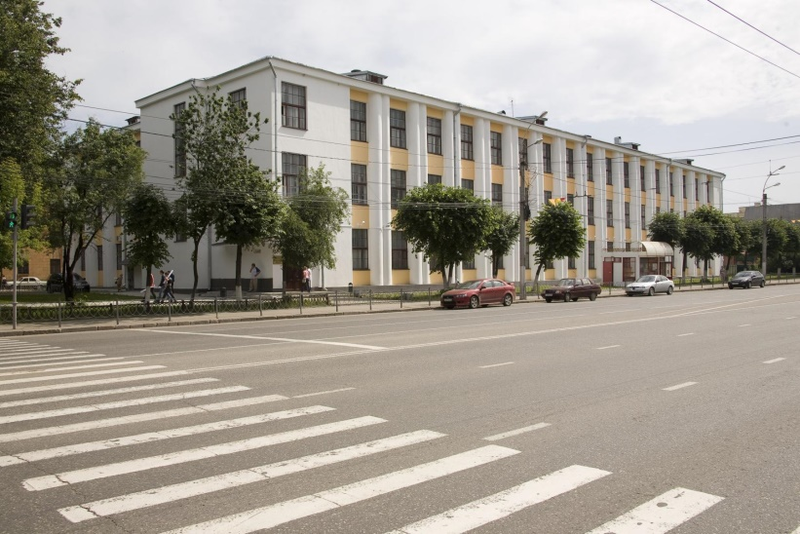
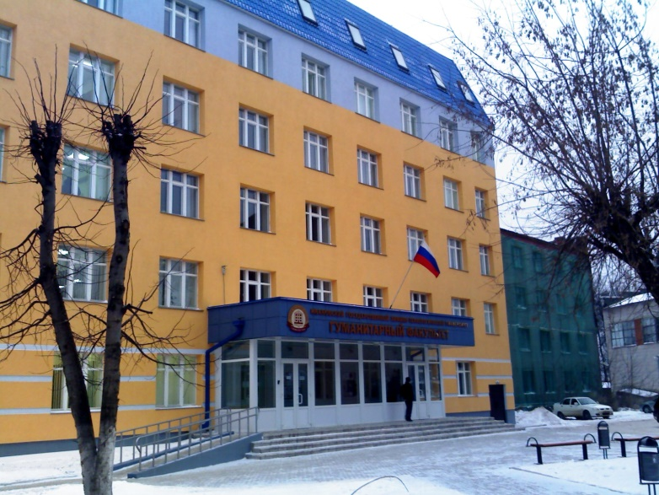
Buildings of the Institute

Slide 4
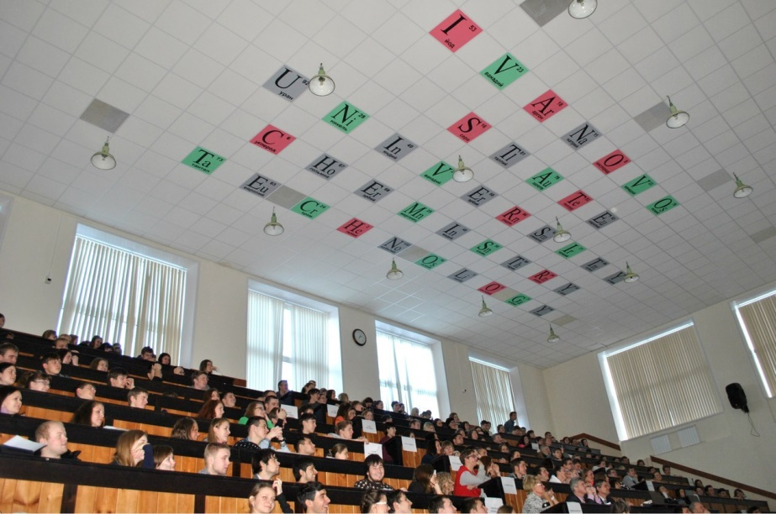
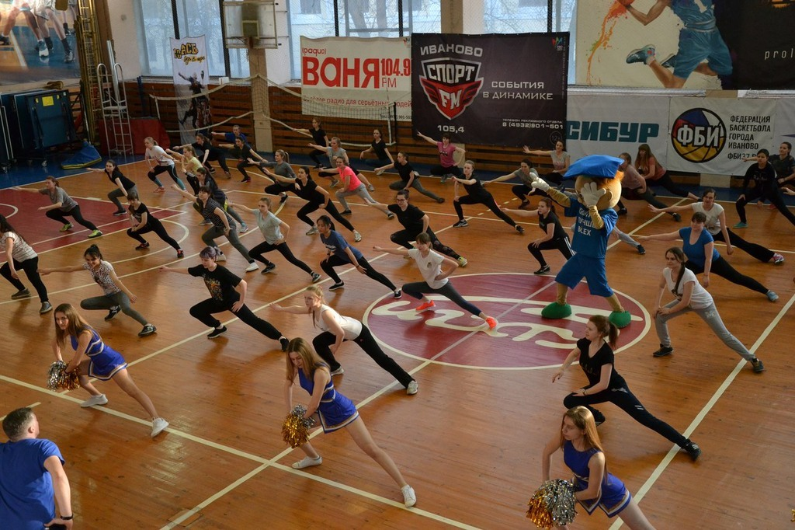
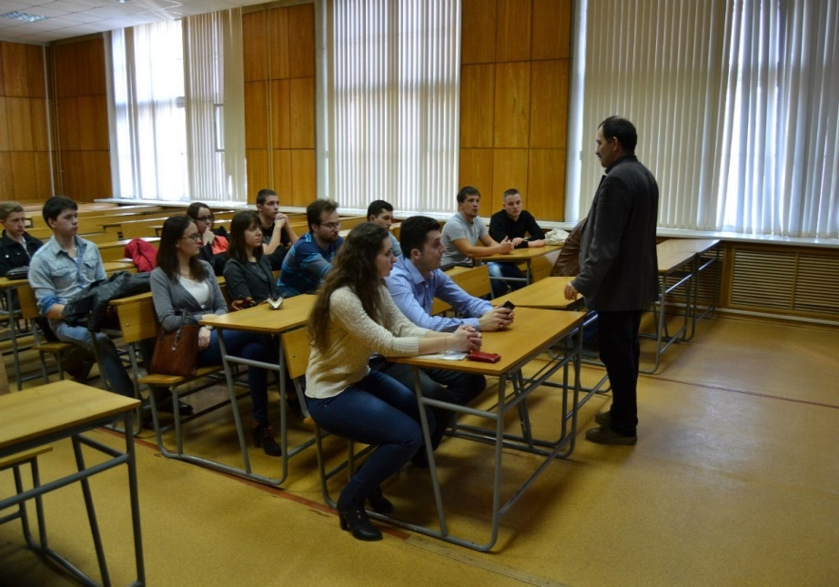
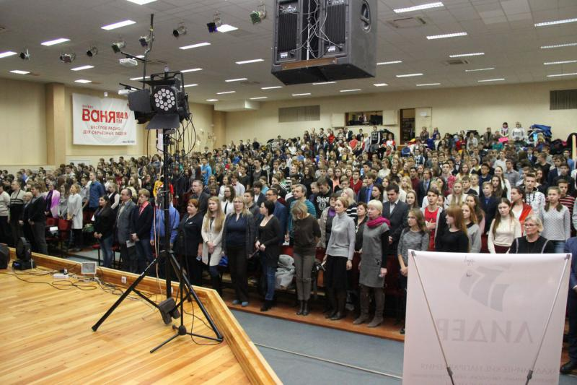

Slide 5
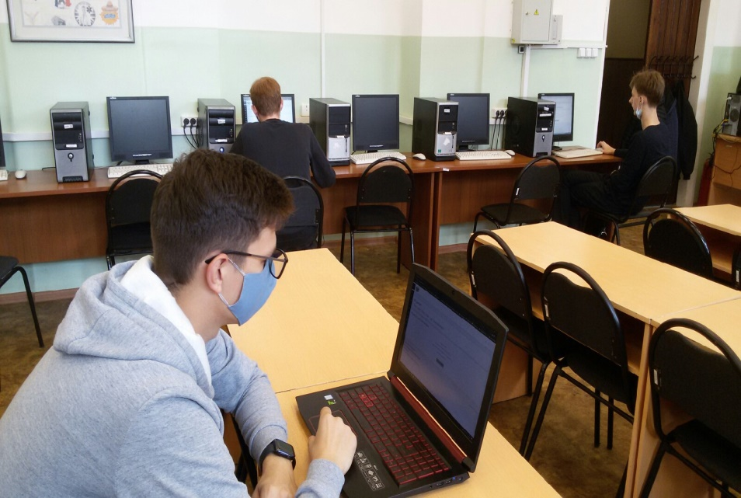
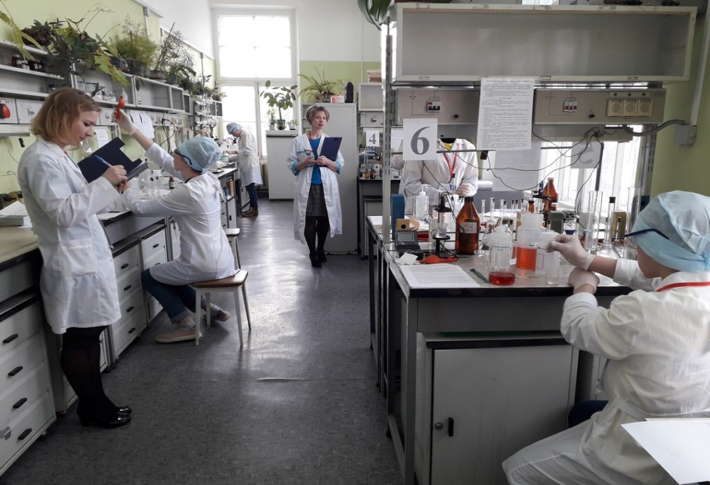
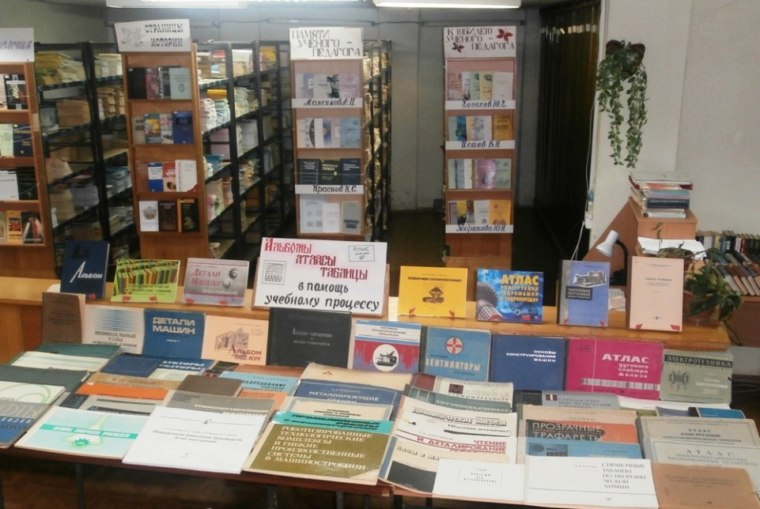
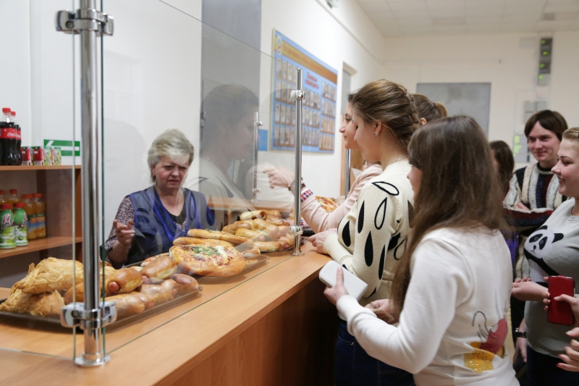

Slide 6
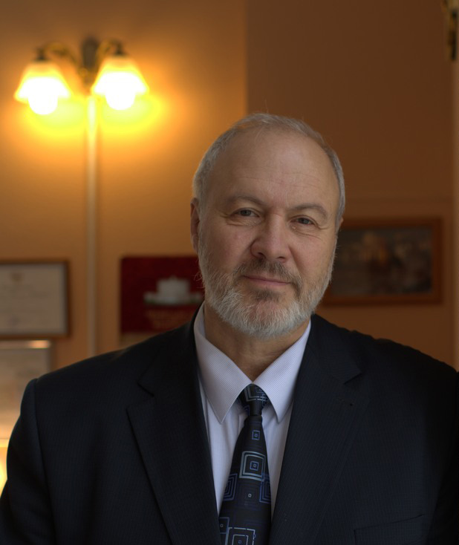
Head of the Institute-rector Бутман M. Ф.

Slide 7
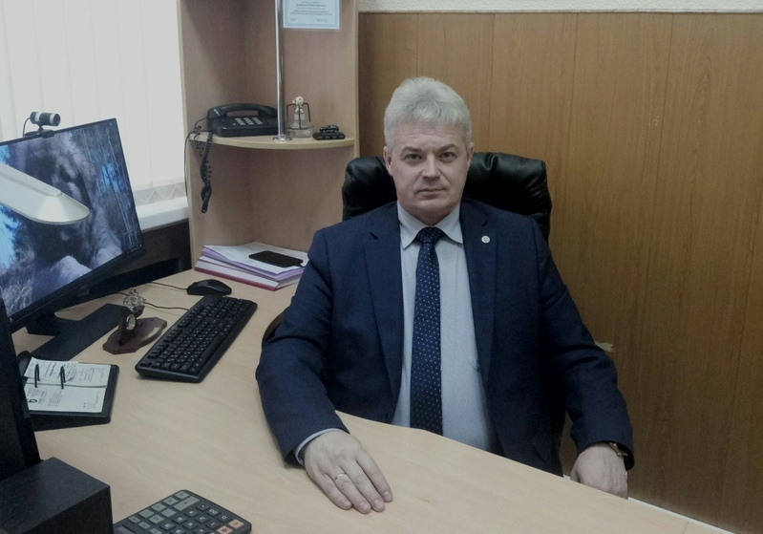
Dean Грименицкий П. Н.

Slide 8




Faculties

Slide 9
Thank you for your attention

