Slide 1
Automatic Number Plate Recognition System for Vehicle Identification Using OCR
Iswar Pradhan
STUDENT ID 1088744
Decembert 2023
Liverpool John Moores University

Slide 2
Introduction
The ANPR system is a computer vision-based technology that automatically reads and recognizes characters on vehicle license plates.
It plays a crucial role in law enforcement, traffic management, toll collection, parking management, and access control.
Reliable character recognition enables efficient vehicle identification and data extraction, used for traffic enforcement, parking management, and toll collection.
Advancements in computer vision, machine learning, and OCR algorithms have significantly improved ANPR systems. Our research aims to compare OCR models and techniques tailored for ANPR. By evaluating accuracy, speed, robustness, and dataset training, we can identify the most suitable OCR models for ANPR applications.

Slide 3
OCR Models for ANPR
Convolutional Neural Networks (CNNs):
CNNs are highly effective in recognizing license plate characters. They use deep learning to learn features from images, achieving high accuracy.
CNNs excel at capturing spatial relationships and handling variations in appearance, fonts, and noise.
Recurrent Neural Networks (RNNs) with Connectionist Temporal Classification (CTC):
RNNs excel at recognizing sequential character sequences on license plates, thanks to their ability to handle sequential data.
By utilizing CTC, RNNs accurately identify variable-length character sequences. They are especially effective for license plates with varying lengths and limited context information.
Transformer Models and Attention-based Models:
Transformer Models and Attention-based Models have gained attention in natural language processing and show promise in OCR, including ANPR.
They capture global dependencies and understand relationships between characters in license plates.
These models excel in capturing long-range dependencies, improving character recognition accuracy in ANPR.

Slide 4
Problem Statement
The problem we aim to address in this research is the accuracy and efficiency of ANPR systems. While ANPR has been widely used in various applications, the accuracy of the OCR technology in recognizing license plate numbers is affected by various factors such as lighting conditions, camera angles, and font styles. In addition, the efficiency of ANPR systems depends on the processing speed and the ability to handle large volumes of data.
The existing literature on ANPR using OCR has focused on the development of algorithms and techniques for recognizing license plate numbers. However, there is a lack of research on the comparison of different machine learning algorithms for ANPR. In this research, we will review the existing literature on ANPR and OCR, with a specific focus on machine learning algorithms.

Slide 5
Aim and Objectives
The objectives of this research are to:
Development of an improved OCR algorithm for recognizing license plates in different lighting and weather conditions. While ALPR systems using OCR technology have been developed before, many of these systems may not work as well in adverse conditions such as low-lighting, fog, or rain
Compare the performance of different machine learning algorithms for ANPR using OCR.
Deep learning has shown promise in many computers vision tasks and using it for ALPR could lead to more accurate and reliable systems. Additionally, exploring the potential of integrating ALPR with other technologies.
This research proposal outlines a study on the use of machine learning algorithms for ANPR using OCR. We aim to compare the performance of different algorithms and identify the best-performing algorithm for ANPR. The results of this research will contribute to the development of a robust ANPR system that can be used in various applications.

Slide 6
Scope of the Study
The study will focus on conducting a comparative analysis of machine learning algorithms for ANPR using OCR.
The study will identify and select suitable algorithms for ANPR based on their accuracy, speed, and robustness.
The study will collect a diverse set of license plate images under different lighting conditions, camera angles, and font styles.
The study will develop a framework for evaluating the performance of the ANPR system using OCR and machine learning algorithms.
The study will provide insights into the factors that affect the accuracy and efficiency of ANPR systems in real-world scenarios.
The study will contribute to the academic literature on ANPR and OCR by providing a comparative study of different machine learning algorithms for ANPR.

Slide 7
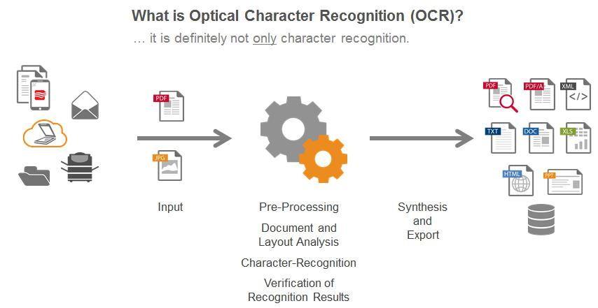
Popular OCR Models
YOLO (You Only Look Once) is a widely popular object detection algorithm used for various computer vision tasks. YOLO can be employed for license plate detection due to its real-time capabilities.
Tesseract OCR, on the other hand, is a widely used open-source OCR engine known for its accuracy and versatility.
It can be used for specific stages of the ANPR pipeline, such as character recognition after license plate detection and segmentation.
Both YOLO and Tesseract OCR have their merits, but the choice of the most suitable OCR model for an ANPR system depends on factors such as accuracy requirements, computational efficiency, and specific system constraints.

Slide 8
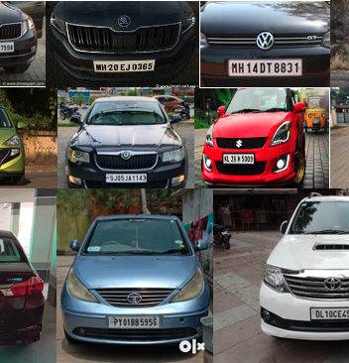
Dataset
The data collection and pre-processing stage involves
collecting and pre-processing the images of number plates.

Slide 9
Advantages & Limitations
Advantages:
• Open-source: Tesseract OCR is freely available and has a large community of contributors, making it continuously improved and enhanced.
• Multilingual support: Tesseract supports a wide range of languages, making it versatile for international applications.
• Robustness: Tesseract can handle various font styles, sizes, and noise levels, making it suitable for diverse OCR tasks.
• Flexibility: Tesseract can be integrated into different programming languages and platforms, allowing for seamless integration into custom applications.data collection and pre-processing stage involvescollecting and pre-processing the images of number plates.
Limitations:
• Complex document layouts: Tesseract may struggle with complex document layouts
or distorted text, leading to reduced accuracy.
• Handwritten text recognition: While Tesseract can handle printed text well, it may not
perform as effectively with handwritten text.
• Inaccurate character segmentation: If the license plate segmentation is not precise,
Tesseract OCR may encounter challenges in accurately recognizing characters.
• Performance with low-quality images: Tesseract's performance may degrade with
low-resolution or highly degraded images.

Slide 10
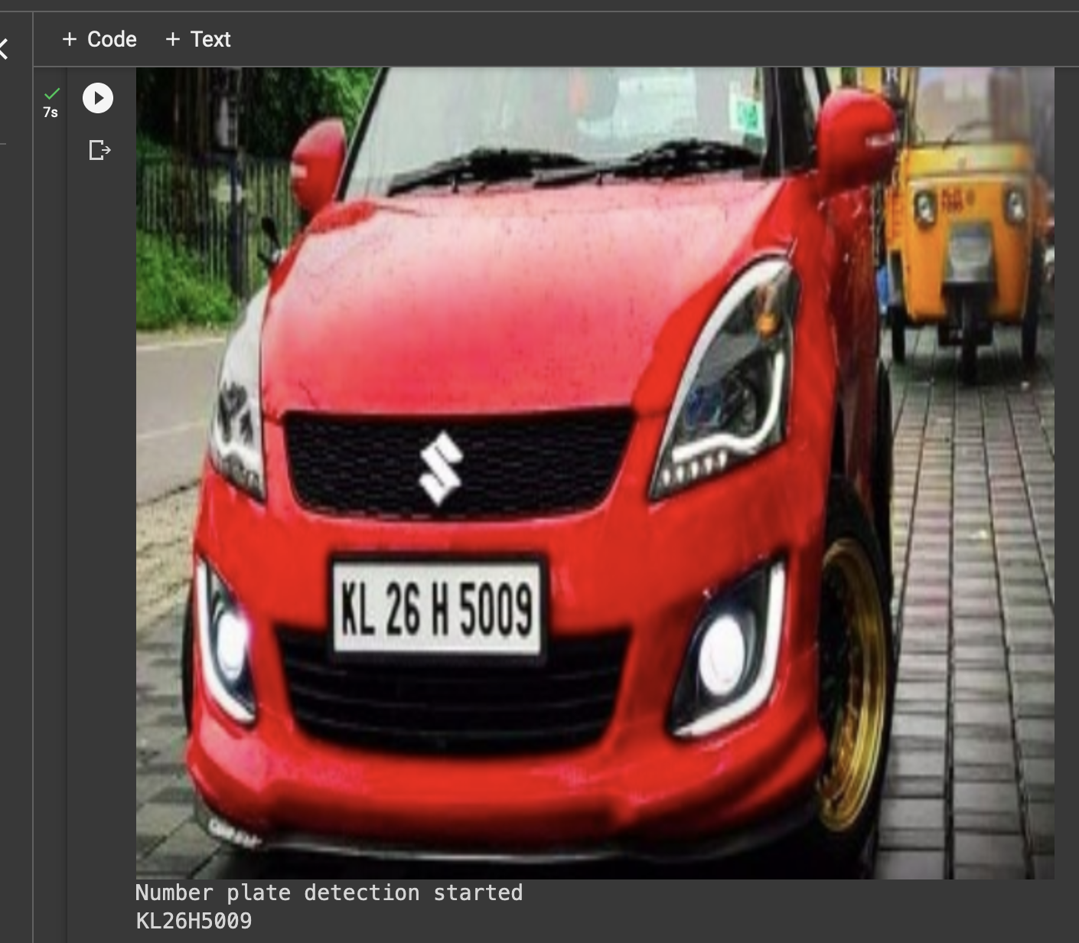
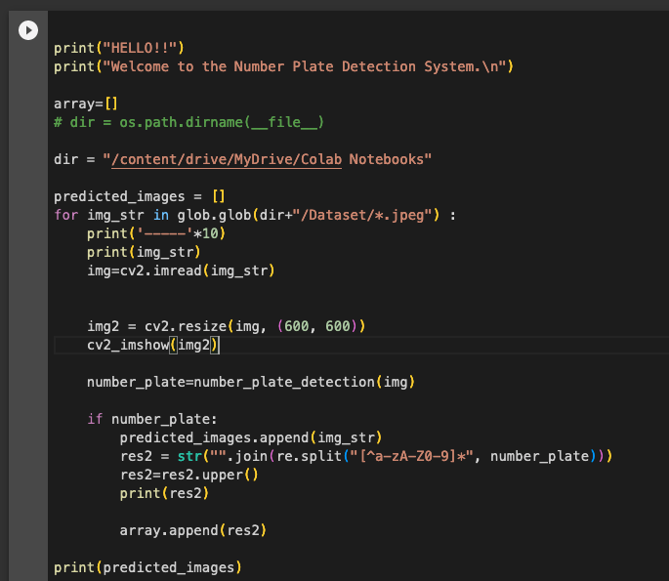
Implementation

Slide 11
Explain code functionality
1. The number_plate_detection function takes an image (img) as input and performs the number plate detection process.
2. The clean2_plate function is responsible for cleaning the extracted license plate region. It converts the color image to grayscale, applies a binary threshold to extract the characters, and removes any noise or unwanted contours.
3. The ratioCheck function checks if the area and aspect ratio of the license plate region are within the expected range. This helps filter out false positives.
4. The is MaxWhite function checks if the average intensity of the license plate region is above a certain threshold. This is used as a criterion to determine if the region contains characters.
5. The ratio_and_rotation function checks the ratio and rotation angle of the bounding rectangle around a contour. It verifies if the ratio is within an expected range and if the angle is relatively horizontal.
6. The input image (img) undergoes pre-processing steps, such as Gaussian blur, conversion to grayscale, and Sobel edge detection.
7. The pre-processed image is thresholded using Otsu's thresholding method.
8. Morphological operations (closing) are applied to further enhance the license plate regions and reduce noise.

Slide 12
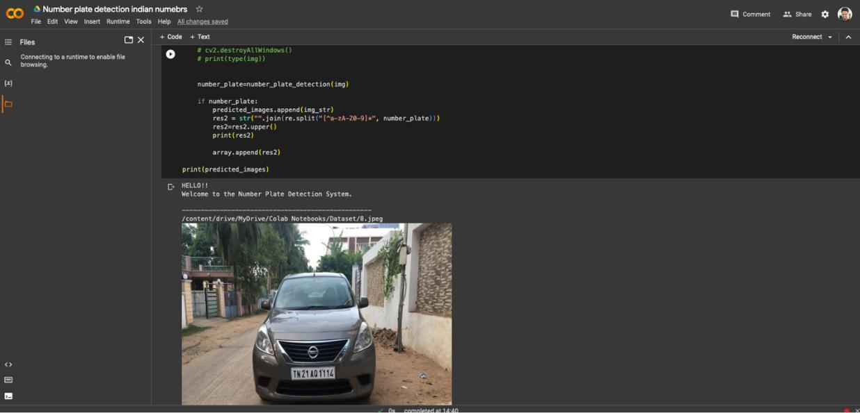
Result Image
9. Contours are extracted from the processed image using the findContours function.
10. The code loops through each contour and applies the ratio_and_rotation function to filter out potential license plate regions.
11. If a potential license plate region is found, it is extracted, and further checks are performed, including maximum white intensity and cleaning using the clean2_plate function.
12.If the cleaned plate region is valid (not empty), it is converted to an image using PIL (Image.fromarray), and OCR is performed using Tesseract (pytesseract.image_to_string) to extract the text from the license plate.
13. The extracted license plate text is returned as the output.

Slide 13
Comparison Factors
Accuracy:
Accuracy is vital for correctly identifying license plate characters.
High accuracy ensures reliable vehicle identification, reduces false positives, and enhances ANPR system effectiveness.
Speed:
Speed is crucial, especially for real-time applications like toll collection and traffic monitoring.
Evaluating OCR model speed involves assessing processing time for character recognition, with real-time performance being essential for time-critical applications.
Robustness:
Ability to handle variations in license plate characteristics, such as font styles, lighting conditions, and image quality.
Dataset and Training:
The dataset used for training OCR models plays a significant role in their performance.
A diverse and representative training dataset, encompassing different license plate designs, backgrounds, and variations, leads to more robust OCR models.

Slide 14
Comparative Analysis Results
Convolutional Neural Networks (CNNs):
Their ability to learn features directly from license plate images allows them to capture intricate patterns and achieve high recognition rates.
CNNs excel in handling variations in character appearance, font styles, and noise, making them suitable for robust ANPR systems.
Recurrent Neural Networks (RNNs) with Connectionist Temporal Classification (CTC):
Their recurrent nature enables them to model dependencies between characters and handle license plates with varying character lengths.
RNNs with CTC are particularly useful for ANPR systems that encounter license plates with limited context information.
Transformer Models and Attention-based Models:
Their ability to capture long-range dependencies and understand the relationships between characters has potential benefits in character recognition.
These models can enhance the recognition of complex license plate patterns and contribute to higher accuracy rates.

Slide 15
Thank you

