Slide 1

Seq 1
Seq 2
Seq 3
…
Seq n

Slide 2




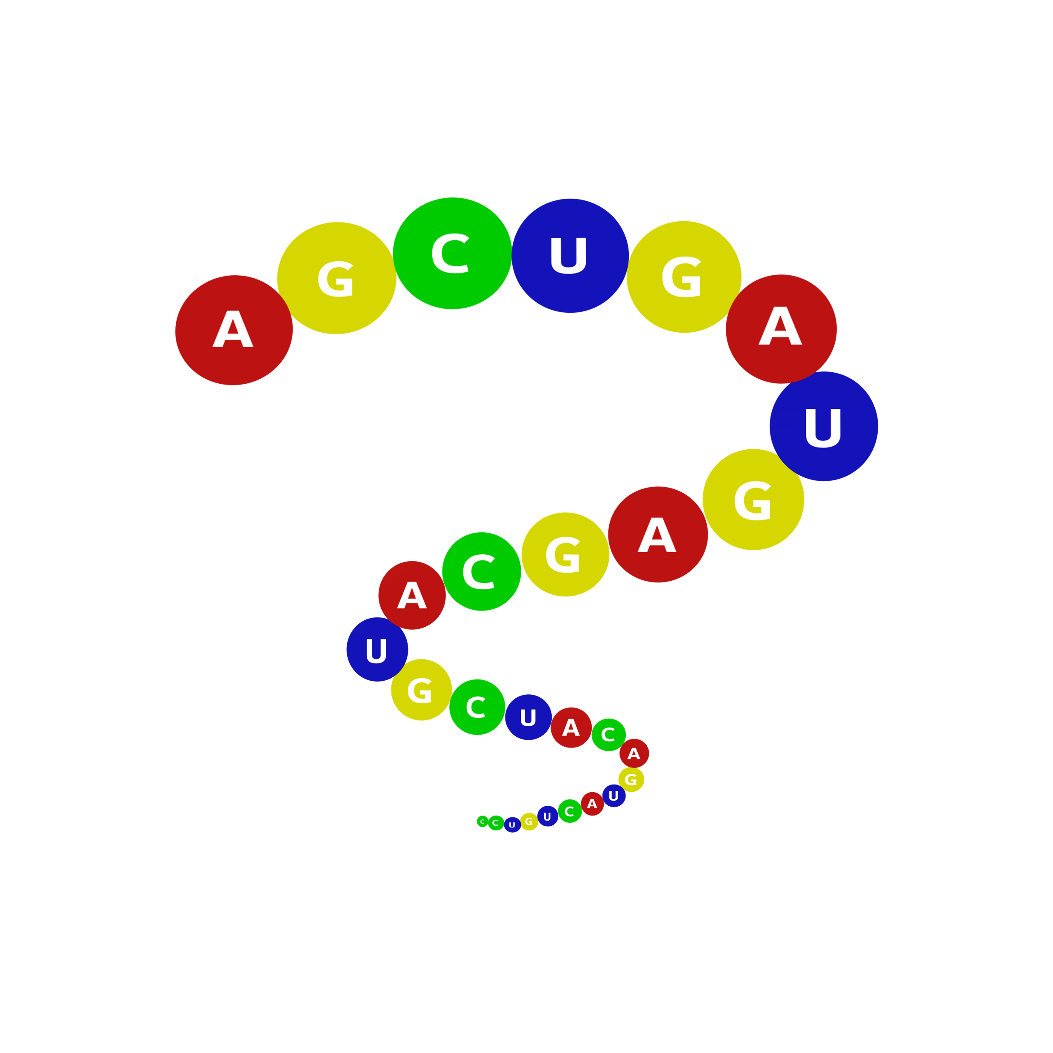
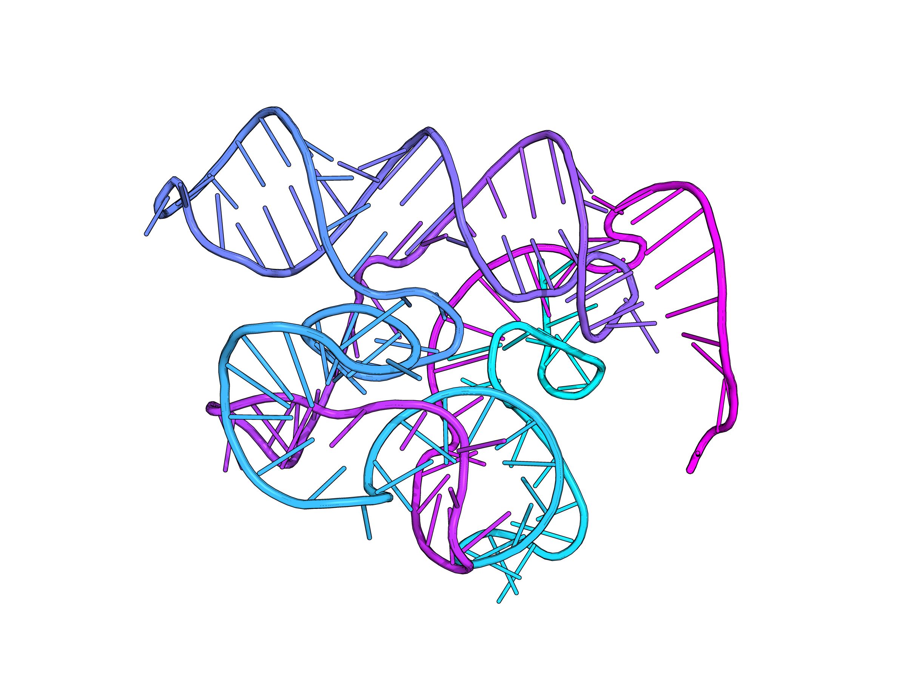




RNA sequence
Database embedding
ncRNAHD
Seq 1
Embedding ranking
Sequence ranking
Seq 2
RNACentral Database
Seq 3
Database encoder
Seq 3
…
…
Seq 1
Seq n
Similarity calculated by cosine
Seq n
ncRNABert
…
…
Seq 2
RNA sequence
Query embedding
Query sequence
Query encoder
Query
(Better performance)
(Default)
Top100K
rMSA
MSA method
trRosettaRNA
(Faster execution)
Predict 3D structure
trRosettaRNA2.search_MSA

Slide 3
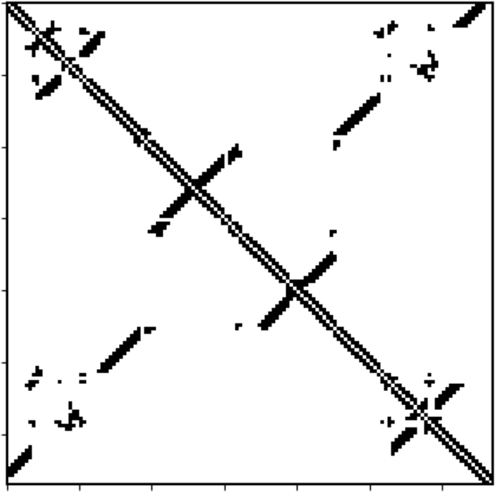
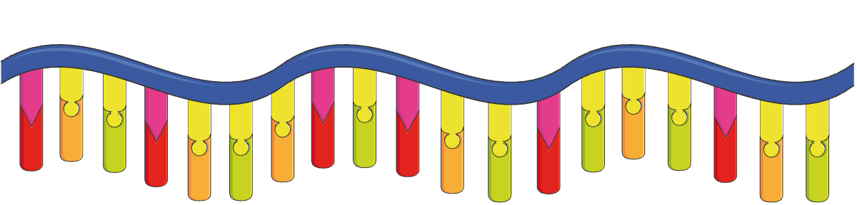
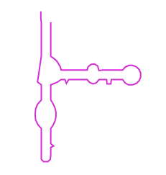
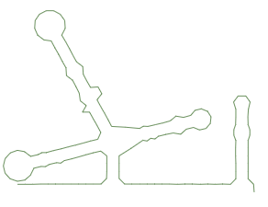

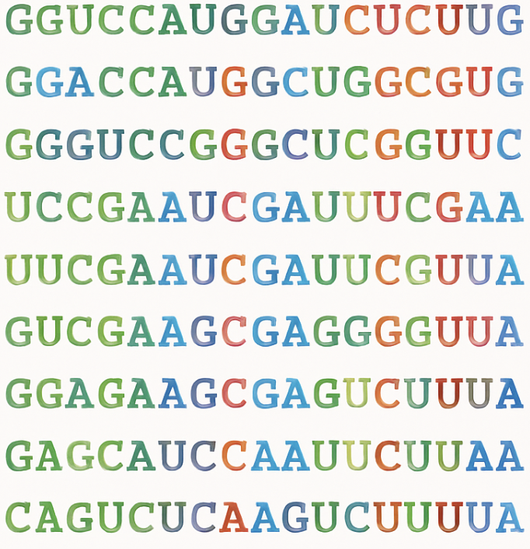




RNAcentral database
(26 Million sequences)
Embedding Layer
LayerNorm & RoPE
Transformer module
Multi-head self-attention
…… 24 Blocks
Add & LayerNorm
3mer tokening(stride=1)
Weight Tying
- A U C G A G C C U G U A
Feed-Forward Network
…
Transformer module
Linear Layer & LayerNorm
RoBERTaLMHead layer
Span masking
- A U C G A G C C U G U A
Linear Layer & SoftMax
- A U C G A G C C U G U A
logits
representation
Downstream Tasks
Evolutionary statistics
Zero-shot function prediction
Secondary structure prediction
Homologs detection
0.8
0.1
0.2
0.5
0.7

