Slide 1
HACKATHON PROJECT
Cool Roofing
Intelligence
Cost, comfort and energy-savings predictions before the first quote
Learned from 2,500 real installations
5 prediction tasks · 6 models · explainable · tested
Cooler roofs · lower bills · clearer quotes
Notes:
[~0.5 min] Good [morning/afternoon]. We built Cool Roofing Intelligence: a system that turns a cool-roofing company's historical installation records into estimates a sales representative can use before the first quote: what it will cost, how much cooler the roof gets, how many electricity units are saved, and how the customer is likely to feel afterwards. Everything you will see today comes from our saved evaluation reports and the running application, including the limitations.
Takeaway: predictive, explainable and honest decision support for cooler buildings.
Transition: let me start with the problem.

Slide 2
THE PROBLEM
A roofing quote still rests on four open questions
How much will it cost?
How much cooler will the roof get?
How many kWh will we save?
Will they rate us highly and refer us?
Installation cost depends on size, method, quality and roof.
Cooling varies by method and quality, not just by price.
Savings depend on current usage and AC load, and can be near zero.
Satisfaction and referrals are driven by experience after the work.
The opportunity
2,500 past installations record cost, roof temperature and electricity use before and after, plus the customer's rating and referral. That is enough to learn from, if the data can be trusted and the answers are explained honestly.
Source: cool_roofing_problem.md; 2,500 historical installation records
2 / 15
Notes:
[~0.75 min] A customer walking in asks four things. How much will it cost? How much cooler will my roof get? How much electricity will I save each month? And will I be happy enough to recommend you? Today a sales rep answers these from experience. The company, however, has a valuable asset: records of thousands of past installations with the cost, the temperatures and electricity use before and after, and the customer's rating and referral. We have 2,500 of them. The opportunity is to learn from those records and give consistent, explained answers.
Takeaway: the data to answer the questions already exists.
Transition: here is the solution we built on it.

Slide 3
THE SOLUTION
One system that predicts, compares, explains and proposes
CORE: implemented and tested
OPTIONAL: implemented
FUTURE: not built
• 5 prediction tasks → 6 models
• Data audit and cleaning pipeline
• Hold-out evaluation vs baselines
• Roofing-option comparison engine
• Per-customer explanations
• Payback calculator (your tariff)
• PDF customer proposals
• React app + FastAPI service
• AI sales assistant: built-in free mode, plus Gemini (live-tested)
• Claude integration built, not live-tested (no credit)
• Assistant only calls validated tools; it cannot invent predictions
• Digital-twin simulator
• Carbon-savings tracker
• Geo-climate intelligence
• Validation on newly measured installations
Status taken from the repository: implemented and tested vs. optional vs. future
3 / 15
Notes:
[~0.75 min] The product has three layers. The core, which is implemented and tested, answers the five required questions with six models, because customer rating is both a numeric prediction and a high-or-not classification. It starts with an audit and cleaning pipeline, because the raw data has problems. It compares every valid roofing option for the same building, explains each prediction, and produces a PDF proposal. The AI assistant is optional: it never calculates numbers itself, it only calls the same prediction service. The three items on the right are future ideas and are not built.
Takeaway: a complete decision-support system, with a clear line between what exists and what is planned.
Transition: all of it rests on the dataset, so let's look at that.

Slide 4
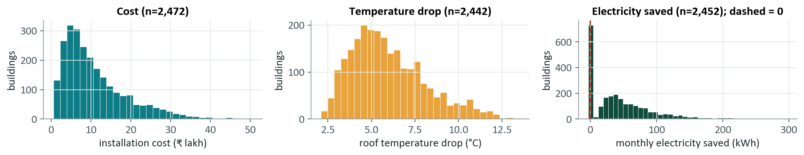
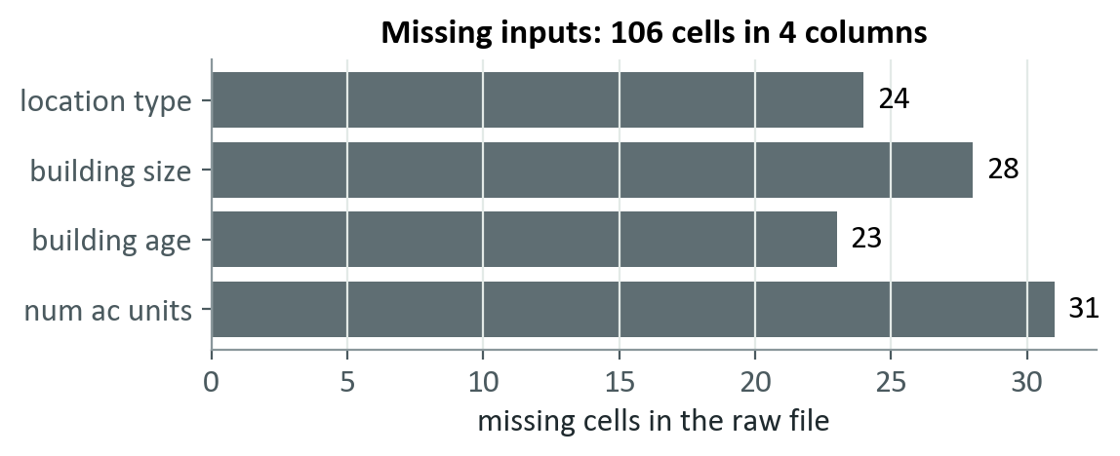
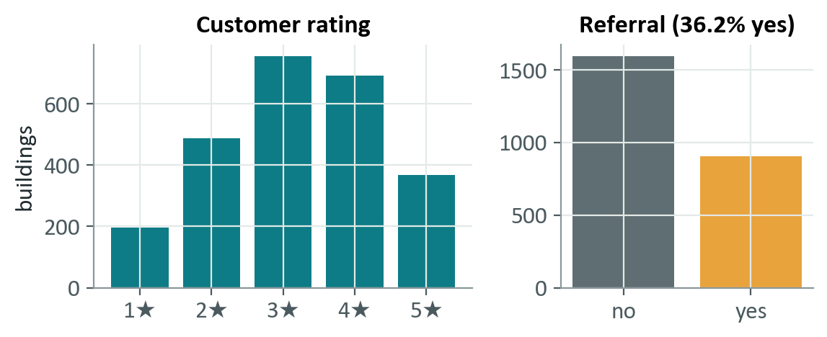
DATASET AND EXPLORATION
2,500 installations, 15 columns, three measurable outcomes
Records: 2,500 · Inputs: location, size, age, existing roof, method, quality, start temperature, AC units, current kWh · Outcomes: cost, temperature, electricity, rating, referral
Source: dataset/cool_roofing_data.csv (read-only); charts computed from reports/data_profile.json after cleaning
4 / 15
Notes:
[~0.75 min] The dataset has 2,500 installation records and 15 columns: building profile (location, size, age), roofing details (existing roof, method, quality), cost, roof temperature and monthly electricity before and after, the customer rating from one to five, and whether the customer referred us. Cost is right-skewed and scales with building size. Roof temperature drops by about 2 to 13 degrees on valid records. Electricity savings are strongly tied to current usage; note the dashed line at zero, because some buildings used more electricity afterwards. Four input columns have 106 missing cells in total. About 36% of customers referred us, so referral is an imbalanced target.
Takeaway: rich data with skewed targets and some gaps.
Transition: and some values that should not be trusted.

Slide 5
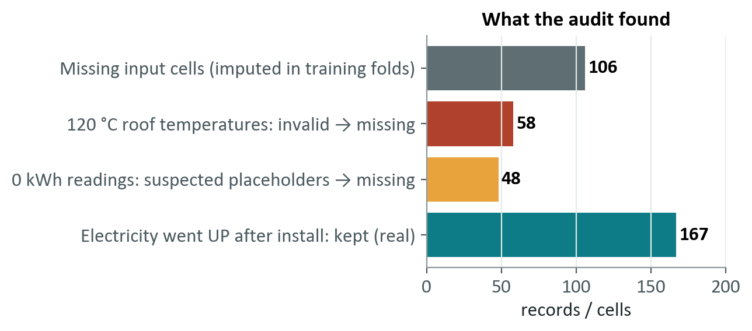
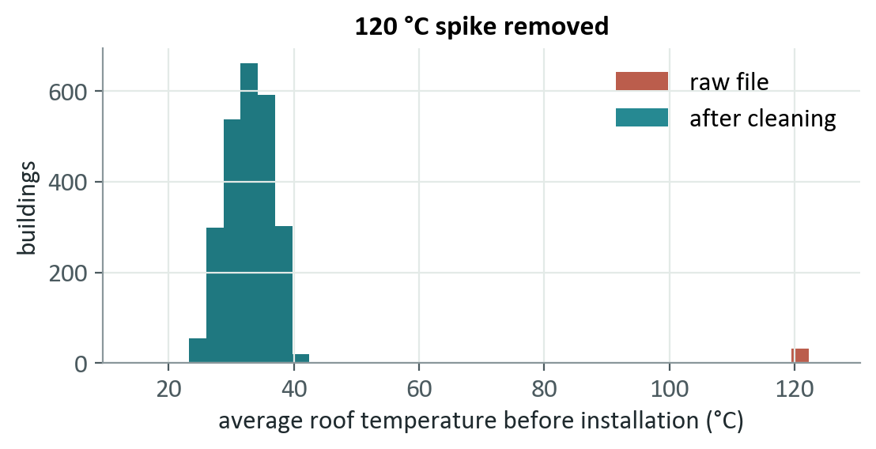
DATA QUALITY
The audit found two silent placeholders that would have corrupted the models
Confirmed invalid
Inferred, high confidence
Kept on purpose
120 °C roof temperature: 58 records (32 before, 26 after)
Set to missing, never capped or guessed
0 kWh: 48 readings. No 1–3 kWh values exist; rows are physically inconsistent
Effect: savings MAE 4.45 → 3.62 kWh
167 buildings used MORE electricity after install: real adverse outcomes
0 records deleted; exclusions are per task only
Source: reports/data_quality_report.md, reports/cleaning_audit.csv (record-level audit trail); raw file never modified
5 / 15
Notes:
[~1 min] Before modelling we audited every column. Two problems stood out. First, exactly 120 degrees appears as a roof temperature in 58 records, never anywhere near other readings, which would imply drops of plus or minus ninety degrees: that is confirmed invalid. Second, exactly zero kilowatt-hours appears 48 times while one to three kWh never occurs, and those rows are physically inconsistent. We treated them as placeholders. That is an inference, a strong one, but not a confirmed fact. We set invalid values to missing rather than guessing, and exclude a record only from the task that needs it. The result was measurable: electricity-savings error on the hold-out fell from 4.45 to 3.62 kWh. We also kept 167 buildings where electricity use went up, because those are real adverse outcomes, and deleting them would flatter the model. No record was deleted outright.
Takeaway: cleaning decisions are documented, evidence-based and measurable.
Transition: with clean data, we must also prevent leakage.

Slide 6
TARGETS, FEATURES AND LEAKAGE PREVENTION
Only what a rep knows at the table can be a model input
Temperature drop (°C)
ALLOWED at quote time (9 inputs)
= roof temperature before − roof temperature after
Location type
Building size
Building age
Existing roof
Proposed method
Proposed quality
Electricity saved (kWh / month)
= monthly kWh before − monthly kWh after
Start roof temp.
AC units
Current kWh
Evaluation protocol
FORBIDDEN as inputs
Realised cost
Temp. after install
kWh after install
2,500 buildings
Customer rating
Referral flag
Building ID
2,000 train + validation
5-fold CV: tuning and selection
500
hold-out
Why it matters: referral rate is 61% for 4★+ customers vs 9% for 1–2★, so rating would leak referral.
Rejected at the API too: unknown fields return HTTP 422.
• Preprocessing fitted on training folds only
• Hold-out scored once; baselines declared first
• Shuffled-label and ID-only controls sit at chance
Source: docs/feature_contract.md; tests/test_features_leakage.py, tests/test_model_review.py
6 / 15
Notes:
[~1 min] Two outcomes are derived: temperature drop is temperature before minus after, and electricity saved is units before minus after. The key design rule is that a model may only use facts known before installation. On the right, nine inputs are allowed: location, size, age, existing roof, the proposed method and quality, and three pre-installation measurements. Realised cost, the after-installation measurements, the customer's rating and the referral flag are forbidden, as is the building ID. This matters: for example, the referral rate is 61 percent for four-star-plus customers against 9 percent for one-to-two stars, so using the rating to predict referral would be pure leakage. For evaluation we fixed a hold-out of 500 buildings before any modelling. Tuning used five-fold cross-validation on the other 2,000. All preprocessing is fitted on training data only. Automated tests and independent controls, such as models trained on shuffled labels, confirm there is no leakage.
Takeaway: the evaluation answers 'how well will this work on a new building?'.
Transition: here is the system that implements it.

Slide 7
SYSTEM ARCHITECTURE
From raw CSV to a tested, explainable web product
Raw CSV
Audit & cleaning
Feature contract
Train & evaluate
Saved artifacts
2,500 × 15, read-only
flags, audit trail
leakage guards, pipelines
CV, hold-out, baselines
6 models + metadata
Reports and figures
FastAPI inference service (models loaded once)
data-quality, evaluation, significance and insight reports feed the Performance and Insights pages
predict · batch · compare options · explain (Shapley) · payback · PDF proposal · strict input validation
Quality gates
153 backend + 30 UI tests (incl. accessibility) · type-check · production build · browser-verified
React + TypeScript UI
8 pages · light/dark · accessible
Optional AI assistant
validated tool calls only
pandas · scikit-learn · LightGBM · FastAPI · React 19 + TypeScript + Vite · Tailwind · Recharts · ReportLab
Source: docs/architecture.md and the implemented code (src/coolroof, frontend/)
7 / 15
Notes:
[~1 min] The pipeline flows left to right. The raw CSV is read-only; the audit and cleaning step produces a cleaned dataset and an audit trail; a feature contract and shared preprocessing pipelines feed training and evaluation, which saves six model files plus metadata. A FastAPI service loads the models once and serves prediction, option comparison, Shapley-value explanations, a payback calculator and PDF proposals. The React and TypeScript front end calls that API. The optional assistant also goes through the API: the language model can only call validated tools, so it never produces official numbers. Quality gates: 153 backend tests and 30 frontend tests including accessibility checks, a clean type check and production build.
Takeaway: one shared feature contract keeps training and serving consistent.
Transition: now the models themselves.

Slide 8
MODELS
Five tasks, six models: simple where the data is simple
# | Task | Prediction | Selected model | Type | Baseline | Train+val / test
A | Installation cost | Installation cost (₹) | Log-linear ridge (multiplicative) | Regression | Training mean | 1,979 / 493
B | Roof temperature drop | Roof temperature drop (°C) | LightGBM: drop-fraction × starting temperature | Regression | Training mean | 1,956 / 486
C | Monthly electricity saved | Electricity saved (kWh/mo) | LightGBM: saved-fraction × current usage | Regression | Training mean | 1,958 / 494
D1 | Customer rating | Customer rating (1–5) | LightGBM | Regression | Training median | 2,000 / 500
D2 | High rating | High rating (≥ 4★) | LightGBM | Classification | Majority class | 2,000 / 500
E | Customer referral | Customer referral | Logistic regression | Classification | Majority and all-positive | 2,000 / 500
Regression predicts a number (₹, °C, kWh, stars). Classification predicts a yes/no with a probability.
The high-rating threshold of 4 stars is our assumption: the organisers gave no definition (configurable).
Source: models/model_metadata.json. Customer rating needs two models (numeric rating + high/not-high classifier)
8 / 15
Notes:
[~1 min] There are five prediction tasks but six trained models, because the rating task has two parts: a regression for the one-to-five rating, scored by mean absolute error, and a classifier for 'high rating', scored by accuracy. Regression predicts a number, such as rupees or degrees; classification predicts a category or probability, such as will the customer refer. Note that the best cost model is not the fanciest one: a log-linear ridge regression beat gradient boosting because cost behaves like size times a rate. The two LightGBM savings and cooling models predict a fraction and multiply it back, which suits how those outcomes scale. Each model is compared with a baseline and tuned with cross-validation only.
Takeaway: we chose models by validation evidence, not sophistication.
Transition: how do we measure them?

Slide 9
EVALUATION METHODOLOGY
Judged on 500 buildings the models never saw
MAE
RMSE
How we kept it honest
Mean absolute error
Root mean squared error
1 500-building hold-out fixed before modelling, scored once
2 Tuning and selection by 5-fold CV on the rest
3 Baselines declared first: training mean (median for rating); majority class and 'everyone positive' for classifiers
4 'Better' only if the paired-bootstrap 95% CI excludes 0
5 Independent review recomputed every metric and replicated the selection on never-explored rows
Average size of the miss, in the target's own unit
Like MAE, but big misses count more
Accuracy
F1
Share correct
Precision × recall balance
Misleading when one class dominates
Matters for the rarer class, e.g. referrals
Precision = flagged who truly are · Recall = true cases we catch · AUC = ranking skill (0.5 = chance)
Same split everywhere: models and their baselines are scored on the identical hold-out rows, so comparisons are direct.
Source: docs/model_evaluation.md and docs/model_review.md; paired bootstrap, 2,000 resamples, 95% intervals
9 / 15
Notes:
[~1 min] A quick guide to the metrics. MAE is the average size of the miss, in the unit of the thing we predict. RMSE also measures error but squares it first, so large misses count more. For yes-or-no tasks, accuracy is the share of correct answers, but it can be misleading when classes are imbalanced: always predicting 'no referral' is right 63 percent of the time. F1 balances precision, how many flagged customers truly are, with recall, how many true cases we catch. Our protocol: the 500-building hold-out was fixed before modelling and scored once. Baselines were declared before looking at it. We call a model 'better' only if a paired bootstrap interval of the improvement excludes zero. An independent review also rebuilt every number from the saved models and replicated the whole selection on a hold-out that exploration had never touched.
Takeaway: results are honest and statistically checked.
Transition: first, the three regression results.

Slide 10
RESULTS: REGRESSION
Regression models cut error 4–25× versus a mean baseline
Task | Selected model | MAE | RMSE | R² | Baseline MAE
Cost | Log-linear ridge | ₹25,299 | ₹38,515 | 0.998 | ₹637,024
Temperature drop | LightGBM (ratio target) | 0.41 °C | 0.51 °C | 0.948 | 1.80 °C
Electricity saved | LightGBM (ratio target) | 3.62 kWh | 5.87 kWh | 0.987 | 38.4 kWh
What this shows
MAE improvement: 95% CI above 0 for all three
80% ranges cover 78% / 79% / 76% (slightly narrow)
Accuracy comes from legitimate inputs: no size → cost R² 0.22
Source: models/model_metadata.json (hold-out n = 493 / 486 / 494); each chart has its own unit and scale
10 / 15
Notes:
[~1 min] For the three regression tasks, each chart compares the baseline, which just predicts the training average, with our selected model, in the task's own unit. Cost: the typical miss falls from ₹637,024 to ₹25,299, about 25 times smaller. Cooling: from 1.80 to 0.41 degrees Celsius. Electricity saved: from 38.4 to 3.62 kWh a month. In all three, the paired bootstrap interval of the improvement is far above zero. R-squared is 0.998, 0.948 and 0.987. An ablation shows these come from legitimate inputs: remove building size and the cost R-squared collapses to 0.22; remove method and quality and cooling drops to 0.25. One caveat: our nominal 80 percent likely-range intervals actually cover 78%, 79% and 76%, so they are slightly narrow.
Takeaway: strong, statistically supported accuracy where the data is structured.
Transition: the human-outcome tasks are harder.

Slide 11
RESULTS: RATING AND REFERRAL
Ratings and referrals are only weakly predictable, and we show it
Customer rating and high rating
Customer referral (best-F1 cut-off 25%)
Rating MAE
High-rating accuracy
 | Predicted: no | Predicted: yes
Actual: no | 95 | 218
Actual: yes | 26 | 161
0.77 ★
0.688
baseline 0.92 · better
majority 0.576 · better
High-rating F1
High-rating AUC
0.614
0.76
F1 0.569 vs 0.544 (everyone refers): not distinguishable
Accuracy 0.512 vs 0.626 (majority class): significantly worse
Recall 0.86 · precision 0.42 · AUC 0.66 (CI 0.61–0.70)
all-high 0.596 · n.s.
95% CI 0.71–0.80 · above chance
High rating means 4 stars or more: our assumption (no official definition).
Accuracy and F1 pull in opposite directions for referrals. No cut-off beats the trivial classifiers on both, so the app shows both and uses referral probability only to rank follow-ups.
Source: models/model_metadata.json and reports/significance.json (hold-out n = 500); trivial baselines declared before scoring
11 / 15
Notes:
[~1 min] These two tasks depend on what happens after installation, so they are harder at quote time. For ratings, mean error is 0.77 stars against 0.92 for the baseline, a significant gain. For high rating, defined as four stars or more, which is our assumption, accuracy is 0.688 against 0.576 for the majority class, also significant, and the AUC is 0.76. But the F1 of 0.61 is not distinguishable from simply saying everyone will rate highly. Referral is the weakest. At its best-F1 cut-off the model catches most referrers, recall 0.86, but flags many people wrongly. F1 is 0.57, statistically indistinguishable from predicting everyone refers at 0.54, and accuracy 0.512 is significantly worse than the majority-class 0.626. The AUC of 0.66 shows a real but weak ranking signal. Even knowing the realised savings would only reach 0.68 AUC, so the information mostly isn't in the data. We use it to rank follow-ups, never to promise.
Takeaway: being transparent about weak results is part of the engineering.
Transition: what actually drives the strong results?

Slide 12
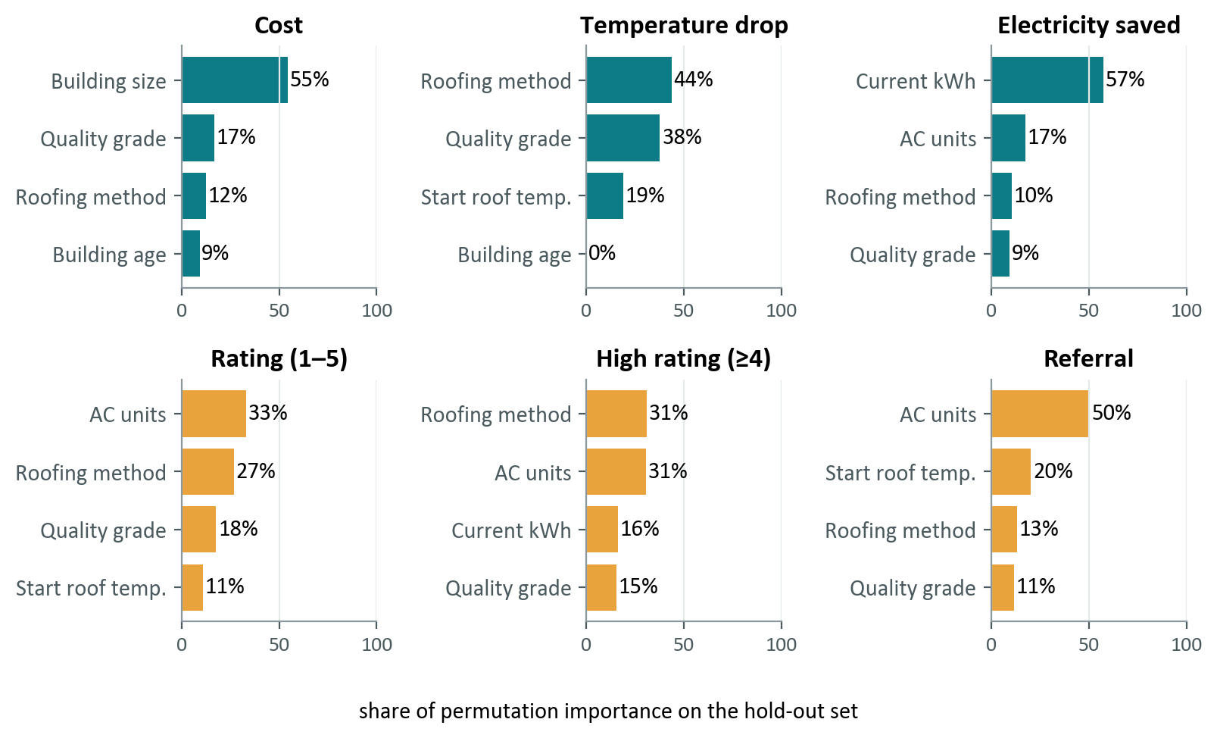
EXPLAINABILITY AND BUSINESS INSIGHTS
Size drives cost; method and quality drive cooling and satisfaction
Model view: methods on concrete roofs
Method | Cost | Cooling | kWh | P(high)
Basic coating | ₹8.9 L | 4.6 °C | 41 | 35%
Sheet | ₹9.8 L | 6.0 °C | 51 | 47%
Sheet + coating | ₹12.5 L | 7.8 °C | 62 | 55%
Tiles | ₹10.7 L | 5.7 °C | 49 | 42%
Tiles + coating | ₹13.4 L | 8.2 °C | 65 | 58%
Careful reading
Coated options lead on cooling, savings and satisfaction; none wins everywhere
Associations, not causation
Electricity savings alone repay slowly: the case rests on comfort
Source: reports/feature_importance.csv (hold-out permutation importance), reports/insights.json (model counterfactuals, concrete roofs, n = 1,323). Associations, not causal effects.
12 / 15
Notes:
[~1 min] On the left is global feature importance from the hold-out set, meaning how much accuracy drops when an input is shuffled. Building size dominates cost; the roofing method and quality dominate cooling; current electricity use and AC count dominate savings; AC count and the method matter most for ratings and referrals. On the right, we ask the model what happens on concrete roofs, the only roofs that accept all five methods, if every building used each method in turn. Coated options are consistently strongest on cooling, savings and predicted satisfaction, but there is no single best method for everyone, and roof type limits what can be installed. Basic coating is cheapest but weakest. These are associations from past installations, not proof of cause. Also, at a plausible electricity price the savings alone would take very long to repay the cost, so the business case rests on comfort and benefits the data doesn't measure.
Takeaway: explanations are specific, computed, and carefully worded.
Transition: and here is how it looks in the product.

Slide 13
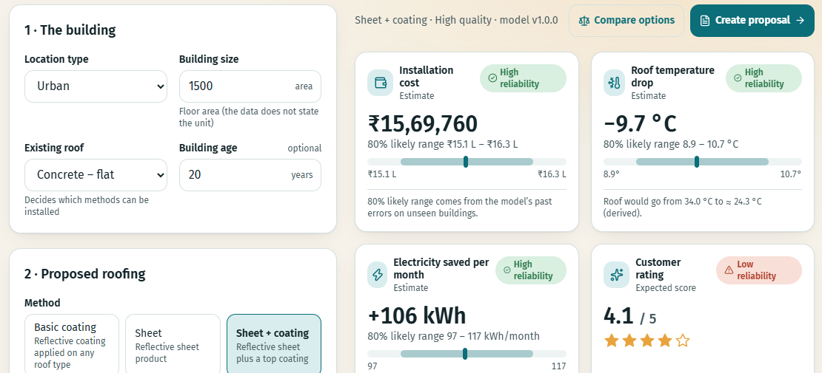
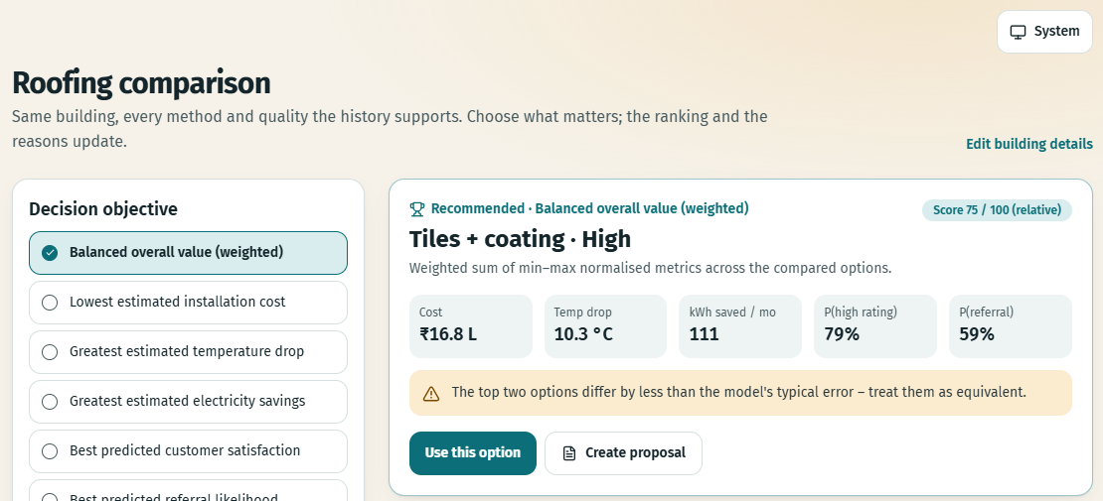
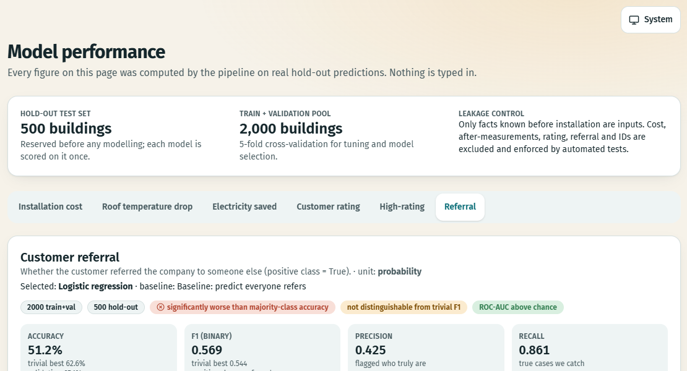
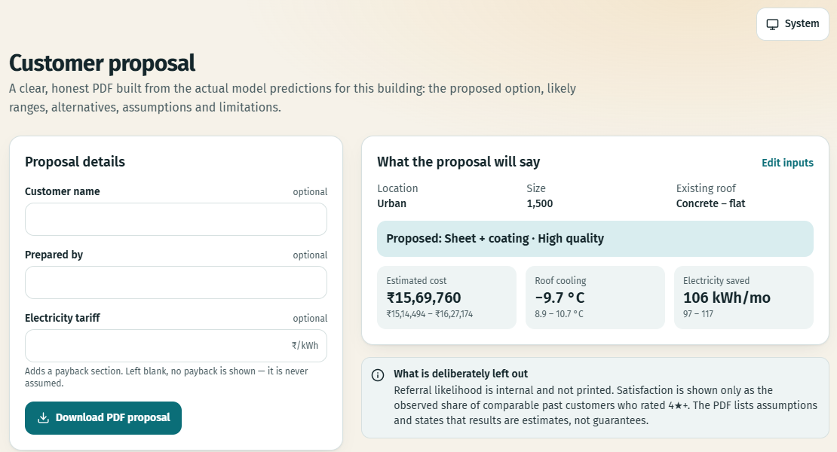
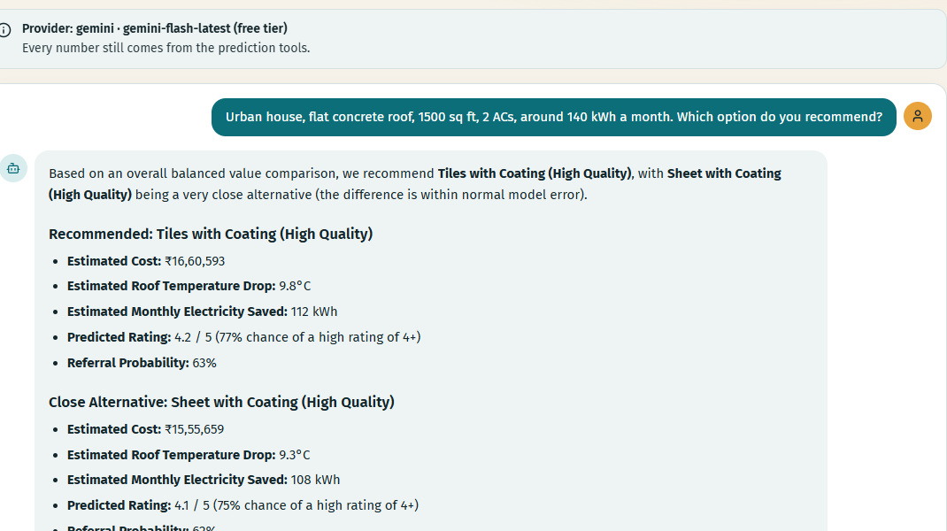
DEMONSTRATION
The product is built and running: predict, compare, explain, propose
Customer prediction: cost, cooling, kWh, rating and referral, each with a likely range and a reliability flag
Roofing comparison: every valid method × quality, ranked for your objective, with the basis shown
Model performance: baselines and intervals
PDF proposal: from real predictions
AI assistant: Gemini live-tested
Source: screenshots of the running local application (React + FastAPI). Assistant: Gemini live-tested; Claude not live-tested.
13 / 15
Notes:
[~1 min] These are real screenshots from the running app. Top left, the prediction workspace: the rep enters a few facts and gets cost, cooling, electricity savings, rating and referral, each with a likely range and a reliability flag, plus a 'why this estimate' explanation and an optional payback calculator that never assumes a tariff. Top right, the comparison page ranks every valid method and quality combination for the same building, with adjustable priorities and a transparent score. Below: the model performance page with baselines and confidence intervals, the PDF proposal page, and the optional AI assistant, which answered live through Gemini by calling the same prediction tools. The Claude integration is built, but we could not live-test it because that account has no credit.
Takeaway: this is working software, not a mock-up.
Transition: finally, value and limits.

Slide 14
BUSINESS VALUE, LIMITATIONS AND ROADMAP
Useful today as decision support; honest about what it cannot do
Business value (demonstrated)
Limitations (stated openly)
Roadmap (future, not built)
• Preliminary estimates in well under a second
• Compare 15 method × quality options per building
• Every prediction explained and assumptions visible
• Proposal PDFs from real model outputs
• Payback only from the customer's own tariff
• Estimates, not guarantees
• 0 kWh placeholder treatment is an inference
• Rating and referral only weakly predictable
• High-rating threshold (4★) is our assumption
• Associations, not causation; no time or location fields
• Claude not live-tested (Gemini is)
• Validate on newly measured installations
• Digital-twin simulator
• Carbon-savings tracker
• Geo-climate intelligence
Source: docs/business_recommendations.md, docs/assumptions_and_decisions.md, docs/model_review.md. Roadmap items are NOT implemented.
14 / 15
Notes:
[~0.75 min] For the business, the product gives a consistent first estimate in well under a second, lets a rep compare fifteen option combinations for the same building, explains each prediction, makes every assumption visible, and produces a proposal PDF. We are equally clear about limits. Predictions are estimates, not guarantees. The zero-kilowatt-hour treatment is an inference. Rating and referral models are weak. The high-rating threshold is our assumption. Method effects are associations from observational data, there is no time or location field to test drift, and the Claude integration has not been live-tested. The roadmap on the right is future work only: a digital-twin simulator, a carbon-savings tracker and geo-climate intelligence are not built. The most valuable next step is validating against newly measured installations.
Takeaway: real value, bounded claims.
Transition: to close.

Slide 15
CONCLUSION
From 2,500 past roofs to decisions that are explained and honest
What we built
What the evidence supports
Strongest capabilities
Next step
• Audit + cleaning pipeline
• 6 models, 5 tasks
• Compare · explain · propose
• 183 automated tests
• Cost MAE ₹25,299
• Cooling MAE 0.41 °C
• Savings MAE 3.62 kWh
• Rating and referral: weak signal
• Leakage-free, hold-out-verified
• Honest baselines and CIs
• Explanations per customer
• Working end-to-end app
• Validate on newly measured installations
• Then: digital twin, carbon tracker, geo-climate
Historical roofing data, turned into estimates a sales rep can trust, with the reasons and the limits attached.
Thank you · Questions?
Cool Roofing Intelligence · all figures from the project's saved reports
15 / 15
Notes:
[~0.5 min] To close. We built a complete system: a cleaned and audited dataset, six models for five tasks, honest hold-out evaluation with baselines and significance tests, explanations, an option-comparison engine, PDF proposals and an optional assistant. The evaluation supports strong predictions of cost, cooling and electricity savings, and modest but real signal for ratings, while referrals remain a ranking aid only. Our strongest contribution may be the discipline: finding the hidden placeholders, preventing leakage, and reporting weak results plainly. The next step is validating on new, measured installations. Thank you; we're happy to take questions.
Takeaway: trustworthy, explainable decisions from historical roofing data.

