Slide 1
Ottawa Infotainment UI/UX Innovation Challenge
Performance-Driven Dashboard Interface
Team InF1nite | Ottawa Infotainment Inc.
[Shaurya, Shrinicketh, Reshma, Timothy, Harinath, and Krishna] — UI/UX Design & HMI Engineering
Challenge Track: Instrument Cluster Design
Feb 18, 2026

Slide 2
1. Problem Statement
The User
A High Net Worth Individual (HNWI) who owns an automotive company. He is purchasing this sports car as a career milestone. He also wants to impress his teenage kids, making the car’s technology feel aspirational and exciting to a younger, tech-savvy generation.
The Problem
This user has an exceptionally high bar. As someone who runs an automotive business, he understands vehicles deeply, generic dashboards won’t impress him. His teenagers, raised on smartphones and gaming, will judge the interface instantly. The current instrument cluster is forgettable i.e. it lacks emotional impact and fails to communicate performance character
Why It Matters
• The dashboard is the first thing driver and passengers react to on entry
• A milestone purchase demands a UI worthy of the occasion
• Dual audience (expert professional + tech-savvy teens) demands sophistication and excitement
• At 195 mph, poor information design is dangerous as a 2 sec glance means 572 ft travelled blind

Slide 3
2. User & Context
Primary User Persona
• Male, 65 years old, HNWI, owns and operates an automotive company
• Deep knowledge of cars as he will notice every design decision
• Purchasing this as a personal career milestone so the emotional significance is very high
• Wants to feel proud showing this car to his family, especially his teenage children
Secondary Audience (Influential)
• Teenage kids, highly tech-literate, expect smooth smartphone and gaming UX
• They reaction matters deeply to the father
Key Constraints
• Safety: 1.5-second glance threshold is non-negotiable
• Sophistication: must feel as premium as the price tag with good animations
• Dual appeal: exciting for teens, refined and purposeful for an industry expert
• Hardware: Dual screen display, 1920×720, 60 fps

Slide 4
3. Existing Solutions & Gaps
Current Benchmarks
• Porsche / McLaren — refined and technical
• Ferrari digital cluster — prestigious but complex
• Corvette / Mustang digital — bold and American but aesthetically rough
• Tesla / Rivian — clean and modern but not performance-oriented, no sports car character
What Works Well
• European premium brands: consistent, polished, brand-coherent visual language
• Tesla/Rivian: immediately impressive startup animation, familiar to younger users
• Sports-focused systems: performance data density that experts appreciate
Critical Gaps — Our Opportunity
• No system targets the dual audience: Data centric design for drivers + appeasing to the passengers
• Startup and ambient animations are absent or forgettable

Slide 5
4. Proposed Solution – Concept Overview
Our Solution
A performance-driven digital instrument cluster that feels like a career milestone every time the car starts while striking enough to earn a teenager’s respect, sophisticated enough to satisfy an automotive industry expert and safe enough to use at higher speeds.
Key Differentiators
• Cinematic startup sequence
• Three-tier visual hierarchy
• Three adaptive modes — Normal/Street (refined, premium), Sports (necessary data-first) and Night mode
• Design language: bold, precise, confident Detroit character
• Ambient display states that make passengers feel they’re in something genuinely special

Slide 6
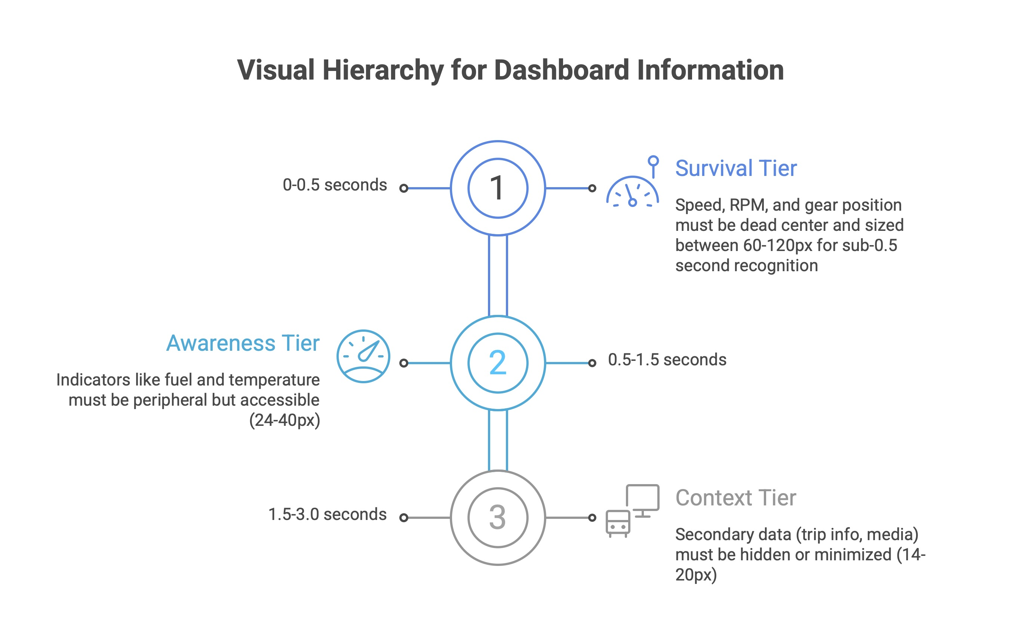

Slide 7
5. User Flow & Interaction
Startup Flow
Driver enters → key press → cinematic startup sweep → Street mode fades in → Dashboard settles into clean premium resting state
Mode Switch Flow
Single steering wheel button press → Smart Animate transition (300ms) →
• Sport: RPM dominates, G-force meter appears, color accent intensifies
• Normal: balanced layout — Speed prominent, navigation and fuel accessible, refined ambient glow
Warning Alert Flow
• Critical (brake failure, engine fire): Full-screen red takeover + audible alarm — no dismiss
• Urgent (low oil, door ajar): Persistent amber icon + text until resolved
• Advisory (service due): Shows once, collapses to small icon only
Spatial Consistency Rule
Speed, RPM, and Gear never move across any mode, muscle memory that holds at 150 mph

Slide 8
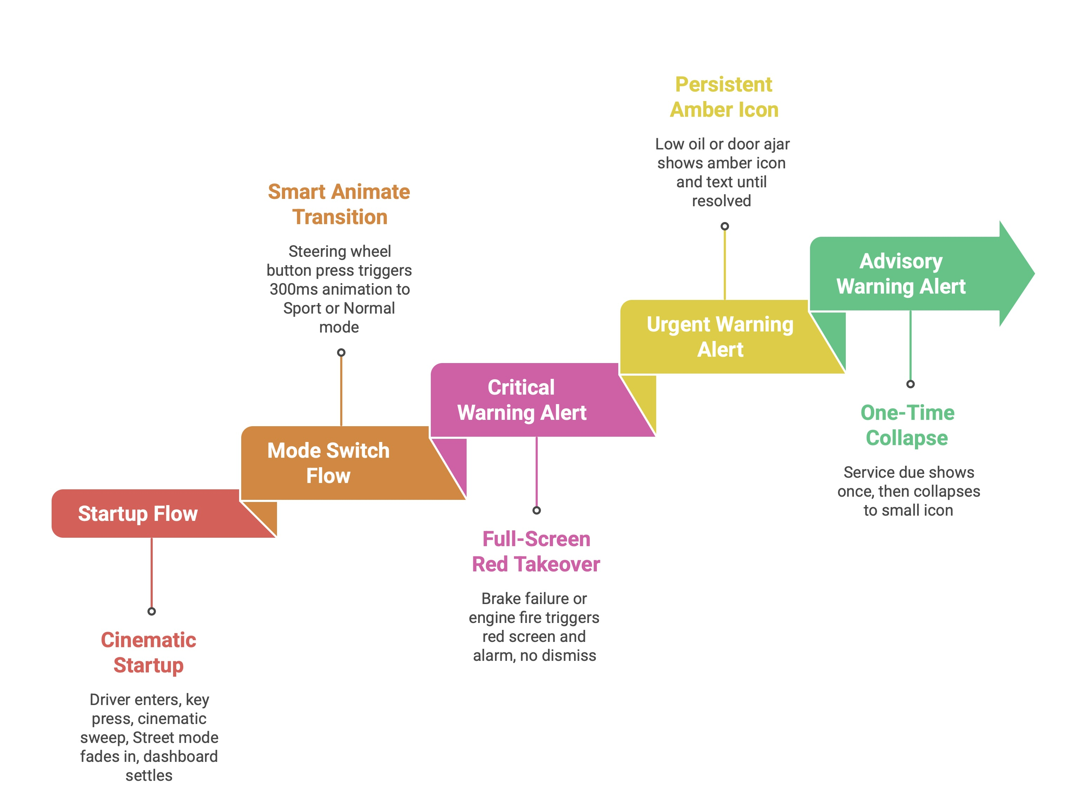

Slide 9
6. Prototype / Visual Design
Figma Prototype 1 (Feb 2–6) — Completed
• Street mode: Speed center (large hybrid digital/analog), RPM arc left, Fuel/Temp/Nav flanking
• Dark background, white primary text, red accent for redline and warnings
• Typography: Bold and clearly distinct
• Cinematic startup
Figma Prototype 2 (Feb 9–15) — In Progress
• Full component library: Warning (Inactive/Active/Critical), Gear (P/R/N/D/1–7), Mode Badge (Street/Sport), Fuel (Full/Half/Low/Critical)
• Smart Animate transitions across all three modes
• Auto Layout status bar — warning icons reflow as alerts appear/clear
• Ambient glow animations designed for passenger-facing first impression
Three-Tier Visual Hierarchy

Slide 10
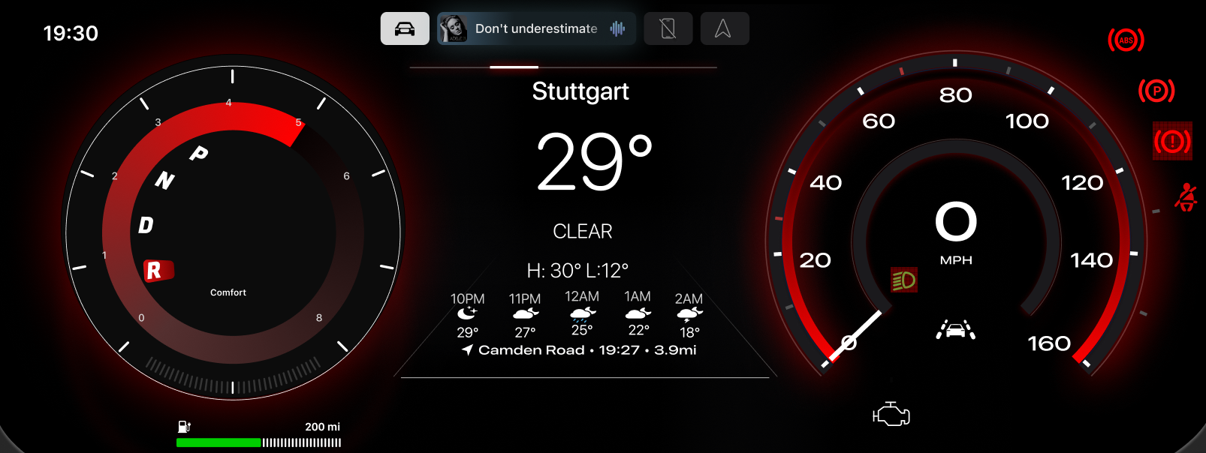
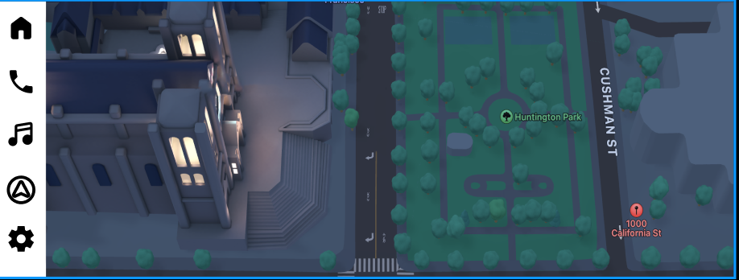

Slide 11
7. Technology & Implementation
Design & Prototyping Stack
• Figma — Component library, Smart Animate, Auto Layout, full variant system
Implementation Stack
• GL Studio 7.x+ — automotive HMI implementation platform
State Machine Architecture
• Mode states: Normal/Street ↔ Sport (single steering wheel button, no menus)
• Alert states: Normal → Advisory → Urgent → Critical (escalating override)
• Startup state: Cinematic sequence → Street default

Slide 12
8. Validation & Evaluation Plan
The Glance Test (Primary Safety Validation)
Show dashboard for 1 second, hide it, ask: “What speed? What gear? Any warnings?”
Any failure triggers a redesign.
Key Usability & Safety Metrics
• Primary info (Speed, RPM, Gear): readable in under 0.5 seconds
• Secondary info (Fuel, Temp, Nav): comprehensible within 1.0 second
• All interactions: complete within 1.5 seconds (NHTSA threshold)
• GL Studio rendering: 60fps minimum
• Critical warning comprehension: under 0.5 sec
• Mode switch: under 400ms
Dual Audience Validation
• HNWI expert test: Does it feel worthy of an automotive professional? Sophisticated, not gimmicky?
• Teen impression test: First reaction to startup and Sport/Street modes

Slide 13
9. Progress & Roadmap
COMPLETED — Phase 1: Figma Prototype 1 (Feb 2–6)
• Street and Sports mode dashboard
• Component library foundation, project documentation (PRD, Design Brief, Tech Specs)
IN PROGRESS — Phase 2: GL Studio + Prototype 2 (Feb 9–20)
• GL Studio installation, tutorials, component architecture exploration
• Figma Prototype 2: Startup animations, Day and night modes added
• Full variant system built
• SVG assets exported for GL Studio
REMAINING — Phase 3: GL Studio Implementation (Feb 21 – Mar 4)
• Core implementation: gauges, state machine, startup animation, CAN simulation
• 60fps optimization, glance testing under adverse conditions
• Final polish, demo setup, rehearsal for presentation

Slide 14
10. Risks & Limitations
Technical Risks
• 60fps on ARM hardware
• Figma to GL Studio translation
UX & Safety Concerns
• Startup animation as distraction
Solution: plays on ignition only, not mode switches
• Mode switching disorientation
Solution: Tier 1 elements never change position across modes
• Teen-appeal features vs. safety hierarchy
Solution: ambient effects are always Tier 3
Assumptions & Scope Limitations
• Glance testing is informal, not clinical

Slide 15
11. Summary & Ask
Value Proposition
An infotainment system that makes it worthy of a career milestone, impressive enough to earn a teenager’s interest, sophisticated enough to satisfy an automotive industry expert, and safe enough to use at full speed.
Key Takeaways
• Every pixel is justified against the 1.5-second glance rule
• Dual audience design: refined premium character for the driver, visual excitement for passengers
• Production-ready pipeline: Figma → SVG → GL Studio → DragonFire Pro
Feedback We’re Seeking from Judges
• Does our dual-audience framing (driver + passengers) feel like a genuine differentiator?
• Is the cinematic startup sequence an asset or a distraction risk — where is the line?
• What would make the most impact for the Final demonstration?

Slide 16
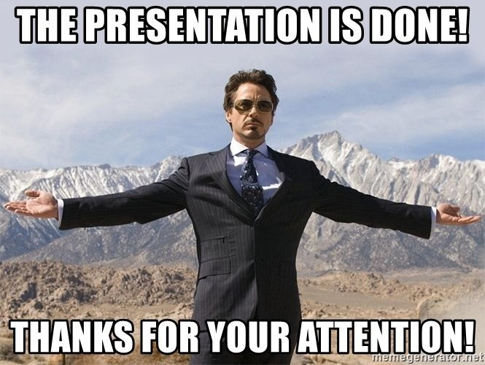
12. Thanks!

