Slide 1
INSTRUMENT CLUSTER DESIGN
Ottawa Infotainment
UI/UX Innovation Challenge - 2
Performance-Driven Dashboard Interface
Team InF1nite | Ottawa Infotainment Inc.
[Shaurya, Shrinicketh, Reshma, Timothy, Harinath, and Krishna] — UI/UX Design & HMI Engineering
Challenge Track: Instrument Cluster Design
Mar 4, 2026

Slide 2
1. Project Overview (Problem Statement & Context)
Primary User Persona
Key Constraints
Male, 65 years old, HNWI, owns and operates an automotive company
Safety
Deep knowledge of cars as he will notice every design decision
1.5-second glance threshold is non-negotiable
Purchasing this as a personal career milestone so the emotional significance is very high
Sophistication
must feel as premium as the price tag with good animations
Wants to feel proud showing this car to his family, especially his teenage children
Dual appeal
exciting for teens, refined and purposeful for an industry expert
Secondary Audience (Influential)
Teenage kids, highly tech-literate, expect smooth smartphone and gaming UX
They reaction matters deeply to the father

Slide 3
2. Existing Solutions & Gaps
Current Benchmarks
The Gap
Ferrari SF90: Precise but emotionally cold
No competitor excels at all four dimensions:
Porsche 911: Clean and Minimal
Performance data clarity
McLaren 720S: Bold but steep learning curve
Visual refinements & Aesthetics
Tesla Model S Plaid: Modern animations that look very stunning
Strong brand startup moment
Dual Audience Appeal (Driver + Passenger)
Rivian R1T/R1S: Great startup animation but adventure focused not performance
Corvette C8: Bold but aesthetically unrefined
Our opportunity: Fill precisely this intersection

Slide 4
3. Proposed Solution – Concept Overview
Our Solution
A performance-driven digital instrument cluster that feels like a career milestone every time the car starts while striking enough to earn a teenager's respect, sophisticated enough to satisfy an automotive industry expert and safe enough to use at higher speeds.
Key Differentiators
Cinematic startup sequence
Three-tier visual hierarchy
1
Creates emotional impact from the first moment
2
Ensures information clarity at a glance
Three adaptive modes
Normal/Street (refined, premium), Sports
(necessary data-first) and Night mode
Design language
3
4
Bold, precise, confident Detroit character
Ambient display states
5
Make passengers feel they're in something genuinely special

Slide 5
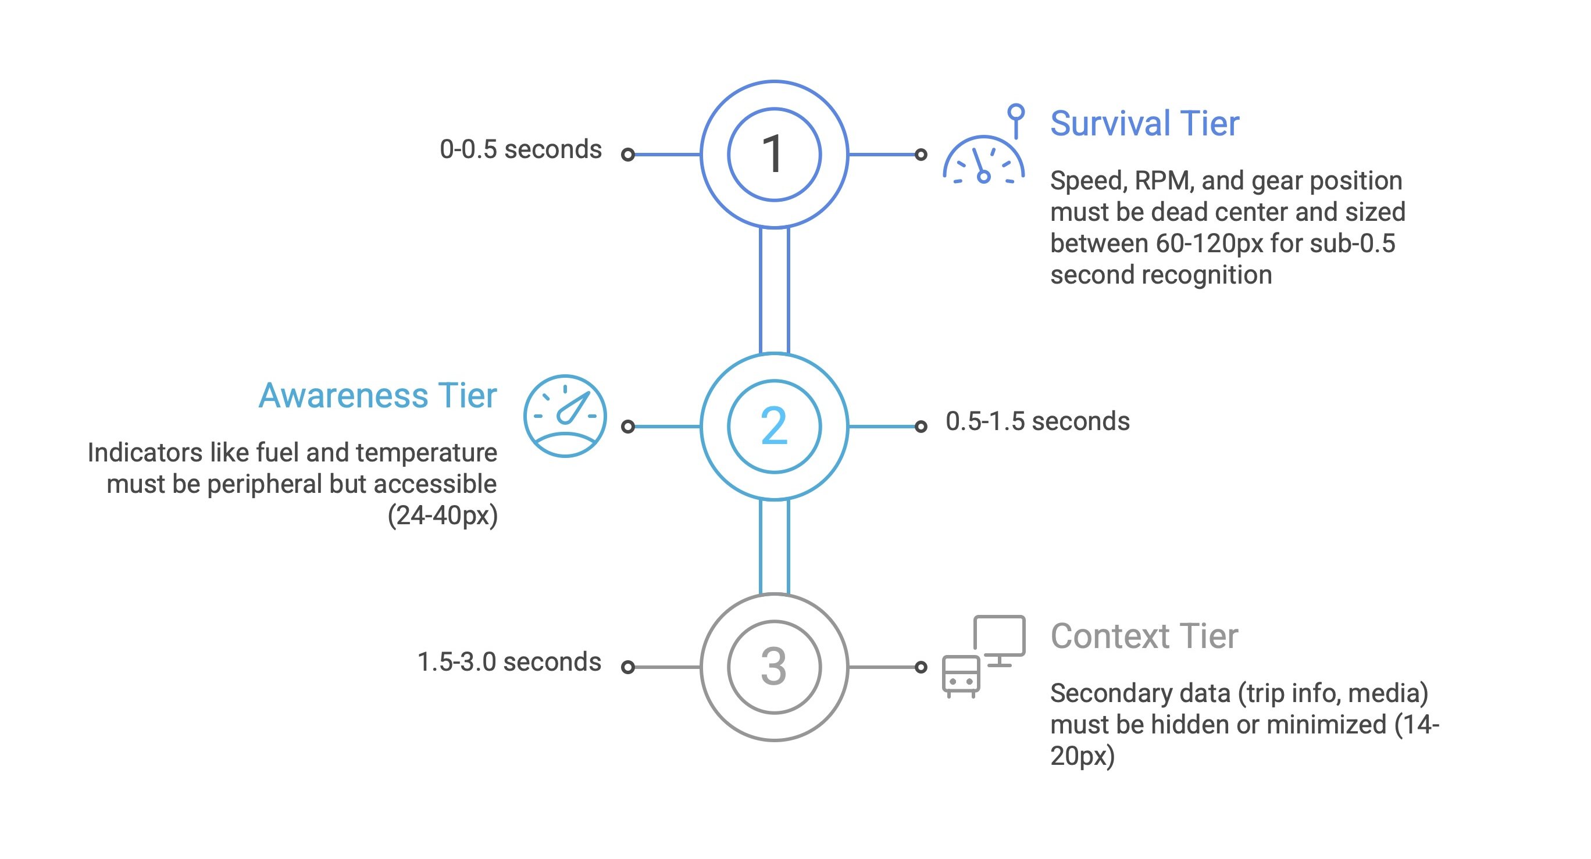
Three-tier Visual Hierarchy Diagram

Slide 6
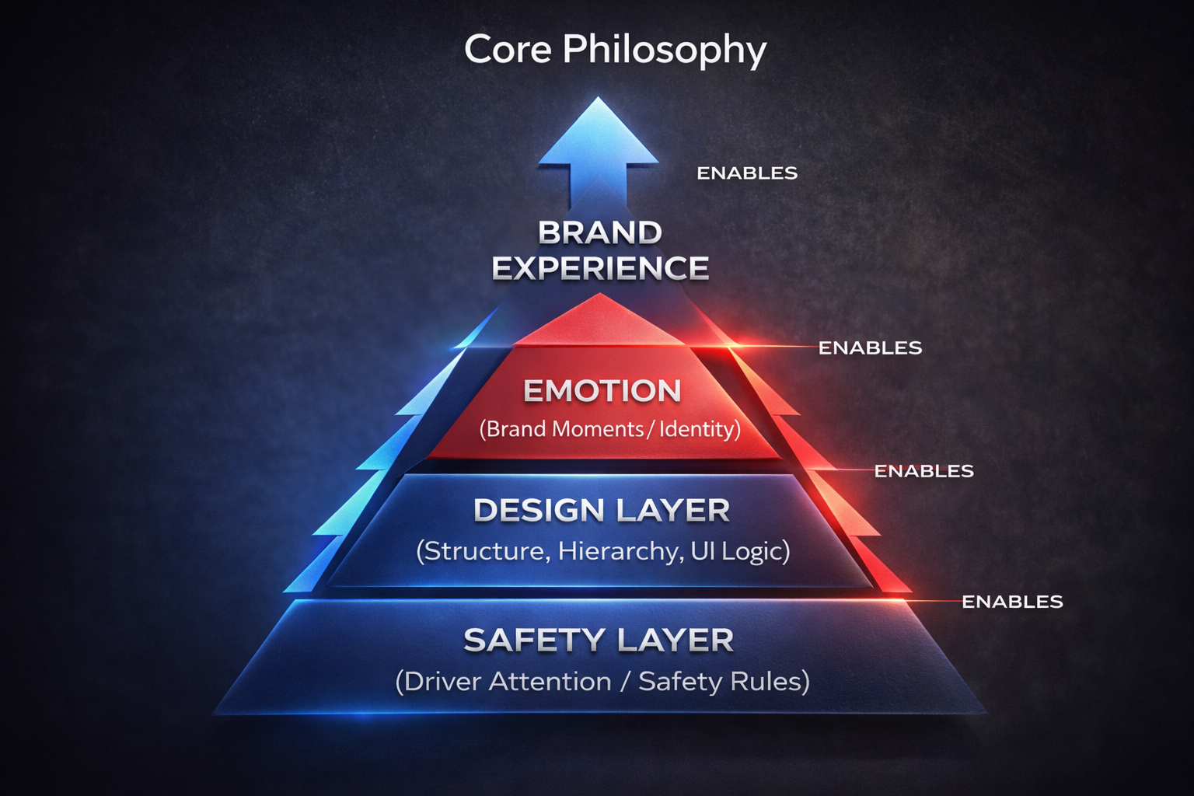
4. UI Methodology & Design Philosophy
“Safety enables emotion; emotion amplifies brand.”
Design Decision Framework:
Layer 1: Foundation – Safety First Constraints (immovable)
Layer 2: Design – Three tier hierarchy (structural)
Layer 3: Emotion – Brand Moments in contextual dead time only
Why This Design Approach:
Rejects the false dichotomy of safety OR emotion
Both are necessary, safety enables the emotional layer to exist
No competitor achieves both, so this is our competitive advantage

Slide 7
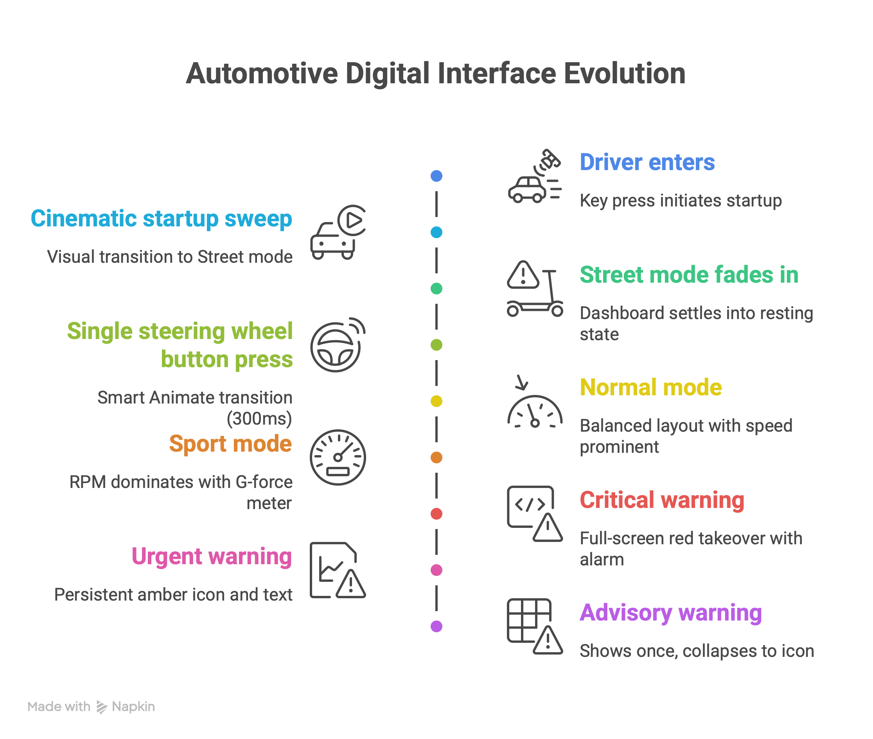
5. User Flow & Interaction

Slide 8
6. Post-Midterm Progress – What We Built
All 8 objectives completed since midterm evaluation:
Ferrari Competitive Research: Detailed analysis of Ferrari’s and other brand’s clusters
Screen 2 Feature Cluster Redesign: 30% less clutter, all functions preserved
Gear Indicator Alignment Fix: Perfect centered positioning verified across all models
Typography Optimization: Inter font hierarchy applied consistently, all tests passing
Ai-Assisted Design Exploration: 20+ design variations generated and analyzed
Startup Animation Created: Full 6 seconds cinematic brand ritual
Amber and Warning Signs Integrated along with their respective animations
Working Prototype: Normal, Sports and Night mode all fully interactive

Slide 9
Prototype / Visual Design
TIME FOR DEMO!

Slide 10
7. Technology & Implementation
Design & Prototyping Stack
State Machine Architecture
Figma
Mode states
Component library, Smart Animate, Auto Layout, full variant system
Normal/Street ↔ Sport (single steering wheel button, no menus)
Alert states
Implementation Stack
Normal → Advisory → Urgent → Critical (escalating override)
GL Studio / Unity
automotive HMI implementation platform
Startup state
Cinematic sequence → Street default
Hardware Assumptions
Minimum 60 Hz refresh rate needed
Assumes NXP or Qualcomm Snapdragon Automotive SoC

Slide 11
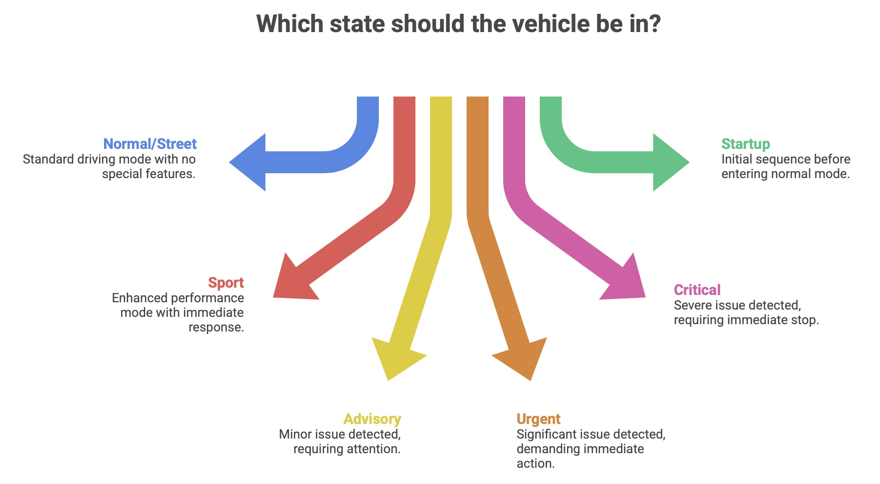
State Machine Architecture Diagram

Slide 12
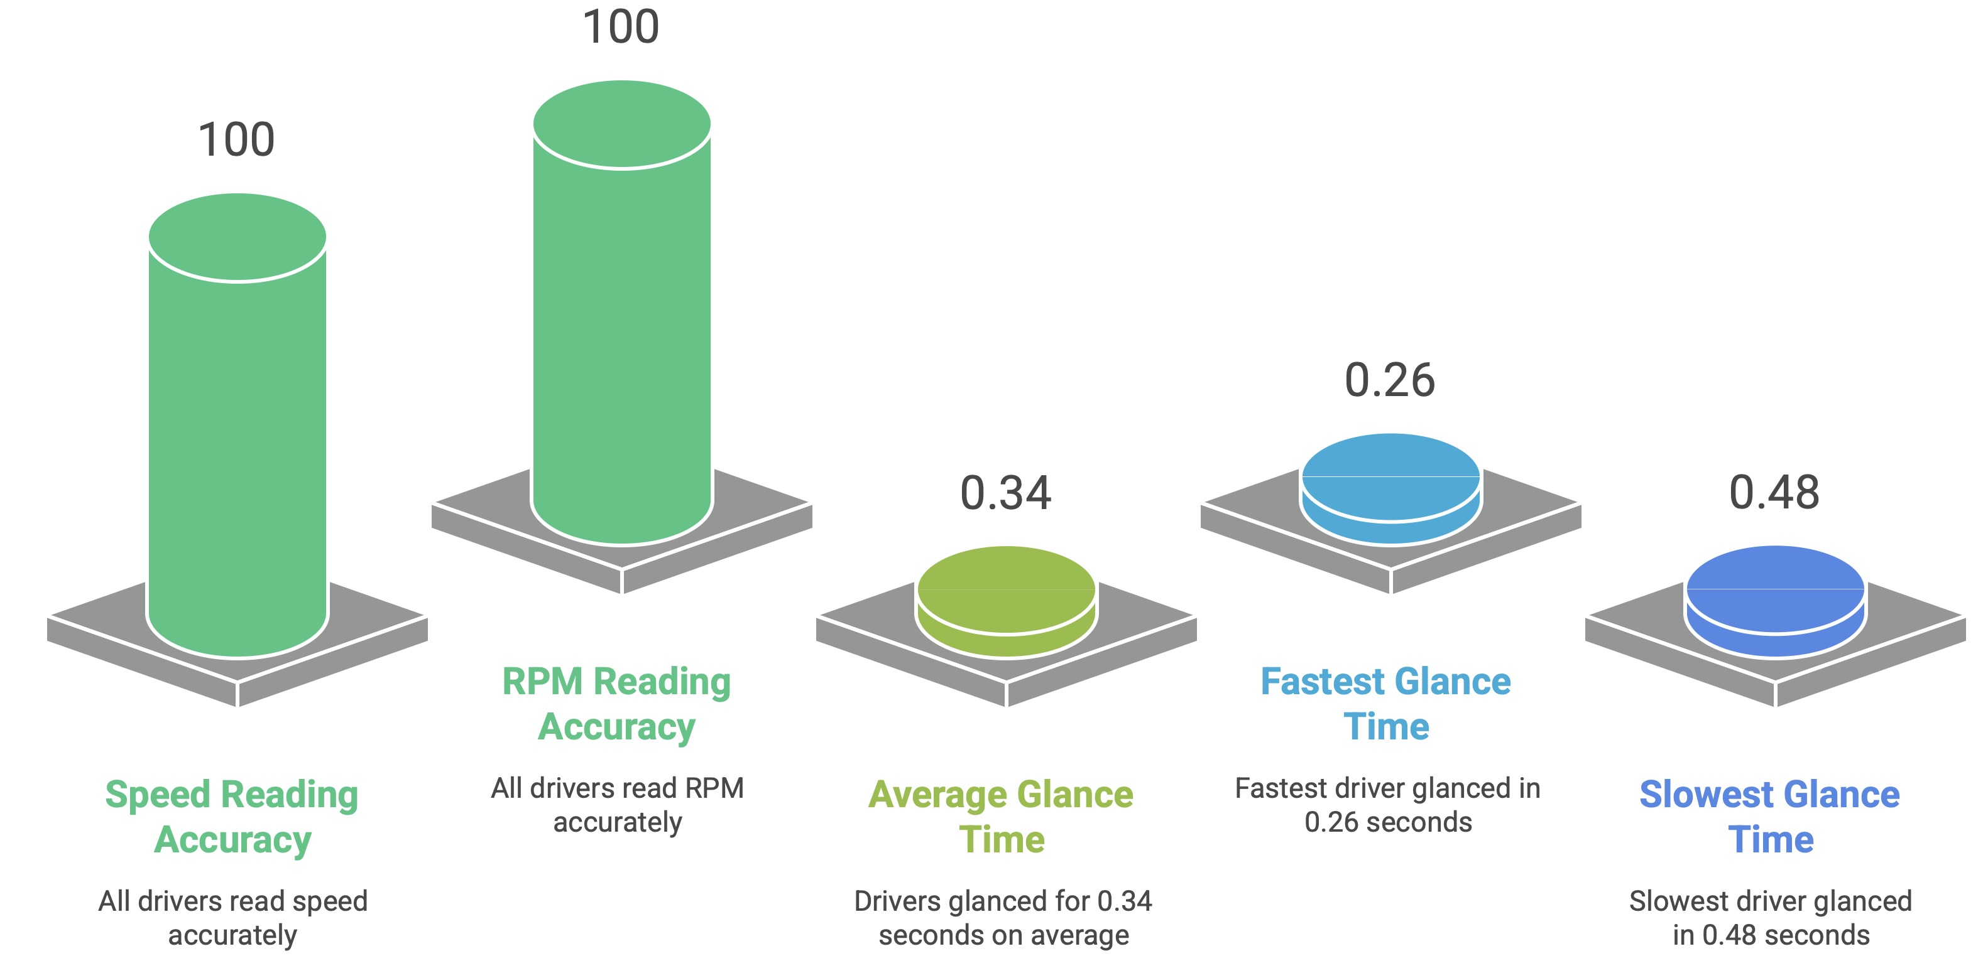
8. Validation & Testing Results

Slide 13
9. Challenges and Solutions
CHALLENGE
Spatial consistency vs information density
SOLUTION
Strict zone system – Tier 1 components never move
CHALLENGE
Typography readable at 195 mph
SOLUTION
Inter Black Weight + stroke + minimum size thresholds
CHALLENGE
GL Studio / Unity Implementation
SOLUTION
Reviewing Documentation, tutorials and YT videos
CHALLENGE
Passenger features distracting driver
SOLUTION
“Dead time” rule – Tier 3 only during startup and idle
CHALLENGE
Mode transition disorientation
SOLUTION
Spatial positions fixed, color shift smooth, brief label 500ms

Slide 14
10. Progress & Roadmap
COMPLETED
Phase 1: Figma Prototype 1 (Feb 2–6)
Street and Sports mode dashboard
Component library foundation, project documentation (PRD, Design Brief, Tech Specs)
IN PROGRESS
Phase 2: GL Studio / Unity + Prototype 2 (Feb 9–20)
GL Studio installation, tutorials, component architecture exploration
Figma Prototype 2: Startup animations, Day and night modes added
Full variant system built
SVG assets exported for GL Studio
REMAINING
Phase 3: Unity Implementation (Feb 21 – Mar 4)
Core implementation: gauges, state machine, startup animation
60fps optimization, glance testing under adverse conditions
Final polish, demo setup, rehearsal for presentation

Slide 15
11. Project Deliverables
Comprehensive Design System
Handoff Package for Future Teams
Component Library with all variants and states
Animation specifications, typography hierarchy and color pallette
Help file with next steps, pitfalls, tools and resources
Figma Repository with all assets and documentation
High Fidelity Figma Prototype
3 fully interactive modes: Normal, Sports, Night
GL Studio Implementation Guide
16 primary components with 120+ variants
20+ Smart Animate transitions
Working prototype with all modes functional

Slide 16
12. Conclusions
“Safety and emotional design are not mutually exclusive”
All 8 objectives completed:
Three-tier hierarchy protects driver while engaging passengers
Critical info readable in 0.34 seconds average (target <0.5s) - validated
Differentiates from all 6 analyzed competitors
Production-feasible: GL Studio/Unity on automotive ARM hardware
The project is ongoing – a solid foundation for production implementation
All documentations, assets, and research can be handed off.

Slide 17
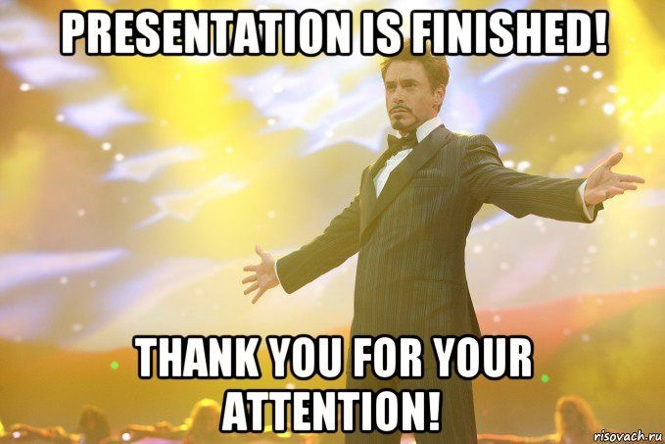
Thanks!
Team InF1nite | Ottawa Infotainment Inc.

