Slide 1
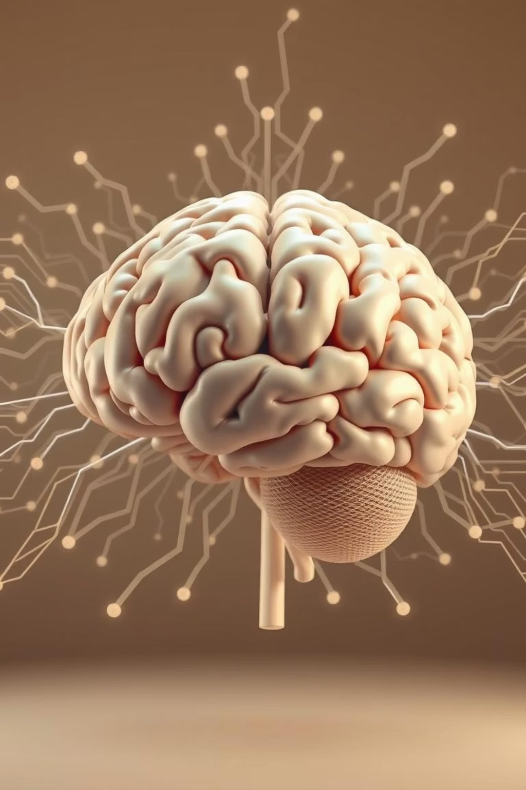
CNN for Object Recognition
A Seminar Presentation for Visual Processing Course
(COMP-8510)
Presented by: Shaurya Parshad (SID: 110191553)

Slide 2

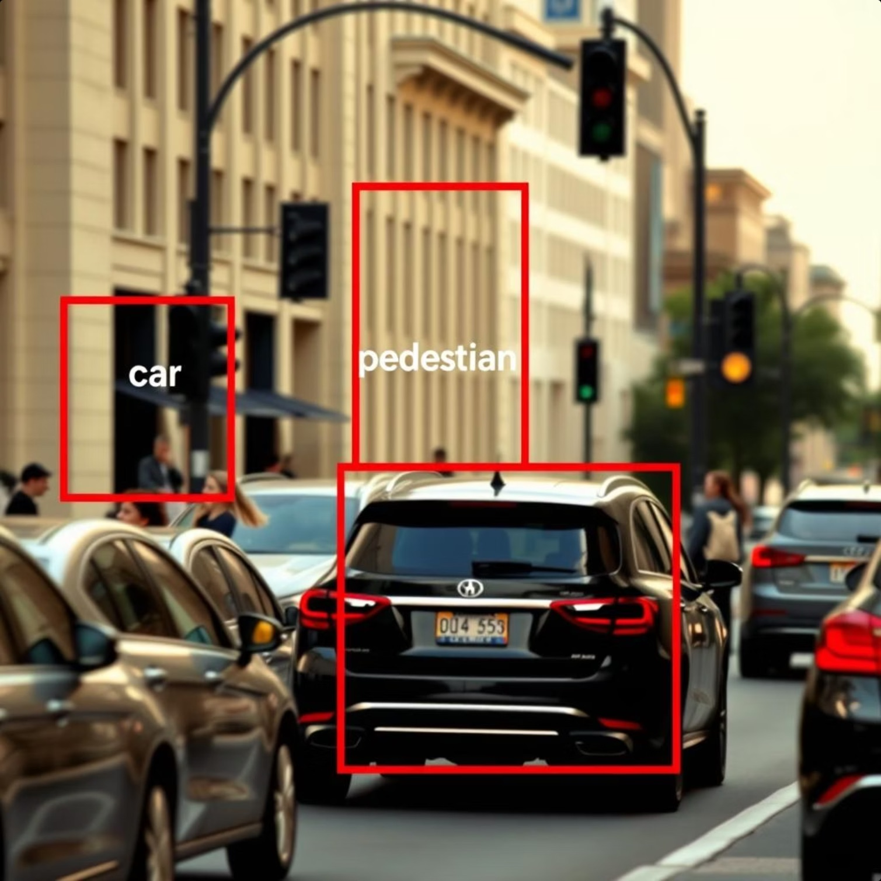
What is Object Recognition?
Object recognition is a fundamental computer vision task that involves identifying and localizing objects within an image or video. It's a two-fold process:
Classification: Determining what an object is (e.g., "cat”, "car").
Localization: Pinpointing where the object is in the image, often with a bounding box.

Slide 3




Importance of Object Recognition
Autonomous Systems
Enhanced Search
Enables self-driving cars and robots to "see" and interact safely with their environment.
Powers image and video search engines, allowing users to find content based on visual cues.
Security & Surveillance
Bridging Perception
Automates threat detection, anomaly identification, and monitoring in real-time video feeds.
Connects machine intelligence with human-like visual perception capabilities.

Slide 4


Introduction to Convolutional Neural Networks (CNNs)
Convolutional Neural Networks (CNNs) are a specialized class of deep neural networks particularly adept at processing visual data. They draw inspiration from the biological visual cortex.
Bio-Inspired: Mimic the hierarchical processing of the human visual system.
Feature Extraction: Excel at automatically learning and extracting features like edges, textures, and shapes.
End-to-End Learning: Can learn directly from raw pixel data, eliminating the need for manual feature engineering.

Slide 5



How CNNs Work: Key Layers
CNNs process images through a series of specialized layers, each performing a distinct function to transform raw pixel data into meaningful features.
Convolutional Layers
Pooling Layers
Fully Connected Layers
Apply filters to input images, detecting local patterns such as edges, corners, and textures. This generates feature maps.
Reduce the dimensionality of feature maps, maintaining important information while reducing computational load and increasing invariance to minor shifts.
Take the high-level features extracted by previous layers and use them to make final classifications or predictions, connecting all neurons from one layer to the next.

Slide 6
CNNs in Object Detection Architectures
CNNs form the backbone of many state-of-the-art object detection models, known for their ability to precisely localize objects.
Classic Examples: Faster R-CNN, YOLO (You Only Look Once), SSD (Single Shot Detector) are prominent CNN-based models.
Methodology: They typically involve generating region proposals, extracting features from these regions, and then classifying
them while predicting bounding box coordinates.
Strength: Exceptional at extracting fine-grained local details and achieving accurate localization of objects within an image.

Slide 7

Transformers in Vision
Originally designed for natural language processing, Transformer architectures have recently been adapted for computer vision tasks, offering a new paradigm for image understanding.
Vision Transformers (ViT)
Global Context
Adapt the self-attention mechanism to process image patches like words.
Excellent at capturing long-range dependencies and relationships across the entire image.
Spatial Relationships
Local Detail Limitation
Effective at understanding the overall context and spatial arrangement of objects.
Often less proficient than CNNs in capturing fine-grained local textures and precise details.

Slide 8
CNNs vs. Transformers: A Comparison
Both CNNs and Transformers offer distinct advantages in visual processing, making them suitable for different aspects of image understanding.
Strengths
Sharp on tiny details (edges, textures) and see small patches at one time
Global context, long-range dependencies, spatial relationships
Best For
Precise localization, speed and details
Understanding overall scene and broad context and relationships.
Examples
Used in VGGNet , AexNet
Used in Vision Transformer, ChatGPT, BERT

Slide 9
Primary Article: "A Dynamic Dual-Processing Object Detection Framework"
Article Title: "A Dynamic Dual-Processing Object Detection Framework Inspired by the Brain’s Recognition Mechanism."
Authors: Minying Zhang, Tianpeng Bu, Lulu Hu (Alibaba Group)
Key Idea: Proposes a novel framework that integrates the strengths of CNNs for local detail extraction and Transformers for global context understanding, mimicking human visual processing.

Slide 10
Motivation and Biological Inspiration
The article's core motivation stems from neuroscience, which suggests that the human brain employs a dual-processing mechanism for visual recognition.
1
2
Familiarity Mechanism
Recollection Mechanism
Quick Recognition: Relies on rapid, local cue processing, enabling instant identification of familiar objects based on specific features.
Contextual Recognition: Involves slower, more deliberate processing that leverages global context and relationships between elements.
CNN Analogy: Similar to how CNNs excel at extracting and using hierarchical local details.
Transformer Analogy: Mirrors the Transformer's ability to grasp long-range dependencies and overall scene understanding.
The research posits that by combining these complementary approaches, a hybrid model can overcome the limitations of single-paradigm systems, leading to more robust and brain-like object detection.

Slide 11
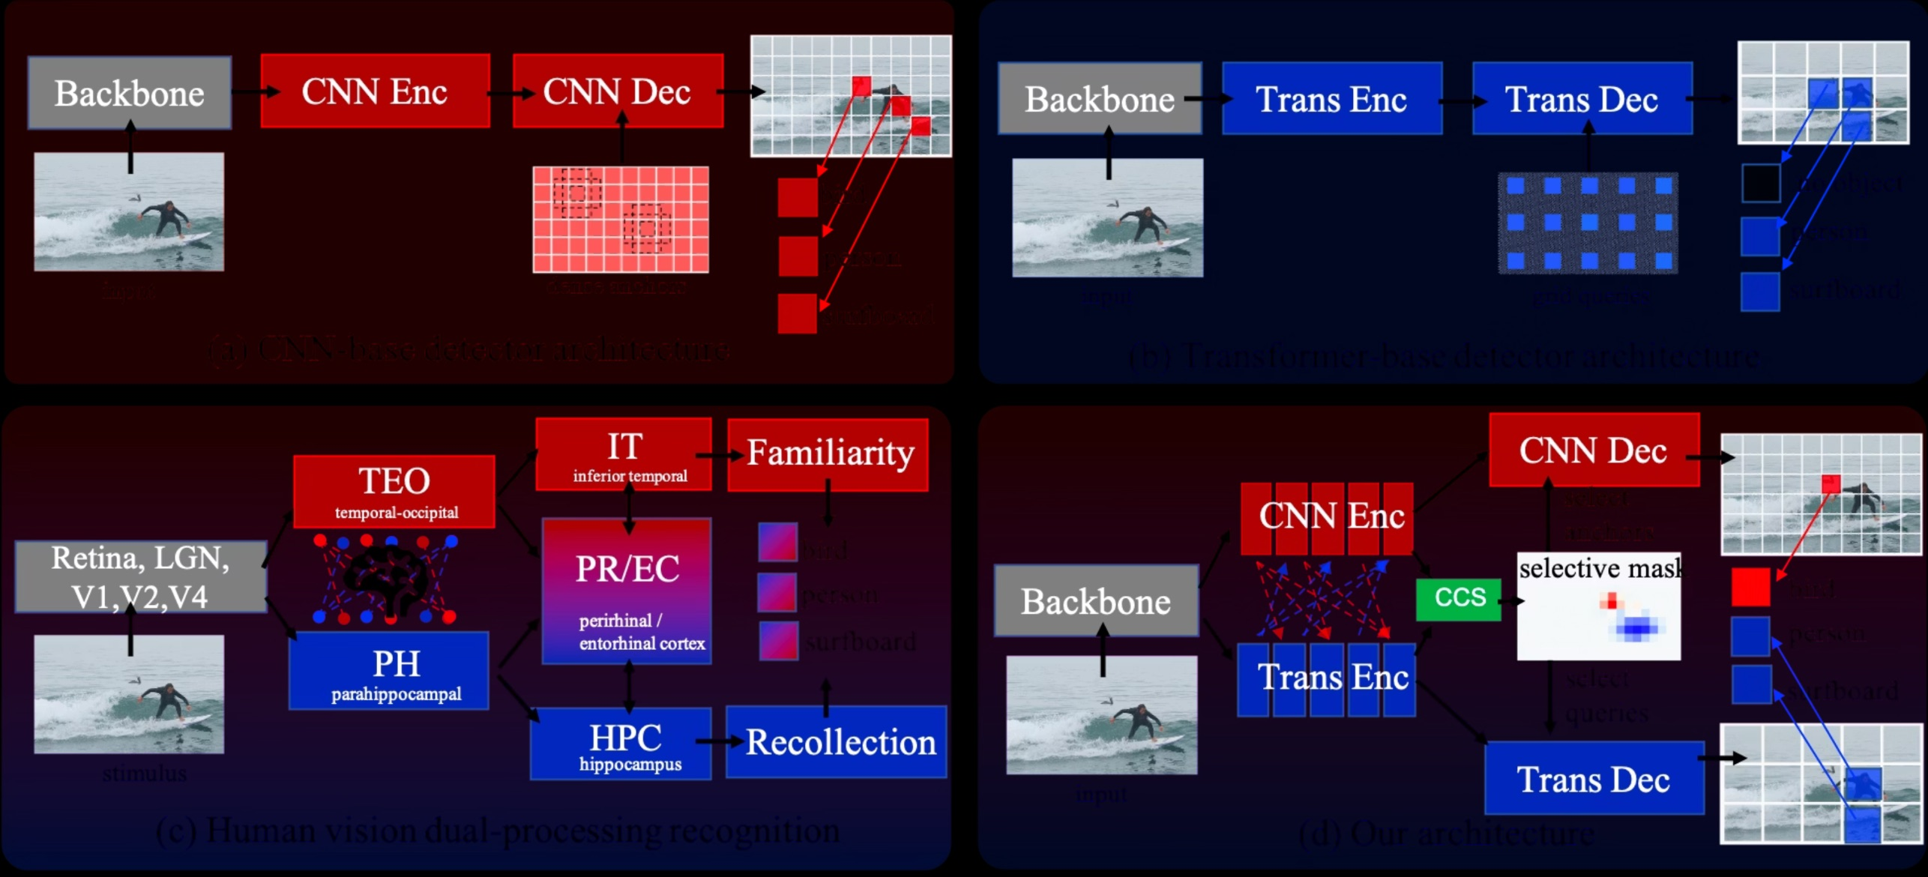
Various Architectures

Slide 12
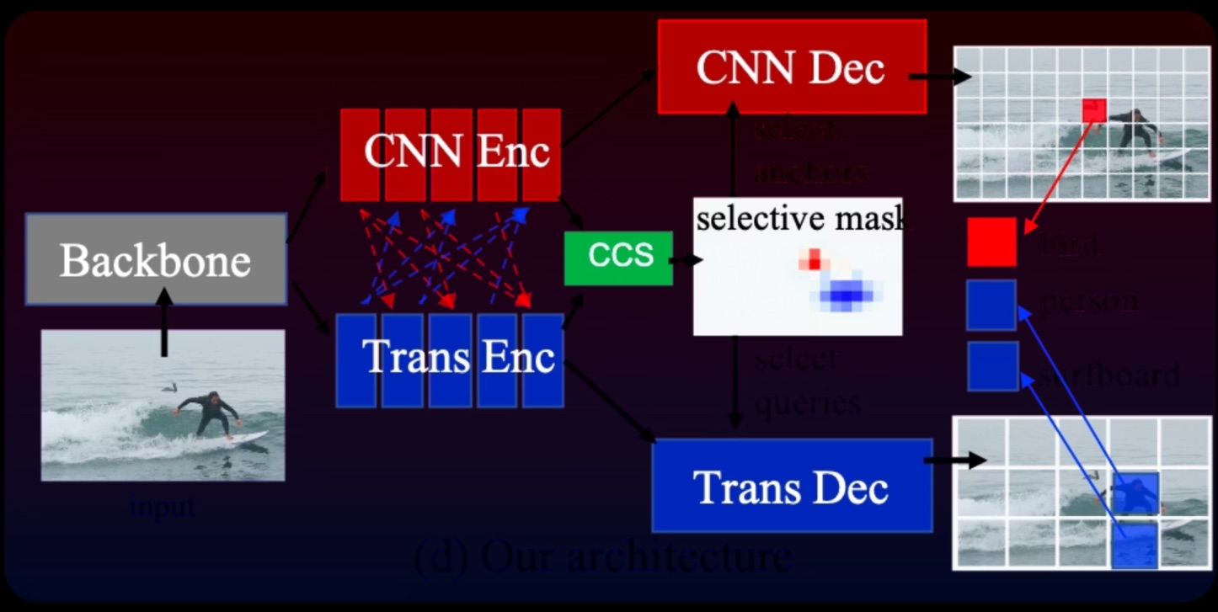
Proposed Framework Overview
Dynamic Dual-Processing (DDP) architecture consists of:
Shared Backbone (common feature extraction).
Dual-stream Encoder (CNN + Transformer for parallel processing).
Dynamic Dual-Decoder (adaptive choice between CNN and Transformer decoding per image region).

Slide 13
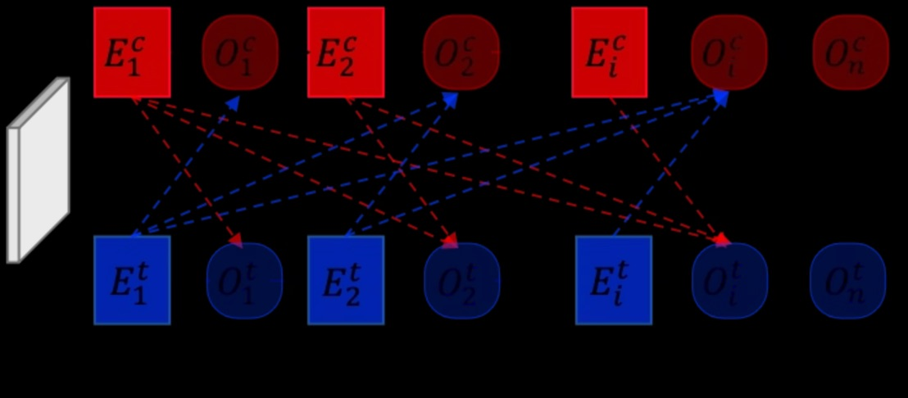
Dual-Stream Encoder
Two parallel processing streams:
CNN pathway (extracts detailed local features).
Transformer pathway (captures global context information).
Intermediate interactions and feature fusion between streams enhance representations.

Slide 14
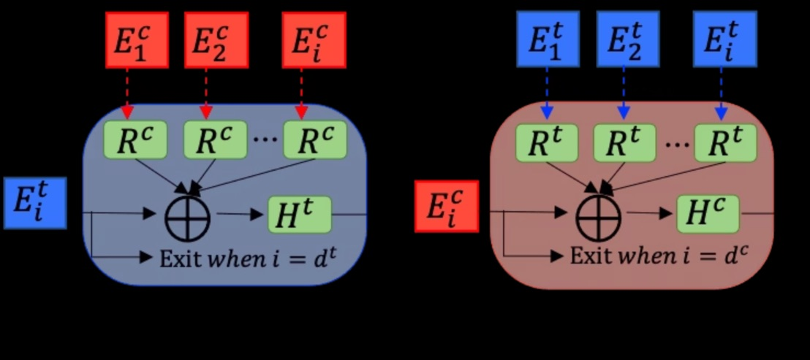
Neural Architecture Search for Feature Fusion
Automated search (NAS) finds best method for combining CNN and Transformer features.
Optimizes performance by intelligently merging local details and global context.
Ensures computational efficiency and effectiveness.

Slide 15
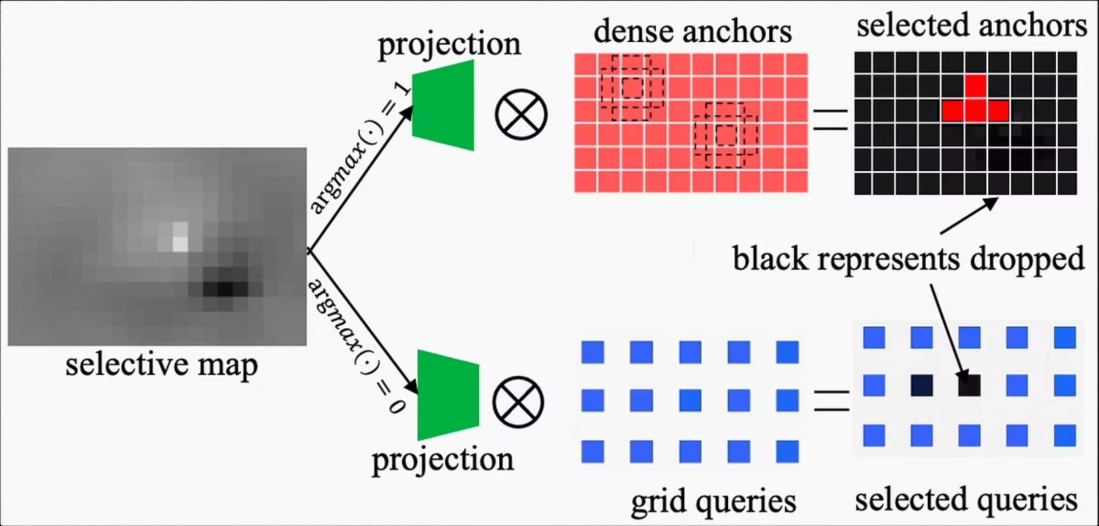
Dynamic Dual-Decoder
Adaptive decoder comprising:
CNN decoder (optimal for clear textures and local details).
Transformer decoder (optimal for ambiguous, context-dependent regions).
Uses selective mask to dynamically assign each object or region to the most suitable decoder.

Slide 16
Selective Mask Mechanism
Binary selective mask determines whether CNN or Transformer decoder is activated at each location.
Mask generation involves Gumbel-Softmax trick for differentiable training.
Dynamically routes detection tasks, significantly boosting detection accuracy without extra computation overhead.

Slide 17
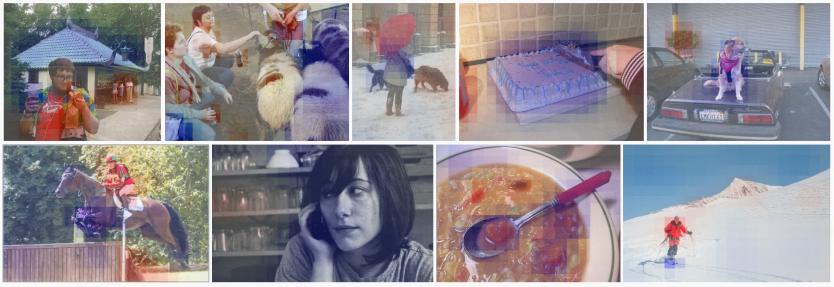

Slide 18
Visualization of Selective Mask Decision-Making
Visual examples of mask decisions:
Blue regions handled by Transformer.
Red regions handled by CNN.
Shows adaptive allocation based on object features (local vs. global).

Slide 19

Multi-Stage Training Strategy
Training involves a careful multi-stage process:
Stand-alone Pre-training
Encoder NAS Search
Initializes CNN and Transformer streams independently.
Finds the optimal encoder feature fusion structure through automated search.
Selective Mask Learning
Joint Fine-tuning
Trains the selective mask to dynamically decide between CNN and Transformer decoders.
Refines the entire model for cohesive performance and overall optimization.

Slide 20
Experimental Setup
Evaluated on widely-used MS COCO object detection benchmark.
Measures performance using mean Average Precision (mAP).
Comparison against state-of-the-art single and hybrid models.

Slide 21

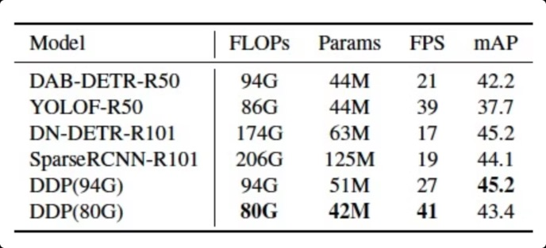
Key Insights:
DDP (94G) matches the top-performing DN-DETR-R101 in mAP (45.2) but uses 46% fewer FLOPs and has ~60% higher FPS.
DDP (80G) variant achieves real-time performance (41 FPS) with minimal accuracy trade-off, outperforming YOLOF-R50 by +5.7 mAP despite similar FLOPs.
The model is efficient, lightweight, and high-performing, validating the effectiveness of combining CNN and Transformer decoding dynamically.

Slide 22
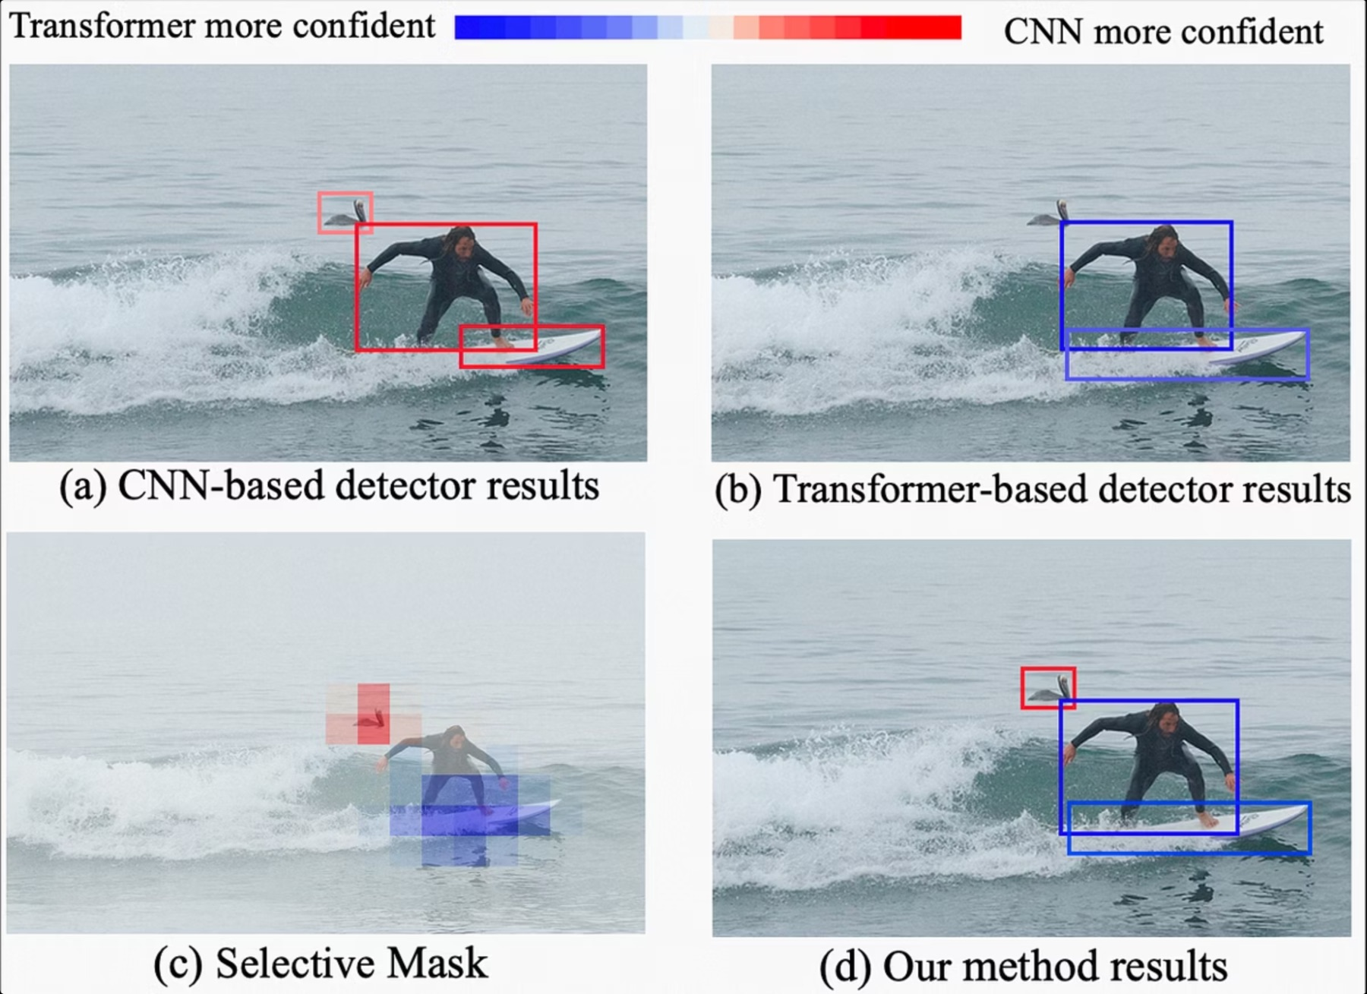
Qualitative Examples
Illustration of dynamic mask behavior:
CNN decoder localizes bird effectively due to clear local textures.
Transformer decoder identifies surfboard using surrounding context clues.

Slide 23
Advantages of Dynamic Dual-Processing
Successfully integrates local CNN strengths and global Transformer advantages.
Selective masking efficiently manages computational resources.
Significantly improves real-world object detection performance.

Slide 24
Limitations
Increased complexity in architecture design (two encoders, two decoders).
Requires detailed multi-stage training strategy.
Slight increase in model parameters.

Slide 25
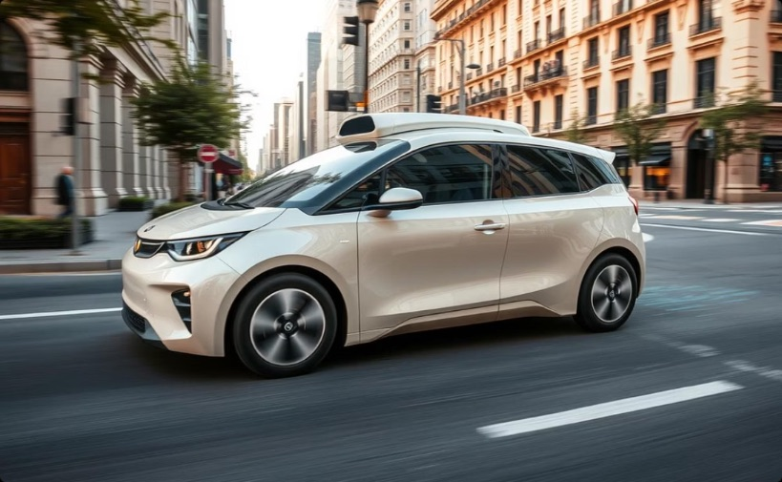
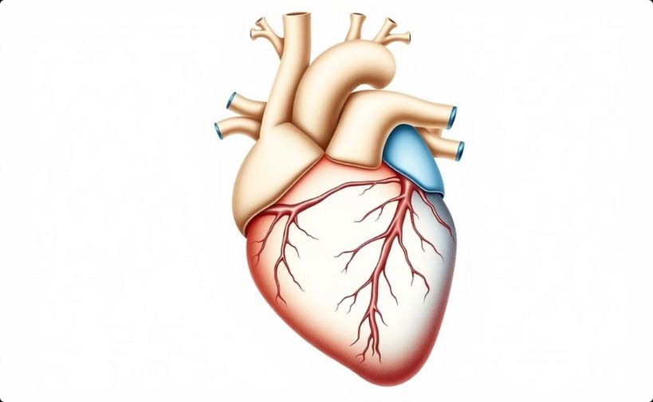
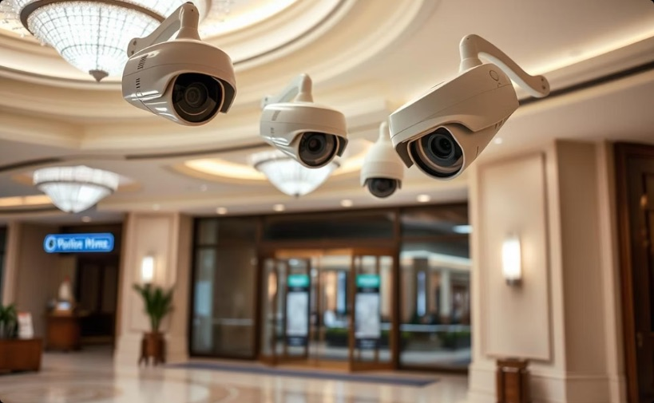
Real-world Impact and Applications
Autonomous Vehicles
Medical Imaging
Surveillance Systems
Enhances object detection capabilities for safer and more reliable navigation in self-driving cars.
Improves diagnostic accuracy and efficiency by precisely identifying anomalies in complex medical scans.
Offers more reliable visual perception under varied and challenging conditions for enhanced security and monitoring.

Slide 26
Future Research Directions
Develop more streamlined and computationally efficient hybrid models to broaden their applicability.
Further investigate deeper biological analogies, such as memory and attention mechanisms, to inspire more sophisticated AI architectures.
Conduct more extensive evaluations across broader and more diverse datasets to ensure robustness and generalization capabilities.

Slide 27
Conclusion
CNNs are important but have limits; Transformers add useful benefits.
The Dynamic Dual-Processing (DDP) framework shows how models inspired by biology can work better.
This is a big step towards smarter computer vision systems that can adapt.

Slide 28
References
Berrios, W., & Deza, A. (2022). Joint Rotational Invariance and Adversarial Training of a Dual-Stream Transformer Yields State of the Art Brain-Score for Area V4.
Zhang, M., Bu, T., & Hu, L. (2023). A Dynamic Dual-Processing Object Detection Framework Inspired by the Brain’s Recognition Mechanism. In Proceedings of the IEEE/CVF International Conference on Computer Vision (ICCV 2023).

Slide 29
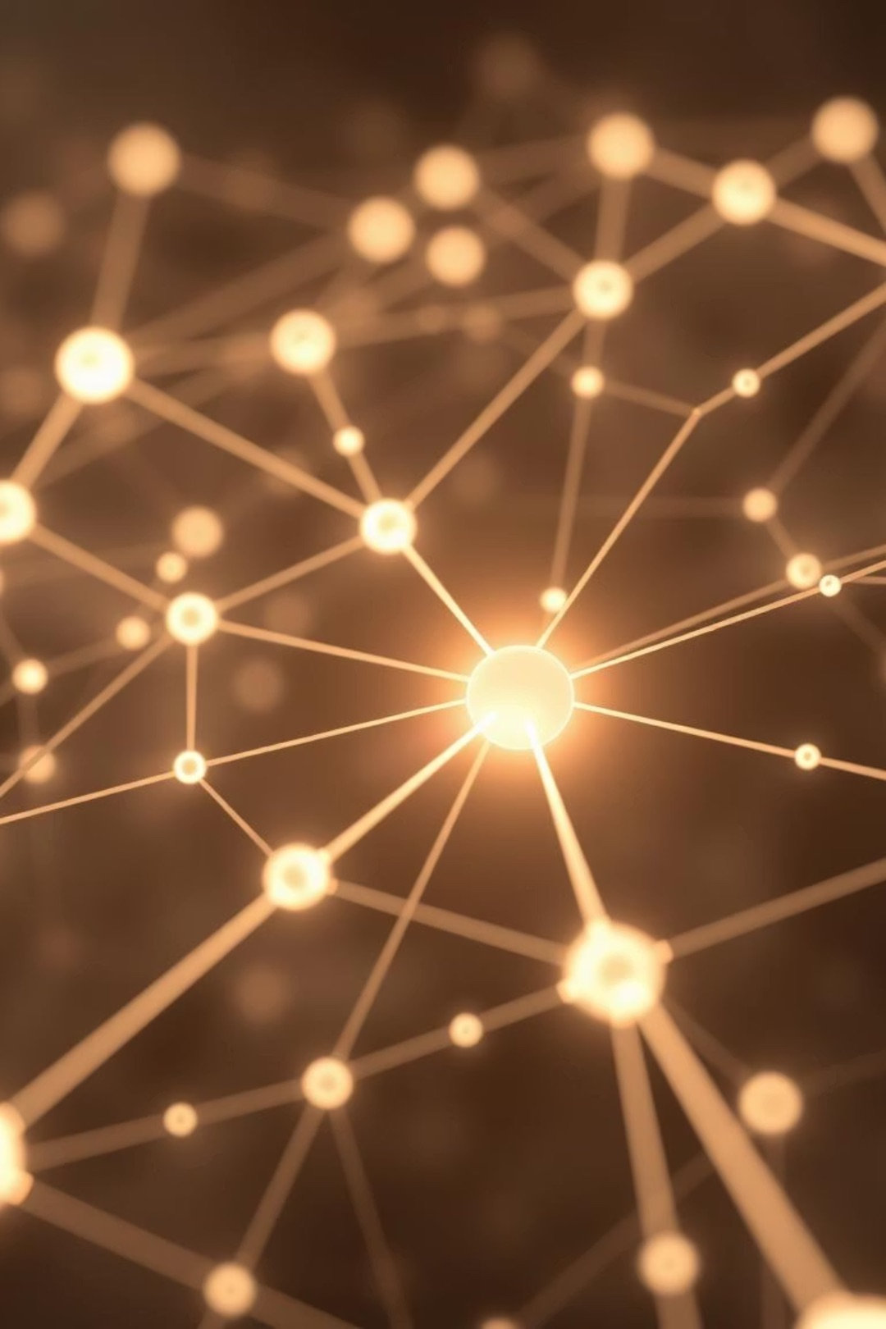
Thank You!

