Slide 1
MACHINE LEARNING
王大兴Email:wangdx3@mail.sustech.edu.cn

Slide 2


OBJECTIVES
Understand the Naive Bayes algorithm
Learn how to implement the Naive Bayes Classifier in python
01
02

Slide 3


Outline
Background and Probability Basics
Probabilistic Classification Principle
Probabilistic discriminative models
Generative models and their application to classification
MAP and converting generative into discriminative
Naïve Bayes – an generative model
Principle and Algorithms (discrete vs. continuous)
Example: Play Tennis
Zero Conditional Probability and Treatment
Summary

Slide 4
Background
There are three methodologies:
Model a classification rule directly
Examples: k-NN, linear classifier, SVM, neural nets, ..
Model the probability of class memberships given input data Examples: logistic regression, probabilistic neural nets (softmax),…
Make a probabilistic model of data within each class Examples: naive Bayes, model-based ….
Important ML taxonomy for learning models
probabilistic models vs non-probabilistic models discriminative models vs generative models

Slide 5
Background
Based on the taxonomy, we can see different the essence of learning models (classifiers) more clearly.
 | Probabilistic | Non-Probabilistic
Discriminative | Logistic Regression Probabilistic neural nets …….. | K-nn Linear classifier SVM Neural networks ……
Generative | Naïve Bayes Model-based (e.g., GMM) …… | N.A. (?)

Slide 6
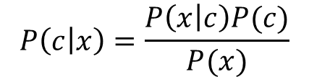

Probability Basics
Prior, conditional and joint probability for random variables
Prior probability: P(x)
Conditional probability: P(x1|x2),P(x2|x1)
Joint probability:
Relationship:
Independence: P(x₂|x₁) =P(x₂), P(x₁|x₂) =P(x₁), P(x₁,x₂) =P(x₁)P(x₂)
x=(x₁,x₂), P(x)=P(x₁,x₂)
P(x₁,x₂) =P(x₂|x₁)P(x₁)=P(x₁|x₂)P(x₂)
$$P\left(c | x\right)=\frac{P\left(x | c\right)P(c)}{P(x)}$$
$$Posterior=\frac{Likelihood×Prior}{Evidence}$$
Bayesian Rule
Discriminative
Generative

Slide 7

Probabilistic Classification Principle
Establishing a probabilistic model for classification
– Discriminative model
P(c|x) c = c₁ ,⋅⋅⋅,c_{L} , x = (x₁ ,⋅⋅⋅, x_{n} )
P(c₁ |x)
P(c₂ |x)
P(c_{L} |x)
• • •
To train a discriminative classifier regardless its probabilistic or non-probabilistic nature, all training examples of different classes must be jointly used to build up a single discriminative classifier.
Output L probabilities for L class labels in a probabilistic classifier while a single label is achieved by a non-probabilistic classifier .
Discriminative Probabilistic Classifier
• • •
x_{n}
x₁ x₂
x = (x₁ , x₂ ,⋅⋅⋅, x_{n} )

Slide 8








Probabilistic Classification Principle
Establishing a probabilistic model for classification (cont.)
– Generative model (must be probabilistic)
P ( x |c ) c = c₁ , ⋅ ⋅ ⋅ , c _{L} , x = (x₁ ,⋅⋅⋅, x )
L probabilistic models have to be trained independently
Each is trained on only the examples of the same label
Output L probabilities for a given input with L models
“Generative” means that such a model produces data subject to the distribution via sampling.
n
P ( x | c ₁ )
P ( x | c _{L} )
Generative Probabilistic Model for Class 1
Generative Probabilistic Model for Class L
• • •
x ₁ x ₂
• • •
x _{n}
x ₁ x ₂
• • •
x _{n}
x = ( x ₁ , x ₂ ,⋅⋅⋅, x_{n} )

Slide 9
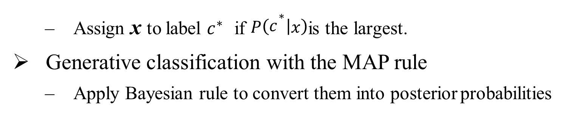
Probabilistic Classification Principle
Maximum A Posterior (MAP) classification rule
– For an input x, find the largest one from L probabilities output by a
discriminative probabilistic classifier
P(c₁ |x), ..., P(c_{L} |x).
– Assign x to label $c^{∗}$ if $P(c^{∗}|x)$is the largest.
Generative classification with the MAP rule
– Apply Bayesian rule to convert them into posterior probabilities
P(x|c_{i} )P(c_{i}) P(x)
P(c |x) =
∝ P(x|c_{i} )P(c_{i} )
i
Common factor for all L probabilities
for i = 1, 2, ⋅⋅⋅, L
– Then apply the MAP rule to assign a label

Slide 10
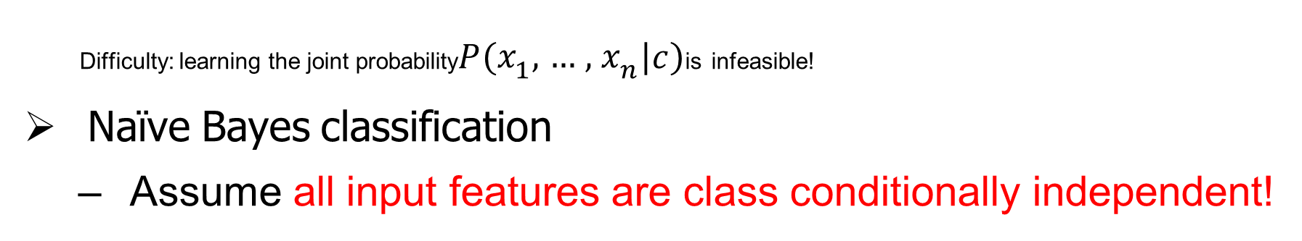
Naive Bayes
Bayes classification
P(c| x) ∝ P(x | c)P(c) = P(x₁,⋅⋅⋅, x_{n} | c)P(c) for c = c₁,...,c_{L}.
Difficulty: learning the joint probability$P(x_{1},…,x_{n}|c)$is infeasible!
Naïve Bayes classification
– Assume all input features are class conditionally independent!
P(x₁ , x₂ ,⋅⋅⋅, x_{n} |c) = P(x₁|x₂ ,⋅⋅⋅, x_{n} ,c)P(x₂ ,⋅⋅⋅, x_{n} |c)
Applying the independence assumption
= P(x₁ |c)P(x₂ ,⋅⋅⋅,x_{n} |c)
= P(x₁|c)P(x₂ |c) ⋅⋅⋅ P(x_{n} |c)
– Apply the MAP classification rule: assign x'= (a₁,a₂,⋅⋅⋅,a_{n} )to c* if
[P(a | c*) ⋅⋅⋅ P(a |c* )]P(c* ) > [P(a | c)⋅⋅⋅ P(a | c)]P(c), c ≠ c*, c = c ,⋅⋅⋅, c
1 n 1 n 1
L
estimate of P(a ,⋅⋅⋅, a | c* )
1 n
esitmate of P(a₁,⋅⋅⋅, a_{n} | c)

Slide 11
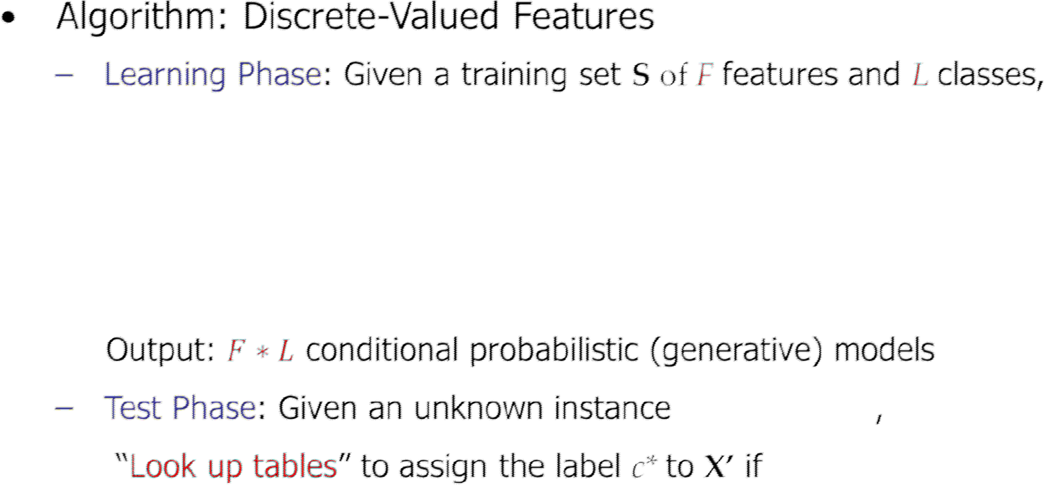
Naive Bayes
For each target value of c_{i} (c_{i} = c₁ ,⋅⋅⋅,c_{L} )
Pˆ(c_{i}) ← estimate P(c_{i} ) with examples in S;
For every feature value x_{jk} of each feature x_{j} ( j = 1,⋅⋅⋅, F; k = 1,⋅⋅⋅, N_{j} )
Pˆ(x_{j}= x_{jk} |c_{i} ) ← estimate P(x_{jk} |c_{i} ) with examples inS;
x'= (a₁′,⋅⋅⋅, a′_{n})
ˆ ˆ
ˆ ˆ
ˆ
ˆ
′
*
′
*
*
′
′
*
[P(a |c )⋅⋅⋅ P(a |c )]P(c ) > [P(a |c )⋅⋅⋅ P(a |c )]P(c ),
c ≠ c , c = c , ⋅⋅⋅,c
1
n
1 i
n i i
i
i 1
L

Slide 12
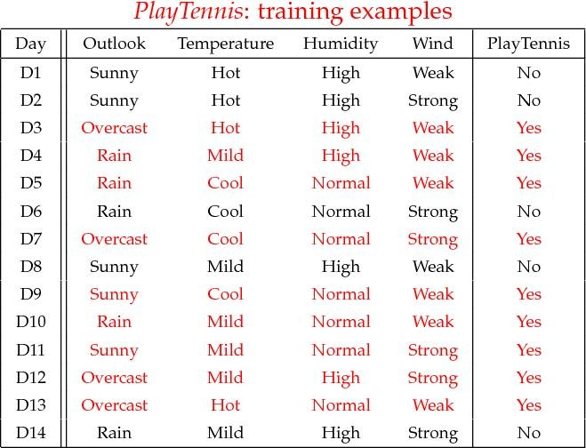
Exampe-Play Tennis

Slide 13
Exampe-Play Tennis
Learning Phase
Outlook | Play=Yes | Play=No
Sunny | 2/9 | 3/5
Overcast | 4/9 | 0/5
Rain | 3/9 | 2/5
Temperature | Play=Yes | Play=No
Hot | 2/9 | 2/5
Mild | 4/9 | 2/5
Cool | 3/9 | 1/5
Humidity | Play=Yes | Play=No
High | 3/9 | 4/5
Normal | 6/9 | 1/5
Wind | Play=Yes | Play=No
Strong | 3/9 | 3/5
Weak | 6/9 | 2/5
P(Play=Yes) = 9/14
P(Play=No) = 5/14

Slide 14
Exampe-Play Tennis
Test Phase
Given a new instance, predict its label
x’=(Outlook=Sunny, Temperature=Cool, Humidity=High, Wind=Strong)
Look up tables achieved in the learning phrase
P(Outlook=Sunny|Play=Yes) = 2/9 P(Temperature=Cool|Play=Yes) = 3/9 P(Huminity=High|Play=Yes) = 3/9 P(Wind=Strong|Play=Yes) = 3/9 P(Play=Yes) = 9/14
P(Outlook=Sunny|Play=No) = 3/5 P(Temperature=Cool|Play==No) = 1/5 P(Huminity=High|Play=No) = 4/5 P(Wind=Strong|Play=No) = 3/5 P(Play=No) = 5/14
– Decision making with the MAP rule
P(Yes|x’) ≈ [P(Sunny|Yes)P(Cool|Yes)P(High|Yes)P(Strong|Yes)]P(Play=Yes) = 0.0053 P(No|x’) ≈ [P(Sunny|No) P(Cool|No)P(High|No)P(Strong|No)]P(Play=No) = 0.0206
Given the fact P(Yes|x’) < P(No|x’), we label x’ to be “No”.

Slide 15

Naive Bayes
Algorithm: Continuous-valued Features
Numberless values taken by a continuous-valued feature
Conditional probability often modeled with the normal distribution
$$\hat{P}\left(\left.x_{i}\right|c_{i}\right)= \frac{1}{\sqrt{2π}σ_{ji}}exp{\left(−\frac{(x_{j}−μ_{ji})}{2σ_{ji}^{2}}\right)}^{2}$$
μ_{ji} : mean (avearage) of feature values x _{j} of examples for which c = c_{i}
σ_{ji} : standard deviation of feature values x _{j} of examples for which c = c_{i}
–
Learning Phase:
for X = ( X₁ ,⋅⋅⋅, X_{F} ), C = c₁,⋅⋅⋅, c_{L}
Output: FxL normaldistributions and _{P(C = c ) i = 1,⋅ ⋅ ⋅, L}
– Test Phase: Given an unknown instance
X′ = (a′ ,⋅ ⋅^{i}⋅,a′ )
Instead of looking-up tables, calculate conditional probabi¹lities w^{n}ith all the normal distributions achieved in the learning phrase
Apply the MAP rule to assign a label (the same as done for the discrete case)

Slide 16
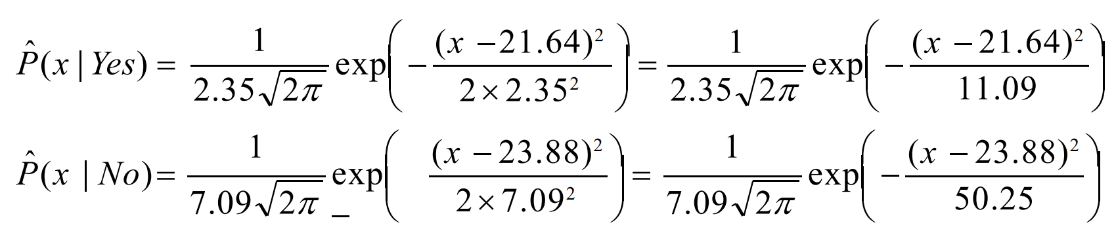
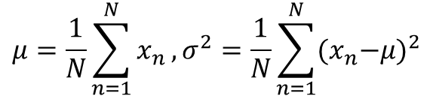
Naive Bayes
Example: Continuous-valued Features
Temperature is naturally of continuous value.
Yes: 25.2, 19.3, 18.5, 21.7, 20.1, 24.3, 22.8, 23.1, 19.8
No: 27.3, 30.1, 17.4, 29.5, 15.1
Estimate mean and variance for each class
$$μ=\frac{1}{N}\sum_{n=1}^{N}{x_{n}}, σ^{2}=\frac{1}{N}\sum_{n=1}^{N}{{{(x}_{n}−μ)}^{2}}$$
μ_{Yes} = 21.64, σ_{Yes} = 2.35
μ_{No} = 23.88, σ_{No} = 7.09
– Learning Phase: output two Gaussian models for P(temp|C)

Slide 17
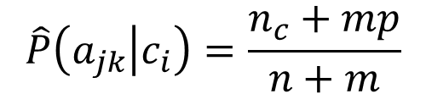
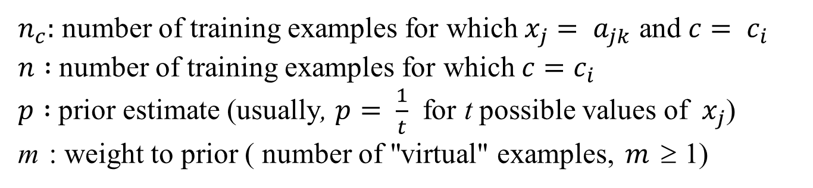
Zero conditional probability
If no example contains the feature value
– In this circumstance, we face a zero conditional probability problem during test
Pˆ(x₁ | c_{i} ) ⋅ ⋅ ⋅ Pˆ(a _{jk} | c_{i} ) ⋅ ⋅ ⋅ Pˆ(x_{n} | c_{i} ) = 0 for x _{j}
= a_{j k} , Pˆ(a _{jk} | c_{i} ) = 0
– For a remedy, class conditional probabilities re-estimated with
$$\hat{P}\left(a_{jk} | c_{i}\right)=\frac{n_{c}+mp}{n+m}$$
(m-estimate)
$n_{c}:$ number of training examples for which $x_{j}= a_{jk}$ and $c= c_{i}$
$n :$ number of training examples for which $c=c_{i}$
$p :$ prior estimate (usually, $p= \frac{1}{t}$ for t possible values of $x_{j}$)
m : weight to prior ( number of "virtual" examples, $m$≥ 1)

Slide 18
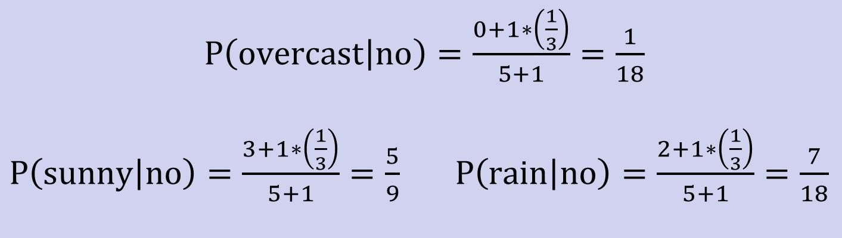
Zero conditional probability
Example: P(outlook=overcast|no)=0 in the play-tennis dataset – Adding m “virtual” examples
In this dataset, training examples for the “no” class is 5.
We can only add m=1 “virtual” example in our m-esitmate remedy.
The “outlook” feature can takes only 3 values. So p=1/3.
Re-estimate P(outlook|no) with the m-estimate

Slide 19
Summary
Probabilistic Classification Principle
Discriminative vs. Generative models: learning P(c|x) vs. P(x|c)
Generative models for classification: MAP and Bayesian rule
Naïve Bayes: the conditional independence assumption
Training and test are very efficient.
Two different data types lead to two different learning algorithms.
Working well sometimes for data violating the assumption!
Naïve Bayes: a popular generative model for classification
Performance competitive to most of state-of-the-art classifiers even in presence of violating independence assumption
Many successful applications, e.g., spam mail filtering
A good candidate of a base learner in ensemble learning
Apart from classification, naïve Bayes can do more…

Slide 20

Lab Task

Slide 21
Lab Task
Complete the exercises and questions in the lab03_Bayes.pdf
Submit it to bb.

Slide 22

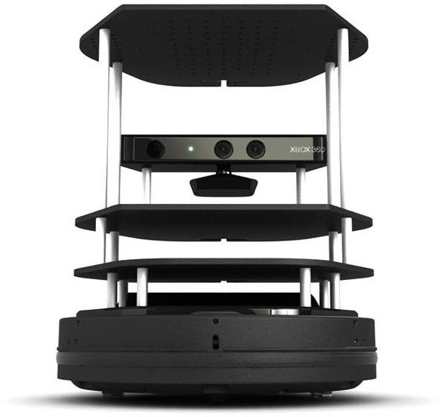

Thanks
王大兴Email:wangdx3@mail.sustech.edu.cn

