Slide 1
Hospital Management System
Team Members:
Salman Shah
Aiman Abdullah
Jyoti Prakash
Abhishek S

Slide 2
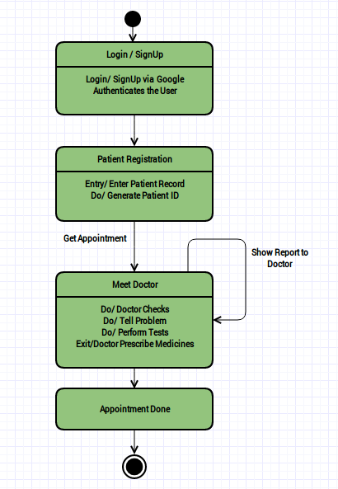
State Diagram

Slide 3
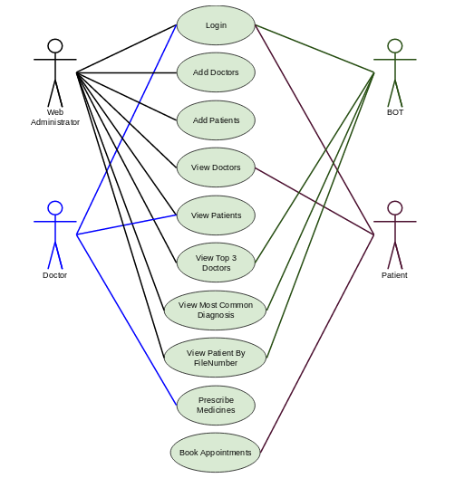
Use Case Diagram

Slide 4
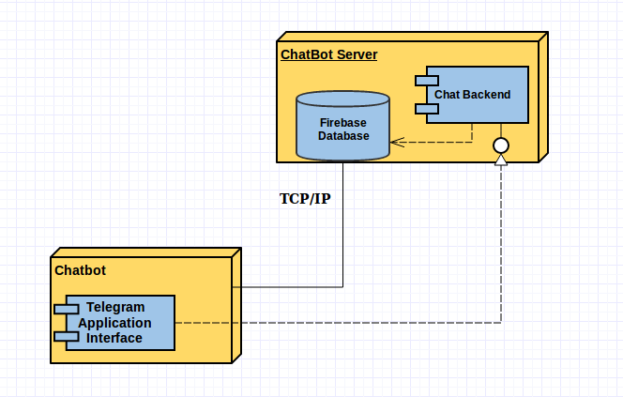
Deployment Diagram - ChatBot

Slide 5
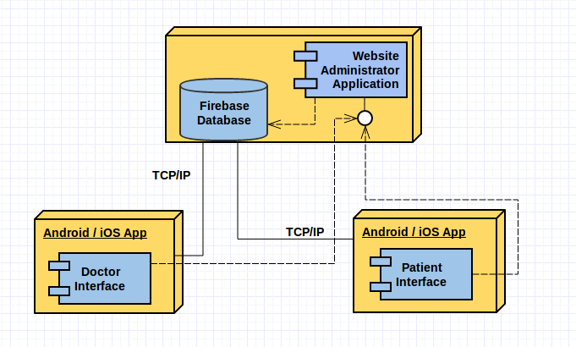
Deployment Diagram - App

