Slide 1

Timers
COMS W6998
Spring 2010
Erich Nahum

Slide 2
Jiffies
In /usr/src/linux/include/linux/jiffies.h:
  unsigned long volatile jiffies
Until 2.6.21, jiffies was just a counter that was incremented every clock interrupt
Tickless kernels removed need for kernels to process timer interrupts on idle systems
  http://www.lesswatts.org/projects/tickless

Slide 3
HZ
Determines how frequently the clock interrupt fires
Default is 1000 on x86, or 1 millisecond
Configurable at compile time or boot time
  Other typical values are 100 (10 ms) or 25 (4)
What’s a good value for HZ?
  Low values: less overhead
    Good for idle systems (power)
    Good for busy systems (thpt)
  High values: better resolution
    Ability to retake control in scheduler (clock interrrupt)
    Good for interactivity
  Tradeoff between responsiveness and throughput, running debate

Slide 4
Jiffies and HZ
Again, incremented HZ times a second
Jiffies can wrap around depending on platform
  32 bits, 1000 HZ: about 50 days
  64 bits, 1000 HZ: about 600 million years
Jiffies_64:
  On 32 bits, jiffies points to low-order 32 bits, jiffies_64 to high-order bits (be careful about atomicity!)
  On 64 bit machines, jiffies == jiffies_64

Slide 5
Some Useful Functions
Macros to compare jiffies values:
  time_after(a,b)
  time_before(a,b)
  time_after_eq(a,b)
  time_before(a,b)
Macros to convert jiffies to/from others:
  timespec_to_jiffes(struct timespec * ts)
  jiffies_to_timespec(unsigned long jiffies, struct timespec * ts)
  timeval_to_jiffes(struct timeval * tv)
  jiffies_to_timeval(unsigned long jiffies, struct timeval * tv)
  jiffies_to_msecs(unsigned long)
  msecs_to_jiffies(int)
  jiffies_to_usecs(unsigned long)
  usecs_to_jiffies(int)

Slide 6
Time Stamp Counter
On many CPUs, including Pentium or better, there exists a counter that is incremented every clock cycle
  1 GHz clock → 1 nanosecond resolution
To use (on x86):
  #include <asm/msr.h>
  rtdsc(low, high) // get 64 bits, put 32 bits in each
  rtdscl(low) // get low order 32 bits
  rtdscl(val) // get all 64 bits in a long long
Be careful using on SMP/Multi-Core

Slide 7
Inserting Delays
#include <linux/delay>
void mdelay(unsigned long milliseconds)
void udelay(unsigned long microseconds)
void ndelay(unsigned long nanoseconds)
void msleep(unsigned int milliseconds)
unsigned long msleep_interruptible(unsigned int milliseconds)
  returns number of seconds left if interrupted

Slide 8
Timers
Runs via softirq like tasklets, but at a specific time
A timer is represented by a timer_list:
    struct timer_list {
    struct list_head entry; /* dbly linked */
    unsigned long expires; /* In jiffies */
    void (*function)(unsigned long);
    unsigned long data; /* optional */
    struct tvec_t_base_s *base;
    );
  expires is an absolute value, not a relative one

Slide 9
Timer Operations
void init_timer(struct timer_list *timer);
void add_timer(struct timer_list *timer);
int del_timer(struct timer_list *timer);
int del_timer_sync(struct timer_list *timer);
void mod_timer(struct timer_list *timer, unsigned long expires);
int timer_pending(const struct timer_list *timer);
// clears prev and next ptrs
// inserts into global timer list
// returns 1 if timer deleted, or 0 if too late
// difference is makes sure timer is not running on any other CPUs
// Changes expiry to new value
// 1 if timer is pending, 0 otherwise

Slide 10
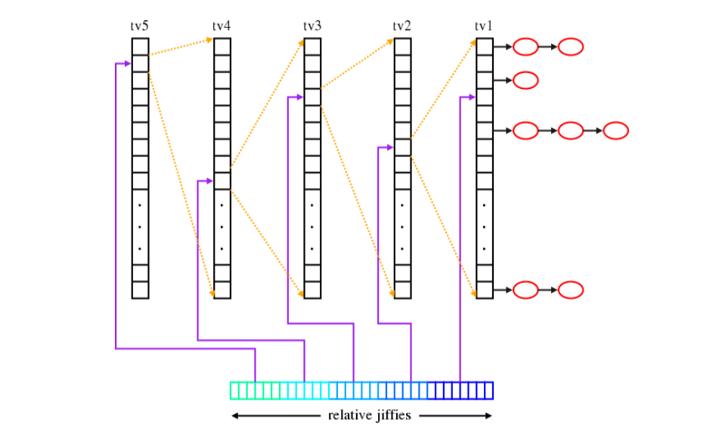
Timer Implementation
Group | Ticks | Time
tv1 | < 2^{^8} | < .256 secs
tv2 | < 2^{^14} | < 16.4 secs
tv3 | < 2^{^20} | < 17.5 mins
tv4 | < 2^{^26} | < 18 hrs
tv5 | < Inf | < Inf
(from lwn.net)

Slide 11
High Resolution Timers
Motivated by the observation of 2 types of timers:
  Timeout functions, which we don’t expect to actually happen (e.g., retransmisison timer for packet loss). Have low resolution and are usually removed before expiration.
  Timer functions, which we do expect to run. Have high resolution requirements and usually expire
Original timer implementation is based on jiffies and thus depends on HZ. Works well for timeouts, less so for timers.
  Resolution no better than HZ (e.g., 1 millisecond)
High resolution timers, introduced in 2.6.16, allow 1 nanosecond resolution
Implemented in an red-black tree (rbtree)
  Insert, delete, search in O(log n) time

Slide 12
ktime Kernel Time
#include <linux/ktime.h>
  union ktime {
  s64 tv64; // in nanoseconds
  }
ktime_t ktime_add(ktime_t kt1, ktime_t kt2);
ktime_t ktime_sub(ktime_t kt1, ktime_t kt2);
ktime_t ktime_add_ns(ktime_t kt, u64 nanoseconds);
ktime_t timespec_to_ktime(struct timespec tspec);
ktime_t timeval_to_ktime(struct timeval tval);
struct timespec ktime_to_timespec(ktime_t kt);
struct timeval ktime_to_timeval(ktime_t kt);
clock_t ktime_to_clock_t(ktime_t kt);
u64 ktime_to_ns(ktime_t kt);

Slide 13
High Res Timer Functions
extern void hrtimer_init(struct hrtimer *timer, clockid_t which_clock, enum hrtimer_mode mode);
int hrtimer_cancel(struct hrtimer *timer);
int hrtimer_try_to_cancel(struct hrtimer *timer);
extern ktime_t hrtimer_get_remaining(const struct hrtimer *timer);
extern int hrtimer_get_res(const clockid_t which_clock, struct timespec *tp);
static inline int hrtimer_active(const struct hrtimer *timer)
// initialize hrtimer
// cancel timer (wait if necessary)
// cancel timer (don’t wait)
// time left before it expires
// get resolution in ns
// 1 if active, 0 otherwise

Slide 14
Restarting Timers
Many timers want to restart
Function passed to hrtimer_start needs to return a particular value:
    enum hrtimer_restart {
    HRTIMER_NORESTART, /* Timer is not restarted */
    HRTIMER_RESTART, /* Timer must be restarted */
    };
RESTART used by functions that need a callback at a regular interval.
The hrtimer code provides a function for advancing the expiration time to the next such interval:
  unsigned long hrtimer_forward(struct hrtimer *timer, ktime_t interval);
Advances the timer's expiration time by the given interval.
The need to add the interval more than once usually means that the system has overrun its timer period, perhaps as a result of high system load.
The return value from hrtimer_forward() is the number of missed intervals, allowing code which cares to detect and respond to the situation.

Slide 15
Dyntick/``Tickless’’ Kernel
Observation: there is no need for a periodic tick in the system, particularly when the system is idle
  Idle CPUs save power
  Why wake up an idle CPU 1000 times a second?
  Especially if it is virtualized?
Instead, when going into idle loop, check next pending timer:
  If event is further away than one tick, re-program clock timer to fire when that event is due
  Other interrupts can still wake up the system
Added in 2.6.21
  CONFIG_NO_HZ
New function added:
  void init_timer_deferrable(struct timer_list *timer);
  These timers are ignored for purposes of calculating wakeup time

Slide 16
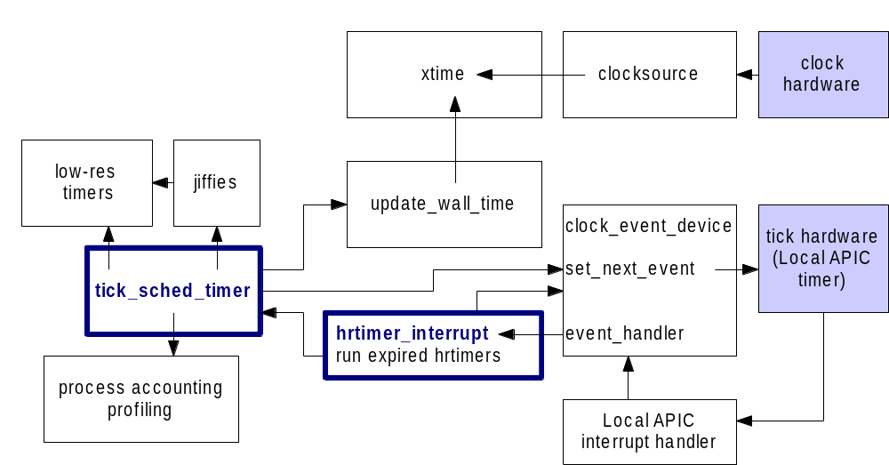
Putting It All Together

Slide 17
Is it still ticking?
The timer tick is now an hrtimer
  This allows it it coexist with the other hrtimers
  Can be programmed in a flexible way, e.g. can be delayed for a while when the system is idle. (NO_HZ)
So, is it still ticking?
  hrtimers will make the hardware tick
  Timer ticks, however, will happen only if needed, therefore less frequently

Slide 18
What’s Your Kernel Running?
grep for HZ in the .config for your kernel
  What is the value of CONFIG_HZ?
  Is CONFIG_NOHZ set? (tickless kernel)
cat /proc/interrupts
  Look at the timer interrupt (irq 0). If you see a low number at irq 0, one of the local APICs is handling the global timer tick duties (local timer interrupts)
  If CONFIG_NOHZ is not set, you can divide the number of timer or local timer interrupts by the number of seconds uptime, the result should be larger than HZ.
  If CONFIG_NOHZ is set the number of timer interrupts will most likely be lower

