Slide 1
Module 2

Slide 2
Module II
Probably Approximately Learning (PAC)
Noise
Learning Multiple classes,
Model Selection and Generalization,
Dimensionality reduction- Subset selection,
Principle Component Analysis

Slide 3
Noise- Noise and their sources
Noise is any unwanted anomaly in the data .
Noise may arise due to several factors:
1. There may be imprecision in recording the input attributes, which may shift the data points in the input space.
2. There may be errors in labeling the data points, which may re-label positive instances as negative and vice versa. This is sometimes called teacher noise.

Slide 4
Noise- Noise and their sources
3. There may be additional attributes, which we have not taken into account, that affect the label of an instance.
Such attributes may be hidden or latent in that they may be unobservable.
The effect of these neglected attributes is thus modeled as a random component and is included in “noise.”

Slide 5
Effect of noise
Noise distorts data.
When there is noise in data, learning problems may not produce accurate results.
Simple hypotheses may not be sufficient to explain the data and so complicated hypotheses may have to be formulated.
This leads to the use of additional computing resources and the needless wastage of such resources.

Slide 6
Effect of noise
In a binary classification problem with two variables, when there is noise, there may not be a simple boundary between the positive and negative instances and to separate them
A rectangle can be defined by four numbers, but to define a more complicated shape one needs a more complex model with a much larger number of parameters.
When there is noise
Make a complex model which makes a perfect fit to the data and attain zero error
Use a simple model and allow some error.

Slide 7
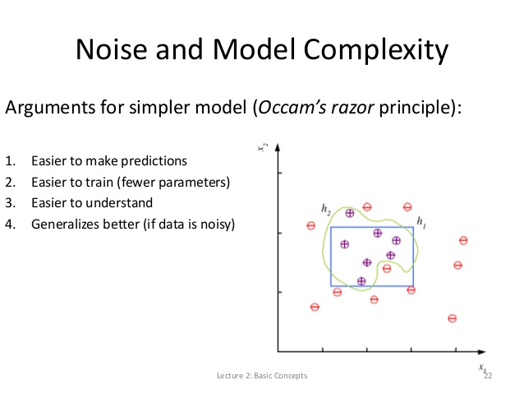
Effect of noise

Slide 8
Effect of noise
Simple model to use
Easy to check whether a point is inside or outside a rectangle
Simple model to train and has fewer parameters
Easier to find corner values of a rectangle
With a small training set when the training instances differ a little bit; we expect the simpler model to change less than a complex model→ less variance
A simpler model has more bias
Finding the optimal model corresponds to minimizing both the bias and the variance

Slide 9
Effect of noise
Simple model to explain
Rectangle corresponds to defining intervals on the two attributes
Given comparable empirical error, a simple model would generalize better than a complex model
Occam’s razor
Simpler explanations are more plausible and unnecessary complexity should be shaved off

Slide 10
Learning multiple classes
More than two classes.
Example
Instances of three classes, family car, sports car, luxury sedan

Slide 11
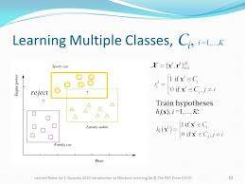

Slide 12
Learning multiple classes
Two methods are used to handle such cases.
“one-against-all" and “one-against-one”.

Slide 13
“One-against all” method
Consider the case where there are K classes denoted by
C₁, . . . , C_{K}.
Each input instance belongs to exactly one of them.
View a K-class classification problem as K two-class problems.
In the i-th two-class problem, the training examples belonging to C_{i} are taken as the positive examples and the examples of all other classes are taken as the negative examples.

Slide 14
“One-against all” method
Find K hypotheses h₁, . . . , h_{K} where h_{i} is defined by
h_{i}(x) = 1 if x is in class C_{i}
0 otherwise
For a given x, ideally only one of h_{i}(x) is 1 and then we assign the class C_{i} to x.
But, when no, or, two or more, hi(x) is 1, we cannot choose a class.
In such a case, we say that the classifier rejects such cases.

Slide 15
“One-against all” method
The total empirical error takes the sum over the predictions for all classes over all instances
E ({h_{i}} _{i=1}^{K} /X) = _{t=1}∑^{N} _{i=1}∑^{K} 1 (h_{i} (x^{t}) ≠ r_{i}^{t} )
For a given x, ideally only one of h_{i}(x) , i=1...K is 1
Build two hypothesis
One for positive and other for negative instances
E.g. Separate family cars from sports car
For luxury sedan, we can have both hypotheses decide negative and reject the input

Slide 16
“One-against-one” method
In the one-against-one (OAO) (also called one-vs-one (OVO)) strategy, a classifier is constructed for each pair of classes.
If there are K different class labels, a total of
K(K − 1)/2 classifiers are constructed.
An unknown instance is classified with the class getting the most votes.
Ties are broken arbitrarily.

Slide 17
“One-against-one” method
For example, let there be three classes, A, B and C.
In the OVO method we construct 3(3 − 1)/2 = 3 binary classifiers.
Now, if any x is to be classified, we apply each of the three classifiers to x.
Let the three classifiers assign the classes B, B, A respectively to x.
Since a label to x is assigned by the majority voting, in this example, we assign the class label of B to x.

Slide 18
Model selection
Learning a boolean function
All inputs and outputs are binary
2^{d} possible ways to write d binary values
Training set has at most 2^{d} samples with d inputs
Each can be labelled as 0 or 1
₂ (2^{d} ) possible boolean functions of d inputs
Distinct training samples can remove hypotheses

Slide 19
Example
x1 | x2 | h1 | h2 | h3 | h4 | h5 | h6 | h7 | h8 | h9 | h10
0 | 0 | 0 | 0 | 0 | 0 | 0 | 0 | 0 | 0 | 1 | 1
0 | 1 | 0 | 0 | 0 | 0 | 1 | 1 | 1 | 1 | 0 | 0
1 | 0 | 0 | 0 | 1 | 1 | 0 | 0 | 1 | 1 | 0 | 0
1 | 1 | 0 | 1 | 0 | 1 | 0 | 1 | 0 | 1 | 0 | 1
h11 | h12 | h13 | h14 | h15 | h16
1 | 1 | 1 | 1 | 1 | 1
0 | 0 | 1 | 1 | 1 | 1
1 | 1 | 0 | 0 | 1 | 1
0 | 1 | 0 | 1 | 0 | 1

Slide 20
Model selection
Start with all possible hypotheses and as we see more training examples, we remove those hypotheses that are not consistent with the training data
In case of boolean functions, to end up with a single hypothesis we need to see all 2^{d} training examples
If training set is a subset of instance space solution is not unique

Slide 21
ILL-POSED PROBLEM
After N samples , there remain ₂ (2^{d} -N) possible functions
Data itself is not sufficient to find a unique solution
See more training samples. Know more about underlying function
Carve out more hypotheses that are inconsistent from the hypotheses classes
Still left with many consistent hypotheses

Slide 22
Model selection
In order to formulate a hypothesis for a problem, we have to choose some model and the term “model selection” has been used to refer to the process of choosing a model.
It has been used to indicates the process of choosing one particular approach from among several different approaches.

Slide 23
Inductive bias
In a learning problem we only have the data.
But data by itself is not sufficient to find the solution.
We should make some extra assumptions to have a solution with the data we have.
The set of assumptions we make to have learning possible is called the inductive bias of the learning algorithm.
One way we introduce inductive bias is when we assume a hypothesis class.

Slide 24
Examples
1. In learning the class of family car, there are infinitely many ways of separating the positive examples from the negative examples.
Assuming the shape of a rectangle is an inductive bias.
2. In regression, assuming a linear function is an inductive bias.
The model selection is about choosing the right inductive bias

Slide 25
Advantages of a simple model
Even though a complex model may not be making any errors in prediction, there are certain advantages in using a simple model.
1. A simple model is easy to use.
2. A simple model is easy to train. It is likely to have fewer parameters. It is easier to find the corner values of a rectangle than the control points of an arbitrary shape.
3. A simple model is easy to explain.
4. A simple model would generalize better than a complex model. This principle is known as Occam’s razor, which states that simpler explanations are more plausible and any unnecessary complexity should be shaved off.

Slide 26
Remarks
A model should not be too simple!
A too simple model assumes more, is more rigid, and may fail if indeed the underlying class is not that simple.
A simpler model has more bias.
Finding the optimal model corresponds to minimizing both the bias and the variance.

Slide 27
Model selection
Choosing an appropriate algorithms from a selection of possible algorithms, or choosing the sets of features to be used for input, or choosing initial values for certain parameters.
The process of picking a particular mathematical model from among different mathematical models which all purport to describe the same data set.
The process of choosing the right inductive bias.

Slide 28
Generalisation
How well a model trained on the training set predicts the right output for new instances is called generalization.
How well the concepts learned by a machine learning model apply to specific examples not seen by the model when it was learning.
The goal of a good machine learning model is to generalize well from the training data to any data from the problem domain.
This allows us to make predictions in the future on data the model has never seen.

Slide 29
Generalisation
Overfitting and underfitting are the two biggest causes for poor performance of machine learning algorithms.
The model should be selected having the best generalisation and avoid overfitting and underfitting

Slide 30
Underfitting
Underfitting is the production of a machine learning model that is not complex enough to accurately capture relationships between a dataset features and a target variable.
Hypothesis class H is less complexity than function representing data
Try to fit a line to data sampled from a third-order polynomial ax³+bx²+cx+d=0
As complexity increases training error decreases

Slide 31
Overfitting
Overfitting is the production of an analysis which corresponds too closely or exactly to a particular set of data, and may therefore fail to fit additional data or predict future observations reliably.
Corresponds too closely to the given dataset and hence it does not account for small random noises in the dataset
Fitting a sixth order polynomial to noisy data sampled from a third-order polynomial

Slide 32
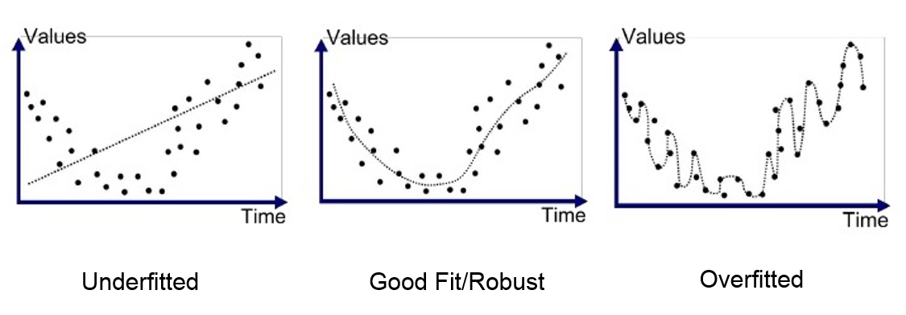
Generalisation

Slide 33
Example
Suppose we have to determine the classification boundary for a dataset two class labels.
The curved line is the classification boundary.
The three figures illustrate the cases of underfitting, right fitting and overfitting.

Slide 34
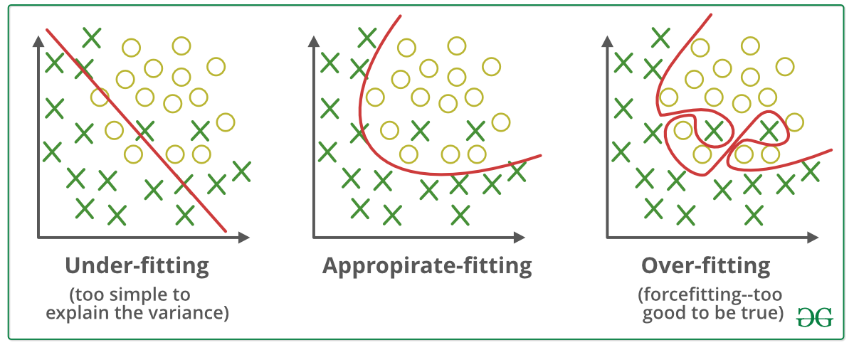
Generalisation

Slide 35
Triple trade-oﬀ
In all learning algorithms that are trained from example data, there is a trade-oﬀ between three factors:
the complexity of the hypothesis we ﬁt to data, namely, the capacity of the hypothesis class,
the amount of training data, and
the generalization error on new examples.

Slide 36
Triple trade-oﬀ
As the amount of training data increases, the generalization error decreases.
As the complexity of the model class H increases, the generalization error decreases ﬁrst and then starts to increase.
The generalization error of an overcomplex H can be kept in check by increasing the amount of training data but only up to a point.

Slide 37
Testing generalisation: Cross-validation
We can measure the generalization ability of a hypothesis, namely, the quality of its inductive bias, if we have access to data outside the training set.
We simulate this by dividing the training set we have into two parts.

Slide 38
Testing generalisation: Cross-validation
We use one part for training (that is, to find a hypothesis), and the remaining part is called the validation set and is used to test the generalization ability.
Assuming large enough training and validation sets, the hypothesis that is the most accurate on the validation set is the best one (the one that has the best inductive bias).
This process is called cross-validation.

Slide 39
Test set
Also called the publication set
Containing examples not used in training or validation.
An analogy from our lives is when we are taking a course:
The example problems that the instructor solves in class while teaching a subject form the training set;
Exam questions are the validation set;
The problems we solve in our later, professional life are the test set.

Slide 40
Training- Validation split
We cannot keep on using the same training/validation split either, because after having been used once, the validation set eﬀectively becomes part of training data.
This will be like an instructor who uses the same exam questions every year; a smart student will ﬁgure out not to bother with the lectures and will only memorize the answers to those questions

Slide 41
Training- Validation split
The training data we use is a random sample
For the same application, if we collect data once more, we will get a slightly different dataset, the fitted h will be slightly different and will have a slightly different validation error.
If we have a fixed set which we divide for training, validation, and test, we will have different errors depending on how we do the division.
These slight differences in error will allow us to estimate how large differences should be to be considered significant and not due to chance.

Slide 42
VC dimension and PAC learning
Measure of the capacity (complexity, expressive power, flexibility) of a space of functions that can be learned by a classification algorithm.
Defined by Vladimir Vapnik and Alexey Chervonenkis
Probably approximate correct (PAC) is a framework for the mathematical analysis of learning algorithms.
The goal is to check whether the probability for a selected hypothesis to be approximately correct is very high.

Slide 43
Vapnik-Chervonenkis dimension
Let H be the hypothesis space for some machine learning problem.
The Vapnik-Chervonenkis dimension of H, also called the VC dimension of H, and denoted by VC(H), is a measure of the complexity (or, capacity, expressive power, richness, or flexibility) of the space H.
To define the VC dimension we require the notion of the shattering of a set of instances.

Slide 44
Vapnik-Chervonenkis dimension
A dataset containing N points can be labeled in 2^{N} ways as positive and negative.
Therefore, 2^{N} different learning problems can be defined by N data points.
If for any of these problems, we can ﬁnd a hypothesis h∈H that separates the positive examples from the negative, then we say H shatters N points.
Any learning problem deﬁnable by N examples can be learned with no error by a hypothesis drawn from H.
The maximum number of points that can be shattered by H is called the VC dimension of H, is denoted as VC(H), and measures the capacity of H.

Slide 45
Shattering of a set
Let D be a dataset containing N examples for a binary classification problem with class labels 0 and 1.
Let H be a hypothesis space for the problem.
Each hypothesis h in H partitions D into two disjoint subsets as follows:
{x ∈ D ∣ h(x) = 0} and {x ∈ D ∣ h(x) = 1}.
Such a partition of S is called a “dichotomy” in D.

Slide 46
Shattering of a set
There are 2^{N} possible dichotomies in D.
To each dichotomy of D there is a unique assignment of the labels “1” and “0” to the elements of D.
Conversely, if S is any subset of D then, S defines a unique hypothesis h as follows:
h(x) = 1 if x ∈ S
0 otherwise

Slide 47
Shattering of a set
To specify a hypothesis h, we need only specify the set {x ∈ D ∣ h(x) = 1}.
All possible dichotomies of D if D has three elements, with only one of the two sets in a dichotomy, namely the set {x ∈ D ∣ h(x) = 1}.

Slide 48
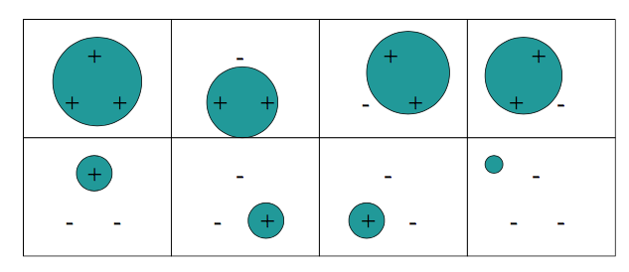

Slide 49
Definition
A set of examples D is said to be shattered by a hypothesis space H if and only if for every dichotomy of D there exists some hypothesis in H consistent with the dichotomy of D.

Slide 50
Vapnik-Chervonenkis dimension
Example
Let the instance space X be the set of all real numbers.
Consider the hypothesis space defined by
H = {hm ∶ m is a real number},
where hm ∶ IF x ≥ m THEN ”1” ELSE “0”.

Slide 51
Example
Let D be a subset of X containing only a single number
D = {3.5}.
There are 2 dichotomies for this set.
These correspond to the following assignment of class labels:
h4 ∈ H is consistent with the former dichotomy and h3 ∈ H is consistent with the latter.
x | 3.25
Label | 0
x | 3.25
Label | 1

Slide 52
Example
So, to every dichotomy in D there is a hypothesis in H consistent with the dichotomy.
Therefore, the set D is shattered by the hypothesis space H.

Slide 53
Example
Let D be a subset of X containing two elements, say, D = {3.25, 4.75}.
There are 4 dichotomies in D and they correspond to the assignment of class labels
In these dichotomies, h5 is consistent with (a), h4 is consistent with (b) and h3 is consistent with (d).
But there is no hypothesis hm ∈ H consistent with (c).
Thus the two-element set D is not shattered by H.

Slide 54
Example
x | 3.25 | 4.75
Label | 0 | 0
x | 3.25 | 4.75
Label | 0 | 1
x | 3.25 | 4.75
Label | 1 | 0
x | 3.25 | 4.75
Label | 1 | 1

Slide 55
VC dimension of H
The size of the largest finite subset of X shattered by H .
VC dimension(H) =1
H = {hm ∶ m is a real number},
where hm ∶ IF x ≥ m THEN ”1” ELSE “0”.

Slide 56
Definition
The Vapnik-Chervonenkis dimension (VC dimension) of a hypothesis space H defined over an instance space (that is, the set of all possible examples) X, denoted by VC(H), is the size of the largest finite subset of X shattered by H.

Slide 57
Examples
Let X be the set of all real numbers (say, for example, the set of heights of people).
For any real numbers a and b define a hypothesis h_{a,b} as follows:
h_{a,b} (x) = 1 if a < x < b
0 otherwise
Let the hypothesis space H consist of all hypotheses of the form h_{a,b} .
We show that VC(H) = 2.
We have to show that there is a subset of X of size 2 shattered by H and there is no subset of size 3 shattered by H

Slide 58
Examples
Consider the two-element set D = {3.25, 4.75}.
The various dichotomies of D are given
It can be seen that the hypothesis h_{5,6} is consistent with (a), h_{4,5} is consistent with (b), h_{3,4} is consistent with (c) and h_{3,5} is consistent with (d).
So the set D is shattered by H

Slide 59
Examples
Consider a three-element subset D = {x1, x2, x3}.
Let us assume that x1 < x2 < x3.
H cannot shatter this subset because the dichotomy represented by the set {x1, x3} cannot be represented by a hypothesis in H (any interval containing both x1 and x3 will contain x2 also).
Therefore, the size of the largest subset of X shattered by H is 2 and so VC(H) = 2.

Slide 60
Examples
Let the instance space X be the set of all points (x, y) in a plane.
For any three real numbers, a, b, c define a class labeling as follows:
ha,b,c(x, y) = 1 if ax + by + c > 0
0 otherwise

Slide 61
Examples
Let H be the set of all hypotheses of the form h _{a,b,c}. VC(H) = 3.
We have show that there is a subset of size 3 shattered by H and there is no subset of size 4 shattered by H.
Consider a set D = {A, B, C} of three non-collinear points in the plane.
There are 8 subsets of D and each of these defines a dichotomy of D.
We can easily find 8 hypotheses corresponding to the dichotomies defined by these subsets

Slide 62
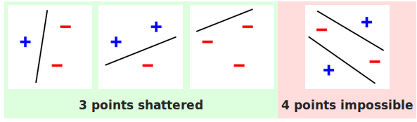

Slide 63
Examples
Consider a set S = {A, B, C, D} of four points in the plane.
Let no three of these points be collinear. Then, the points form a quadrilateral.
It can be easily seen that, in this case, there is no hypothesis for which the two element set formed by the ends of a diagonal is the corresponding dichotomy

Slide 64
Examples
So the set cannot be shattered by H. If any three of them are collinear, then by some trial and error, it can be seen that in this case also the set cannot be shattered by H.
No set with four elements cannot be shattered by H.
From the above discussion we conclude that V C(H) = 3.

Slide 65
Examples
Let X be set of all conjunctions of n boolean literals. Let the hypothesis space H consists of conjunctions of up to n literals.
It can be shown that VC(H) = n.

Slide 66
Learning theory
Find what tasks can be learned
What type of data is required for learning this task
How much data required
Number of samples
Resource Requirement
Space and time complexity of algorithm required to solve the learning task
Confidence/Guarantee of that algorithm

Slide 67
Learning theory
Design Algorithm
Find confidence on this algorithm
How well this algorithm will work on future data instances
Generalization ability of the algorithm

Slide 68
Probably approximately correct learning
Computational learning theory is a subfield of artificial intelligence devoted to studying the design and analysis of machine learning algorithms.
Probably approximately correct learning (PAC learning) is a framework for mathematical analysis of machine learning algorithms.
In this framework, the learner (that is, the algorithm) receives samples and must select a hypothesis from a certain class of hypotheses.
With high probability , the selected hypothesis will have low generalization error

Slide 69
Probably approximately correct learning
Error= h ⊕ C
P ( h ⊕ C ) ≤ ϵ
h
C

Slide 70
Probably approximately correct learning
A hypothesis is said to be approximately correct if the error is ≤ ϵ
0 < ϵ ≤ 1/2
Probability that we get an approximately correct hypothesis Pr(P ( h ⊕ C ) ≤ ϵ ) ≥ (1- δ )
δ is called confidence parameter
0 < δ ≤ ½
δ is 0.01 then 99% we get an approximately correct hypothesis

Slide 71
Probably approximately correct learning
Instance space X→ Consists of all the instances
Distribution D over X
Target concept C→ We want to learn
Hypothesis space H
Training samples S={ (xi, c(xi)) }
Consistent Hypothesis
Hypothesis that agrees with the training examples
Produce correct labelling for training examples
Find a hypothesis with small error over the distribution over the instances

Slide 72
Function Approximation
N features
2^{N} instance space
Hypothesis space partitions instance space into positive and negative
2 ^{2N} possible partitions of instance space
To fix exactly one hypothesis 2^{N} samples required
Find a hypothesis using fewer instances

Slide 73
Error
Measure error of h on S(training data)
True error Pr (h(x) ≠ c(x))

Slide 74
Dimensionality Reduction
Observation data contain information are taken as inputs and fed to the system for decision making
In many learning problems, the datasets have large number of variables.
Sometimes, the number of variables is more than the number of observations.
image processing, internet search engines, and automatic text analysis
Statistical and machine learning methods have some difficulty when dealing with such high-dimensional data.

Slide 75
Dimensionality Reduction
Features contain information about target
Classification function defined in terms of features
More features→ more information/
Better classification power

Slide 76
Dimensionality Reduction
Some features are irrelevant
Features can introduce noise
Some features are redundant
Do not contribute additional information
Leads to performance degradation of learning algorithms
Limited training examples
Limited resources
Classifier performance degrade for large number of features

Slide 77
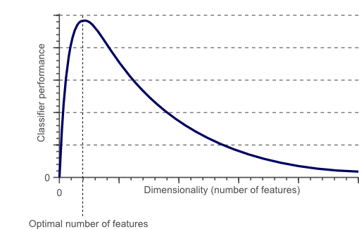
Curse of Dimensionality

Slide 78
Dimensionality Reduction
The complexity of any classiﬁer or regressor depends on the number of inputs.
This determines both the time and space complexity and the necessary number of training examples to train such a classiﬁer or regressor.
How to decrease input dimensionality without losing accuracy.

Slide 79
Dimensionality Reduction- Reasons
The complexity of the machine learning algorithm depends on
the number of input dimensions, d,
the size of the data sample, N,
For reduced memory and computation, reduce the dimensionality of the problem.
Decreasing dimension also decreases the complexity of the inference algorithm during testing.
When an input is decided to be unnecessary, we save the cost of extracting it.

Slide 80
Dimensionality Reduction- Reasons
Simpler models are more robust on small datasets.
Simpler models have less variance, that is, they vary less depending on the particulars of a sample, including noise, outliers, and so forth.
When data can be explained with fewer features, we get a better idea about the process that underlies the data and this allows knowledge extraction.
When data can be represented in a few dimensions without loss of information, it can be plotted and analyzed visually for structure and outliers.

Slide 81
Dimensionality reduction
Normally the number of input variables is reduced before the machine learning algorithms can be successfully applied.
In statistical and machine learning, dimensionality reduction or dimension reduction is the process of reducing the number of variables under consideration by obtaining a smaller set of principal variables.
Dimensionality reduction may be implemented in two ways
Feature selection
Feature extraction

Slide 82
Dimensionality reduction
Feature selection methods choose a subset of important features pruning the rest and feature extraction methods that form fewer, new features from the original inputs
Ideally, we should not need feature selection or extraction as a separate process; the classiﬁer (or regressor) should be able to use whichever features are necessary, discarding the irrelevant.
Helps to maintain classification accuracy and simplify classifier complexity

Slide 83
Feature selection
Find k of the total of n features that give us the most information and we discard the other (n−k) dimensions.
Subset selection is a feature selection method.

Slide 84
Feature extraction
Finding a new set of k features that are the combination of the original n features.
These methods may be supervised or unsupervised depending on whether or not they use the output information.
The best known and most widely used feature extraction methods are
Principal Components Analysis (PCA)
Unsupervised
Linear Discriminant Analysis (LDA)
Supervised .

Slide 85
Measures of error
In regression problems, use the Mean Squared Error (MSE) or the Root Mean Squared Error (RMSE) as the measure of error.
MSE is the sum, over all the data points, of the square of the difference between the predicted and actual target variables, divided by the number of data points.
If y₁, . . . , y_{n} are the observed values
yˆ_{i} , . . . , yˆ_{n} are the predicted values
MSE = 1/n _{i=1} ∑ ^{n} (y_{i} − yˆ_{i}) ²

Slide 86
Measures of error
In classification problems, use the misclassification rate as a measure of the error.
misclassification rate =( no. of misclassified examples)/ ( total no. of examples)

Slide 87
Subset selection
Also called feature selection, or variable selection, or attribute selection
The process of selecting a subset of relevant features (variables, predictors) for use in model construction.
Feature selection techniques are used for four reasons:
simplification of models to make them easier to interpret by researchers/users
shorter training times,
to avoid the curse of dimensionality
enhanced generalization by reducing overfitting

Slide 88
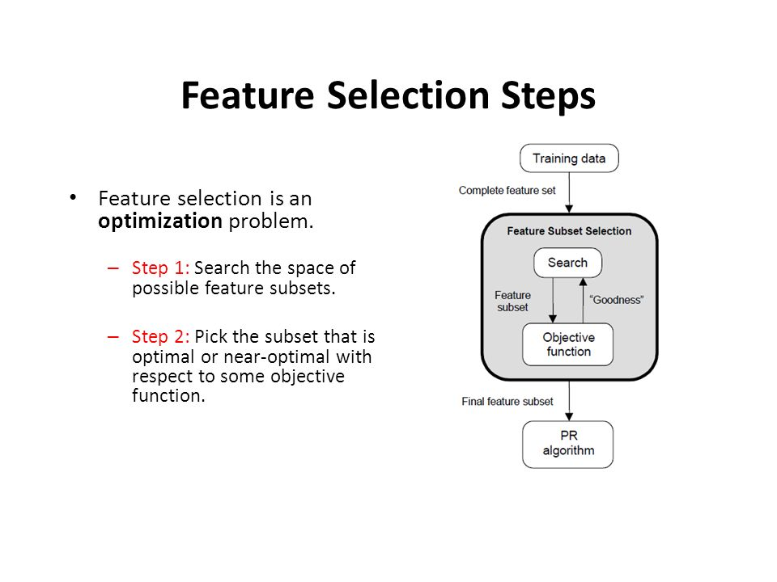

Slide 89
Subset selection
Find the best subset of set of features.
The best subset contains the least number of dimensions that most contribute to accuracy.
Discard the remaining, unimportant dimensions.
Using a suitable error function, this can be used in both regression and classiﬁcation problems.
There are 2^{d} possible subsets of d variables, but we cannot test for all of them unless d is small and we employ heuristics to get a reasonable (but not optimal) solution in reasonable (polynomial) time.

Slide 90
Subset selection
The data contains many features that are either redundant or irrelevant, and can thus be removed without incurring much loss of information.
Two of the simplest approaches for subset selection
forward selection
backward selection

Slide 91
Subset selection
Forward selection,
Start with no variables and add them one by one, at each step adding the one that decreases the error the most, until any further addition does not decrease the error (or decreases it only sightly).
Backward selection
Start with all variables and remove them one by one, at each step removing the one that decreases the error the most (or increases it only slightly), until any further removal increases the error signiﬁcantly.
Checking the error should be done on a validation set distinct from the training set because we want to test the generalization accuracy.
With more features, generally we have lower training error, but not necessarily lower validation error

Slide 92
Sequential Forward selection
Also known as wrapper approach (Greedy Method)
Process of feature extraction is thought to wrap around the learner it uses as a subroutine
Select uncorrelated features and remove irrelevant features
Start with no variables
Add them one by one, at each step
Adding the one that decreases the error the most
Until any further addition does not decrease the error (or decreases it only sightly).

Slide 93
Forward selection-- Notations
n : number of input variables
x₁, . . . , x _{n} : input variables
F_{i} : a subset of the set of input variables
E(F_{i}) : error incurred on the validation sample when only the inputs in F_{i} are used

Slide 94
Forward selection--Procedure
Set F₀ = ∅ and E(F₀) = ∞.
For i = 0, 1, . . ., repeat the following until E(F_{i}+1) ≥ E(F_{i}):
For all possible input variables x_{j} , train the model with the input variables F_{i} ∪{x_{j} } and calculate E(F_{i} ∪ {x_{j} }) on the validation set.
Choose that input variable x_{m} that causes the least error
E(F_{i} ∪ {x_{j} }):
m = arg min _{j} E(F_{i} ∪ {x_{j} })
Set F_{i}+1 = F_{i} ∪ {x_{m}}.
The set F_{i} is outputted as the best subset.

Slide 95
Forward selection
Stop if adding any feature does not decrease the error E.
We may even decide to stop earlier if the decrease in error is too small, where there is a user-defined threshold that depends on the application constraints.
This process may be costly because to decrease the dimensions from n to k, we need to train and test the system n + (n − 1) + (n − 2) + ⋯ + (n − k) times, which is O(n ² ).

Slide 96
Forward selection
This is a local search procedure and does not guarantee ﬁnding the optimal subset, namely, the minimal subset causing the smallest error.
For example, xi and xj by themselves may not be good but together may decrease the error a lot, but because this algorithm is greedy and adds attributes one by one, it may not be able to detect this.
It is possible to generalize and add multiple features at a time, instead of a single one, at the expense of more computation.

Slide 97
Forward selection
Backtrack and check which previously added feature can be removed after a current addition, thereby increasing the search space, but this increases complexity.
In ﬂoating search methods , the number of added features and removed features can also change at each step.

Slide 98
Sequential Backward selection
Start with the set containing all features
At each step remove the one feature that causes the least error.
Start with full feature set
Try removing features
Find improvement in performance by feature removal
Drop the feature with smallest impact on error

Slide 99
Backward selection-- Notations
n : number of input variables
x₁, . . . , x _{n} : input variables
F_{i} : a subset of the set of input variables
E(F_{i}) : error incurred on the validation sample when only the inputs in F_{i} are used

Slide 100
Backward selection--Procedure
Set F₀ = {x₁, . . . , x _{n} } and E(F₀) = ∞.
For i = 0, 1, . . ., repeat the following until E(F_{i}+1) ≥ E(F_{i}):
For all possible input variables x_{j} , train the model with the input variables F_{i} - {x_{j} } and calculate E(F_{i} - {x_{j} }) on the validation set.
Choose that input variable x_{m} that causes the least error E(F_{i} - {x_{j} }):
m = arg min _{j} E(F_{i} - {x_{j} })
Set F_{i}+1 = F_{i} - {x_{m}}.
The set F_{i} is outputted as the best subset.

Slide 101
Backward selection
We stop if removing a feature does not decrease the error.
To decrease complexity, we may decide to remove a feature if its removal causes only a slight increase in error.
All the variants possible for forward search are also possible for backward search.
The complexity of backward search has the same order of complexity as forward search, except that training a system with more features is more costly than training a system with fewer features, and forward search may be preferable especially if we expect many useless features.

Slide 102
Backward selection
Subset selection is supervised in that outputs are used by the regressor or classiﬁer to calculate the error, but it can be used with any regression or classiﬁcation method.
In an application like face recognition, feature selection is not a good method for dimensionality reduction because individual pixels by themselves do not carry much discriminative information; it is the combination of values of several pixels together that carry information about the face identity

Slide 103
Feature Extraction
n dimensional feature X₁, X₂, . . . , X_{N}
Mapped to lower dimensional space Z₁, Z₂, . . . , Z_{M}
M<N
Z₁, Z₂, . . . , Z_{M} = f(X₁, X₂, . . . , X_{N} )
Find features
Uncorrelated and cannot be reduced further
With large variance
Feature should be able to distinguish between different instances

Slide 104
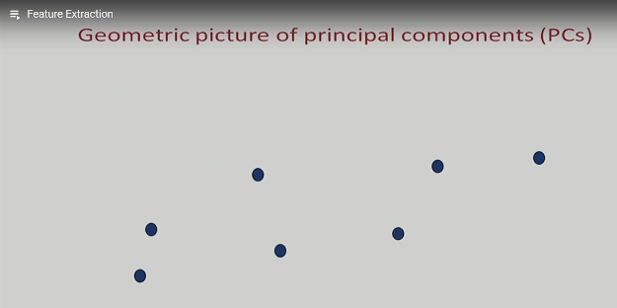

Slide 105
Geometric picture of principal components
Map two dimensional feature space points into one dimension feature space
Project to a line

Slide 106
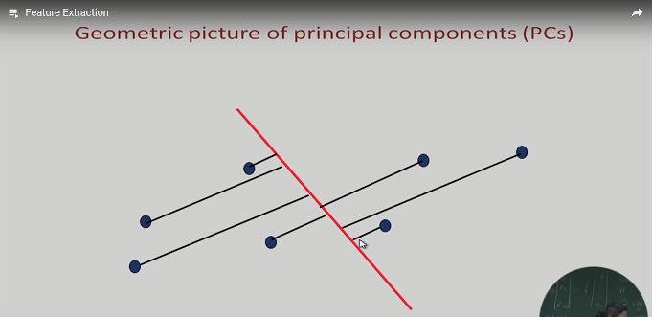

Slide 107
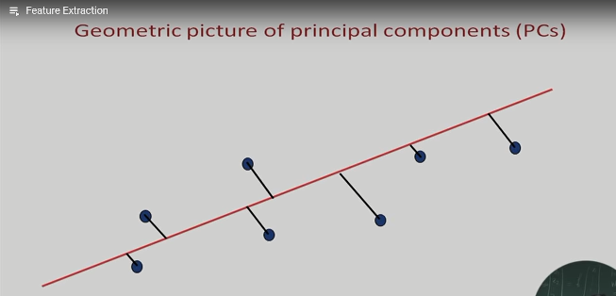

Slide 108
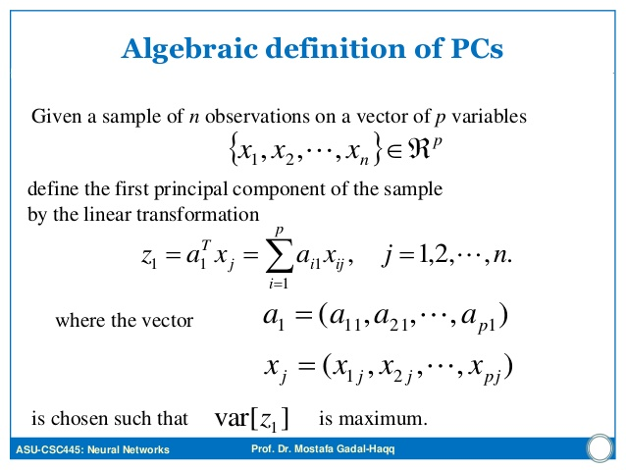

Slide 109
Algebraic definition of PCs
X₁ = { X₁₁ , X₁₂ ,⋯ X_{1p} }
X₂ = { X₂₁ , X₂₂ , ⋯ X_{2p} }
X_{i} = { X_{i1} , X_{i2} , ⋯ , X_{ip} }
Xn = { X_{p1} , X_{p2} , ⋯ , X_{np} }
First principal component is chosen based on largest variance
Second feature should be uncorrelated with the first feature
Orthogonal to the first feature

Slide 110
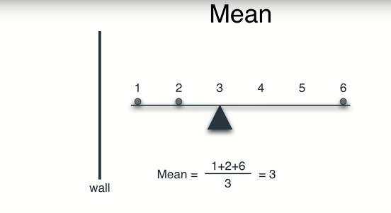

Slide 111
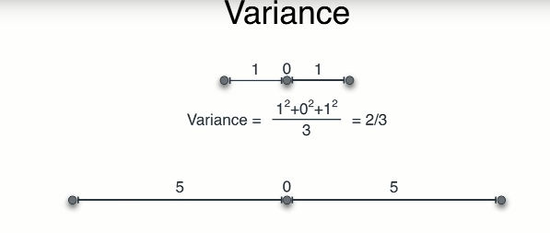

Slide 112
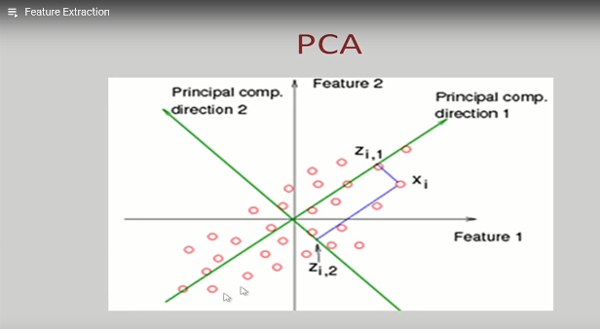

Slide 113
Choose directions
Maximize total variance
Minimize correlation
Choose M orthogonal directions M < p(dimensions) which maximize total variance
Find M * p symmetric covariance matrix of training data
Find top M principal components → eigen vectors

Slide 114
Principal component analysis
Statistical procedure that uses an orthogonal transformation to convert a set of observations of possibly correlated variables into a set of values of linearly uncorrelated variables called principal components.
The number of principal components is less than or equal to the smaller of the number of original variables or the number of observations.
This transformation is defined in such a way that the first principal component has the largest possible variance (that is, accounts for as much of the variability in the data as possible), and each succeeding component in turn has the highest variance possible under the constraint that it is orthogonal to the preceding components.

Slide 115
Graphical illustration
Consider a two-dimensional data, that is, a dataset consisting of examples having two features.
Let each of the features be numeric data.
So, each example can be plotted on a coordinate plane (xcoordinate indicating the first feature and y-coordinate indicating the second feature).
Plotting the example, we get a scatter diagram of the data.

Slide 116
Graphical illustration
Scatter diagram of a two-dimensional data.
Spread of the data in the x direction
Spread of the data in the y-direction.
The spread in the x-direction is more than the spread in the y direction
The maximum spread occurs in the direction (maximum variance)

Slide 117
Graphical illustration
The point whose coordinates are the mean values of the two features in the dataset.
This direction is called the direction of the first principal component of the given dataset.
The direction which is perpendicular (orthogonal) to the direction of the first principal component is called the direction of the second principal component of the dataset.
The unit vectors along the directions of principal components are called the principal component vectors, or simply, principal components.

Slide 118
Principal component analysis
Consider a dataset consisting of examples with three or more features.
The first principal component is defined based on variance
But, for the second component, it may be noted that there would be many directions perpendicular to the direction of the first principal component.
The direction of the second principal component is that direction, which is perpendicular to the first principal component, in which the spread of data is largest.
The third and higher order principal components are constructed in a similar way.

Slide 119
Computation of the principal component vectors (PCA algorithm)
The procedure is heavily dependent on mathematical concepts.
A knowledge of these concepts is essential to carry out this procedure
Outline of the procedure for performing a principal component analysis on a given data.

Slide 120
Step 1. Data
We consider a dataset having n features or variables denoted by X₁, X₂, . . . , X_{n}.
Let there be N examples.
Let the values of the i-th feature Xi be X_{i1}, X_{i2}, . . . , X _{iN}
Features Example1 Example 2 ⋯ Example N
X₁ X₁₁ X₁₂ ⋯ X_{1N}
X₂ X₂₁ X₂₂ ⋯ X_{2N}
X_{i} X_{i1} X_{i2} ⋯ X_{iN}
Xn X_{n1} X_{n2} ⋯ X_{nN}

Slide 121
Step 2. Compute the means of the variables
We compute the mean Ã_{i} of the variable X_{i} :
Ã_{i} = 1/N (X_{i1} + X_{i2} + ⋯ + X_{iN} ).

Slide 122
Step 3. Calculate the covariance matrix
Consider the variables X_{i} and X_{j} (i and j need not be different).
The covariance of the ordered pair (X_{i} , X_{j} ) is defined as
Cov (X_{i} , X_{j} ) = (1/ N − 1) _{k=1} ∑ ^{N} (X_{ik} − X¯ i)(Xjk − X¯ j ).
We calculate the following n × n matrix S called the covariance matrix of the data.
The element in the i-th row j-th column is the covariance Cov (Xi , Xj ): S = Cov (X1, X1) Cov (X1, X2) ⋯ Cov (X1, Xn) Cov (X2, X1) Cov (X2, X2) ⋯ Cov (X2, Xn) ⋮ Cov (Xn, X1) Cov (Xn, X2) ⋯ Cov (Xn, Xn)

Slide 123
Step 4. Calculate the eigenvalues and eigenvectors of the covariance matrix
Let S be the covariance matrix and let I be the identity matrix having the same dimension as the dimension of S. i) Set up the equation: det(S − λI) = 0. (4.2) This is a polynomial equation of degree n in λ. It has n real roots (some of the roots may be repeated) and these roots are the eigenvalues of S. We find the n roots λ1, λ2, . . . , λn of Eq. (4.2)

Slide 124
ii) If λ = λ ′ is an eigenvalue, then the corresponding eigenvector is a vector U = u1 u2 ⋮ un such that (S − λ ′ I)U = 0. (This is a system of n homogeneous linear equations in u1, u2, . . ., un and it always has a nontrivial solution.) We next find a set of n orthogonal eigenvectors U1, U2, . . . , Un such that Ui is an eigenvector corresponding to λi . 2 iii) We now normalise the eigenvectors. Given any vector X we normalise it by dividing X by its length. The length (or, the norm) of the vector X = x1 x2 ⋮ xn is defined as ∣∣X∣∣ = √ x 2 1 + x 2 2 + ⋯ + x 2 n . Given any eigenvector U, the corresponding normalised eigenvector is computed as 1 ∣∣U∣∣U. We compute the n normalised eigenvectors e1, e2, . . . , en by ei = 1 ∣∣Ui ∣∣Ui , i = 1, 2, . . . , n.

Slide 125
Step 5. Derive new data set
Order the eigenvalues from highest to lowest. The unit eigenvector corresponding to the largest eigenvalue is the first principal component. The unit eigenvector corresponding to the next highest eigenvalue is the second principal component, and so on. i) Let the eigenvalues in descending order be λ1 ≥ λ2 ≥ . . . ≥ λn and let the corresponding unit eigenvectors be e1, e2, . . . , en. ii) Choose a positive integer p such that 1 ≤ p ≤ n. iii) Choose the eigenvectors corresponding to the eigenvalues λ1, λ2, . . ., λp and form the following p × n matrix (we write the eigenvectors as row vectors): F = e T 1 e T 2 ⋮ e T p where T in the superscript denotes the transpose

Slide 126
iv) We form the following n × N matrix: X = X11 − X¯ 1 X12 − X¯ 1 ⋯ X1N − X¯ 1 X21 − X¯ 2 X22 − X¯ 2 ⋯ X2N − X¯ 2 ⋮ Xn1 − X¯ n Xn2 − X¯ n ⋯ XnN − X¯ n v) Next compute the matrix: Xnew = F X. Note that this is a p × N matrix. This gives us a dataset of N samples having p features.

Slide 127
Step 6. New dataset
The matrix Xnew is the new dataset. Each row of this matrix represents the values of a feature. Since there are only p rows, the new dataset has only features.
Step 7. Conclusion
This is how the principal component analysis helps us in dimensional reduction of the dataset. Note that it is not possible to get back the original n-dimensional dataset from the new dataset.

Slide 128
Illustrative example

Slide 129
PCA
In projection methods, we are interested in ﬁnding a mapping from the inputs in the original d-dimensional space to a new (k < d)-dimensional space, with minimum loss of information.
The projection of x on the direction of w is z =wTx
Principal components analysis (PCA) is an unsupervised method in that principal components analysis it does not use the output information; the criterion to be maximized is the variance.
The principal component is w1 such that the sample, after projection on to w1, is most spread out so that the diﬀerence between the sample points becomes most apparent.

Slide 130
PCA
Proportion of variance
From d dimensions reduced to k
(λ1+ λ2+... λk)/(λ1+ λ2+.... λd)
Screen Graph
Plot of variance explained as a function of the number of eigen vectors
By visually analysing screen graph we can decide k

Slide 131
Sample questions -Short answer questions
Explain the “one-against-all” method for learning multiple classes.
Describe the “one-against-one” method for learning multiple classes.
What is meant by inductive bias in machine learning? Give an example.
What is meant by overfitting of data? Explain with an example.
What is meant by overfitting and underfitting of data with examples.

Slide 132
Sample questions -Short answer questions
What is VC dimension?
Explain Vapnik-Chervonenkis dimension.
Give an informal definition of PAC learnability.
Give a precise definition of PAC learnability.
Give an application of PAC learnable algorithm.

Slide 133
Sample questions -Short answer questions
What is dimensionality reduction? How is it implemented?
Explain why dimensionality reduction is useful in machine learning.
What are the commonly used dimensionality reduction techniques in machine learning?
How is the subset selection method used for dimensionality reduction?

Slide 134
Sample questions -Short answer questions
Explain the method of principal component analysis in machine learning.
What are the first principal components of a data?
Is subset selection problem an unsupervised learning problem? Why?
Is principal component analysis a supervised learning problem? Why?

Slide 135
Sample questions -Longer answer questions
What is meant by “noise” in data? What are its sources and how it is affecting results?
What issues are to be considered while selecting a model for applying machine learning in a given problem.
Let X be the set of all real numbers. Describe a hypothesis for X for which the VC dimension is 0.
Let X be the set of all real numbers. Describe a hypothesis for X for which the VC dimension is 1.

Slide 136
Sample questions -Longer answer questions
Let X be the set of all real numbers. Describe a hypothesis for X for which the VC dimension is 2.
Describe an example for which the VC dimension is 3.
Describe an example of a PAC learnable concept class.
An open interval in R is defined as (a, b) = {x ∈ R ∣ a < x < b}. It has two parameters a and b. Show that the sets of all open intervals has a VC dimension of 2.

Slide 137
Sample questions -Longer answer questions
Describe the forward selection algorithm for implementing the subset selection procedure for dimensionality reduction.
Describe the backward selection algorithm for implementing the subset selection procedure for dimensionality reduction.
What is the first principal component of a data? How one can compute it?
Describe with the use of diagrams the basic principle of PCA.
Explain the procedure for the computation of the principal components of a given data.

Slide 138
Sample questions -Longer answer questions
Describe how principal component analysis is carried out to reduce dimensionality of data sets.
Given the following data, compute the principal component vectors and the first principal components:
x 2 3 7
y 11 14 26
Given the following data, compute the principal component vectors and the first principal components:
x -3 1 -2
y 2 -1 3

