Slide 1
Module III
Java Server Pages

Slide 2
Introduction
In any web application, a program on the server processes requests and generates responses.
Drawbacks of servlets:
Thorough Java programming knowledge is needed
Changes requires the servlet code to be recompiled
It's hard to take advantage of web page development tools when designing the application interface

Slide 3
JSP
In a simple implementation, the browser directly invokes a JSP page, which then generates the requested content (perhaps invoking JDBC to get information directly from a database).
The JSP page can call JDBC components to generate results, and creates standard HTML that it sends back to the browser as a result.

Slide 4
JSP
A JSP page is executed by a JSP engine, which is installed in a Web server or a JSP enabled application server such as WebLogic or SilverStream.
JSP page will be compiled into a Java Servlet class and stored in the server cache.
Then the class file will get executed

Slide 5
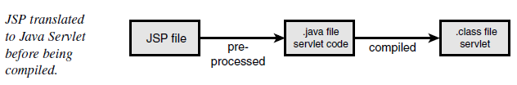
JSP file execution

Slide 6
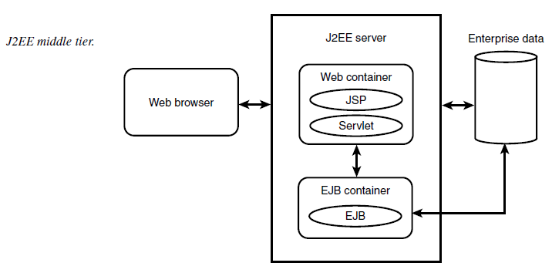
J2EE

Slide 7
Features of JSP Pages
The Efficient Use of Server-Side Java
Web Development, Deployment, and Maintenance are easy
Components are Reusable (uses reusable components such as EJB)
Separating Business Logic and Presentation
Large Development Community and Widespread Support
Platform Independence
Next Generation Page Development with Tags

Slide 8
The Components of a JSP Page
JSP Directives - used to pass instructions to the JSP engine
JSP Tags – like html
Scripting Elements – we can include small scripts called scriptlets

Slide 9
JSP Directives
Page directives —These directives communicate page-specific information, such as buffer and thread information or error handling.
Language directives —These specify the scripting language, along with any extensions.
The include directive — This directive can be used to include an external document in the page
A taglib directive—This indicates a library of custom tags that the page can invoke.

Slide 10
JSP Tags
jsp:useBean—This tag declares the usage of an instance of a JavaBeans component.
jsp:setProperty — This sets the value of a property in a bean.
jsp:getProperty—This tag gets the value of a bean instance property, converts it to a string, and put it in the implicit object “out”.
jsp:include — This tag will cause the specified file to be included in the current JSP page.
jsp:forward — This tag will forward or redirect control to another JSP page.

Slide 11
JSP Scripting Elements
Expressions: <%= expression %>
Evaluated and inserted into the servlet’s output. i.e., results in something like out.println(expression)
Examples
Current time: <%= new java.util.Date() %>
Your hostname: <%= request.getRemoteHost() %>
Scriptlets: <% java code %>
Declarations: <%! code %>
Examples
– <%! private int someField = 5; %>
– <%! private void someMethod(...) {...} %>

Slide 12
Implicit JSP Objects
request - This is the HttpServletRequest object associated with the request.
response - This is the HttpServletResponse object associated with the response to the client.
out - This is the PrintWriter object used to send output to the client.
session - This is the HttpSession object associated with the request.
application - This is the ServletContext object associated with the application context.

Slide 13
Implicit JSP Objects ...
config - This is the ServletConfig object associated with the page.
pageContext - This encapsulates use of server-specific features like higher performance JspWriters.
(Eg: pageContext.removeAttribute("attrName", PAGE_SCOPE);
page - This is simply a synonym for this, and is used to call the methods defined by the translated servlet class.
Exception - The Exception object allows the exception data to be accessed by designated JSP.

Slide 14
Implicit objects – Class files
•application: javax.servlet.ServletContext
•config: javax.servlet.ServletConfig
•exception: java.lang.Throwable
•out: javax.servlet.jsp.JspWriter
•page: java.lang.Object
•pageContext: javax.servlet.jsp.PageContext
•request: javax.servlet.ServletRequest
•response: javax.servlet.ServletResponse
•session: javax.servlet.http.HttpSession

Slide 15
JSP Scripting Elements – xml compatible syntax
JSP Expressions
<jsp:expression>Java Expression</jsp:expression>
JSP Scriptlets
–<jsp:scriptlet>Java Code</jsp:scriptlet>
JSP Declarations
–<jsp:declaration>Java Code</jsp:declaration>

Slide 16
Error Handling & Debugging
JSP code may contain the following errors:
Checked exceptions
Runtime exceptions
Errors

Slide 17
Checked exceptions
A checked exception is an exception that is typically a user error or a problem that cannot be foreseen by the programmer.
For example, if a file is to be opened, but the file cannot be found, an exception occurs.
These exceptions cannot simply be ignored at the time of compilation.

Slide 18
Runtime exceptions
A runtime exception is an exception that occurs that probably could have been avoided by the programmer
As opposed to checked exceptions, runtime exceptions are ignored at the time of compilation.

Slide 19
Errors
These are not exceptions at all, but problems that arise beyond the control of the user or the programmer.
Errors are typically ignored in your code because you can rarely do anything about an error.
For example, if a stack overflow occurs, an error will arise. They are also ignored at the time of compilation.

Slide 20
Error Handling
Using Exception Object:
The exception is an object of Throwable class (e.g., java.lang.NullPointerException) and is only available in error pages.
Using JSTL Tags for Error Page
Using Try...Catch Block
Assignment - II

Slide 21
Methods in the Throwable class.
public String getMessage() Returns a detailed message about the exception that has occurred. This message is initialized in the Throwable constructor.
public Throwable getCause() Returns the cause of the exception as represented by a Throwable object.
public String toString() Returns the name of the class concatenated with the result of getMessage()

Slide 22
Methods in the Throwable class...
public void printStackTrace() Prints the result of toString() along with the stack trace to System.err, the error output stream.
public StackTraceElement [] getStackTrace() Returns an array containing each element on the stack trace. The element at index 0 represents the top of the call stack, and the last element in the array represents the method at the bottom of the call stack.
public Throwable fillInStackTrace() Fills the stack trace of this Throwable object with the current stack trace, adding to any previous information in the stack trace.

Slide 23
Error Handling ...
JSP gives an option to specify Error Page for each JSP.
Whenever the page throws an exception, the JSP container automatically invokes the error page.
To set up an error page, use the
<%@ page errorPage="xxx" %> directive.

Slide 24
Using JavaBeans Components in JSP Pages
Create a java bean
Create a jsp page with <%code fragment%>
Use the useBean action to declare the JavaBean for use in jsp page
Use the getProperty and setProperty actions to access methods of bean

