Slide 1
Module IV

Slide 2
Sharing Data Between JSP Pages, Requests, and Users
Any real application consists of multiple pages often need access to the same information and server-side resources.
When multiple pages are used to process the same request, for instance one page that retrieves the data the user asked for and another that displays it, there must be a way to pass data from one page to another.

Slide 3
Sharing Data ...
In an application in which the user is asked to provide information in multiple steps, such as an online shopping application, there must be a way to collect the information received with each request and get access to the complete set when the user is ready.
Other information and resources need to be shared among multiple pages, requests, and all users. Examples are information about currently logged-in users, database connection pool objects, and cache objects to avoid frequent database lookups

Slide 4
To share Data
Need to know how to
structure a JSP application
pass control from one JSP page to another
pass data from one JSP to another

Slide 5
Example
A shopping application that accepts a users payment details on a form, validates the details and displays a confirmation page or error depending upon user input
Various ways that JSP pages for collection of payment details can be structured. Can even have everything on a single JSP page

Slide 6
Example ...
Can be implemented using 3 JSP pages
payment details on a form(userinput.jsp)
validation of the details (validateinfo.jsp)
display of a confirmation page (confirmed.jsp) or error (userinput.jsp) depending upon user input

Slide 7
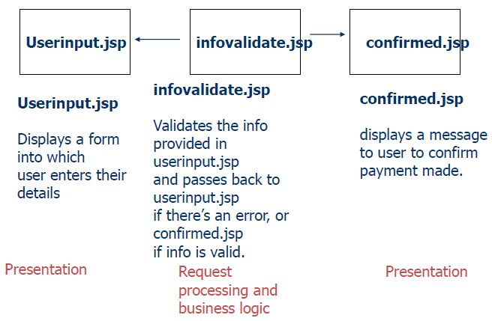
Structure of JSP pages: example

Slide 8
Passing control from one page to another
Separating presentation pages from request processing/business logic
more than one page used to process client request
need to be able to pass control from one page to another
e.g. in the example, infovalidate.jsp need to be able to forward to either userinput.jsp or confirmed.jsp depending on validation result
Can use the <jsp:forward> standard action tag

Slide 9
Passing control from one page to another
A validation page (infovalidate.jsp) forward control to a page, userinput.jsp, in order to display an error message. Need to include error message in the forwarding instruction.
<jsp:forward page = “userinput.jsp”>
<jsp:param name = “msg” value = “invalid credit card number”/>
</jsp:forward>

Slide 10
Sharing Session & application Data
HTTP is a stateless, request-response protocol. This means that the browser sends a request for a web resource, and the web server processes the request and returns a response. The server then forgets this transaction ever happened.
So when the same browser sends a new request, the web server has no idea that this request is related to the previous one.

Slide 11
Sharing Session & application Data ...
Problem : In a travel agency application, for instance, it's important to remember the dates and destination entered to book the flight so the customer doesn't have to enter the same information again when it's time to make hotel and rental car reservations.

Slide 12
Sharing Session & application Data ...
Solution : The way to solve this problem is to let the server send a piece of information to the browser that the browser then includes in all subsequent requests.
This piece of information, called a session ID.
A session starts when the browser makes the first request for a JSP page in a particular application. The session can be ended explicitly by the application, or the JSP container can end it after a period of user inactivity (the default value is typically 30 minutes after the last request).

Slide 13
Sharing Session..
Examples of session tracking information:
Shopping website: Items in a shopping cart:
Item1, “Gone with the Wind”
Item2, “BeatlesCD”)
Select these on one web page, check-out in a different part of the website. Web site “remembers” what you ordered by using session tracking

Slide 14
Sharing Session..
There are a number of different techniques available to web applications to enable session tracking, including cookies
In JSP, it can be done by simply using the ‘scope’ attribute of whatever needs to be tracked.
Set the ‘scope’ to session, and the relevant attribute will be available throughout the session of the client

Slide 15
Sharing Session..
Example: a JSP page that displays two counters – a hit counter for the session, and a hit counter for the application
sess.jsp (home page)
displaySession.jsp

Slide 16
JSP Architectures – Application Models
Basic Architecture
Mature Architecture

Slide 17
Basic Architecture
In the basic architecture, just like the servlet, the incoming request from a Web browser is sent directly to the JSP page, which is responsible for processing it and replying to the client.
There is still separation of presentation from content, because all data access is performed using beans

Slide 18
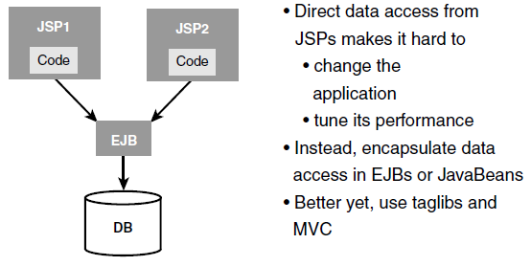
Basic Architecture ...

Slide 19
Pros and Cons
Advantage : There is only one file per view to maintain for changes to your application.
Disadvantages :
The major disadvantage is readability and the difficulty of maintaining the JSP pages.
Unless you are very careful, HTML and Java code can become so intermingled that it is difficult to debug and maintain the application.

Slide 20
Mature Architecture
Otherwise known as MVC Architecture
Model: JavaBeans or EJB—business logic.
View: JSP—used to compose the user interface.
Controller: Servlet—used to process the HTTP request and manage the application’s workflow.

Slide 21
Model Layer
This is the data layer which consists of the business logic of the system.
It consists of all the data of the application
It also represents the state of the application.
It consists of classes which have the connection to the database.
The controller connects with model and fetches the data and sends to the view layer.
The model connects with the database as well and stores the data into a database which is connected to it.

Slide 22
View Layer
This is a presentation layer.
It consists of HTML, JSP, etc...
It normally presents the UI of the application.
It is used to display the data which is fetched from the controller which in turn fetching data from model layer classes.
View layer shows the data on UI of the application.

Slide 23
Controller Layer
It acts as an interface between View and Model.
It intercepts all the requests which are coming from the view layer.
It receives the requests from the view layer and processes the requests and does the necessary validation for the request.
This requests is further sent to model layer for data processing, and once the request is processed, it sends back to the controller with required information and displayed accordingly by the view

Slide 24
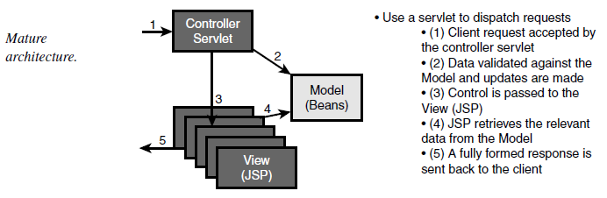
MVC

Slide 25
Advantages
Easy to maintain
Easy to extend
Easy to test
Navigation control is centralized

Slide 26
Example
Model layer : model.java (session bean)
View layer : view.jsp, success.jsp
Controller layer : controller.java

