Slide 1
Module VI

Slide 2
Life cycle of EJB
1. The client locates the bean’s home using the JNDI services in the application server.
2. The JNDI service returns a reference to the client’s Home interface.
3. The client uses its Home interface to call home.create(). In response to this call, the Home object creates an EJBObject. A new instance of the code in the bean class is also instantiated by the newInstance() method.

Slide 3
Life cycle of EJB ...
4. The new instance of the bean class is given a session context. This instantiation is now called a Session Bean.
5. The Home object gives the client’s Remote interface a reference to the EJBObject in the container.
6. The client’s Remote interface can now invoke methods on the EJBObject in the container. This EJBObject then passes these method calls to the Session Bean.

Slide 4
Life cycle of EJB ...
7. The session bean returns a resultset to the EJBObject, which in turn returns it to the client’s Remote interface.

Slide 5
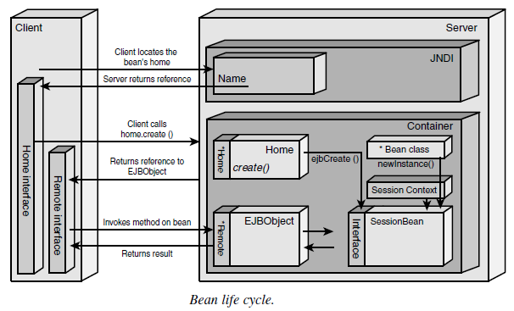

Slide 6
Java Message Service (JMS)
JMS is a vendor-independent API used to access messaging systems.
It provides a common way for Java programmers to create, send, receive, and read an enterprise messaging system’s messages
It is similar to Java Database Connectivity (JDBC), an API used to access different relational databases.
JMS provides vendor-independent access to messaging services.
JMS allows messages to be sent from one JMS client to another via a messaging service called a message broker or a router.

Slide 7
Java Message Service (JMS) ...
Communication Modes
Synchronous Communication : acknowledge receipt of a message (blocking call)
Asynchronous Communication : no acknowledgement required eg : e-mail

Slide 8
JMS in Applications
• Easy integration of incompatible systems
• Asynchronous communications
• One-to-many communications
• Guaranteed messaging
• Transactional messaging

Slide 9
Message Models in JMS
Publish/Subscribe (Pub/Sub)
Point-to-Point (PTP).

Slide 10
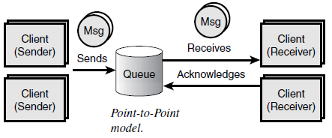
The Point-to-Point Message Model
The Point-to-Point model sends messages to a receiver on a one-to-one basis.

Slide 11
applications
Instant messaging
Receiving a transaction from another system
Sending an order to another system
Supply-chain processing

Slide 12
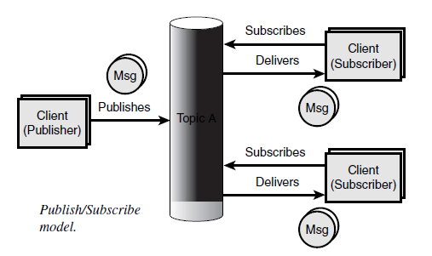
The Publish/Subscribe Model
The Publish/Subscribe model allows an application to publish messages on either a one-to-many or a many-to-many basis.

Slide 13
Applications
Sending news stories to interested parties
Sending sales forecasts to various people in an organization
Sending stock prices to traders on the trading floor

Slide 14
Message-Driven Beans (MDB)
The Message-Driven Bean (MDB) is a stateless component that is invoked by a container as a result of the arrival of a JMS message
A MDB acts as a message consumer, it receives messages from a JMS Topic and performs business logic based on the message contents

Slide 15
Containers and Message-Driven Beans
The container handles communications for JMS messages.
The container checks its pool of available instances in order to see which MDB should be used.
The container enables the propagation of a security context by associating the role designated in the deployment descriptor to the appropriate thread of execution.
The container creates an association with a transactional context if one is required by the deployment descriptor.
The container passes the JMS message to the onMessage() method of the appropriate MDB instance.
The container re-allocates MDB resources to a pool of available instances.

Slide 16
Message-Driven Bean Container Services
MDB life cycle management
Exception handling
Threading and concurrency
Message acknowledgment
Security

Slide 17
Message-Driven Beans (MDBs) Versus Session and Entity Beans
Message bean has neither a Remote nor a Home interface.
This is because the message bean is not an RPC component
MDBs do not have business methods that are synchronously invoked by EJB clients
In addition to MDBs being similar to stateless session beans because both beans maintain no state between requests

Slide 18
MDBs Versus Session and Entity Beans ...
MDBs can consume messages from any topic provided by a JMS-compliant vendor.
Messages consumed by MDBs may have come from other beans such as session, entity or message beans, non-EJB Java applications or non-Java applications that use a JMS compliant vendor.

Slide 19
Distributed programming services
Naming and Registration : For each class installed in a container, the container automatically registers an EJBHome interface in a directory using the Java Naming and Directory Interface (JNDI) API.
Using JNDI, any client can locate the EJBHome interface to create a new bean instance or to find an existing entity bean instance.

Slide 20
Distributed programming services ...
Remote Method Invocation (RMI): RMI is a high-level programming interface that makes the location of the server transparent to the client.
The RMI compiler creates a stub object for each Remote interface. The stub object is either installed on the client system or it can be downloaded at runtime, providing a local proxy object for the client.
The stub implements all the Remote interfaces and transparently delegates all method calls across the network to the remote object.

Slide 21
Common Object Request Broker Architecture (CORBA)
The Common Object Request Broker Architecture is a language-independent, distributed object model specified by the Object Management Group (OMG)
This architecture was created in order to support the development of object-oriented applications across heterogeneous computing environments that might contain different hardware platforms and operating systems.

Slide 22
CORBA
CORBA relies on the protocol Internet InterORB Protocol (IIOP) for communications between objects.
The center of the CORBA architecture lies in the Object Request Broker (ORB).
The ORB is a distributed programming service that enables CORBA objects to locate and communicate with one another.
CORBA objects have interfaces that expose sets of methods to clients.

Slide 23
CORBA ...
To request access to an objects method, a CORBA client acquires an object reference to a CORBA server object.
Then the client makes method calls on the object reference as if the CORBA object were local to the client.
The ORB finds the CORBA object and prepares it to receive requests, to communicate requests to it, and then to communicate replies back to the client.

Slide 24
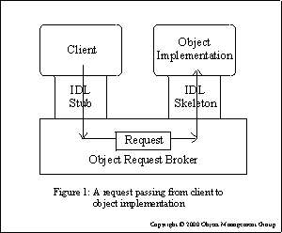
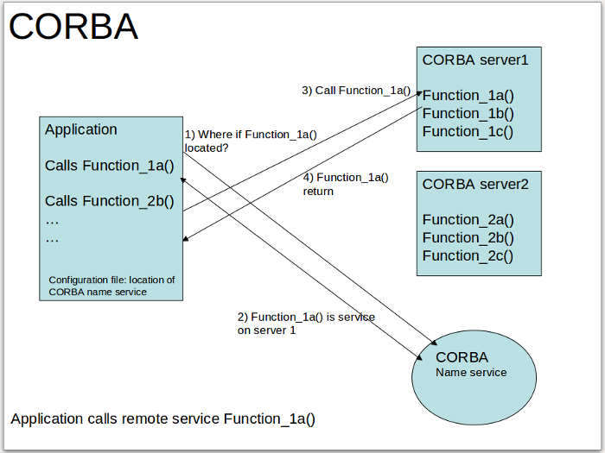
CORBA ...

Slide 25
Transactions and Transaction Management
A transaction is one or more tasks that execute as a single atomic operation or unit of work.
If all tasks involved in a transaction do not proceed successfully then an inverse task or rollback procedure for all tasks is performed, setting all resources back to their original state.
Transactions are characterized by the acronym ACID that stands for Atomic, Consistent, Isolated, and Durable.
The EJB container provides the services and management functions required to support transactions

Slide 26
Java Transaction Service (JTS)
The Java Transaction Service specifies the implementation of a transaction manager supporting the Java Transaction API (JTA)
JTS supports distributed transactions, which have the ability to span multiple databases on multiple systems coordinated by multiple transaction managers.
By using JTS, an EJB container ensures that its transactions can span multiple EJB containers.

Slide 27
Java Transaction API (JTA)
EJB applications communicate with a transaction service using the Java Transaction API (JTA).
JTA provides a programming interface to start transactions, to join existing transactions, to commit transactions, and to roll back transactions.

Slide 28
Security
In order to simplify the development process for the Bean Writer, the implementation of the security infrastructure is left to the EJB Container provider and the task of defining security policies is left to the Bean Deployer.
The EJB framework specifies flexibility with regards to security management allowing it to be declarative (container-managed) or programmatic (bean-managed).

Slide 29
Deployment
When an EJB application is ready to be deployed to an EJB container, the desired beans and deployment information must be placed in an ejb-jar file.
The deployment information to be placed in this JAR file is contained in an XML file called a deployment descriptor.
The deployment descriptor is an XML file containing elements that specify how to create and maintain EJB components and how to establish runtime service settings.
The deployment descriptor contains settings that are not to be hard-coded inside EJB components.
These settings tell the EJB container how to manage and control EJB components.

Slide 30
creating session beans
Define state attribute
Stateful / stateless / singleton
Define the Session Bean Class
Public
Session Beans and Inheritance
Implement Session Bean Interface
ejbActivate()
ejbPassivate()
ejbRemove()
setSessionContext(SessionContext)
(Remote clients access a session bean via their remote and remote home interfaces (javax.ejb.EJBObject and javax.ejb.EJBHome, respectively))

Slide 31
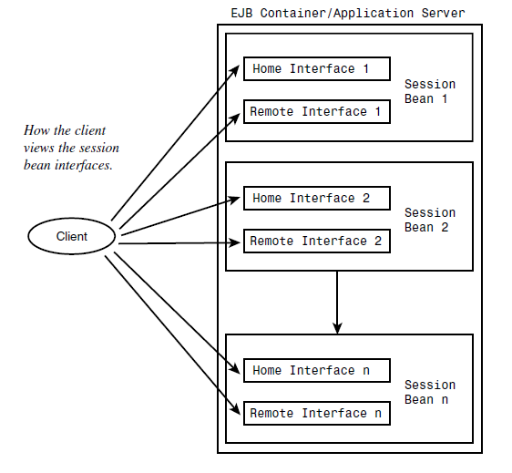
Create Remote Interfaces
All remote interfaces must extend the class javax.ejb.EJBObject

Slide 32
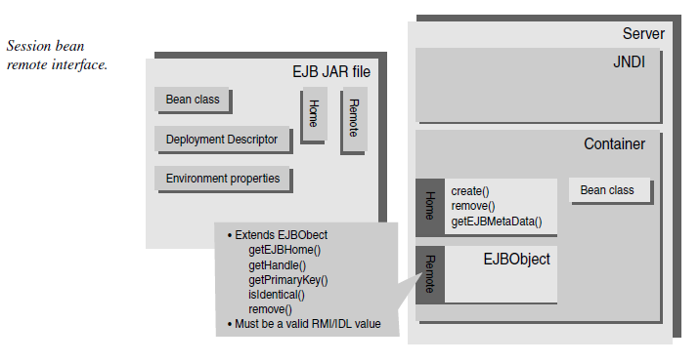

Slide 33
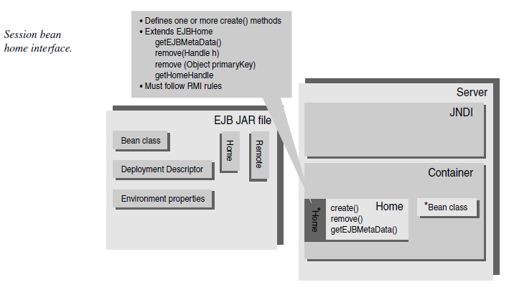
Create Home Interface

Slide 34
Create Session Bean Class Methods
Session bean classes are used as the “molds” for instantiating session bean instances.
These instances are indirectly called as local and remote clients via home and remote interfaces.
Create Business Methods
Create Stub, Tie, and Object
Package and Deploy the Session Bean

Slide 35
Developing Entity Beans
Step 1—Set Up A Data Source to a Database
Step 2—Develop a Primary Key Class
Step 3—Develop the Entity Bean Class
Step 4—Define the Home or Local Home Interface
Step 5—Define the Local or Remote Interface
Step 6—Define a Deployment Descriptor
Step 7—Deploy Using Container-Provided Tools
Step 8—Create a Client Application

