Slide 1
CS467 MACHINE LEARNING

Slide 2
Course Objectives
To introduce the prominent methods for machine learning
To study the basics of supervised and unsupervised learning
To study the basics of connectionist and other architectures

Slide 3
Syllabus
Introduction to Machine Learning
Learning in Artificial Neural Networks
Decision trees, HMM(Hidden Markov Model), SVM,
Supervised and Unsupervised learning methods.

Slide 4
References
Christopher M. Bishop, Pattern Recognition and Machine Learning, Springer, 2006.
Ethem Alpaydın, Introduction to Machine Learning (Adaptive Computation and Machine Learning), MIT Press, 2004.
Margaret H. Dunham. Data Mining: introductory and Advanced Topics, Pearson, 2006
Mitchell. T, Machine Learning, McGraw Hill.
Ryszard S. Michalski, Jaime G. Carbonell, and Tom M. Mitchell, Machine Learning : An Artificial Intelligence Approach, Tioga Publishing Company

Slide 5
Question Paper Pattern
There will be FOUR parts in the question paper – A, B, C, D
Part A
Total marks : 40
TEN questions, each have 4 marks, covering all the SIX modules (THREE questions from modules I & II; THREE questions from modules III & IV; FOUR questions from modules V & VI).
All the TEN questions have to be answered.
Part B
Total marks : 18
THREE questions, each having 9 marks. One question is from module I; one question is from module II; one question uniformly covers modules I & II.
Any TWO questions have to be answered.
Each question can have maximum THREE subparts.

Slide 6
Question Paper Pattern
Part C
Total marks : 18
THREE questions, each having 9 marks. One question is from module III; one question is from module IV; one question uniformly covers modules III & IV.
Any TWO questions have to be answered.
Each question can have maximum THREE subparts.
Part D
Total marks : 24
THREE questions, each having 12 marks. One question is from module V; one question is from module VI; one question uniformly covers modules V & VI.
Any TWO questions have to be answered. d. Each question can have maximum THREE subparts.
There will be AT LEAST 60% analytical/numerical questions in all possible combinations of question choices.

Slide 7
Module I
Introduction to Machine Learning
Examples of Machine Learning applications
Learning associations, Classification,
Regression, Unsupervised Learning,
Reinforcement Learning.
Supervised learning- Input representation,
Hypothesis class, Version space,
Vapnik-Chervonenkis (VC) Dimension

Slide 8
Machine Learning
Making computers to act without explicitly programming them
Machine Learning can figure out how to perform tasks based on generalizing from data or examples and they can learn to improve themselves from the experience of past data

Slide 9
Machine Learning
Arthur Samuel
American leader in the field of computer gaming and artificial intelligence
coined the term “Machine Learning” in 1959
“the field of study that gives computers the ability to learn without being explicitly programmed.”

Slide 10
Machine Learning- Definition
Machine learning is programming computers to optimize a performance criterion using example data or past experience.
We have a model defined up to some parameters, and learning is the execution of a computer program to optimize the parameters of the model using the training data or past experience.
The model may be predictive to make predictions in the future, or descriptive to gain knowledge from data, or both
The field of study known as machine learning is concerned with the question of how to construct computer programs that automatically improve with experience

Slide 11
Machine Learning
What is Machine Learning?
“Learning is any process by which a system improves performance from experience.”
-Herbert Simon
Definition by Tom Mitchell (1998):
Machine Learning is the study of algorithms that
• improve their performance P
• at some task T
• with experience E.
A well-defined learning task is given by <P, T, E>.

Slide 12
Machine Learning- History
1950
Samuel’s checker playing program
Able to observe positions at the game and learn a model that gives moves for the machine player
Experienced with more games
Samuel coined the term Machine Learning
Field of study gives computers the ability without being explicitly programmed

Slide 13
Machine Learning- History
1960
Neural Networks
Rosenblatt’s perceptron
Simple Neural Network
Pattern Recognition
Delta learning rule for training perceptrons
Least square problem
Limitation of perceptron
XOR cannot be represented
Decision Tree learning

Slide 14
Machine Learning- History
1980
Advanced Decision Tree and Rule Learning
Multi layer perceptron
Back Propagation Algorithm
Support Vector Machines
Data Mining
Esemblers
Create a strong classifier from an essemble of weak classifiers e.g. Random Forest
Bayesian Learning

Slide 15
Machine Learning- History
1994
Self driving car road test
1997
Deep blue beats Gary Kasparov
2009
Google builds self driving car

Slide 16
Machine Learning
New Algorithms
Neural Networks
Deep Learning
New Hardware
GPU
Cloud Enable
Availability of big data

Slide 17
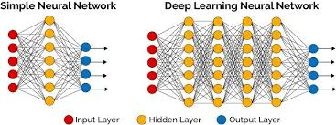

Slide 18
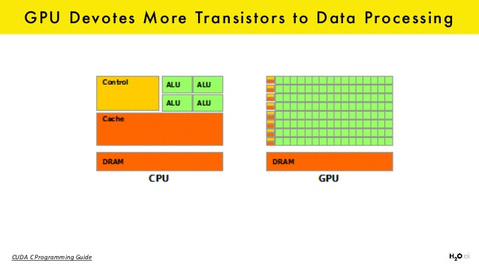

Slide 19
Age of big data Generator and Consumer of data
Buy a product
Rent a movie
Visit a web page
Write a blog
Post on social media
Walk or drive around

Slide 20
Machine Learning
A computer program is said to learn
from experience E with respect to
some class of tasks T and
performance measure P,
if its performance at tasks T, as measured by P,
improves with experience E.

Slide 21
Machine Learning
Tasks
Prediction, classification, acting in an environment
Experience
Data
Performance
Accuracy in prediction, improves the efficiency of problem solving

Slide 22
Examples
Handwriting recognition learning problem
Task T:
Recognizing and classifying handwritten words within images
Performance P:
Percent of words correctly classified
Training experience E:
A dataset of handwritten words with given classifications

Slide 23
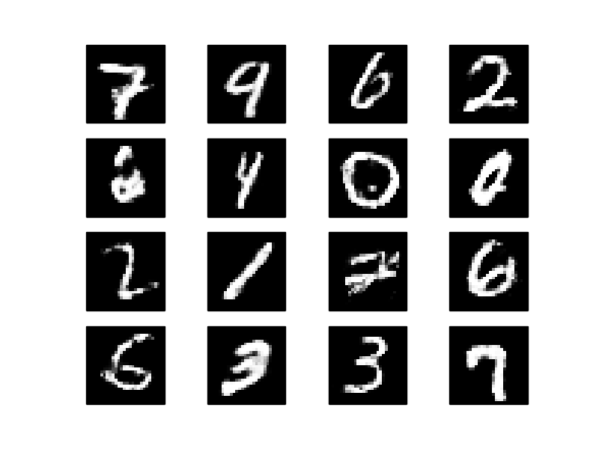

Slide 24
Examples
A robot driving learning problem
Task T:
Driving on highways using vision sensors
Performance measure P:
Average distance traveled before an error
Training experience E:
A sequence of images and steering commands recorded while observing a human driver

Slide 25
Examples
A chess learning problem
Task T:
Playing chess
Performance measure P:
Percent of games won against opponents
Training experience E:
Playing practice games against itself

Slide 26
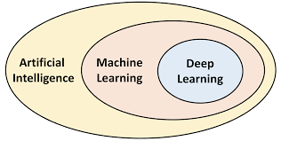

Slide 27
Algorithm
Sequence of instructions that should be carried out to transform the input to output
Sorting
Input:- set of numbers
Output:- ordered list
Various algorithms
Use efficient one

Slide 28
Algorithm
Some tasks do not have algorithm
Predicting customer behaviour
Classify spam and legitimate mails
Input: email document
Output: yes/no
Spam changes from time to time and individual to individual
Find good and useful approximation

Slide 29
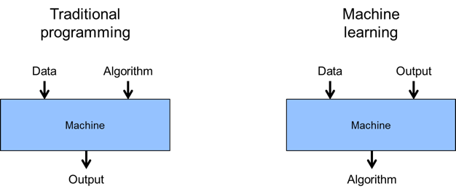

Slide 30
Experience (Data)
Problem / Task
Learner
Models
Reasoner
Background Knowledge
Answer
Performance Measure

Slide 31
Machine Learning Problems
Regression
Predict value
Feature (x) :- diameter of pizza, age
Target(y, dependant variable):- price, height
Classification
Classify spam/non-spam mails
Linear decision boundary
Clustering
Group similar data

Slide 32
Machine Learning Problems
Recommendation System
Amazone, Youtube
Sentiment Analysis
Write review of a movie.
Machine Learning tells positive or negative review
Product review

Slide 33
Machine Learning Problems
Object Detection
Given an image detect all objects in the image
Face detection
Analyze the image and finds it happy/sad/neutral
Identify movements of eye and detect attention status

Slide 34
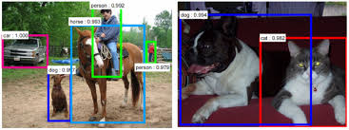

Slide 35
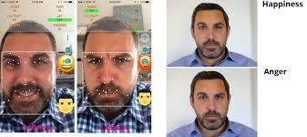

Slide 36
Machine Learning Problems
Multi object tracking
Multiple people tracked at the same time
Sketch-AI
Generate photo

Slide 37


Slide 38
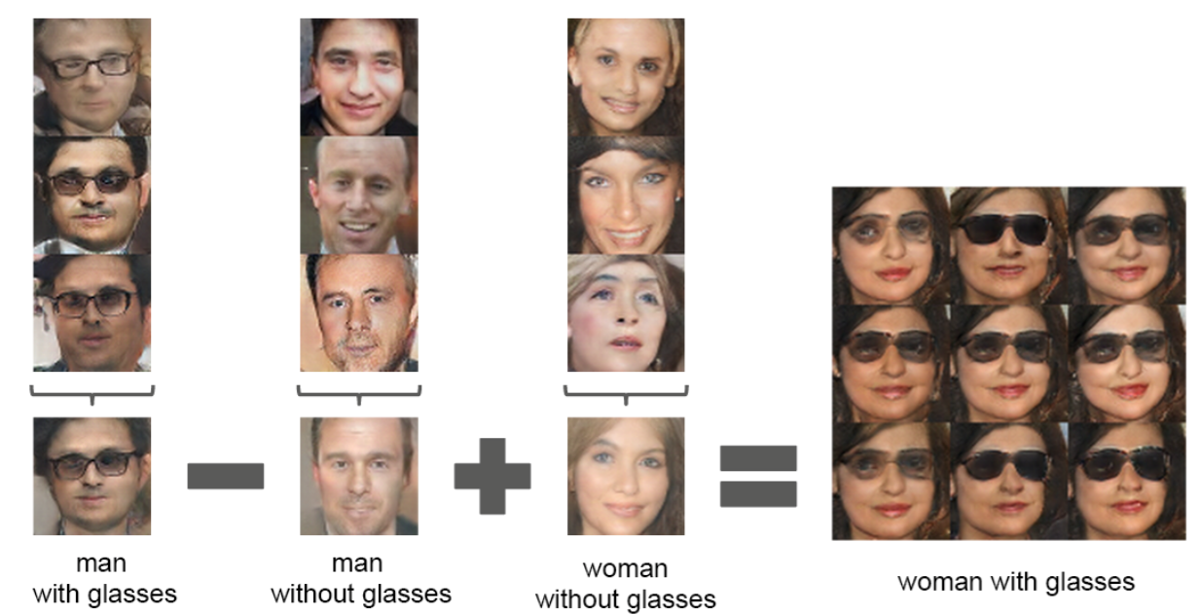

Slide 39
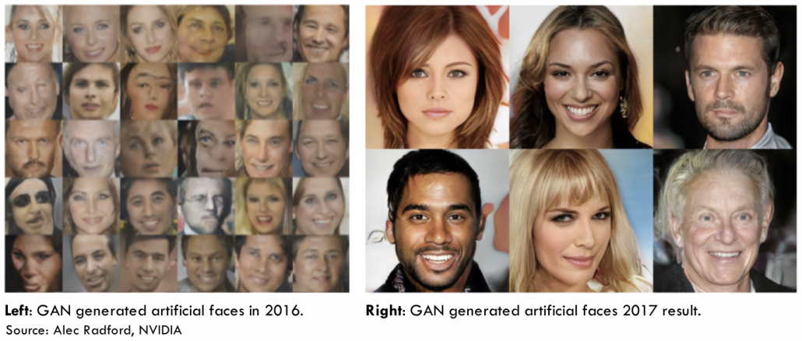

Slide 40
Machine Learning
The learning process can be divided into 4 components namely
Data storage
Abstraction
Generalization
Evaluation

Slide 41
Data storage
Facilities for storing and retrieving huge amounts of data are an important component of the learning process.
In a human being, the data is stored in the brain and data is retrieved using electrochemical signals.
Computers use hard disk drives, flash memory, random access memory and similar devices to store data and use cables and other technology to retrieve data.

Slide 42
Data Mining
Application of machine learning methods to large databases
Large volume of data is processed to construct a simple model with valuable use having high predictive accuracy
Applications
Finance banks
Fraud detection, credit application, Stock market

Slide 43
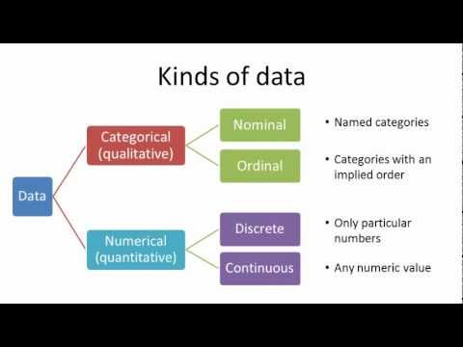

Slide 44
Different forms of data
Numeric data
If a feature represents a characteristic measured in numbers, it is called a numeric feature.
Nominal
A categorical feature is an attribute that can take on one of a limited, and usually fixed, number of possible values on the basis of some qualitative property.
A categorical feature is also called a nominal feature.
e.g. Sex, eye colour
3. Ordinal data
This denotes a nominal variable with categories falling in an ordered list.
Examples include clothing sizes such as small, medium, and large, or a measurement of customer satisfaction on a scale from “not at all happy” to “very happy.”

Slide 45
Abstraction
Process of extracting knowledge about stored data.
Creating general concepts about the data as a whole.
The creation of knowledge involves application of known models and creation of new models.
The process of fitting a model to a dataset is known as training.
When the model has been trained, the data is transformed into an abstract form that summarizes the original information.

Slide 46
Generalization
The process of turning the knowledge about stored data into a form that can be utilized for future action.
These actions are to be carried out on tasks that are similar, but not identical, to those what have been seen before.
The goal is to discover those properties of the data that will be most relevant to future tasks

Slide 47
Evaluation
Process of giving feedback to the user to measure the utility of the learned knowledge.
This feedback is then utilized to effect improvements in the whole learning process

Slide 48
Applications of machine learning
Application of machine learning methods to large databases is called data mining. In data mining, a large volume of data is processed to construct a simple model with valuable use, for example, having high predictive accuracy.
In retail business, machine learning is used to study consumer behaviour.
In finance, banks analyze their past data to build models to use in credit applications, fraud detection, and the stock market.
In manufacturing, learning models are used for optimization, control, and troubleshooting.
In medicine, learning programs are used for medical diagnosis.
In telecommunications, call patterns are analyzed for network optimization and maximizing the quality of service.

Slide 49
Applications of machine learning
In science, large amounts of data in physics, astronomy, and biology can only be analyzed fast enough by computers. The World Wide Web is huge; it is constantly growing and searching for relevant information cannot be done manually.
In artificial intelligence, it is used to teach a system to learn and adapt to changes so that the system designer need not foresee and provide solutions for all possible situations.
It is used to find solutions to many problems in vision, speech recognition, and robotics.
Machine learning methods are applied in the design of computer-controlled vehicles to steer correctly when driving on a variety of roads.
Machine learning methods have been used to develop programmes for playing games such as chess, backgammon and Go.

Slide 50
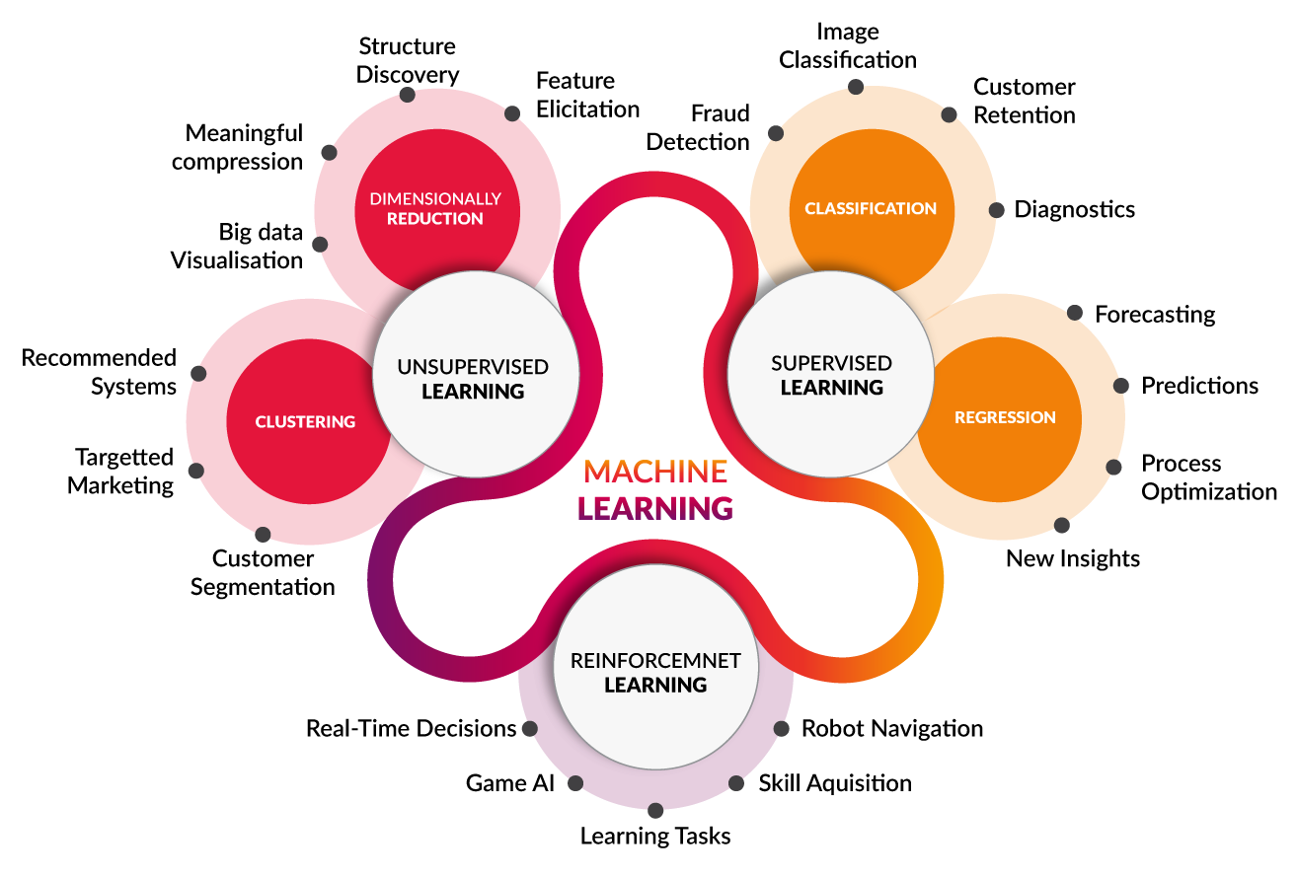

Slide 51
General classes of machine learning problems
Learning Associations
Association Rule Learning
Classification
Regression

Slide 52
Association Rule Learning
A machine learning method for discovering interesting relations, called “association rules”, between variables in large databases using some measures of “interestingness”.

Slide 53
Example-- supermarket chain
Basket analysis
Finding associations between products brought by customers
The management of the chain is interested in knowing whether there are any patterns in the purchases of products by customers
“If a customer buys onions and potatoes together, then he/she is likely to also buy hamburger.”
From the standpoint of customer behavior, this defines an association between the set of products {onion, potato} and the set {burger}.

Slide 54
Example-- supermarket chain
This association is represented in the form of a rule as follows: {onion, potato} ⇒ {burger}
The measure of how likely a customer, who has bought onion and potato, to buy burger also is given by the conditional probability P({onion, potato}∣{burger}).
If this conditional probability is 0.8, then the rule may be stated more precisely as follows: “80% of customers who buy onion and potato also buy burger.”

Slide 55
How association rules are made use of
Consider an association rule of the form X ⇒ Y, that is, if people buy X then they are also likely to buy Y .
Suppose there is a customer who buys X and does not buy Y .
That customer is a potential Y customer.
Target potential Y customer for cross-selling.
Selling additional product to an existing customer
A knowledge of such rules can be used for promotional pricing or product placements.

Slide 56
General case
association rule X ⇒ Y , conditional probability of the form P(Y ∣X)
Y is the product the customer may buy
X is the product or the set of products the customer has already purchased.
to make a distinction among customers, estimate P(Y ∣X, D) where D is a set of customer attributes, like gender, age, marital status, and so on, assuming that we have access to this information.

Slide 57
Algorithms for Generating Association Rules
Apriori algorithm
Eclat algorithm
FP-Growth Algorithm (FP stands for Frequency Pattern)

Slide 58
Classification
The problem of identifying to which of a set of categories a new observation belongs, on the basis of a training set of data containing observations (or instances) whose category membership is known.

Slide 59
Example
Score1 29 22 10 31 17 33 32 20
Score2 43 29 47 55 18 54 40 41
Result Pass Fail Fail Pass Fail Pass Pass Pass
There are two attributes “Score1” and “Score2”.
The class label is called “Result”.
The class label has two possible values “Pass” and “Fail”.
The data can be divided into two categories or classes: The set of data for which the class label is “Pass” and the set of data for which the class label is“Fail”.
Let us assume that we have no knowledge about the data other than what is given in the table.

Slide 60
Example
If we have some new data, say “Score1 = 25” and “Score2 = 36”, what value should be assigned to “Result” corresponding to the new data; in other words, to which of the two categories or classes the new observation should be assigned?
Using the given data, find a rule, formula or a method that has been used in assigning the values to the class label “Result”.
The problem of finding the rule or formula or the method is called a classification problem

Slide 61
Discriminant
A discriminant of a classification problem is a rule or a function that is used to assign labels to new observations.
The following rules for the classification of the new data:
IF Score1 + Score2 ≥ 60, THEN “Pass” ELSE “Fail”.
IF Score1 ≥ 20 AND Score2 ≥ 40 THEN “Pass” ELSE “Fail”.

Slide 62
Discriminant
Consider a finance company which lends money to customers.
Before lending money, the company would like to assess the risk associated with the loan.
The company assesses the risk based on two variables, namely, the annual income and the annual savings of the customers.
Let x1 be the annual income and x2 be the annual savings of a customer.
After using the past data, a rule of the following form with suitable values for θ1 and θ2 may be formulated: IF x1 > θ1 AND x2 > θ2 THEN “low-risk” ELSE “high-risk”.

Slide 63
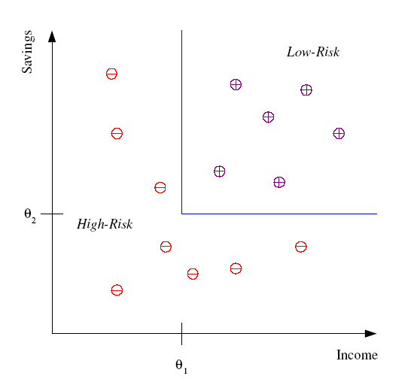
Credit scoring
Differentiating between low-risk and high-risk customers from their income and savings
Discriminant: IF income > θ₁ AND savings > θ₂
THEN low-risk ELSE high-risk
Model

Slide 64
Classification
A classification problem requires that examples be classified into one of two or more classes.
A classification can have real-valued or discrete input variables.
A problem with two classes is often called a two-class or binary classification problem.
A problem with more than two classes is often called a multi-class classification problem.
A problem where an example is assigned multiple classes is called a multi-label classification problem.

Slide 65
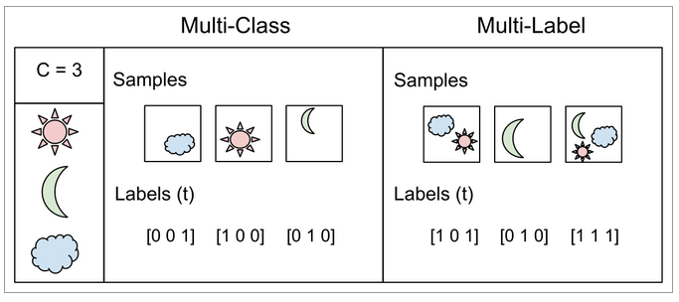

Slide 66
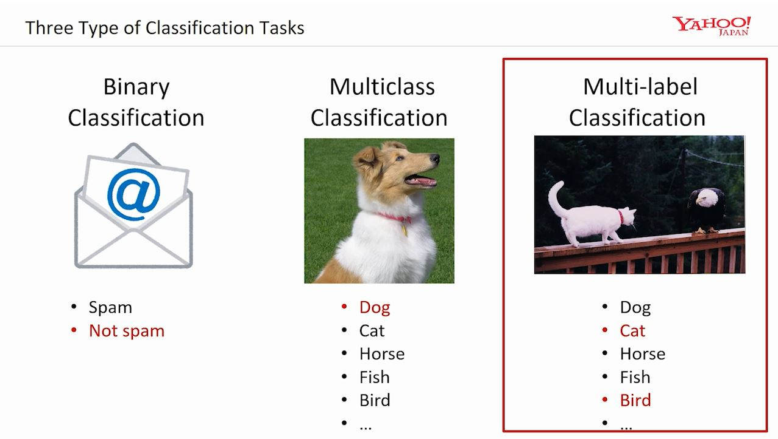

Slide 67
Algorithms
Logistic regression
Naive Bayes algorithm
k-NN algorithm
Decision tree algorithm
Support vector machine algorithm
Random forest algorithm

Slide 68
Classification
Knowledge Extraction
Learning a rule from data allows knowledge extraction
Compression
Fitting a rule to data
Explanation simpler than data
Require less memory to store and less computation to process
E.g. Rule of addition , no need to store sum of all numbers

Slide 69
Classification
Outlier Detection
Exceptions
Finding instances that do not obey the general rule

Slide 70
Regression
Regression problem is the problem of predicting the value of a numeric variable based on observed values of the variable.
The value of the output variable may be a number, such as an integer or a floating point value.
Input variables van be discrete or continuous

Slide 71
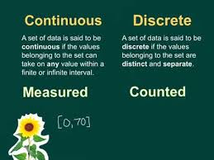

Slide 72
Example
Consider the data on used car prices
Price Age Distance Weight
(years) (KM) (pounds)
23 46986 1165
23 72937 1165
24 41711 1165
26 48000 1165
30 38500 1170
32 61000 1170
27 94612 1245
30 75889 1245
27 19700 1185
12950 23 71138 1105

Slide 73
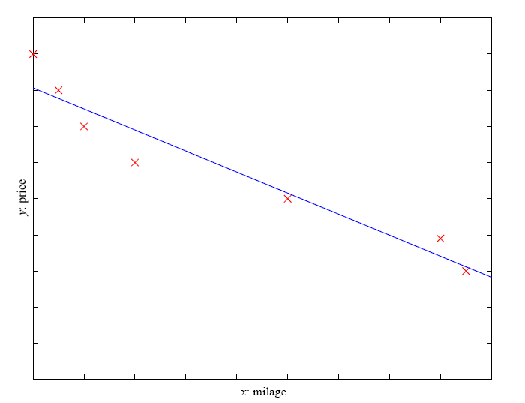
Prediction: Regression
Example: Price of a used car
x : car attributes
y : price
y = wx+w₀

Slide 74
Example
Suppose we are required to estimate the price of a car aged 25 years with distance 53240 KM and weight 1200 pounds.
This is an example of a regression problem because we have to predict the value of the numeric variable “Price”.

Slide 75
General approach
Let x denote the set of input variables and y the output variable.
The general approach to regression is to assume a model, that is, some mathematical relation between x and y, involving some parameters say, θ, in the following form
y = f(x, θ)
The function f(x, θ) is called the regression function.

Slide 76
General approach
if the input variables are “Age”, “Distance” and “Weight” and the output variable is “Price”, the model may be
y = f(x, θ)
Price = a0 + a1 × (Age) + a2 × (Distance) + a3 × (Weight)
where x = (Age, Distance, Weight) denotes the set of input variables and
θ = (a0, a1, a2, a3) denotes the set of parameters of the model.

Slide 77
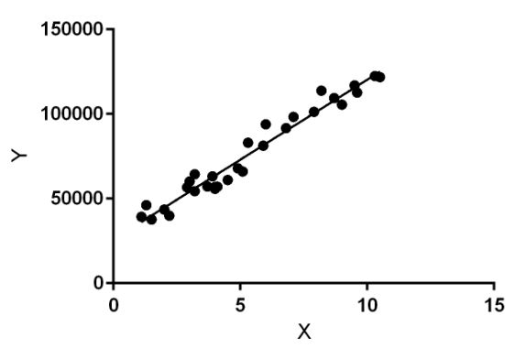

Slide 78
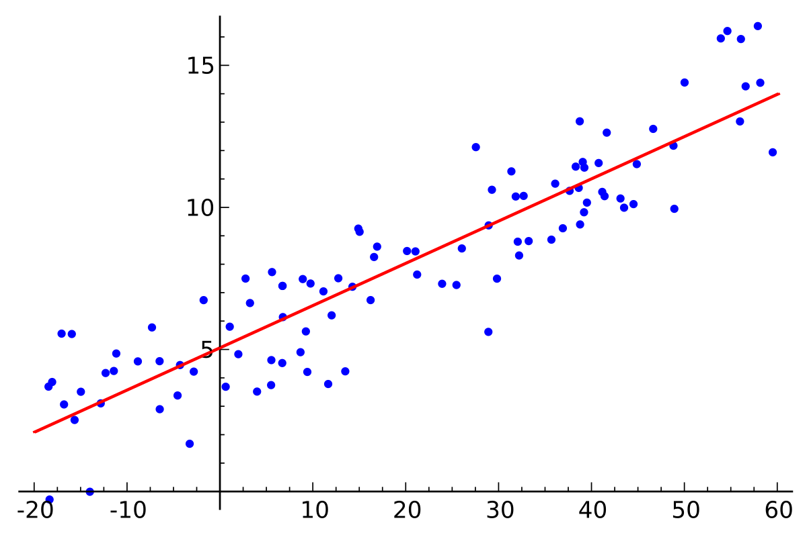

Slide 79
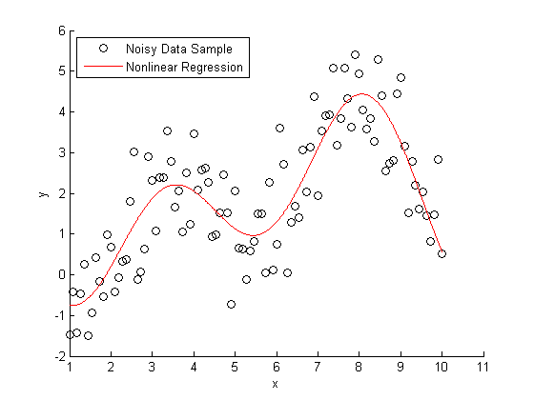

Slide 80
Different regression models
Various regression techniques mostly differ in three aspects,
the number and type of independent variables,
the type of dependent variables
the shape of regression line.
Simple linear regression:
There is only one continuous independent variable x
the assumed relation between the independent variable and the dependent variable y is y = a + bx.

Slide 81
Different regression models
Multivariate linear regression:
There are more than one independent variable, say x₁, . . . , x_{n},
The assumed relation between the independent variables and the dependent variable is y = a₀ + a₁x₁ + ⋯ + a_{n}x_{n}.
Polynomial regression:
There is only one continuous independent variable x
The assumed model is y = a₀ + a₁x + ⋯ + a_{n}x_{n} .
Logistic regression:
The dependent variable is binary, that is, a variable which takes only the values 0 and 1.
The assumed model involves certain probability distributions.

Slide 82
Different Types of Learning
Supervised Learning
Unsupervised Learning
Reinforcement Learning
Taking suitable action to maximize reward in a particular situation

Slide 83
Supervised Learning
Learn an input and output map
Classification
Categorical output
Regression
Continuous output

Slide 84
Unsupervised Learning
Discover Patterns in the data
Clustering
Cohesive grouping
Association
Frequent cooccurance

Slide 85
Algorithms
Supervised learning
Classification
discrete labels
[ e.g. will buy computer or not, predict rain or not]
Create classifier using training data
Validation of classifier
Regression
real values
[e.g. temperature at time of day, price of a house]
Minimize sum of squared error[ errors positive or negative]

Slide 86
Supervised learning
Training Set
<X ,Y>
Training Algorithm
Classifier

Slide 87
Algorithms
Unsupervised learning
Clustering
Finding association (in features)
Dimension reduction
Semi-supervised learning
Reinforcement learning
Decision making (robot, chess machine)

Slide 88

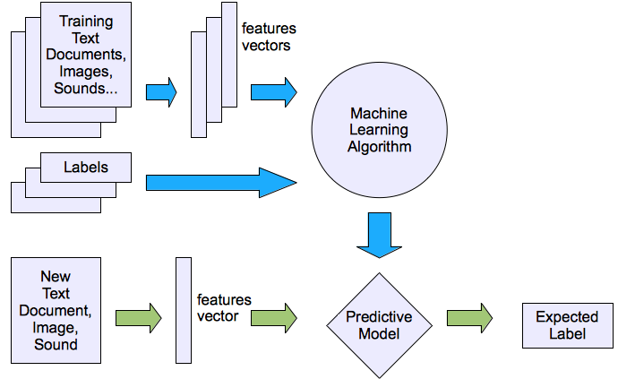
Machine learning structure
Supervised learning

Slide 89
Features
Individual observations are analysed into a set of quantifiable properties
Categorical [ blood groups, gender]
Ordinal [large, medium, small]
Feature vector
N dimensional vector of numeric features that represent some object
Instance Space
Set of all possible objects described by features

Slide 90
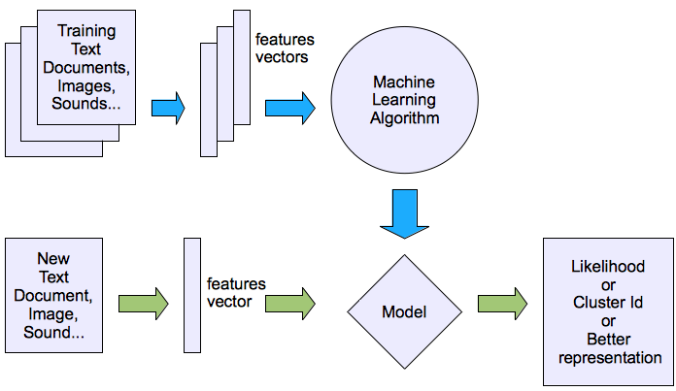
Machine learning structure
Unsupervised learning

Slide 91
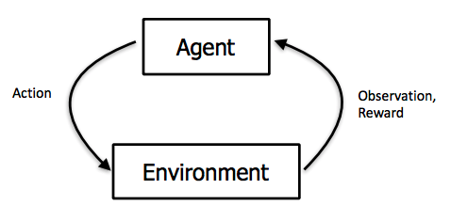

Slide 92
Reinforcement Learning
Topics:
Policies: what actions should an agent take in a particular situation
Utility estimation: how good is a state (→used by policy)
No supervised output but delayed reward
Credit assignment problem (what was responsible for the outcome)
Applications:
Game playing
Robot in a maze
Multiple agents, partial observability, ...

Slide 93
Machine Learning Tasks
Task Measure
Classification Error
Regression Error
Clustering Scatter of cluster
Associations Confidence
Reinforcement Learning Reward

Slide 94
Supervised Learning
Machine learning task of learning a function that maps an input to an output based on example input-output pairs
In supervised learning, each example in the training set is a pair consisting of an input object (typically a vector) and an output value.
A supervised learning algorithm analyzes the training data and produces a function, which can be used for mapping new examples.

Slide 95
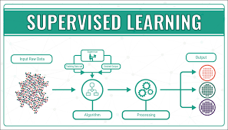

Slide 96
Supervised Learning
A “supervised learning” is so called because the process of an algorithm learning from the training dataset can be thought of as a teacher supervising the learning process.
We know the correct answers (that is, the correct outputs), the algorithm iteratively makes predictions on the training data and is corrected by the teacher.
Learning stops when the algorithm achieves an acceptable level of performance

Slide 97
Example
Gender age label
M 48 sick
M 67 sick
F 53 healthy
M 49 healthy
F 34 sick
M 21 healthy
Based on this data, when a new patient enters the clinic, how can one predict whether he/she is healthy or sick?

Slide 98
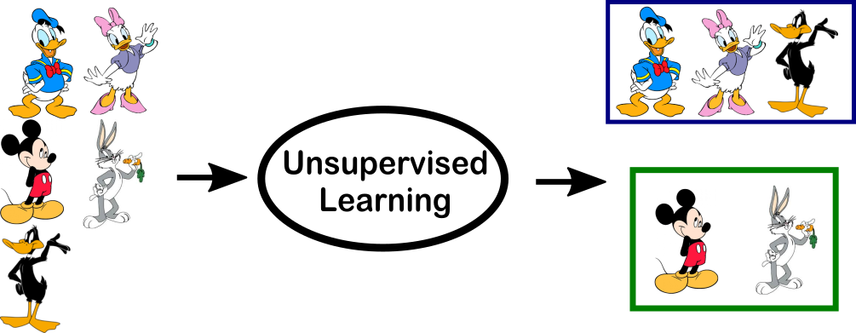
Unsupervised learning

Slide 99
Unsupervised learning
Machine learning algorithm used to draw inferences from datasets consisting of input data without labeled responses.
In unsupervised learning algorithms, a classification or categorization is not included in the observations.
There are no output values and so there is no estimation of functions.

Slide 100
Unsupervised learning
Aim is find regularities in the input
Since the examples given to the learner are unlabeled, the accuracy of the structure that is output by the algorithm cannot be evaluated.
The most common unsupervised learning method is cluster analysis, which is used for exploratory data analysis to find hidden patterns or grouping in data

Slide 101
Example
Gender age
M 48
M 67
F 53
M 49
F 34
M 21
Based on this data, can we infer anything regarding the patients entering the clinic

Slide 102
Unsupervised learning
There is a structure to the input space such that certain patterns occurs more often than others.
find what generally happens and what does not
Density estimation
One method is clustering
Find clusters or grouping of input

Slide 103
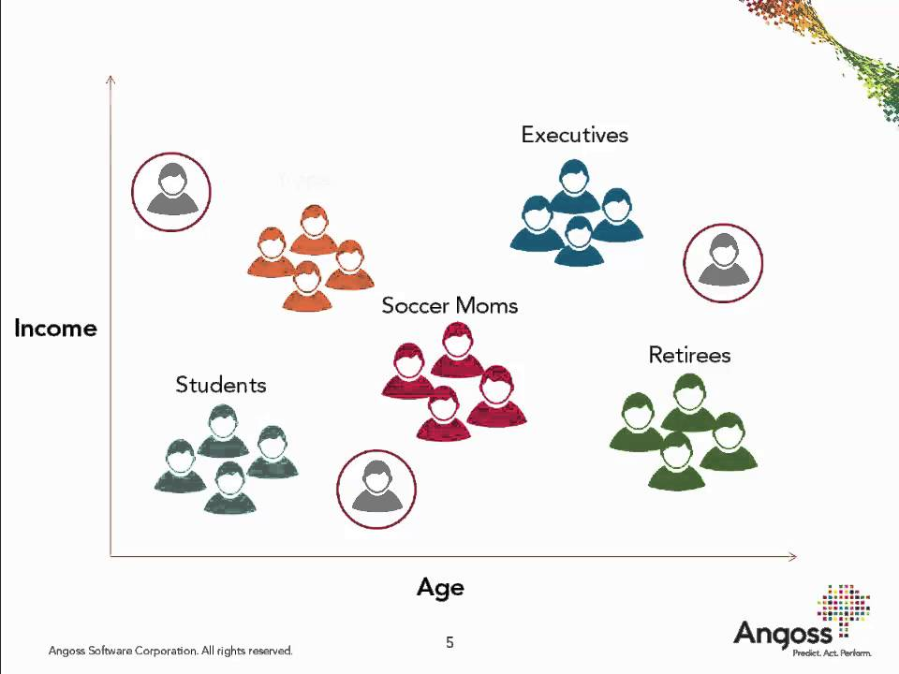
Unsupervised learning

Slide 104
Customer Segmentation
Company with data of past customers
Demographic information
Past transactions with the company
Company wants to find out distribution of the profile of customers
What type of customers frequently occur
Allocates customers similar in their attributes to the same group, called customer segmentation

Slide 105
Customer Segmentation
Company can decide services and products to different groups
Customer relationship management
Allows identifying outliers
Different from other customers
Niche market
subset of the market on which a specific product is focused.

Slide 106
Image Compression
Input instances are image pixels represented as RGB values
Clustering program groups pixels with similar colours in the same group
Quantization
Image has shades of a colour
Code to same group using average value

Slide 107
Image Compression
Pixel has 24 bits to represent 16 million colours
For example shades of only 64 main colours
Each pixel needs only 6 bits
If scene has various shades of blue in different parts of the image, and if we use the same average blue for all of them
Lose the details
Gain space in storage and transmission

Slide 108
Document clustering
Group similar objects
News reports can be subdivided into politics, sports, fashion , arts etc.
A document is represented as a bag of words
Predefine lexicon of N words
Document is grouped depending on the number of shared words

Slide 109
Document clustering
Each document is an N-dimensional binary vector whose element i is 1 if word i appears in the document
Suffixes –s and –ing are removed to avoid duplicates
Non informative words are not used
E.g. and, of
Critical how lexicon is chosen

Slide 110
Bioinformatics
DNA in our genome is the blueprint of life
Sequence of bases A,G,C and T
RNA is transcribed from DNA
Proteins are translated from RNA
Proteins are what a living body is and does

Slide 111
Bioinformatics
DNA is a sequence of bases
Protein is a sequence of amino acids as defined by bases
Alignment
Matching one sequence to another
Difficult string matching problem
Strings are quite long
Many template strings to match against
Frequent insertions, deletions or substitutions

Slide 112
Bioinformatics
Clustering can be used in learning motifs
Sequence of amino acids that occur repeatedly in proteins
Amino acids are letters
Proteins are sentences
Motifs are words
Learning motif
Find string of letters with a particular meaning occurring frequently in different sentences

Slide 113
Supervised vs Unsupervised
Supervised
Unsupervised
Training examples contains (input, target)
Input is description of present case
Target is true value
Do not have target values
Training examples contains input

Slide 114
Example
Dataset contains one million images with their ground truth labels. If it is image of a truck along the image the label truck also given. Dataset contains images from a wide range of categories like vehicles, birds, plants, human faces etc.

Slide 115
Cluster images into groups of similar objects. Then train one classifier per cluster
Vehicless
Classifier1
Bus/truck/train
Images
People
Classifier1
Male/Female face
Animalss
Classifier1
Cat/Dog
Unsupervised
Supervised

Slide 116
Reinforcement learning
Output of the system is a sequence of actions
Single action is not important
Important is policy
Sequence of correct actions to reach the goal
Action is good if it is part of a good policy
Reinforcement learning is the problem of getting an agent to act in the world so as to maximize its rewards.

Slide 117
Reinforcement learning
Reinforcement Learning Algorithm
Machine leaning program should be able to assess the goodness of policies and lean from past good action sequences to be able to generate a policy
A learner (the program) is not told what actions to take as in most forms of machine learning, but instead must discover which actions yield the most reward by trying them.
In the most interesting and challenging cases, actions may affect not only the immediate reward but also the next situations and, through that, all subsequent rewards.

Slide 118
Reinforcement learning
For example, consider teaching a dog a new trick: we cannot tell it what to do, but we can reward/punish it if it does the right/wrong thing
It has to find out what it did that made it get the reward/punishment.
We can use a similar method to train computers to do many tasks, such as playing backgammon or chess, scheduling jobs, and controlling robot limbs.

Slide 119
Examples
Game Playing
Single move is not important
Sequence of right move is good
A move is good if it is part of a good game playing policy
Robot navigation in an environment
Robot can move in one of the number of directions
After number of trial runs, robot should learn correct sequence of actions to each to the goal state from an initial state

Slide 120
Input representation
The general classification problem is concerned with assigning a class label to an unknown instance from instances of known assignments of labels.
In a real world problem, a given situation or an object will have large number of features which may contribute to the assignment of the labels.
But in practice, not all these features may be equally relevant or important.

Slide 121
Input representation
Only those which are significant need be considered as inputs for assigning the class labels. These features are referred to as the “input features” for the problem.
They are also said to constitute an “input representation” for the problem.

Slide 122
Example
Consider the problem of assigning the label “family car” or “not family car” to cars.
Let us assume that the features that separate a family car from other cars are the price and engine power.
These attributes or features constitute the input representation for the problem.
While deciding on this input representation, we are ignoring various other attributes like seating capacity or colour as irrelevant

Slide 123
Hypothesis space
binary classification problems
classification problems with only two class labels.
The class labels are usually taken as “1” and “0”.
The label “1” may indicate “True”, or “Yes”, or “Pass”, or any such label.
The label “0” may indicate “False”, or “No” or “Fail”, or any such label.
The examples with class labels 1 are called “positive examples” and examples with labels “0” are called “negative examples”

Slide 124
Hypothesis space
Hypothesis
In a binary classification problem, a hypothesis is a statement or a proposition purporting to explain a given set of facts or observations.
Hypothesis space
The hypothesis space for a binary classification problem is a set of hypotheses for the problem that might possibly be returned by it.

Slide 125
Hypothesis space
Consistency and satisfying
Let x be an example in a binary classification problem and let c(x) denote the class label assigned to x (c(x) is 1 or 0).
Let D be a set of training examples for the problem.
Let h be a hypothesis for the problem and h(x) be the class label assigned to x by the hypothesis h.
We say that the hypothesis h is consistent with the set of training examples D if h(x) = c(x) for all x ∈ D.
We say that an example x satisfies the hypothesis h if h(x) = 1.

Slide 126
Examples
X 27 15 23 20 25 17 12 30 6
Class 1 0 1 1 1 0 0 1 0
it appears that the class labeling has been done based on the following rule.
h ′ : IF x ≥ 20 THEN “1” ELSE “0”.
h ′ is consistent with the training examples in Table .
For example, we have: h ′ (27) = 1, c(27) = 1, h′ (27) = c(27) h ′ (15) = 0, c(15) = 0, h′ (15) = c(15)

Slide 127
Examples
for x = 5 and x = 28 (not in training data), h ′ (5) = 0, h′ (28) = 1.
The hypothesis h ′ explains the data.
The following proposition also explains the data:
h ′′ : IF x ≥ 19 THEN “0” ELSE “1”.
It is not enough that the hypothesis explains the given data; it must also predict correctly the class label of future observations.
So we consider a set of such hypotheses and choose the “best” one.
The set of hypotheses can be defined using a parameter, say m, as given below: hm : IF x ≥ m THEN “1” ELSE ”0”.

